Slide 1
AMINOGLYCOSIDES

Slide 2
LEARNING OBJECTIVES
After this session you should be able to:
know the source & chemistry of aminoglycosides;
describe salient pharmacokinetic features of aminoglycosides;
describe the mechanism of action, resistance, adverse effects & drug interactions of aminoglycosides; and
comprehend the spectrum of activity & clinical uses of aminoglycosides.

Slide 3
SOURCES
Natural
Streptomycin - Streptomyces griseus
Tobramycin - Streptomyces tenebrarius
Neomycin - Streptomyces fradiae
Kanamycin - Streptomyces kanamyciticus
Gentamicin - Micromonospora purpurae
Semisynthetic
Amikacin
Netilmicin
Paromomycin
Notes:
Streptomyces – y in name
Micromonospora – i in name

Slide 4
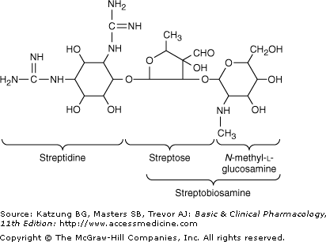
CHEMISTRY
Hexose ring: streptidine/ 2-deoxystreptamine
Amino sugars attached by glycosidic linkages
Water soluble
Highly polar
Stable in solution
Notes:
Streptomyces – y in name
Micromonospora – i in name

Slide 5
PHARMACOKINETICS
Highly polar – poorly absorbed and distributed
Administered I/V 30-60min infusion
Concentration dependent killing
Post antibiotic effect
Toxicity – time & conc. dependent
Trough concentration above 2mcg/ml

Slide 6
Dose adjustment in renal function
Normal dose/creatinine clearance
Cockcroft- Gault formula

Slide 7
MECHANISM OF ACTION
Irreversible inhibition of protein synthesis by binding to 30 S ribosomal subunit
Passive diffusion
Active transport with the transmembrane electrochemical gradient supplying the energy
Low pH and anaerobic conditions inhibit transport
Synergism with cell wall synthesis inhibitors

Slide 8
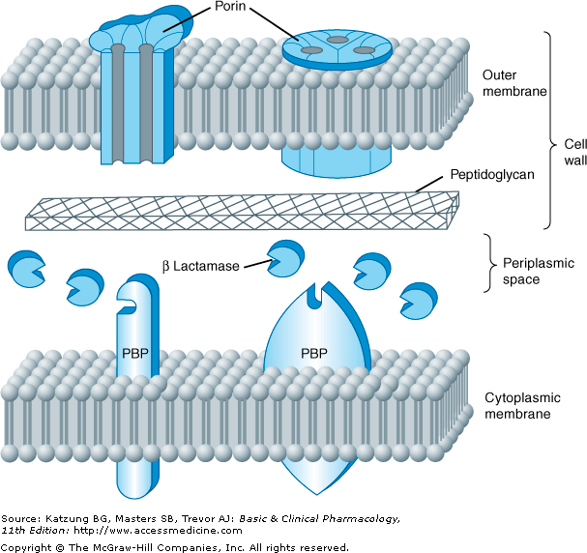

Slide 9
Inhibition of protein synthesis by:
Interference with initiation complex of peptide formation
Misreading of mRNA
Breakup of polysomes into nonfunctional monosomes
Damage of inner cytoplasmic membrane
Interference with the bacterial respiration

Slide 10
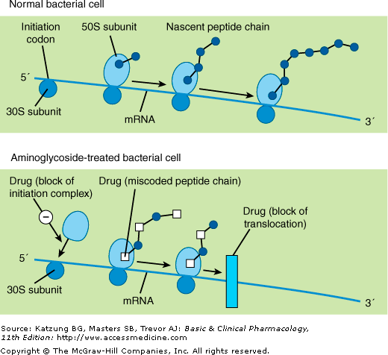

Slide 11
RESISTANCE
Production of enzymes:
Acetyl Transferase
Adenyl transferase
Phosphorylases
Lack of permeation to 30S ribosomal sub unit
Change in receptor protein on 30S ribosomal sub unit

Slide 12
SPECTRUM OF ACTIVITY
Narrow
No activity against G +ve
Only G -ve Aerobic
Pseudomonas aeuriginosa
Enterobacter
Proteus
Klebsiella
Shigella
E.Coli
Serratia
H. Influenza
Brucella
M. Tuberculosis

Slide 13
SIDE EFFECTS
Ototoxicity
Irreversible
Auditory damage
Vestibular damage
Permanent deafness, tinnitus, nausea, vomiting, dizziness, ataxia
Aggravated by furosemide & ethacrynic acid

Slide 14
Nephrotoxicity:-
Reversible
Renal malfunction
Decreased GFR
Proteins, hyaline & granular casts.
Aggravated by Vancomycin, Cyclosporin, amphotericin
Neomycin, tobramycin, amikacin

Slide 15
Neuromuscular blockade
Curare like effect
Decreased acetylcholine release
Decreased sensitivity
Respiratory paralysis
Antidotes:- Ca-gluconate or Neostigmine

Slide 16
Hypersensitivity reactions
Skin rashes
Contact dermatitis
Blood dyscrasias
CNS effects (Rare)
Optic nerve damage
Peripheral neuritis

Slide 17
DRUG INTERACTIONS
Loop diuretics
Amphotericin B
Cyclosporin
Vancomycin
Skeletal muscle relaxants

Slide 18
THERAPEUTIC USES
Gram Negative Bacterial Infections
Alone or with beta lactam antibiotics
UTIs
Pneumonia
Meningitis
Peritonitis after peritoneal dialysis
MRSA infections
Enterococcal endocarditis
Pseudomonas infections
Gram negative bacillus sepsis

Slide 19
STREPTOMYCIN
SOURCE: Streptomyces griseus
TUBERCULOUS INFECTIONS
Treatment of TB along with other Anti-TB drugs. (I/V or I/M)
0.5-1gm/day (7.5-15mg/kg/day)
DOT regimen

Slide 20
STREPTOMYCIN
NON-TUBERCULOUS INFECTIONS
Tularemia (With tetracyclines)
Plague ” ”
Brucellosis ” ”
Bacterial (enterococcal & streptococcal) endocarditis (with Penicillins)
Enterococcal peritonitis ” ”

Slide 21
GENTAMICIN
SOURCE: micromonospora purpurae
Active against both gm+ve and gm-ve
Staphylococci, coliforms & other gm-ve bacteria- pseudomonas, proteus, enterobcter, klebsiella, serratia
No activity against anaerobes

Slide 22
GENTAMICIN
Intravenous or intra muscular administration
Sepsis, pneumonia, UTI
Endocarditis (+ cell wall active drugs )
Topical- Infected burns, wounds, prevention of IV catheter infection
Ocular infections- Sub conjunctival inj.
Intrathecal- meningitis (3rd gen preferred)

Slide 23
TOBRAMYCIN
Spectrum similar to gentamicin
Solution for P aeruginosa LRTI complicating cystic fibrosis
AMIKACIN
Semisynthetic derivative of kanamycin
Resistant to many enzymes that inactivate gentamicin & tobramycin
TB (7.5-15mg/kg/d)

Slide 24
NEOMYCIN Group
Neomycin, kanamycin & paromomycin
Gm+ve & gm-ve bacteria; some mycobacteria
Poorly absorbed from GIT

Slide 25
NEOMYCIN
Topically in infections of skin, mucous membranes including infected burns, ulcers, wounds and dermatosis
Oral use for preparation of bowel for surgery
Hepatic coma to prevent encephalopathy

Slide 26
Parmomycin: is used for treatment of intestinal amoebiasis, visceral leishmaniasis
Kanamycin: Instilled into peritoneal cavity after operation
Neomycin, Paromomycin and Framycetin should not be used parenterally because of marked toxicity.

Slide 27
SPECTINOMYCIN
Aminocyclitol antibiotic
Structurally related to aminoglycosides
Active against many gm+ve & gm-ve organisms
Solely used as an alternative to penicillin in treatment of gonorrhea (drug resistant or penicillin allergic pts)
I/M-rapid absorption
Single dose of 40mg/kg upto max of 2gm

Slide 28
CLINDAMYCIN
Chlorine derivative of lincomycin
Streptomyces lincolnensis
Mechanism of Action
Inhibits protein synthesis
Binding site on the 50 s subunit of bacterial ribosome is identical with erythromycin

Slide 29
ANTIBACTERIAL SPECTRUM
Streptococci, staphylococci and pneumococci
Bacteroides species and other anaerobes, both gram positive and gram negative are usually susceptible.

Slide 30
RESISTANCE
Mutation of the ribosomal receptor site
Modification of receptor by methylase
Enzymatic inactivation of clindamycin
Gram-negative aerobic species are resistant because of poor permeability of outer membrane

Slide 31
PHARMACOKINETICS
90% protein bound
Penetrates well into tissues, abscesses except into brain and CSF
Metabolized by liver excreted in bile and urine

Slide 32
CLINICAL USES
Skin & soft tissues infections caused by streptococci and staphylococci-MRSA
Anaerobic infections caused by bacteroides
In combination with aminoglycosides for penetrating wound of the abdomen and gut infections (septic abortions, pelvic infections)
With primaquin for Pneumocystis jiroveci pneumonia in AIDS patient

Slide 33
ADVERSE EFFECTS
Diarrhea, nausea
Skin rashes
Impaired liver function
Enterocolitis

Slide 34
STREPTOGRAMINS
Quinupristin – streptogramin B
Dalfopristin – streptogramin A
Bactericidal
Gm +ve cocci
Protein synthesis inhibitors – 50S
Resistance:
Modification of the quinupristin binding site (MLS-B type)
Enzymatic inactivation of dalfopristin
Efflux

Slide 35
Treatment of infections caused by staphylococcus, vancomycin resistant strains of E faecium
Intravenous over 1 hr in 5% dextrose
Enzyme inhibitors – CYP3A4
Pain at infusion site, arthralgia-myalgia syndrome
Notes:
Structurally related to aminoglycosides- lacks aminosugars and glycosidic bonds
Pain at inj site, occasionally fever and nausea; rarely nephrotoxicity and anemia

Slide 36
LINEZOLID
Oxazolidinone
Gm +ve organisms
Bacteriostatic
Mycobacterium tuberculosis
Protein synthesis inhibitor – 23S ribosomal RNA of 50 S subunit
Resistance: mutation of binding site
Hematologic toxicity, optic & peripheral neuropathy, lactic acidosis
Notes:
Structurally related to aminoglycosides- lacks aminosugars and glycosidic bonds
Pain at inj site, occasionally fever and nausea; rarely nephrotoxicity and anemia

Slide 37
100% oral BA
T1/2 4-6 hrs
Weak reversible MAO inhibitor
Serotonin syndrome with SRIs
600mg BD
Vancomycin resistant E, faecium, nosocomial pneumonia, CAP, skin infections, MDR gm +ve bacterial infections
Notes:
Structurally related to aminoglycosides- lacks aminosugars and glycosidic bonds
Pain at inj site, occasionally fever and nausea; rarely nephrotoxicity and anemia

Slide 38
THANK YOU!

