Slide 2
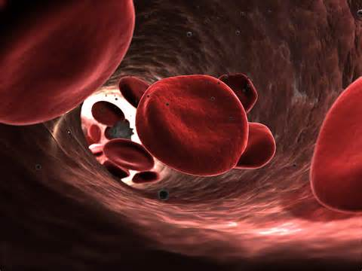
PHARMACOLOGICAL management of IRON DEFICIENCY ANEMIA
Dr. Sarah Zahid

Slide 3
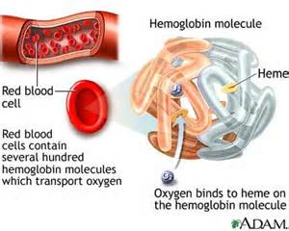
Definitions
Anemia :Blood disorder, characterized by an abnormally low levels of healthy red blood cells or reduced hemoglobin
A deficiency in number of oxygen carrying erythrocytes

Slide 4
Types of anemia
Normochromic normocytic
Anemia of chronic disease
Normochromic macrocytic
Vitamin B12 deficiency
Hypochromic microcytic
Iron deficiency
Hemolytic anemia
Aplastic anemia
Folate deficiency
Thalassemia
Anemia of chronic disease

Slide 5
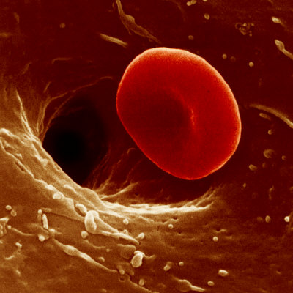
IRON DEFICIENCY ANEMIA
Definition: too low body iron stores to support RBC
production
Hemoglobin
Women <12
Men <13.5
Hematocrit
Women <36
Men <41

Slide 6
EPIDEMIOLOGY
Two billion people worldwide (30% of world’s population)
Western world: 1 in 24 (4.12%)
20% - women of child bearing age
2% - men
Pakistan. ????????????????????

Slide 7
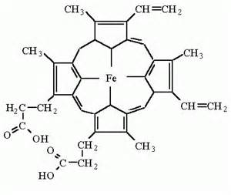
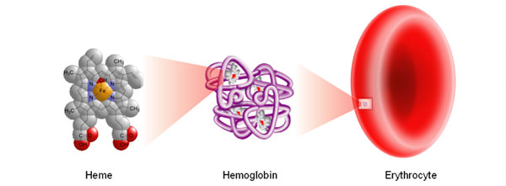

Slide 9
ETIOLOGY
Dietary factors
Impaired absorption
Gastric surgery
Celiac disease
Increased iron loss
GI bleed
Ulcerative colitis
Peptic ulcer
Drugs
Excessive menstrual flow

Slide 10
Increased physiological requirement
Infancy
Pregnancy
Lactation
Idiopathic

Slide 11
PATHOPHYSIOLOGY
Total iron body stores in 70 Kg adult man: 4 g
A person with 5L of blood has 2.5 g of iron incorporated into Hb.
Daily iron requirement : 20 – 25 mg
Total daily intake : 10-15 mg
Total daily absorption : 1 mg
Daily iron destroyed 0.8%

Slide 12
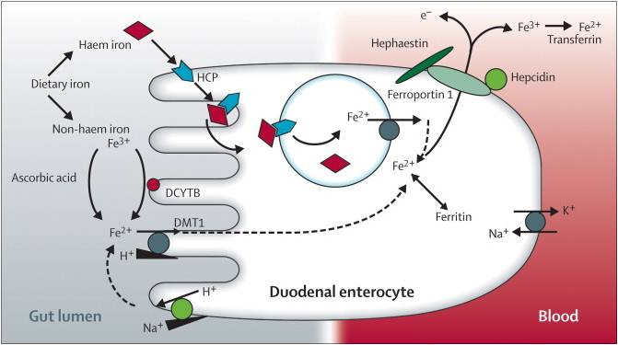
Iron absorption

Slide 13
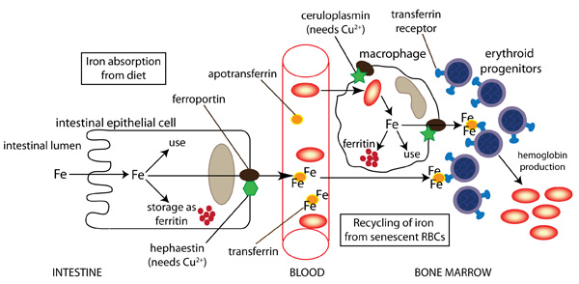
Iron transport

Slide 14
Iron storage

Slide 15
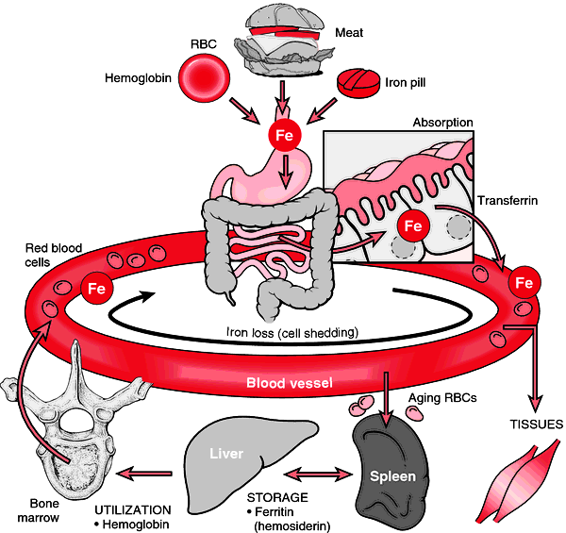

Slide 16
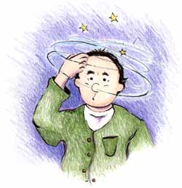
Clinical presentation
Symptoms
Decreased oxygenation
Dyspnea, Fatigue, Lethargy, Confusion
Light headedness
Decreased volume
Fatigue, Muscle cramps, Postural dizziness,
Syncope
CVS adaptations
Palpitations
Pica

Slide 17
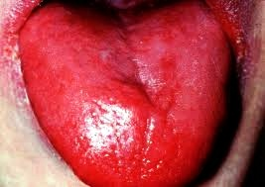
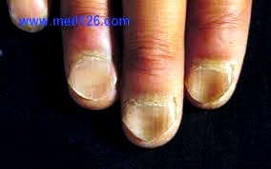
SIGNS
Pallor on mucous
membranes and palm
Koilonychia
Glossitis
Angular stomatitis
Splenomegaly

Slide 18
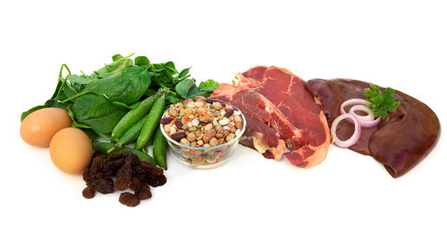
MANAGEMENT
Diet

Slide 19
Oral hematinics
Drugs
Indications for therapy
Ferrous sulphate
Ferrous gluconate
Ferrous fumerate
Prevention of anemia
Pregnancy
Lactation
Mennorhagia
Patients with chronic renal disease
Postoperative therapy
Treatment of anemia

Slide 20
hematinics
Oral
Parenteral
Ferrous sulphate
I/V
I/M
Ferrous gluconate
Ferrous fumerate
Iron dextran
Sodium ferric gluconate
Iron sucrose
Iron dextran

Slide 21
Iron preparations
Pharmacokinetics
Absorption
Promoters
Inhibiters
Elimination
Duration of treatment
3-6months

Slide 22
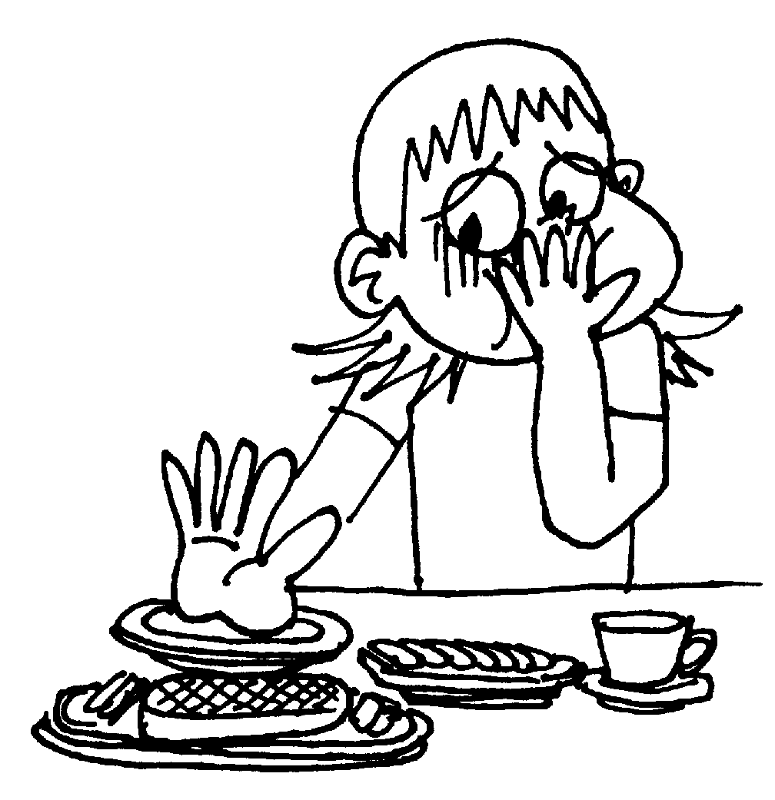
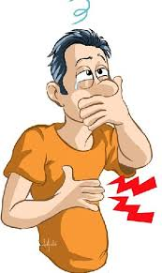
Adverse effects (dose related)
Nausea
Epigastric discomfort
Abdominal cramps
Constipation
Diarrhea
Black stools
Discoloration of teeth

Slide 23
Parenteral therapy
Drugs
Iron dextran
Iron sucrose
Sodium ferric gluconate
Indications
Pharmacokinetics
TDI…wt x 14 – (Hb x 2.145) /C

Slide 24
Adverse effects
Local pain & tissue staining
Hypersensitivity reactions
Headache
Fever
Arthralgias
Nausea, vomiting
Duration of treatment
3 – 6 months

Slide 25
Acute Iron toxicity
Cause ……….
Clinical presentation
Toxic doses:
GI Toxicity: 20mg/kg
Moderate toxicity: 40mg/kg
Lethal toxicity: 60mg/kg
Vomiting, Diarrhea
Abdominal cramps
Shock
Dyspnea
Severe metabolic acidosis
Coma, death

Slide 26
Management of acute iron toxicity
Gastric lavage
General measures
Iron chelation
Deferoxamine
Source: Streptomyces pilosus
MOA
Binds free iron in blood
DOSE
100mg binds 8mg iron

Slide 27
Chronic iron toxicity (hemochromatosis)
Cause
Clinical presentation
Signs of heart failure
Signs of liver failure
Coma and death
Management
Deferoxamine
Deferasirox
High affinity for Fe⁺³
Fecal excretion

Slide 28
THANK YOU !

