Slide 1
In the Name of Allah , The Most Merciful & The Most Beneficent

Slide 2
Hadith Shareef
ALLAH LOVES THE BELIEVERS
WHO EARN THEIR LIVING THROUGH LAWFUL
MEANS
(Tabarani)

Slide 4
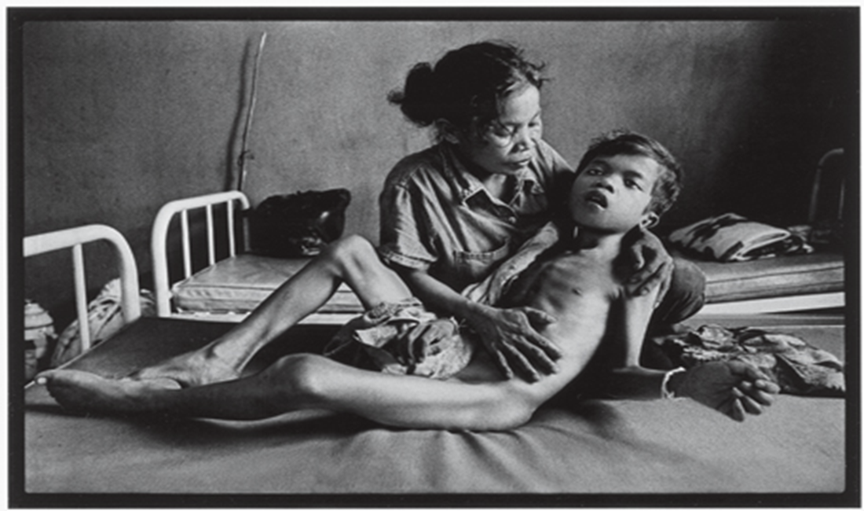
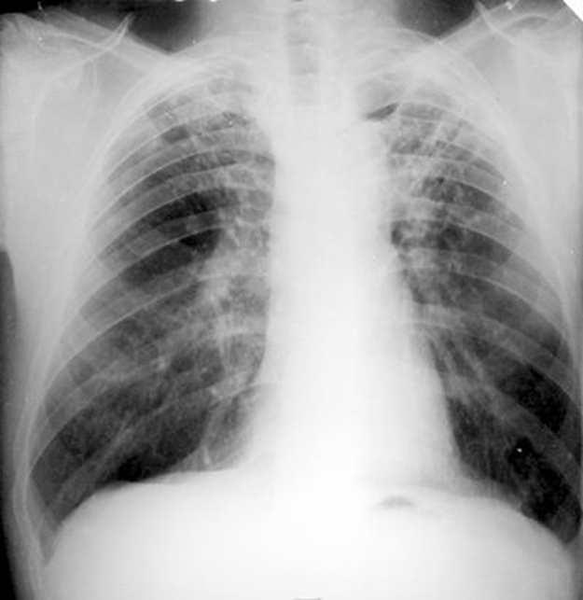

Slide 5
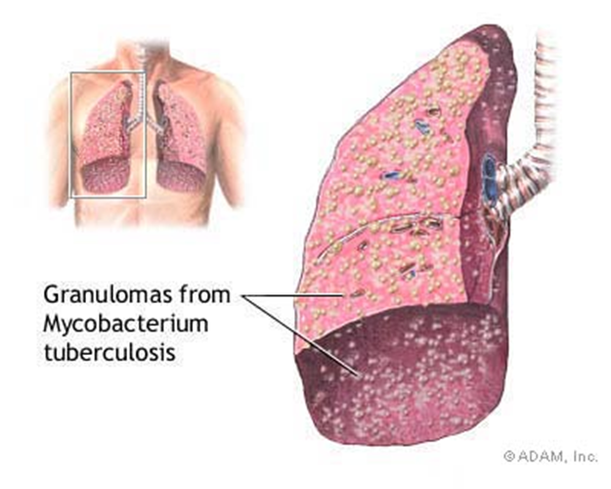
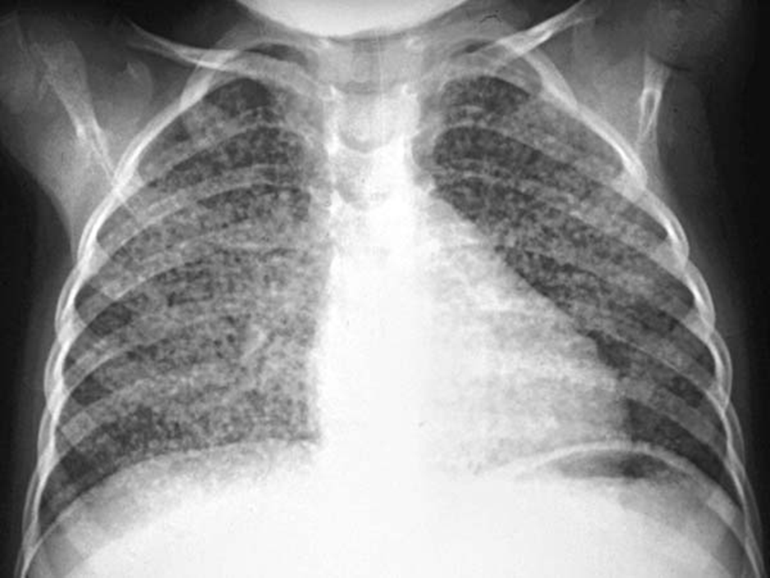
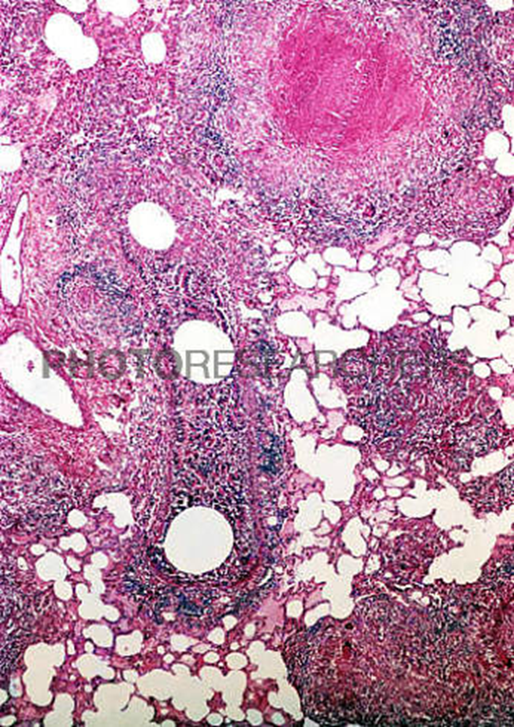

Slide 6
Some Special features of M. Tuberculosis
1. Intracellular (difficult to reach)
2. Dormant (difficult to reach)
3. Slowly replicating / (relatively rapid growers)
4. Cell wall made of mycolic acid/lipids
5. AAFB…….Efflux pump present inherently.
6. Develops Resistance rapidly to single drug
7. Difficult to culture.
8. cell wall is rich in lipids and drugs has to penetrate it.
Koch’s Bacillus
AAFB

Slide 7
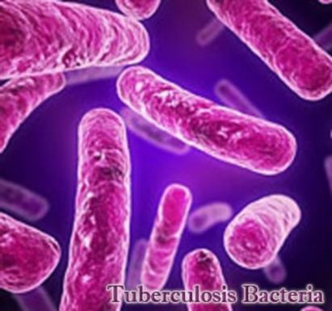
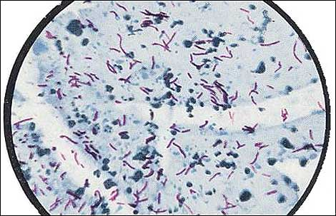
Some Strains of Mycobacterium
M. Tuberculosis
M. Bovis
M .Scroflaceum
M. Fortuitum
M. Kansasii
M. Chelonae
M. Ulcrans
M. Marinum
M. Avium
M. Avium complex
M. Leprae

Slide 8
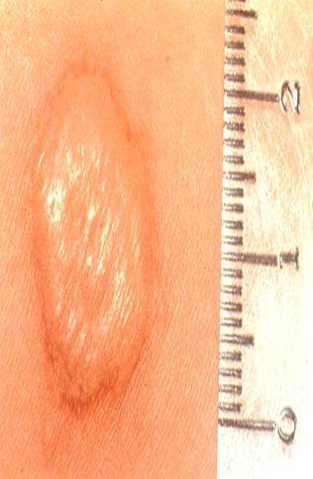
Diagnosis
Koch’s Disease or
Pulmonary Koch’s
History
Symptoms
Signs
Mantoux test
Sputum exam & culture
Chest x-ray (MMR ?)
Mantoux Test

Slide 9
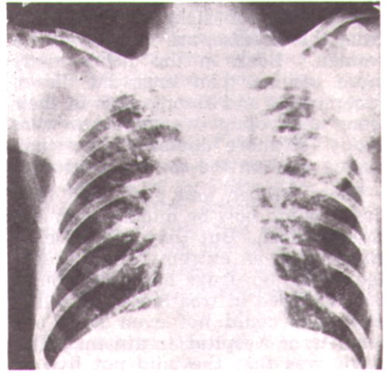

Slide 10
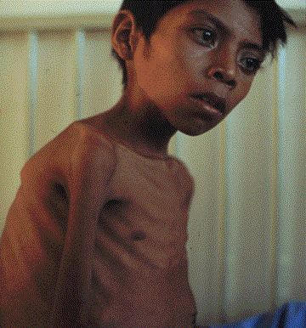
PROPHYLAXIS
BCG Vaccination
INH prophylaxis to vulnerable persons.
Incidence increasing----------
Refugees \
HIV
Starvation
Immunocompromised
contacts
AIDS
Radiotherapy
Immunosuppressants
Corticosteroids
Malnutrition
anticancers

Slide 11
Special features of Anti-TB Treatment
1. Longer duration of treatment
2. Quick development of Resistance
3. multi-drug therapy(in combination) indicated so
4. Various regimens of drugs used
5. Duration of therapy dependent on the organ involved
6. Duration of treatment also depends upon the drugs used in a regimen.

Slide 12
Virtually any organ can be involved.
Lungs
Lymph nodes
Intestines
liver
Bones
Skin
F. Tube
Ovaries
Testis
kidneys
Bladder
epididymus
Impotant points to be Noted
Primary TB
Secondary TB
Gohn’s Complex
“Caseation”
BCG
Mantoux test
Or Tuberculin test
DOTs
Sterilizing Agents
Clinical Use of INH resistant strains
Atypical Mycobacteria

Slide 13
Anti Tubercular
Drugs

Slide 14
First ATT was PAS--------- 1943 by Lehman
Streptomycin………….. By Wakesman and Schatz
Thiacetazone---------------1946 by Domagk
Isoniazid-------------------------1952 by squib, roche and Bayer
Pyrazinamide -------------------------1952 by Kushner
Rifamycins ---------------------------- 1957 by sensi
Ethambutol --------------------------- 1961 by lederle labs
Moxifloxacin, PA- 824, TMC- 207 under clinical testing

Slide 15
Classified into two groups.
A . First line Drugs
Isoniazid (INH)
Rifampicin
3. Pyrazinamide
4. Ethambutol
5. Streptomycin

Slide 16
II. Second Line Drugs
Para-aminosalicylic acid
Thiacetazone
Ethionamide
Kanamycin
Amikacin
Capreomycin
Cycloserine
Ciproflaxacin / Levofloxacin
Macrolides
Tetracyclins
Clofazimine
Rifabutin

Slide 17
Isoniazid (INH) Nydrazid
Synthesized in 1952. Primary anti T.B drug.
Chemistry:
Hydrazide of Iso-nicotinic acid . MW = 137
Structure is similar to pyridoxine and a MAO inhibitor Iproniazid.

Slide 18
Mechanism of Action
Inhibition of synthesis of mycolic acid in cell bacterial wall. it also
inhibiTs DNA & RNA synthesis.
INH is activated by mycobacterial kat G catalase –peroxidase
Nicotinoyl-NADP, inhibits bacterial DHF Enzyme …….. Blocks nucleic acid synthesis
Highly selective for M.tub.
Most of atypical ones are resistant to INH .
Bacteriostatic in low conc:
Bactericidal in high conc:
Active against both intracellular and extracellular mycobacteria.

Slide 19
Resistance
Increased levels of product of inh A gene.
Mutation for deletion of kat G (encodes bact catalase)
Absence of catalase leads to resistance.

Slide 20
Pharmacokinetics:
Well absorbed orally
PP levels reached within 2 hrs
Well distributed to all tissues
Crosses BBB
Acetylated in liver (Fast & Slow Acet)
Fast acetylators are dominant trait
Slow acet is recessive trait.
Excreted 95 % in urine

Slide 21
Therapeutic Uses
I. For Treatment of T.B: in combination for Many forms of TB.
II. For Prevention of TB : as single agent
a. Newborns
b. Immuno-compromised
c. New converters
d. (HIV & AIDS)

Slide 22
Dose:
2-5 mg /Kg / day
Typical Adult dose is 300 mg

Slide 23
Advantages of Isoniazid
The most active drug against Myco.TB
High selectivity against mycobacteria
Bactericidal action
Cost-effective
Easily available
Orally administered

Slide 24
Well absorbed
Widely distributed in body tissues/fluids
Enters macrophages
Penetrates caseous material
Crosses Blood-Brain Barrier
9. Single dose administration
10. Low incidence of serious toxicity

Slide 25
Most important adverse effect are:
Liver damage by Acetyl hydralazine
Peripheral Neuropathy
Prevention: by admin of Pyridoxine 25-50 mg/day

Slide 26
Other Adverse effects
CNS effects
Mental disturbances, incoordination,
optic neuritis and convulsions
AllergicReactions: Fever, skin rashes, Rarely SLE
Inhibits the metabolism of Phenytoin
Miscellaneous:- Hematologic abnormalities, tinnitus and gastrointestinal discomfort.

Slide 27
2- Rifampicin or Rafampin
A Large molecule
Semisynthetic
Derivative of Rifamycin obtained from Streptomycis Mediterranei
Also covers some Gram +ve, Gram –ve and enteric bacteria
No cross resistance to other classes of anti-bacterials but exists between rifamycin derivatives.

Slide 28
MOA
Binds with β- subunit of bacterial DNA dependent RNA polymerase to inhibit RNA synthesis
Bactericidal for mycobacteria as it penetrates well into most of tissues & macrophages.

Slide 29
Resistance
Point mutation in rpo B gene
Ph: kinetics
Absorbed well orally, highly lipid soluble,
Distributed to all body tissues & fluids (CSF, saliva, tears, urine, faeces, sweat)
Excreted in bile
undergoes entero-hepatic circulation
Excreted as a deacylated metabolite in faeces. (Small amount appears in urine & discolors it)
Potent Hepatic microsomal enzyme inducer
Dose: 10 mg /kg/day or 600 mg /day for 6 months

Slide 30
Anti Bacterial Spectrum
Mycobacterium T.B
Mycobacterium Leprae
Meningococcus
H. Influenzae
5. Staphylococci
6. Pneumococci--- Penicillin resistant strains.

Slide 31
Therapeutic Uses
Mycobacterial infections → 600 mg/day (10mg/kg/day)
Meningococcal carrier state → 600 mg bd x 2 days
Hemophilus influenzae → 20mg /kg/day x 4 days
Staphylococcal carrier state → in combination with other agent

Slide 32
Penicillin resistant pneumococci in meningitis
Staph infections like prosthetic valve endocarditis & osteomyelitis
Alternative of INH prophylaxis
Atypical mycobacterial infections

Slide 33
Adverse effects
Serious toxicity is rare.
Flue-like syndrome
GIT upsets
Skin rash and fever
Harmless orange discoloration of the urine, sweat, tears and contact lenses.
Hepatotoxicity ………Jaundice
Potent Enzyme Inducer .increased metabolism of drugs, including
Oral Contraceptives Warfarin Methadone Corticosteroids
Sulfonylureas Digoxin

Slide 34
3- Pyrazinamide
It is synthetic analog of Nicotinamide.
Slightly soluble in water
Cheaper compound
Active against intracellular Mycobacteria
Inactive at neutral pH but at 5.5, it inhibits tubercle bacilli.
Clinical Uses
Pulmonary T.B.
T.B. meningitis
Bone T.B
Resistance develop rapidly (due to mutation in pnc A)
Dose: 25 mg/kg/day → …………serum levels 30 – 50 µg/ml

Slide 35
Pyrazinamide (cont)
Absorbed readily from GIT
Widely distributed
t½ is 12 – 24 hrs
Adverse effects
Hepatotoxicity
Hyperuricemia → gouty arthritis
Nausea vomiting
Drug fever
Malaise

Slide 36
Therapeutic Uses
Treatment of T.B in Combination with INH and Rifampicin
For prevention of active disease in close contacts with multidrug resistant cases,
In combination with ciprofloxacin or ofloaxacin

Slide 37
4- Ethambutol
Source & Chemistry
1ST Synthetic anti TB Agent.
Dextro isomer of 2, 2 ethylene di amino- di- L – butamol- HCl
water soluble, heat stable
MOA
Inhibits synthesis of arabino-galactane an essential component of cell wall of Mycobacterium ( by inhibiting arabinosyl transferases)
Enhances the activity of lipophilic drugs such as Rifampicin & ofloxacin

Slide 38
Ethambutol
Ph: Kinetics
Absorbed well orally -.. -2 – 4 hrs → P. plasma level
50% excreted in urine & 20% in faeces
Cross B.B.B when meninges are inflammed
Resistance
Emerges rapidly
Mutations resulting in over expression of emb gene products
Mutation within the structural gene emb B
Dose: 15 mg/kg/day Orally Once daily

Slide 39
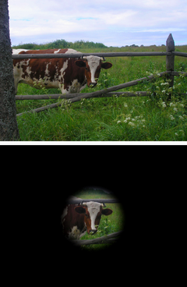
Clinical uses
15 -25 mg/kg/day with INH & Rifampin in pulmonary T.B.
Higher doses for T.B. meningitis
ADVERSE EFFECTS
Loss of usual acuity…………..Retrobulbar neuritis……..tubular vision so contraindicated in children under five years.
Loss of red – green color appreciation
Interstitial nephritis
Drug fever
Rash,
Confusion
GI. Upset

Slide 40
Aminoglycosides
Streptomycin
Kenamycin
Amikacin
Viomycin
Active against extra cellular Mycobacteria.
Most mycobacteria are inhibited but non T.B are resistant.

Slide 41
5- Streptomycin
Belongs to Aminoglycosides antibiotics.
Obtained from streptomyces griseus.
First line Anti TB drug.
It has last priority, may be used to kill resistant strains of organism.
Dose: 15 mg /kg/ day. Given I/M in dose of 1G daily.

Slide 42
MOA
Bactericidal
1. Irreversible inhibitor of protein synthesis
Binds to S¹⁶ ribosomal sub unit of s30 and acts in 3 ways:
2. Misreading of mRNA, incorrect AA sequences enter into peptide chains.
3. Interference with initiation complex of Peptide formation.
4. Break up of polysomes into non-functional monosomes.
5. Damage to inner cytoplasmic membrane.
6. Interference with respiration of bacteria.

Slide 43
Clinical Uses
Mycobacterium TB Infections
Pulmonary Tuberculosis
Miliary Tuberculosis
Tuberculous Meningitis
NON-Mycobacterium TB Infections

Slide 44
B. Non Tuberculous Infections
With a tetracycline in
Plague
Tularemia
Brucellosis
With Penicillin in
Enterococcal Endocarditis
Enterococcal Peritonitis

Slide 45
Adverse Effects
Allergic reactions
Dose related, more in elderly
Ototoxicity
Nephrotoxicity
N. M. Blockade ( Contraindicated in M. Gravis & With NMJ blocking drugs)

Slide 46
Sterilizing Agents
INH
Rifampin
PZA
Streptomycin

Slide 47
Second Line Drugs
Ethionamide
It is chemically related to INH.
Blocks thy synthesis of mycolic acids.
It is given orally 1g/day.
Adverse effects.
Intense gastric irritation
Hepatotoxicity
Neurological symptoms
Low level cross resistant b/w INH and Ethionamide may occur.

Slide 48
Capreomycin
Peptide Antibiotic
Source: steptomyces capreolus
Given by I/m injection.
Dose: 15 mg/kg/day
Drug is nephrotoxic and ototoxic.
Useful in treatment of
multidrug resistant TB

Slide 49
Cycloserine
Antibiotic---Streptomyceus Orchidacious
Inhibitor of cell-wall synthesis.
Given orally ½ -1g/day in 2-doses.
Adverse effects:
Peripheral Neuropathy
CNS dysfunction including depression and psychotic reactions.

Slide 50
Para-Amino-salicylic acid (PAS)
Structure resembles PABA and sulfonamides.
MOA: Folate antagonist
Rapidly absorbed from GIT .
widely distributed except CSF
Dose is 8-12g/day.
A/Effects: 1. Severe GIT irritation ,peptic ulcer
2. Crystaluria
3. Hypersensitivity reactions
Used infrequently b/c of
Poor tolerance & Primary resistance

Slide 51
Ciprofloxacin and Levofloxacin
Fluoroquinolones
used in combination therapy for resistant cases.
With Pyrazinamide as prophylactic in contacts of multi drug resistant TB..

Slide 52
Kanamycin and Amikacin
Aminoglycosides
Kanamycin Very toxic , so obsolete
Amikacin is used for treatment of Streptomycin / multidrug resistant cases
Dose: 15mg/mg/day I/Vor I/M

Slide 53
Clofazimine
Anti-Leprosy drug but also has some activity against mycobacterium T B in vitro.
A drug of last resort for the treatment of multi drug resistant cases.
Dose: 200mg/day orally
But its efficacy not well established as a antituberculosis drug.

Slide 54
Rifabutin (Ansamycin)
Derived from Rifamycin related to Rifampin
Active against
M. avium intracellular
M. tuberculosis
M. Fortuitum
Dose:- 300 mg/day
Effective:- Against disseminated atypical mycobacterial infections in pts with advanced AIDS
Useful in multi drug resistant cases
RIFAPENTINE
LINEZOLID

Slide 55
Thiacetazone
Sulphonamide
Active orally
Low cost
Side effects → G. intestinal

Slide 56
Indications of Corticosteroids in T.B: along with Anti TB treatment
Massive T.B pleural effusion
Massive T.B pericardial effusion
T.B ascites (massive)
T.B meningitis
T.B choroiditis

Slide 57
Duration of Therapy
SN | Regimens | Duration in months
1 | INH + Pyrazinamide +Rifampin | 6
2 | INH + Rifampin | 9
3 | Rifampin + Pyrazinamide + Ethambutol | 6
4 | Rifampin + Ethambutol | 12
5 | INH + Ethambutol | 18
6 | All others | 24

Slide 58
Treatment failure
High Resistance
Poor compliance (Poor Adherence)
Long duration of treatment
Side effects
Fads

Slide 59
D.O.T REGIMEN (Directly Observed Treatment)
It is the strategy to ensure cure by providing the most effective medicine and confirming that it is taken.
During the intensive phase of treatment a health worker or other trained person watches as the patient swallows the drugs in his presence.
During continuation phase, a blister pack is given to the patient and first dose is swallowed in the presence of a health worker. on his next visit, empty blister pack in inspected to confirm the compliance.

Slide 60
In DOTS daily dosing regimens as well as intermittent dosing regimens may be applied.
During intensive phase usually four drugs are given for 02 months either on daily bases or intermittently.
Then two or three drugs are continued for 4 to 6 months. ( Continuation phase).
INH 600 mg
PYRAZINAMIDE 1500 mg
ETHAM 1200 mg
STREPTO 750 mg
Intensive phase/ intermittent

Slide 61
Alternative Second Line Drugs
Indicated when
Resistance to other drugs is encountered
Allergic reactions to 1st line drugs
Expert guidance is available to deal with toxicities of 2nd line drug
Clinical response absent with conventional therapy

Slide 62
Drugs active against atypical Mycobacteria
10% cases occur
Atypical mycobacteria have distinctive Lab characteristics.
Disease is less severe
Not communicable from person to person
Atypical mycobacteria are present in environment
less sensitive to usual anti-tuberular treatment

Slide 63
Drugs
Fluoroquinolones
Tetracyclins
Sulphonamides
Erythromycin
M. Kansasii → Rifampin + Ethambutol +cipro & clarithro or cotrimoxazole (Resistant to INH & PZA)
M. Avium, M intracellular (MAC) in AIDS patients life long treatment given with → Azithromycin 500mg/d or, clarithromycin 500 mg bid + ethambutol
OR cipro 750 mg od or Rifabutin 300 mg od

Slide 64
M. Scroflaceum…….Amikacin+ Erythro
M. Ulcerans ----------- INH+Strepto+Rifampin+ minocyclin
M. Chelonae……….Amikacin or Doxy or impenem or Macrolides
MAC…………Cipro or Ofloxa + Pyrazinamide may also be effective

Slide 65
A.T.T ends
Anti-leprosy starts

Slide 67
leprosy

Slide 68
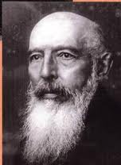
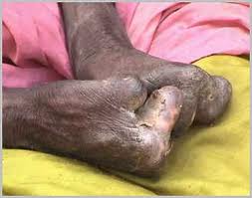
leprosy
Hansen’s Disease
Dr. Gerhard Armeur Hansen
In 1873, discovered M. leprae
6/25/2012
68
68

Slide 69
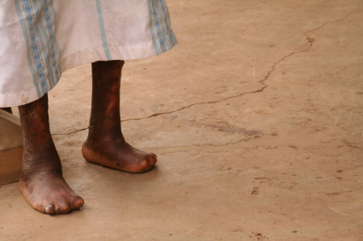
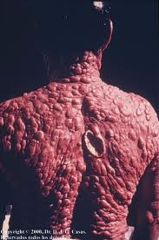

Slide 70
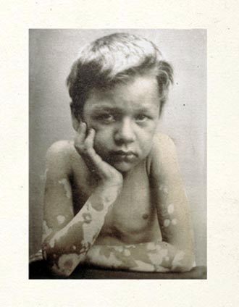
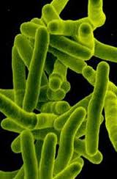
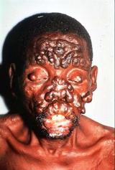

Slide 71
A HISTORICAL DISEASE

Slide 72
Leprosy (Hansen’s Disease)
Most disabling disease
20 million suffer
Spreads by droplet infection (nasal mucosa) & upper resp tract
Through prolonged skin contact
Types of Leprosy
Tuberculoid (cell mediated immunity +)
Borderline or diamorphous
Lepromatous (no immunity, fulminant disease)

Slide 73
Infectious disease
Mycobacterium leprae
Prolonged + persistent contact with host may be necessary
Spread by droplets from sneezing
Involves skin, P. nerves, sweat glands, hair follicles.
Bones, muscles, kidneys, etc

Slide 74
Anti Leprosy Drugs

Slide 75
Drugs used in treatment of Leprosy
1.Sulfones:
Dapsone
Sulfoxone
2. Rifampicin
3. Clofazimine
4. Miscellaneous:
i. Corticosteroids
ii. Ethionamide
iii. Thalidomide

Slide 76
Sulfones
Dapsone (di-amino-diphenyl sulphone)
Acedapsone
Sulfoxone sodium
Absorption
Well absorbed by GIT
Distribution
Distributed to all tissues & body fluids
Serum t ½ is 1 -2 days
Drug retained in skin, muscle, liver & kidney

Slide 77
Excretion
Excreted into bile & reabsorbed
Acetylated sulfones excreted in urine
Dose
25 mg / week increasing upto 400 – 600 mg/wk

Slide 78
Untoward reactions
Methaemoglobinemia
GIT irritation
Fever
Rashes
Erythema nodosum
G – 6 PDH deficiency → Haemolysis
Other uses
Pneumocystis pneumonia in AIDS
Used in combination Resistant malaria

Slide 79
Clofazimine
Phenazine dye
Weak M. laprae inhibitory activity
MOA
Inhibit the template function DNA , anti inflammatory effect
Absorption
Well absorbed orally
Distribution
Accumulate in tissue (skin Reticulo- endothelinl cells)
Slowly released → serum t ½ → 2 months
Excertion
Bile & urine
Through faeces (major portion)
Dose:-
100 mg/day orally
In combination therapy 50 -100 mg/day

Slide 80
uses
Sulfone resistant leprosy
To treat erythema no
Chronic skin ulcers
Combination therapy
Myco avium infections in AIDS
When pts intolerant to sulphones

Slide 81
Adverse effects
Skin discoloration (red brown → black)
G. l intolerance

Slide 82
Amithiozone
A thio-sem-icarbazone
Effective in tuberculoid leprosy
Used as substitute for dapsone
Dose:-
150mg/day or 450mg twice weekly
Unwanted effects
G. I intolerance
hepatotoxic

Slide 83
Rifampin
A Large molecule
Semisynthetic
Derivative of Rifamycin obtained from Streptomycis Mediterranei
Gram +ve, Gram –ve and some enteric bacteria
No cross resistance to other classes of anti-bacterials

Slide 84
MOA
Binds with β- subunit of bacterial DNA dependant RNA polymerase to inhibit RNA synthesis
Bactericidal for mycobacteria as it penetrates well into most of tissues & macrophages.

Slide 85
Resistance
Point mutation in rpo B gene
Ph: kinetics
Absorbed well orally, highly lipid soluble,
Distributed to all body tissues & fluids (CSF, saliva, tears, urine, faeces, sweat)
Excreted in bile
undergoes entero-hepatic circulation
Excreted as a deacylated metabolite in faeces. (Small amount appears in urine & discolors it)
Potent Hepatic microsomal enzyme inducer
Dose:- 10 mg /kg body wt/day or 600 mg /day for 6 months

Slide 86
Adverse effects
Serious toxicity is rare.
Hepatotoxicity , Jaundice
GIT upsets
Skin rash and fever
Flue like syndrome
Harmless orange discolouration of the urine, sweat tears and contact lenses.
Enzyme induction of many drugs, including
Oral Contraceptives Warfarin Methadone Corticosteroids
Sulfonylureas Digoxin

Slide 87
Miscellaneous anti leprosy Drugs
Ethionamide: Substitute for Clofazimine, 250---375mg/d
Thalidomide : for Erythema nodosum leprosum, 100-300mg
Teratogenic
Agents in animal trials: Minocycline ,Clarithromycin ,Pefloxacin , Ofloxacin
87

Slide 88
Modified WHO-recommended multidrug therapy regimens in leprosy
Type of leprosy* | Monthly supercised drug treatment | Daily self administered drug treatment | Duration of treatment
Paucibacillary | Rifampicin 600mg | Dapsone 100mg | 6 months
Multibacillary | Rifampicin 600mg Clofazimine 300mg | Clofazimine 50mg Dapsone 100mg | 12 months
Paucibacillary single-lesion | Ofloxacin 400mg Rifampicin 600mg Minocycline 100mg |  | Single dose
* WHO classification for field use when slit skin smears are not available: Paucibacillary single-lesion leprosy (one skin lesion) Paucibacillary (2-5 skin lesions) Multibacillary (more than 5 skin lesions) In this field classification WHO recommends treatment of multibacillary patients for 12 months only

Slide 89
Ends
That’s All for Today
89

