Slide 1
ANTIFUNGAL DRUGS

Slide 2
Learning objectives
Important characteristics of fungi.
Importance of fungal infections.
Classification of antifungal drugs.
Mechanism of action, spectrum of activity, clinical uses and adverse effects of important drugs

Slide 3
Fungi
Yeasts
Molds
Mushrooms
Smuts
Pathogens
Aspergillus fumigatus
Candida albicans
Penicilium chrysogenum

Slide 4
Fungal Infection in Humans = Mycosis
Major Types of Mycoses
superficial
cutaneous
subcutaneous
systemic
opportunistic
Symptoms vary from cosmetic to life threatening

Slide 5
People prone to fungal infections
AIDS patients
Patients whose immune system is compromised by drugs
Corticosteroids
Immunosuppressant's

Slide 6
Fungi
Eukaryotes
Cell wall containing glucans and chitin
Their eradication require different strategies

Slide 7
Classification Antibiotics
AZOLES
Amphotericin B
Nystatin
Griseofulvin
IMIDAZOLES
Clotrimazole
Ketoconazole
Miconazole
Econazole
Butoconazole
Oxiconazole
Sulconazole
TRIAZOLE
Itraconazole
Fluconazole
Voriconazole
Posaconazole
Echinocandins
Caspofungin
Micafungin
Anidulafungin

Slide 8
ANTIMETABOLITE:-
Flucytosine
ALLYLAMINES:-
Terbinafine , Naftifine, Butenafine
MISC:
Ciclopirox Olamine, Haloprogin, Benzoic acid, Salicylic acid

Slide 9
CLASSIFICATION
a. SYSTEMIC ANTIFUNGAL DRUGS
SYSTEMIC INFECTIONS (Mycosis)
Amphotericin B, Flucytosine, Itraconazole, Fluconazole, Voriconazole
MUCOCUTANEOUS INFECTIONS (Dermatophytes)
Griseofulvin, Terbinafine, Caspofungin

Slide 10
b. TOPICAL ANTIFUNGAL DRUGS (Dermatophytes)
AZOLES:- Miconazole, Econazole, Oxiconazole,
ALLYLAMINE:- Butenafine, Naftifine, Terbinafine
NYSTATIN
HALOPROGIN
BENZOIC ACID, SALICYLIC ACID

Slide 11
AMPHOTERICIN B
SOURCE Streptomyces nodosus
CHEMISTRY
(7,Polyene macrolide-O-Mycosamine)

Slide 12
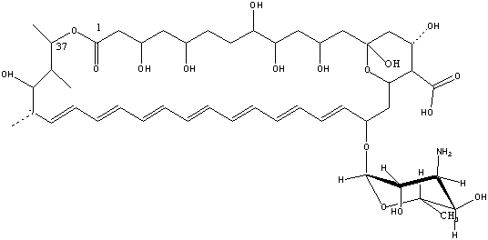
CHEMISTRY

Slide 13
GENERAL
Poorly water soluble
Suspension with Desoxycholate Na for I/V use
Amphoteric molecule
Stable at extremes of pH
Liposomal amphotericin B (lipid packaged drug)

Slide 14
Pharmacokinetics
Oral absorption poor (local action on the mucosal surface)
IV 0.6mg/kg/day
Protein binding 90%
Wide distribution (CNS 2-3%)
t_{1/2} 15 days

Slide 15
MECHANISM OF ACTION
Preferential binding to ERGOSTEROL
Ergosterol is cell membrane sterol, present in cell membrane of fungi
Predominant sterol of bacteria and human cells is cholesterol
Pores or channels are formed in membranes of sensitive fungi
Cell unable to maintain internal environment
Fungicidal action

Slide 18
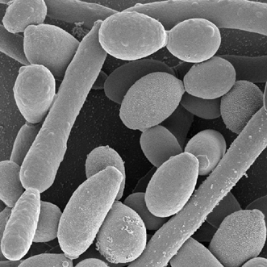
SPECTRUM OF ACTIVITY (The broadest spectrum)
Candida albicans
Cryptococcus neoformans
Histoplasma capsulatum
Blastomyces dermatitidis
Coccidioides immitis
Aspergillus fumigatus

Slide 19
Clinical Uses
INDUCTION THERAPY
(The drug of choice)
Severe fungal pneumonia
Severe cryptococcal meningitis
Disseminated infections, histoplasmosis or coccidioidomycositis
Maintenance therapy is with azoles

Slide 20
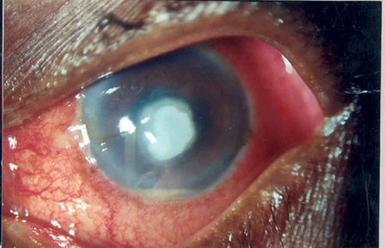
Topical use
EYE:
Mycotic corneal ulcers
Keratitis
Topical drops
Direct subconjunctival injection
Others:
Fungal arthritis (local injection into joint)
Candiduria (bladder irrigation)

Slide 21
Adverse effects
IMMEDIATE (related to infusion of drug)
Fever, chills, muscle pain, headache
vomiting, hypotension
Test dose:- 1mg IV
Slow infusion rate
Decrease the daily dose
Premedication (Antipyretics, antihistamines, meperidine or corticosteroids)

Slide 22
Adverse effects
LATE
Renal damage
(Irreversible >4g cumulative dose is given)
Renal tubular acidosis
Severe K⁺ and Mg⁺⁺ wasting
Dialysis
Saline infusion

Slide 23
Adverse effects
Abnormal liver function test
Anemia renal origin
Loss of Erythropoietin formation (damaged renal tubular cells)
Cerebral damage….Seizures

Slide 24
FLUCYTOSINE
Discovered in 1957 accidentally during search for anticancer drugs
Water soluble pyrimidine analog related to chemotherapeutic agent Fluorouracil
Spectrum of action much narrower than Amphotericin B

Slide 25
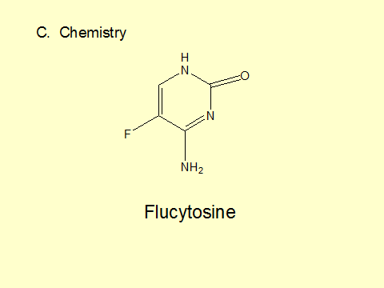
FLUCYTOSINE
5 Fluorocytosine, 5-FC

Slide 26
PHARMACOKINETICS
Oral (100/150 mg/kg/d)
BA >90%
t_{1/2} 3-4h
Distribution (all parts, CSF high )
Excretion by glomerular filtration plasma levels high in renal failure

Slide 27
FLUCYTOSINE
MECHANISM OF ACTION
1- Taken by fungal cells via enzyme cytosine permease.
2- Deaminated to 5-FU
3- Converted into 5-FdUMP and 5-FUTP
3-Incorporated as 5-FUTP in RNA
3- 5-FdUMP (Inhibitor of thymidylate synthetase) DNA
4- Block dUMP dTMP
Synergy with Amphotericin B

Slide 29
SPECTRUM Of ACTIVITY
Cryptococcus neoformans , Candida spp and dermatiaceous molds
CLINICAL USES
Cryptococcal meningitis: Flucytosine + Amphotericin B
Chromoblastomycosis : Flucytosine + Itraconazole
keratitis, sinusitis, allergic bronchopulmonary mycoses
Development of resistance very common
Mechanism is altered metabolism of flucytosine
Develops rapidly when monotherapy is given

Slide 30
ADVERSE EFFECTS
(Active metabolites produced by intestinal flora fluorouracil)
Bone marrow toxicity, anemia, leukopenia and thrombocytopenia
Toxic enterocolitis
Derangement of liver enzymes
Nephrotoxicity

Slide 31
AZOLES IMIDAZOLE

Slide 32
TRIAZOLES

Slide 33
MECHANISM OF ACTION
Selectivly binds with fungal 14-α-sterol demethylase, cytochrome p450 enzyme and inhibit its activity
Demethylation of lanosterol does not occur
Decrease ergosterol synthesis

Slide 36
SPECTRUM OF ACTIVITY
Candida albicans, C tropicals ,C parasilosis, C glabrata
Cryptococcus neoformans (Fluconazol)
Blastomyces dermatitidis, Histoplasma capsulatum, Coccidioidomycosis
Ring worm (dermatophytes)
Pseudallescheria boydii ( Amphotericin B resistant)

Slide 37
Resistance
Mutations in genes coding 14-α sterol demethylase

Slide 38
Clinical uses
Blstomycosis (wart like lesion)
Coccidioidomycosis (respiratory infection)
Histoplasmosis (systemic disease)
Dermatophytes (infection of body surfaces)
Aspergillus infections (Itraconazole and voriconazole)

Slide 39
 | Solulibility | Absorption | availability | t1/2 hours | Excretion | Route
Ketoconazole | Low | Erratic | Less | 7-10 | Hepatic | Oral
Itraconazole | Low | Erratic | 55 ↑food | 24-42 | Hepatic | Oral, IV
Fluconazole | High | High | >90% | 22-31 | Renal | Oral, IV
Voriconazole | High | High | 96↓ food | 6 | Hepatic | Oral, IV

Slide 40
Ketoconazole
First oral azole (low cost)
Greater propensity to inhibit mammalian cytochrome P450 than are the new azoles
Itraconazole
oral and I/V
Drug of choice for histoplasma, blastomyces and sporothrix
Dermatophytoses and onchomycosis

Slide 41
ADVERSE EFFECTS
Nausea, vomiting
Allergic rash
Hormone imbalance
Fluid retention
Hepatitis
Teratogenic
Inhibits drug metabolism
Absorption reduced by H₂ antihistamines and omeprazole and antacids (KETOCONAZOLE)

Slide 42
Drug interactions
Azoles are cytochrome inhibitors thus increasing level of alprazolam, carbamazepine, digoxin etc
Drugs that decrease azole concentration are antacids, barbiturates, phenytoin, rifampin etc

Slide 43
ECHINOCANDIN
Newest class
Large cyclic peptides linked to long chain fatty acids
Caspofungin
Micafungin
Anidulafungin

Slide 44
Caspofungin
Caspofungin acetate
Water soluble, semisynthetic lipopeptide

Slide 45
Mechanism of action
Inhibits 1,3-β-D-glucan synthase, which is required for glucan polymerization in the wall of filamentous fungi
Reduces structural integrity of cell wall
Cell death

Slide 47
SPECTRUM OF ACTIVITY
Candida albicans, C glabrata, C tropicalis,
C krusei,
Aspergillus fumigatus, A flavus, A terreus
Pneumocystis jiroveci*

Slide 48
PHARMACOKINETICS
Given IV only
Volume of distribution (l) 9.7
Half life 9-11 hrs
Protein binding (%) 96 %
Elimination renal

Slide 49
USES
Disseminated fungal infections
Initial therapy of deep invasive candidiasis
Aspergillosis
Mucocutaneous candidiasis, esophageal candidiasis
Empiric antifungal therapy during febrile neutropenia
Candidemia

Slide 50
Adverse effects
Elevated liver enzymes
Minor gastrointestinal side effects
Flushing (histamine like effects)
Anidulafungin has less drug interactions

Slide 51
Oral systemic antifungal drugs for mucocutaneous infections

Slide 52
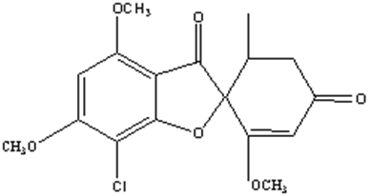
Griseofulvin (Chemistry)
Source:
Penecillium griseofulvin

Slide 53
Pharmacokinetics
Orally given
Poorly soluble
Absorption related to food and size
Increase absorption when fatty food is given
Ultramicronized griseofulvin
Gets deposited in keratin ( stratum corneum)
T1/2 24 hrs, renal excretion

Slide 54
Mechanism of action
Fungistatic
Binds to microtubules comprising the spindles and inhibits mitosis.
Incorporates into affected keratin.

Slide 55
Spectrum of activity
Microsporum
Trichophyton
Epidermophyton

Slide 56
Therapeutic uses
Mycotic disease of the skin, hair and nails
Tinea capitis in children (oral suspension)
Tinea pedis
One month treatment is needed for scalp and hair ringworm infection
6-9 months for finger nails
1 year for toe nail

Slide 57
Side Effects
GIT
Nausea, vomitting, diarrhea, heartburn, flatulence, dry mouth and angular stomatitis
CNS:
Headache, vertigo, lethargy, fatigue, peripheral neuritis
Allergic reactions
Hepatotoxicity, blood disorders, alcohol intolerance

Slide 58
ALLYLAMINES

Slide 61
Topical antifungal therapy

Slide 62
NYSTATIN
A polyene macrolide
Obtained from Streptomyces noursei
It is too toxic to be used systemically
Available as creams, ointment, powder form
Poorly absorbed from GIT, skin or vagina
Used topically in candidiasis

Slide 63
Topical azoles
CLOTRIMAZOLE
Broad spectrum topical imidazole
Used in candidiasis, dermatophytosis, trichomonas vaginalis, oropharyngeal candidiasis
Miconazole
Cream or lotion
vaginal cream or suppositories
Ketoconazole
Shampoo is available , seborrheic dermatitis

Slide 64
CICLOPIROX OLAMINE
May block amino acid transport - penetrates well –
Uses:- candidiasis, dermatomycosis and tinea versicolor (rash on trunk)
HALOPROGIN
Used for dermatophytes and candida, may cause burning at site of application

