Slide 1
In the Name of Allah , The Most Merciful & The Most Beneficent

Slide 2
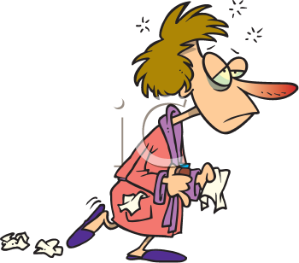
ANTI TUSSIVES & OTHER COUGH SUPPRESSANTS

Slide 3
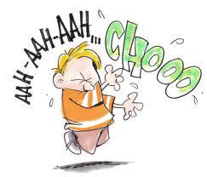
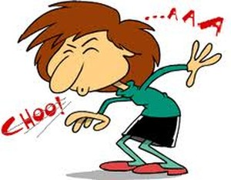
COUGH
A protective reflex to remove foreign material and secretions from the bronchi and bronchioles
Occurs due to stimulation of chemoreceptors in throat,resp passages or stretch receptors in the lungs
May be productive or non productive
Whenever possible ,treat the underlying cause,
not the cough

Slide 4
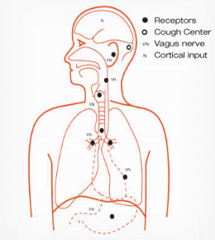

Slide 5
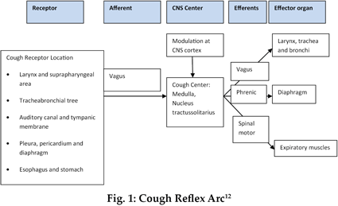
X
cough diagram More
www.delsym.com
Image Search
Search Box
Search query
X
cough diagram More
www.delsym.com
Image Search
Search Box
Search query

Slide 6
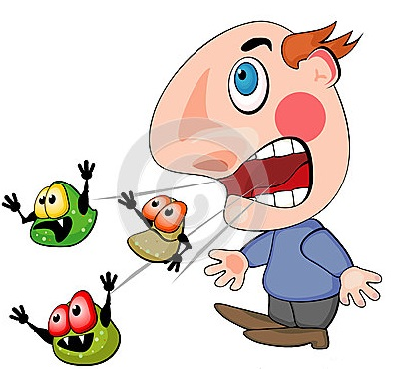
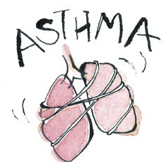
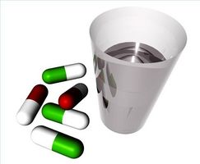
COUGH - ETIOLOGY
Inflammation in respiratory tract e.g
bacterial – antibiotics
viral – usually self limiting
Tuberculosis – ATT
Asthma – Anti asthmatic
PND (allergic , sinusitis)
Chronic reflux with aspiration – H2 antagonist/ proton pump inhibitors
Neoplasm
ACE inhibitors associated cough – substitute the drug like losartan (ARBs)
CCF – specific treatment

Slide 7
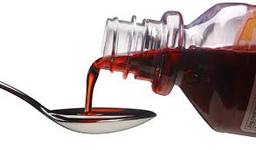
Drugs for Cough
Anti-Tussives
Central
Peripheral
Cough Expectorants
Bronchial secretion expulsion enhancers
Mucolytics

Slide 8
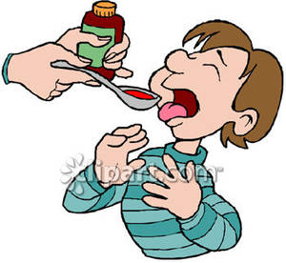
CLASSIFICATION – ANTI TUSSIVES
CENTRAL ANTITUSSIVES
OPIOIDS
Codeine
Pholcodeine
Levopropoxyphene
Dextromethorphan
Noscapine
NON-OPIOIDS
Benzonatate
Anti histamines
Chlorpheniramine
Diphenhydramine
Promethazine

Slide 9
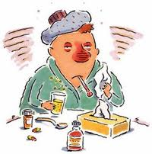
CLASSIFICATION – ANTI TUSSIVES
PERIPHERAL ANTITUSSIVES
1 Demulcents
Linctus
Lozenges
2 Inhalation
Steam inhalation
Benzoin
Menthol
3 Local anaesthetics
Benzonatate
Lignocaine (only in special circumstances)

Slide 10
CLASSIFICATION OF EXPECTORANTS
Bronchial secretion expulsion enhancers
Ammonium chloride
Potassium iodide
Guaiphenesin
Sodium or potassium citrate
Mucolytics
Bromhexine
Ambroxol
Acetyl cysteine
Carbocysteine

Slide 11
ANTITUSSIVES
Antitussives are drugs that specifically inhibit or suppress the act of cough by…
Depression of medullary centre or associated higher centers.
Increasing threshold of the cough centre.
Interruption of tussal impulses peripherally in the respiratory tract.

Slide 12
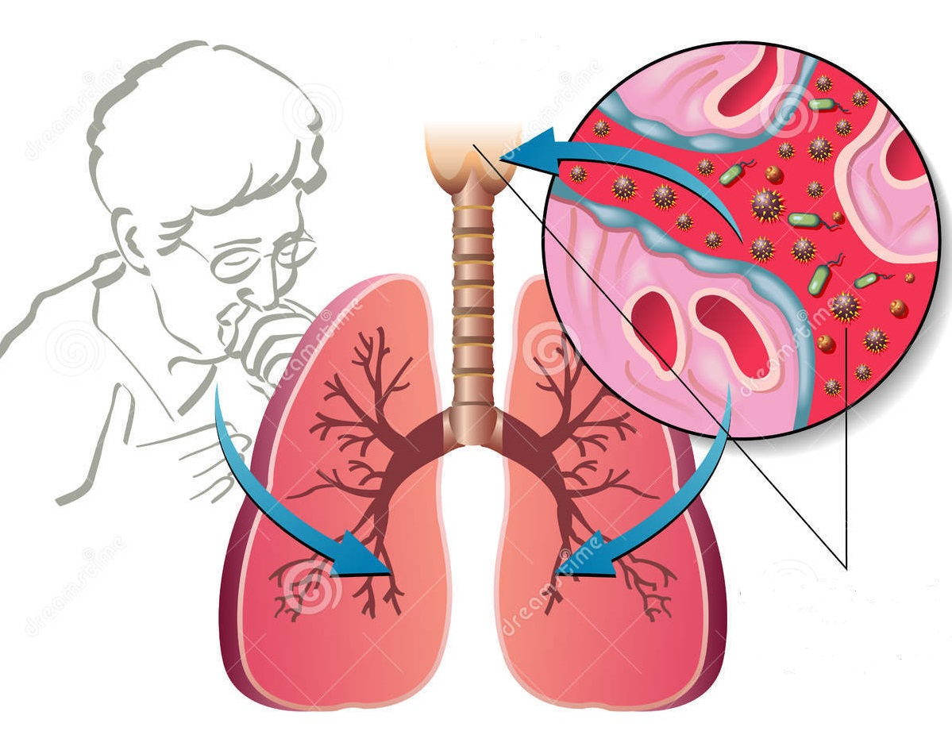
ANTITUSSIVES - USES
Aim is to control rather than eliminate cough
For dry unproductive cough
If cough is unduly tiring.
Disturbed sleep or hazardous ( hernia,
piles, occular or any abdominal surgery).

Slide 13
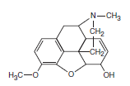
OPIOID ANTITUSSIVES
Codeine
Most effective antitussive
More selective for cough centre
Different opioid receptors involved for cough suppression at doses lower than for analgesic action.
Adverse effects:
Sedation, nausea, constipation, respiratory depression.
Abuse liability is low, but present.
C/I:
Asthma, pt with respiratory reserve.

Slide 14
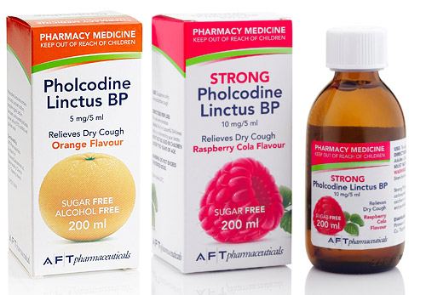
OPIOID ANTITUSSIVES
PHOLCODIENE
Similar in efficacy as antitussive to codeine,
but has longer duration of action
low liability of addiction
No analgesic property.

Slide 15
OPIOID ANTITUSSIVES
DEXTROMETHORPHAN
MOA:
Controls cough spasm by increasing the threshold of cough centre
ADVANTAGES:
Does not depress mucociliary function
No CNS depression
No addiction potential
Less constipation than codeine
SIDE EFFECTS:
Dizziness, nausea, drowsiness, ataxia

Slide 16
OPIOID ANTITUSSIVES
NOSCAPINE
Nearly equipotent antitussive as codeine.
Especially useful in spasmodic cough.
No analgesic or dependence inducing properties
SIDE EFFECTS
Headache,nausea ,bronchoconstriction in asthmatics

Slide 17
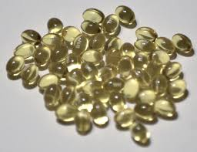
NON OPIOID ANTITUSSIVES
BENZONATATE:
Chemically related to tetracaine.
MOA:
Reduces the cough reflex by anesthetizing the stretch receptors in the respiratory passages, lungs and pleura.
Has some central effects also.
Adverse Effects:
Headache, dizziness, pruritis,nasal congestion, burning of eyes & tightness in chest.

Slide 18
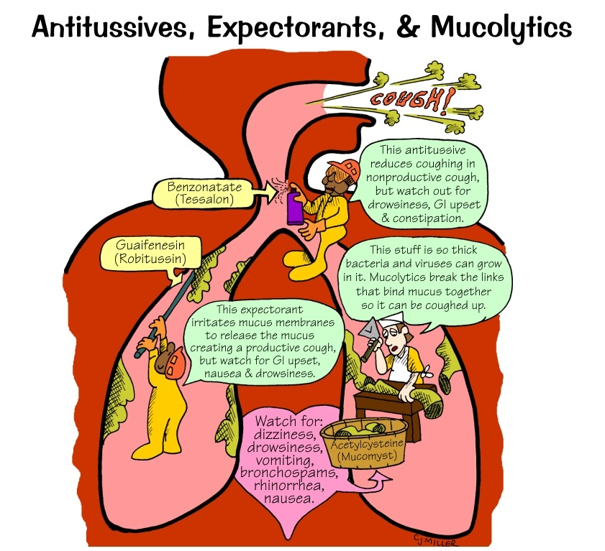

Slide 19
ANTIHISTAMINES
Relieves cough due to their sedative and anticholinergic actions
Decreased secretion in productive cough
lack selectivity for cough centre.
Especially helpful in allergic cough.
2nd generation antihistamines - ineffective

Slide 20
PERIPHERAL ANTITUSSIVES
DEMULCENTS
Soothing of throat
Promotes salivation
Inhibit afferent impulses from inflamed pharyngeal mucosa.
Lozenges ;
small,sometimes medicated tab dissolved slowly in mouth
Linctus
viscous,sticky syrup

Slide 21
EXPECTORANTS
These are the drugs which make the cough more productive by loosening and liquefying bronchial secretions.
Also known as Mucokinetics.

Slide 22
BRONCHIAL SECRETION EXPULSION ENHANCER
GUAIPHENISEN
MOA:
Decrease sputum viscosity and increase sputum volume thereby decreasing difficulty in expectoration
Only FDA Approved expectorant .
Uses:
For symptomatic relief of productive cough in the presence of mucus in respiratory tract.
Adverse effects:
Gastric disturbances and drowsiness.

Slide 24
BRONCHIAL SECRETION EXPULSION ENHANCER
Sodium and potassium citrate
Increase bronchial secretion by salt action
Potassium iodide
Thinning of mucous secretion making them less sticky
Ammonium chloride
Thinning of mucous secretion

Slide 25
MUCOLYTICS
Inhalational Mucolytics
Acetylcysteine
Tyloxapol
Oral Mucolytics
Bromhexine
Carbocysteine

Slide 26
INHALATIONAL MUCOLYTICS
ACETYLCYSTEINE
MOA:
It opens disulphide bonds in the mucoproteins present in the sputum making it less viscid
Has to be administered directly into the respiratory tract.
Nebulized or instilled through tracheostomy tube

Slide 28
ORAL MUCOLYTICS
BROMHEXINE
MOA
It produces fragmentation of mucopolysaccharide fibres in sputum which reduces its viscosity.
Clinical uses:
Chronic bronchitis, bronchial asthma.
Adverse effects:
Rhinorrhoea , lacrimation, gastric
irritation,hypersensitivity.

