Slide 1
CANCER CHEMOTHERAPY
Dr. Naila Abrar

Slide 2
Learning Objectives
Background
Cell cycle kinetics
Toxicity of anti-neoplastic drugs
Principles of combination therapies
Mechanisms of anti-neoplastic drugs
Classification of anticancer drugs

Slide 3
CAUSES OF CANCER
Age
Gender
Race
Unknown
Genetic
Environmental/occupational
Biological agents
Diet
Iatrogenic

Slide 4
CANCER TREATMENT MODALITIES
Prevention
Surgery
Radiotherapy
Chemotherapy
Stem cell transplantation
Psychotherapy

Slide 5
APPROACHES TO USE CHEMOTHERAPY
Primary induction (palliative )
Neoadjuvant
Adjuvant

Slide 6
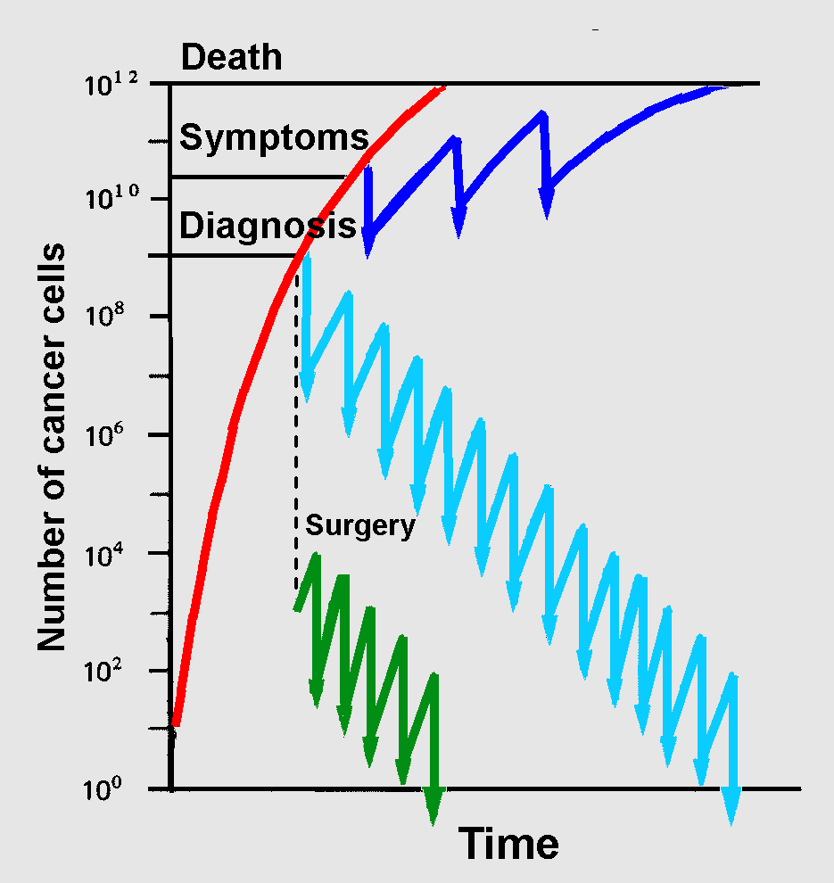
EVALUATION OF RESPONSE
Untreated patients
SIGNS/SYMPTOMS
TUMOR SIZE
MARKERS
Infrequent scheduling of
treatment courses.
Prolongs survival but does not cure.
More intensive and
frequent treatment.
Kill rate > growth rate.

Slide 7
CELL CYCLE KINETICS
GOMPERTZIAN KINETICS
GROWTH FRACTION
Notes:
a pattern of cell growth in tumors in which there is increased doubling time and decreased growth fraction as a function of time.
One hundred and fifty years later, Norton and Simon found that tumors follow Gompertzian growth functions—small tumors grow faster than larger ones. Moreover, the scientists found the rate of cell-killing by many drugs is proportional to tumor growth rates; that is, smaller tumors are more easily eradicated with drugs than larger tumors. From these observations, the scientists proposed the Norton–Simon hypothesis, which suggests that tumors given less time to regrow between treatments are more likely to be destroyed.
Tumor cells can be classified as proliferating cells and non-proliferating cells.
The ratio of proliferating cells in the whole tumor tissue is called growth fraction (GF).
The faster the tumor cells proliferate, the bigger the GF is and the higher the sensitivity of tumor to a drug is.
Generally, in the early stage, the GF of a tumor is bigger and the effect of a drug on the tumor is better

Slide 8
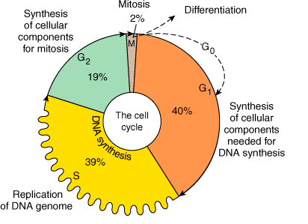
CELL CYCLE

Slide 9
Based on the DNA changes in cells, proliferating cycle of tumor cells can be divided into 4 phases
Pre-synthetic phase (G1 phase). cells chiefly make preparations for the synthesis of DNA.
Synthetic phase (S phase). Cells are synthesizing their DNA
Post-synthetic phase (G2 phase). DNA duplication has been finished and they are equally divided to the two of future sub-cells.
Mitosis phase (M Phase). Each cell is divided into two sub-cells. Some of these new cells enter the new proliferating cycle, the others become non-proliferating cells

Slide 10
MECHANISM OF ACTION OF ANTI-NEOPLASTIC DRUGS
Most antineoplastic drugs act on the proliferating cycle of cell
Destruction of DNA or inhibition of DNA duplication– e.g. alkylating agents, mitomycin C
Inhibition of nucleic acid (DNA and RNA) synthesis– e.g. 5-fluorouracil, 6-mercaptopurine, methotrexate, cytarabine, etc.
Interfering with the transcription to inhibit RNA synthesis– e.g. dactinomycin, dauoruicin, and doxorubicin
Inhibition of protein synthesis– e.g. vinca alkaloids, pipodophylotoxins, and paclitaxel
Interfering with hormone balance– e.g. adrenal corticosteroids, estrogens, tamoxifen etc.

Slide 11
DRUG COMBINATIONS
Maximal cell kill within range of toxicity
Different mechanisms of action targeting different levels of activity

Slide 12
PRINCIPLES THAT GUIDE SELECTION OF DRUGS
Efficacy
Toxicity
Optimum safety
Mechanism of interaction
Avoidance of arbitrary dose changes

Slide 13
RESISTANCE
PRIMARY
Loss of p53 gene
ACQUIRED

Slide 14
RESISTANCE
Increased capability to repair DNA lesions
Decreased transport into cell
Increased production of proteins & enzymes
Altered target proteins or enzymes
MDR1 gene: P- glycoprotein

Slide 15
GENERAL TOXICITY
Bone marrow suppression
Lymphoreticular tissue
GIT
Gonads
Appendages
Nephrotoxicity, cystitis
Neuropathies
Cardiotoxicity
Pulmonary toxicity
Hyperuricemia
Teratogenicity

Slide 16
MANAGEMENT OF TOXICITIES
Corticosteroids
Folinic acid
Mesna (mercaptoethane sulfonate sodium)
Ondansetron
Allopurinol
Bisphosphonates
Platelets
GM-CSF

Slide 17
AIM OF CANCER CHEMOTHERAPY
Eradicate all cancer cells
Target micro-metastasis

Slide 18
CLASSIFICATION
CELL CYCLE SPECIFIC (CCS)
CELL CYCLE NON-SPECIFIC (CCNS)

Slide 19
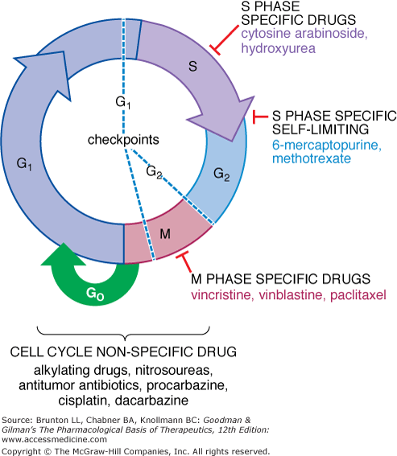

Slide 20
CLASSIFICATION
CELL CYCLE SPECIFIC (CCS)
Antimetabolites
Vinca alkaloids
Epipodphyllotoxins
Taxanes
Antitumor antibiotics
Microtubule inhibitor

Slide 21
CELL CYCLE SPECIFIC (CCS)
I. ANTIMETABOLITES
Capecitabine Fludarabine
Gemcitabine Fluorouracil (5-FU)
Cladribine 6-Mercaptopurine (6-MP)
Clofarabine Methotrexate (MTX)
Cytarabine (ara-C) 6-Thioguanine (6-TG)

Slide 22
II. VINCA ALKALOIDS
Vincristine
Vinblistine
Vinorelabine
III. EPIPODOPHYLLOTOXINS
Etoposide
Teniposide
IV. TAXANS
Docetaxel
Paclitaxel
Albumin bound paclitaxel

Slide 23
V. ANTI-TUMOR ANTIBIOTICS
Bleomycin
VI. MICROTUBULE INHIBITOR
Ixabepilone

Slide 24
CELL CYCLE NON-SPECIFIC (CCNS)
I. ALKYLATING AGENTS
Altretamine Dacarbazine
Bendamustine Lomustine
Busulfan Mechlorethamine
Cyclophosphamide Temozolamide
Melphan Thiotepa
Carmustine
Chlorambucil

Slide 25
II. PLATINUM ANALOG
Cisplatin
Carboplatin
Oxaliplatin
III. ANTRACYCLINES
Daunorubicin
Doxorubicin
Epirubicin
Idarubicin
Mitoxantrone

Slide 26
IV. ANTITUMOR ANTIBIOTICS
Dactinomycin
Mitomycin
V. CAMPTOTHECINS
Irinotecan
Topotecan

Slide 27
MISCELLANEOUS
Hydroxyurea
L-asparaginase
Arsenic trioxide
Erlotinib
Imatinib
Cetuximab
Panitumumab
Bevacizumab
Sorafenib
Tretinoin

Slide 28
HORMONES used in CANCER CHEMOTHERAPY
Glucocorticoids
Estrogens (prostate)
SERM –tamoxifen
Selective estrogen receptor down regulators (fulvestrant)
Aromatase inhibitors (letrozole)
Antiandrogens (flutamide, bicalutamide)
5-α reductase inhibitor (finasteride
GnRH agonists (gonadorelin, goserelin)
Progestins

Slide 29
THERAPEUTIC CLASSIFICATION
CARCINOMA BREAST
Cyclophosphamide, methotrexate,
5-flourouracil (CMF)
5-flourouracil, doxorubicin,
cyclophosphamide (FAC)
Doxorubicin, cyclophosphamide
5-flourouracil, doxorubicin,
cyclophosphamide (FEC)
Trastuzumab
Tamoxifen/ Anastrozole

Slide 30
CARCINOMA LUNG
NON SMALL CELL LUNG CA
Cisplatin, paclitaxel
Carboplatin, paclitaxel, bevacizumab
SMALL CELL LUNG CA
Cisplatin, etoposide
Cisplatin, irinotecan

Slide 31
ACUTE LYMPHOBLASTIC LEUKEMIA (ALL)
Vincristine +prednisone +I/T methotrexate
Daunorubicin/6-mercaptopurine/ asparaginase/cyclophosphamide
ACUTE MYELOGENOUS LEUKEMIA (AML)
Cytarabine + idarubicin/daunorubicin

Slide 32
CHRONIC LYMPHOID LEUKEMIA (CLL)
Chlorambucil +prednisone
Cyclophosphamide + vincristine + prednisone (COP)
Cyclophosphamide + doxorubicin + vincristine + prednisone (CHOP)
Alemtuzumab/rituximab

Slide 33
CHRONIC MYELOID LEUKEMIA (CML)
Imatinib
Interferon
Busulfan
Hydroxyurea

Slide 34
HODGKINS DISEASE
1. ABBG - doxorubicin, bleomycin, vinblastine, dacarbazine
2. MOPP- mechlorethamine, vincristine
prednisone, procarbazine
3. Stanford V- doxorubicin, vinblastine, mechloethamine, vincristine, etoposide, prednisone, bleomycin

Slide 35
NON-HODGKINS’S LYMPHOMA
CHOP- Cyclophosphamide, doxorubicin, vincristine, prednisone
Cyclophosphamide, doxorubicin, vincristine, prednisone, rituximab

Slide 36
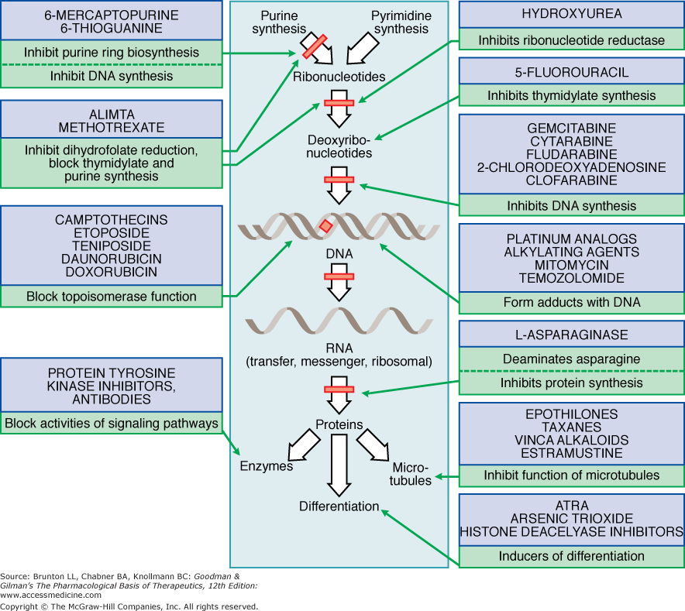

Slide 37
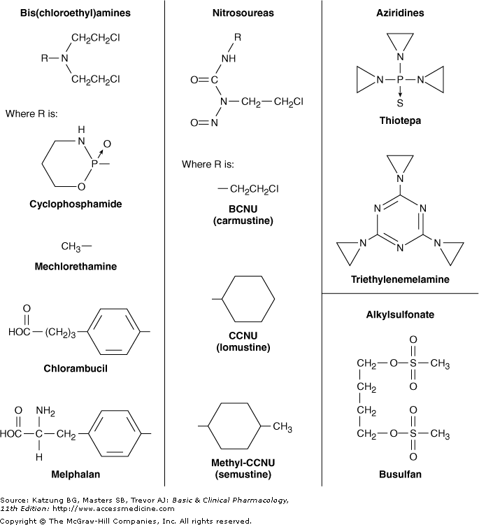
ALKYLATING AGENTS

Slide 38
MECHANISM OF ACTION
Contain chemical gps that form covalent bonds with nucleophilic cell constituents
Transfer of their alkyl groups to cellular components
Alkylation of DNA within the nucleus – cell death
Intramolecular cyclization to form an ethyleneimonium - transfers an alkyl group to cellular components

Slide 39
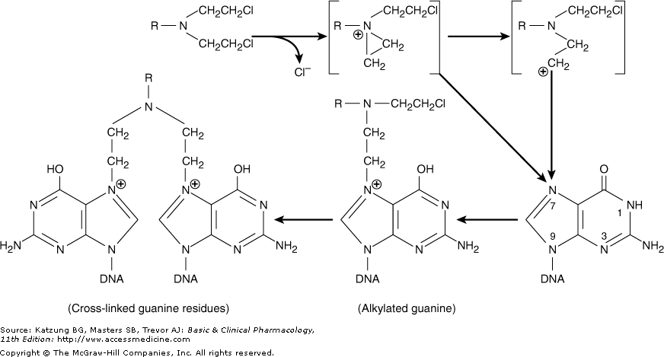
Ethyleneimonium ion
Carbonium ion

Slide 40
N7 position of guanine
Most agents are bifunctional with two reactive groups
Intra or interchain cross linking –transcription & more importantly replication is affected
Miscoding through abnormal base pairing with thymine
Depurination by excision of guanine - DNA strand breakage through scission of the sugar-phosphate backbone of DNA
Replicating cell more susceptible (late G1 and S phases (some zones of DNA are unpaired)& express blockage in G2-subsequent apoptotic cell death

Slide 41
RESISTANCE
Increased capability to repair DNA lesions
Decreased transport into cell
Increased production of glutathione & glutathione- associated proteins – conjugate alkylating agents
Glutathione S-transferase activity, which catalyzes the conjugation

Slide 42
ADVERSE EFFECTS
Dose related adverse effects – rapidly growing tissues
Nausea, vomiting
Vesicant effect – damage tissue at site of injection
Carcinogenic – increased risk of secondary malignancies (AML)

Slide 43
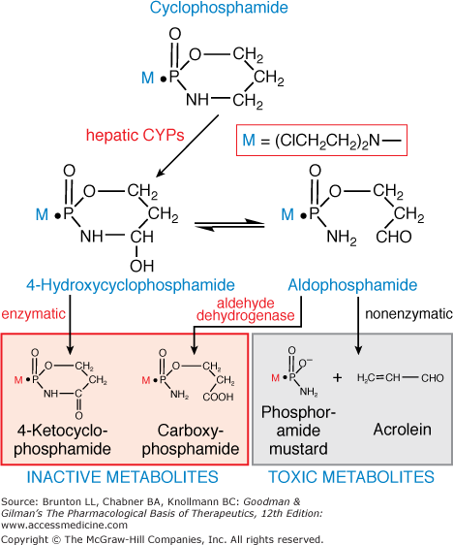
CYCLOPHOSPHAMIDE
Nitrogen mustard
High oral BA
Inactive prodrug
Activated to
cytotoxic form
by microsomal
enzymes –
CYP mixed function
oxidases
Immunosupressant
Hmgic cystitis

Slide 44
NITROSOUREAS
CARMUSTINE, LOMUSTINE, SEMUSTINE
Biotransformation- Nonenzymatic decomposition to active metabolites
Alkylating & carbamoylating activity
O6 of guanine- G-C cross links in DNA
Highly lipid soluble- cross BBB-brain tumors
STREPTOZOCIN- minimal BM toxicity- treatment of insulin-secreting islet cell carcinoma of pancreas

Slide 45
PROCARBAZINE
Oral, methylhydrazine derivative
Hodgkin’s & non-Hodgkin’s lymphoma, brain tumors
Inhibits RNA, DNA & protein synthesis, prolongs interphase and produces chromosome breaks
Oxidative metabolism- azoprocarbazine & H2O2
One metabolite is a weak MAO inhibitor
Increased risk of secondary cancers (Acute Leukemia)

Slide 46
DACARBAZINE
Parenteral, synthetic compound
Metabolic activation- methyl derivative- spontaneous decomposition to diazomethane which generates a methyl carbonium ion – cytotoxic
Malignant melanoma, Hodgkin’s lymphoma, soft tissue sarcomas, neuroblastoma
Myelosuppression, NV, Potent vesicant

Slide 47
PLATINUM ANALOGS
CISPLATIN
CARBOPLATIN
OXALIPLATIN
MOA similar to alkylating agents
All stages & bind DNA through formation of intrastrand & interstrand cross links
N7 position of guanine
Inhibit both cytoplasmic and nuclear proteins
Synergize with other anticancer drugs

Slide 48
Solid tumors- NSCL & SCL CA, esophageal, gastric, head, neck, testicular, ovarian, bladder CA
Renal toxicity, ototoxicity, nerve dysfunction
Dose modification in renal dysfunction
Carboplatin- less renal toxicity & GI toxicity
Myelosuppression
OXALIPLATIN- used in tumors resistant to others(FOLFLOX regimen)
Neurotoxicity- peripheral sensory neuropathy

Slide 49
ANTIMETABOLITES
ANTIFOLATES
Methotrexate
Pemetrexed
FLUOROPYRIMIDINES
5-Fluorouracil
Capecitabine
DEOXYCYTIDINE
Cytarabine
Gemcitabine
PURINE ANTAGONISTS
6-Thiopurines
6-Mercaptopurine
6-Thioguanine
Fludarabine
Cladarabine

Slide 50
METHOTREXATE
Folic acid analog
Binds with high affinity to the active catalytic site of dihydrofolate reductase (DHFR)
Interferes with synthesis of tetrahydrofolate (THF)
Inhibition of formation of DNA, RNA & key cellular proteins
Polyglutamate metabolites formed by action of enzyme folylpolyglutamate synthase (FPGS)- retained within cancerous cells

Slide 51
RESISTANCE TO MTX
Decreased drug transport via the reduced folate carrier or folate receptor protein
Decreased formation of cytotoxic MTX polyglutamates
Increased levels of the target enzyme DHFR through gene amplification and other genetic mechanisms
Altered DHFR protein with reduced affinity for MTX
Decreased accumulation of drug through activation of the multidrug resistance transporter P170 glycoprotein

Slide 52
Intravenous, intrathecal, or oral route
Renal excretion- GF and tubular secretion
Dose modification in renal dysfunction
Aspirin, penicillin, cephalosporins, and nonsteroidal anti-inflammatory agents- inhibit the renal excretion
LEUCOVORIN RESCUE- rescue normal cells from undue toxicity
Leucovorin- reduced folate (5-formyltetrahydrofolate)
L-leucovorin- active enantiomer
Notes:
The biologic effects of MTX can be reversed by administration of the reduced folate leucovorin (5-formyltetrahydrofolate) or by L-leucovorin, which is the active enantiomer.
LEUCOVORIN RESCUE is used in conjunction with high-dose MTX therapy to rescue normal cells from undue toxicity, and it has also been used in cases of accidental drug overdose.

Slide 53
5-FLUOROURACIL
Inactive - activated via enzymatic reactions to ribosyl and deoxyribosyl nucleotide metabolites
5-FU is converted to 5-fluorouridine-5'-triphosphate (FUTP), which is then incorporated into RNA, where it interferes with RNA processing and mRNA translation
5-FU is also converted to 5-fluorodeoxyuridine-5'-triphosphate (FdUTP), which can be incorporated into cellular DNA, resulting in inhibition of DNA synthesis and function

Slide 54
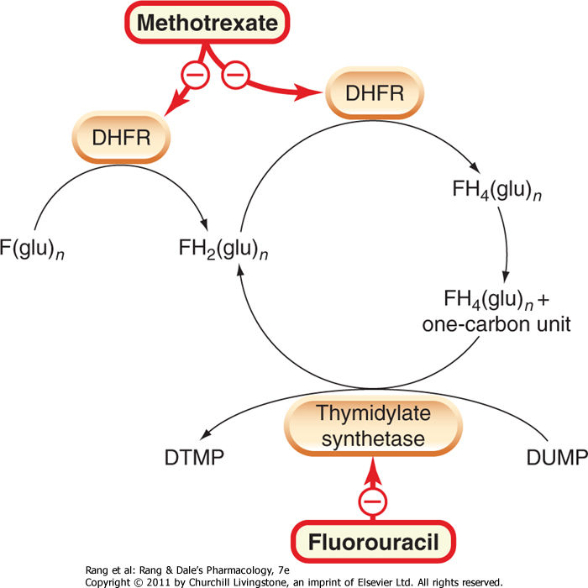
5-fluoro-2'-deoxyuridine-5'-monophosphate (FdUMP), forms a complex with the enzyme thymidylate synthase and the reduced folate 5,10-methylenetetrahydrofolate, a reaction critical for the de novo synthesis of thymidylate
Results in inhibition of DNA synthesis through "thymineless death.“

Slide 55
Intravenously - infusion
Half-life of 10–15 minutes
80–85% - catabolized by the enzyme dihydropyrimidine dehydrogenase
A pharmacogenetic syndrome that involves partial or complete deficiency of the DPD enzyme, and in this setting, which is seen in up to 5% of all cancer patients, severe toxicity in the form of myelosuppression, diarrhea, nausea and vomiting, and neurotoxicity, has been observed.

Slide 56
Most widely used agent in the treatment of colorectal cancer, both as adjuvant therapy and for advanced disease
Activity against a wide variety of solid tumors, including cancers of the breast, stomach, pancreas, esophagus, liver, head and neck, and anus
Major toxicities include myelosuppression, gastrointestinal toxicity in the form of mucositis & diarrhea, skin toxicity manifested by the hand-foot syndrome, & neurotoxicity

Slide 57
Capecitabine – a fluoropyrimidine which is converted to 5-FU
Thymidine phosphorylase is responsible for final conversion
Oral BA of 70-80%
Metastatic breast CA, colon CA
Diarrhea, handfoot syndrome

Slide 58
DEOXYCYTIDINE ANALOGS
Cytarabine (ara-C)\Sphase specific antimetabolite
Converted to ara-CTP triphosphate- main cytotoxic metabolite
Competitively inhibits DNA polymerase α and β resulting in blockade of DNA synthesis and repair
Effective in hematological malignancies - AML
No use in solid tumors
Short half life- infusion
GEMCITABINE
Also used in solid tumors

Slide 59
PURINE ANTAGONISTS
6-THIOPURINES
6-Mercaptopurine (6-MP)
Childhood acute leukemia
Analog azathioprine- immunosuppressive agent
Inactive in its parent form - metabolized by hypoxanthine-guanine phosphoribosyl transferase (HGPRT) – forming monophosphate nucleotide 6-thioinosinic acid- inhibits several enzymes of de novo purine nucleotide synthesis

Slide 60
Converted to an inactive metabolite by an oxidation reaction catalyzed by xanthine oxidase
Important issue because the purine analog allopurinol, a potent xanthine oxidase inhibitor, is frequently used as a supportive care measure in the treatment of acute leukemias to prevent the development of hyperuricemia that often occurs with tumor cell lysis
Simultaneous therapy with allopurinol & 6-MP would result in increased levels of 6-MP, thereby leading to excessive toxicity.
Dose of mercaptopurine must be reduced by 50–75%

Slide 61
Thiopurines are also metabolized by the enzyme thiopurine methyltransferase (TPMT)
A pharmacogenetic syndrome in which there is partial or complete deficiency of this enzyme
Patients with this genotype are at increased risk for developing severe toxicities in the form of myelosuppression and gastrointestinal toxicity with mucositis and diarrhea.

Slide 62
VINCA ALKALOIDS
Vinblastine- alkaloid from vinca rosea
Vincristine- alkaloid from vinca rosea
Vinorelbine- semisynthetic
Mitotic arrest in metaphase through inhibition of tubulin polymerase- disrupts assembly of microtubules
Metabolized by liver P450-Excreted in feces via biliary system
NV, BM suppression, alopecia, SIADH, mucositis
Hodgkin’s, non- Hodgkins lymphoma, breast & germ cell tumors
ABVD (doxorubicin(adriamycin), bleomycin, vinblastine, dacarbazine)
CHOP (cyclophosphamide, doxorubicin, vincristine, prednisone)
MOPP (mechlorethamine, vincristine(oncovin), procarbazine, prednisone

Slide 63
VINCA ALKALOIDS
Vincristine- different clinical spectrum
ALL with prednisone
CHOP, COP, MOPP, VAD regimens
Hodgkin’s, non- Hodgkins lymphoma
Multiple myeloma
Pediatric tumors
Neurotoxicity- peripheral sensory neuropathy
ANS dysfunction
Myelosupression
SIADH

Slide 64
TAXANES
Paclitaxel- alkaloid ester
Docetaxel- semisynthetic taxane
Mitotic spindle poison - High affinity binding to microtubules - Enhancement of tubulin polymerization - Microtubule assembly without microtubule associated proteins & GTP
Inhibition of mitosis and cell death
Solid tumors, AIDs related kaposi’s sarcoma
Hypersensitivity in 5% pts
Albumin bound formulation- no hypersensitivity, less myelosuppression, reversible neurotoxicity- CA breast
Ixabepilone- not a taxane but inhibits microtubule – CA breast

Slide 65
EPIPODOPHYLLOTOXINS
Etoposide
Teniposide
Inhibition of topoisomerase II- results in DNA damage through strand breakage
Germ cell tumors, Hodgkin’s, non-Hodgkin’s lymphoma, gastric cancers, small cell and non-small cell lung CA
Breast CA and lymphomas

Slide 66
CAMPTOTHECANS
Topotecan
Irinotecan
Inhibition of topoisomerase I- enzyme responsible for cutting single strand DNA strands
Inhibition of DNA damage
Ovarian cancer- second line after platinum based regimens
Myelosuppression & diarrhea

Slide 67
ANTITUMOR ANTIBIOTICS
Anthracyclins
Doxorubicin (cardiac myopathy)
Daunorubicin
Idarubicin and epirubicin
Inhibition of topoisomerase I- enzyme responsible for cutting single strand DNA strands
Inhibition of DNA damage
Ovarian cancer- second line after platinum based regimens
Myelosuppression & diarrhea

Slide 68
DACTINOMYCIN
Also known as actinomycin D
Capacity of actinomycins to bind with double-helical DNA is responsible for their biological activity and cytotoxicity

Slide 69
BLEOMYCINS
DNA-cleaving antibiotics
Cleave DNA by generating free radicals
Drug currently employed clinically is a mixture of the two copper-chelating peptides, bleomycins A₂ and B₂
Significant antitumor activity against both Hodgkin's lymphoma and testicular tumors
Minimally myelo- and immunosuppressive
Cutaneous side effects and pulmonary fibrosis

Slide 70
Newer agents
Tyrosine kinase inhibitor:
IMITANIB (CML)
Growth factor inhibitors:
CETUXIMAB, PANITUMUMAB (metastatic colon cancer
Irinotecan)
Inhibitors of VEGF:
BEVACIZUMAB, SORAFENIB

Slide 71
ASPARAGINASE
L- asparagine amidohydrolase
Childhood ALL
Purified from E.coli
Hydrolyzes circulating L-asparagine into aspartic acid
Tumor cells lack asparagine synthetase- require exogenous source of L-asparagine
Hypersensitivity reactions, increased risk of blood clotting and bleeding, pancreatitis, neurologic toxicity

Slide 72
HYDROXYUREA
has unique and surprisingly diverse biological effects as an antileukemic drug, radiation sensitizer, and an inducer of fetal hemoglobin in patients with sickle cell disease
orally administered
toxicity in most patients is modest and limited to myelosuppression
inhibits the enzyme ribonucleoside diphosphate reductase, which catalyzes the reductive conversion of ribonucleotides to deoxyribonucleotides, a rate-limiting step in the biosynthesis of DNA
specific for S phase

Slide 73
HORMONES & RELATED DRUGS
Glucocortiocoids
Progestins
Estrogens and Androgens
Anti-Estrogen Therapy – SERMS (Tamoxifen)
Gonadotropin-Releasing Hormone Agonists and Antagonists

Slide 74
(Childhood) ALL – CMF, intrathecal MTX
(Adult) AML – cytarabine, daunorubicin
CML – imitanib, interferon-α, busulfan, alkylating agent
CLL- chlorambucil. Chlophosphamide, prednisone, COP, CHOP
Hodgkin’s- MOPP, ABVD, Stanford V
Non-Hodgkin’s – CHOP
Multiple myeloma – melphalan, prednisone (MP)
CA breast - CMF, FAC, (epirubicin) FEC, tamoxifen
Prostate - taxanes, antiandrogens, LHRH agonists

