Slide 1
Cardiac Poisons
By
Dr Romana

Slide 2
These include
Digitalis
Oleander
Aconite
Nicotine

Slide 3
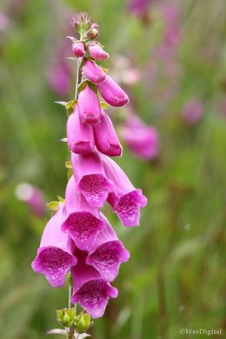
Digitalis
Also called digitalis purpurea and foxglove
Roots,leaves and seeds contain glycosides.
Glycosides include digitoxin,digitalin,
digitalein and digitonin

Slide 4
S/S:
Cumulative action
GIT:nausea,vomiting,abd pain,diarhea
Depression,headache,convulsions
Heart:bradycardia,heart block,extra
systoles,fibrillation,faintness
Respiration:slow and sighings

Slide 5
Treatment:
Stomach wash-tannic acid
Atropine 0.6mg-bradycardia
Potassium salts-extrasystoles
Novocaine/propranolol-arrythmias
EDTA

Slide 6
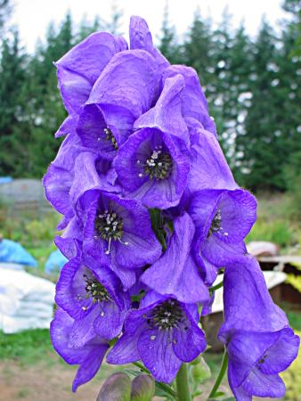
Aconite
Mithazahar,Mithabish,
Monks hood,
All parts are poisonous esp roots
Freshly cut root is white,later pink,
Aconite root is confused with horse radish.

Slide 7
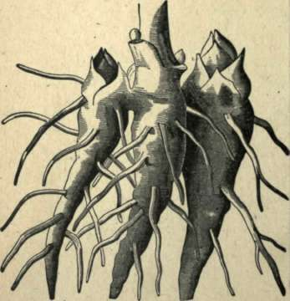
Aconite root may be confused with horse radish.Cut surface of aconite is white at first and pink later. HR remains white.

Slide 8
Active Principle: alkaloid aconitine
Action:stimulates sensory nerves
(tingling),paralyses of sensory nerve
terminals(numbness)
Similar effects on motor nerves
and centers of medulla and S.cord

Slide 9
S/S:
Tingling/numbness is a characteristic
symptom of aconite poisoning
Nausea,vomiting
Muscular weakness,slow/weak resp
Slow,weak and irregular pulse
Pupils contract and dilate(hippus) in
early stage,later become dilated

Slide 10
Treatment:
Stomach wash
Atropine 1mg
Novocaine 0.1%
Artificial resp/ oxygen

Slide 11
Acetic acid and rectified spirit in
ratio of 1:2 is used to preserve
the vomit(acidified spirit).Alkali in
wood ash meant to preserve vomit
may destroy aconite.

Slide 12
Oleander
Two varieties
Nerium odorum(white)
Cerbera thevetia(yellow)

Slide 13
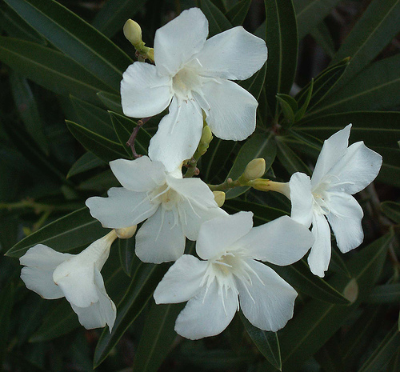
Nerium odorum
White oleander,Kaner
Active principle:Nerin consisting of
three glycosides,neriodorin,
neriodorein and karabin.
.

Slide 14
S/S:
Vomiting,pain abdo,restlessness
Slow pulse,hurried resp
Muscular twitching of extremities
deepen into tetanic spasm
Difficulties in swallowing,lock jaw
Drowsiness,coma and death

Slide 15
Treatment:
PM: resists heat(burnt remains)
Other poison which resists heat
is …………

Slide 16
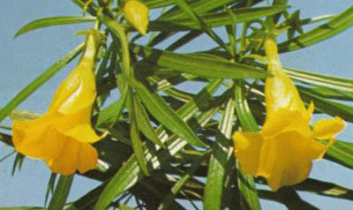
Cerbera thevetia
Active principle:three glycosides
thevetin,thevotoxin,
cerberin.
S/S:
burning sensation in mouth,tingling of tongue,
dryness of throat,
diarrhoea,headache, dizziness,coma, death.

Slide 17
Treatment:molar soln of sodium
lactate to combat acidosis and
5% glucose with 1.2mg of atropine,
2ml of adrenaline 1:1000 and 2mg
of noradrenaline(low BP) to counter-
act heart block.
Resists putrefaction

Slide 18
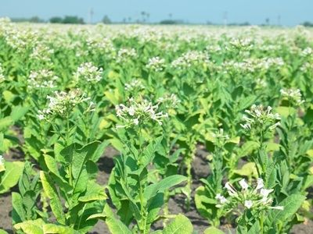
Nicotine(Tobacco)
Active Principle
All parts of the plant exp the ripe seed
contain the alkaloid nicotine
Poisoning is caused by
- intact or broken skin
-inhalation
-ingestion

Slide 19
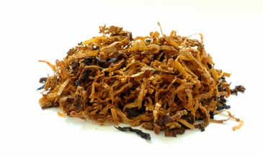
Action:
Nicotine first stimulates,then
depresses and later paralyses
autonomic ganglia.

Slide 20
S/S:
-Nausea,vomiting,burning in mouth,
throat and stomach.
-Chronic cough,laryngitis,pharyngitis,
and bronchitis(chew)
-Dermatitis(handle)
-Stains on teeth,bad breath,blindness,

Slide 21
-Chest pain,cardiac arrythmias
-Cancer of mouth,tongue,throat,lungs
-Non-thrombocytopenic purpura
(mentholated cigarettes)

Slide 22
Treatment:
Skin:
Stomach wash:
Purgative:
Supportive
Imp: addiction,
psychological dependence.

