Slide 1
CELL WALL SYNTHESIS INHIBITORS
Dr. Naila Abrar

Slide 2
Other β- lactam drugs
β-lactamase inhibitors
Clavulanic acid, sulbactam, tazobactam
Carbapenems
Imipenem, Meropenem, Doripenem, Ertapenem
Monobactams
Aztreonam

Slide 3
GLYCOPEPTIDE ANTIBIOTICS
Vancomycin
Tiecoplanin, dalbavancin, telavancin
OTHER CELL WALL –OR MEMBRANE ACTIVE DRUGS
Daptomycin
Fosfomycin
Bacitracin
Cycloserine

Slide 4
β-LACTAMASE INHIBITORS
β-lactam antibiotics require β-lactam ring for activity
β-lactamases destroy this ring- inactivate the drug
β-lactamase inhibitors resemble β-lactam molecules & inactivate β-lactamases, thereby preventing destruction of β-lactam drugs

Slide 5
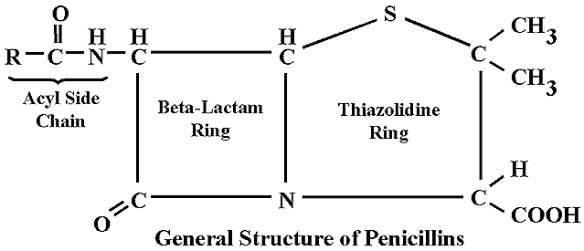
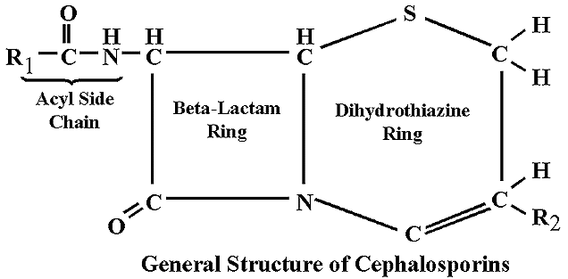
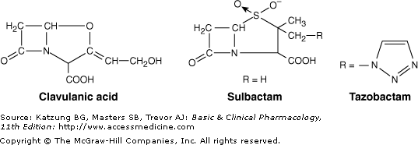

Slide 6
β-LACTAMASE INHIBITORS
Most active against plasmid encoded ambler class A β-lactamases such as those produced by staphylococci, H.influenza, N. gonorrhea, salmonella, shigella, E. coli, K. pneumoniae
Not good inhibitors of class C β-lactamases which are typically chromosomally encoded and inducible produced by enterobacter, citrobacter, serratia & pseudomonas
Inhibit chromosomal β-lactamases of bacteroides & moraxella

Slide 7
Clavulanic Acid
Sulbactam
Tazobactam
Combinations:
Amoxicillin + clavulinic acid (oral)
Ticarcillin + clavulinic acid (parenteral)
Ampicillin + sulbactam
Piperacillin + tazobactam

Slide 8
CLAVULANIC ACID (A suicide inhibitor)
Isolated from streptomyces clavuligerus
Is a suicide inhibitor of enzyme
Has β-lactam ring
Attracts & binds the enzyme covalently (at or near active site)
Complex is slowly cleaved
Some enzyme molecules are irreversibly inactivated

Slide 9
CARBAPENEMS
Synthetic β-lactam antibiotics
Doripenem, ertapenem, imipenem, meropenem
Differ from penicillin in sulfur atom of thiazolidine ring

Slide 10
CARBAPENEMS
Imipenem
Combined with cilastin- broadest spectrum β-lactam antibiotic available against penicillinase-producing gram + ve & – ve, anaerobes, and pseudomonas
Resists β-lactamase hydrolysis
Meropenem, doripenem, ertapenem
Greater activity against gram-ve aerobes & slightly less against gm+ves
Ertapenem less active against pseudomonas & acinobacter spp.

Slide 11
Imipenem destroyed by renal dehydropeptidase therefore combined with cilastatin
Used Intravenously
Penetrate well into CNS
Excreted by kidneys
Toxic metabolite may cause nephrotoxicity
Administered with cilastatin to prevent cleavage and toxic metabolite formation
Nausea, vomiting, diarrhea, skin rashes & reaction at infusion site
Seizures in pts of renal failure

Slide 12
USES OF CARBAPENEMS
Mixed aerobic and anaerobic infections
Penicillin resistant strains of pneumococci
Enterobacter infections
Pseudomonas infections
Extended spectrum β-lactamase producing gm –ves
Febrile neutropenic patients

Slide 13
MONOBACTAMS
Monocyclic β-lactam ring
Narrow spectrum: aerobic gm -ve rods (pseudomonas);
No activity against gm +ve or anaerobes
Resistant to β-lactamase
Aztreonam IV or IM 1-2gm 8hrly
Penetrates well into CNS
Adverse effects
Phlebitis, skin rash, abnormal liver function tests
Little cross reactivity with penicillin

Slide 14
MONOBACTAMS (contd.)
In patients with history of penicillin anaphylaxis, aztreonam may be used to treat serious infections caused by susceptible gram -ve pathogens such as
Meningitis
Pneumonia
Sepsis

Slide 15
VANCOMYCIN
Streptococcus orientalis
Amycolatopsis orientalis
Gram +ve only particularly staphylococci
A glycopeptide
Water soluble & stable

Slide 16
MOA
It binds firmly to the D-Ala-D-Ala terminus and inhibits transglycosylase--Prevent further elongation of peptidoglycan & cross-linking--Peptidoglycan is weakened & cell becomes susceptible to lysis
Cell membrane is also damaged thus contributing to the antibactericidal effect
RESISTANCE due to
Modification of D-Ala-D-Ala binding site
Thickened cell wall with incresed D-Ala-D-Ala

Slide 17
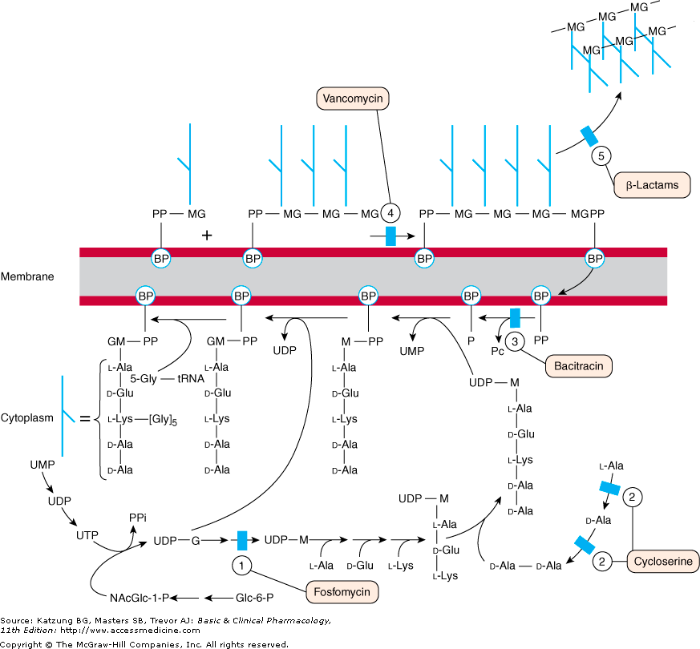

Slide 18
SPECTRUM & USES
Bactericidal for gm +ve bacteria
Narrow-spectrum
Sepsis(MRSA)
Prophylaxis for subacute bacterial endocarditis in penicillin allergic patients for high risk surgery
Enterococcal endocarditis (+ gentamicin)
Meningitis (resistant pneumococci + 3rd gen or rifampin)
Pseudomembranous colitis

Slide 19
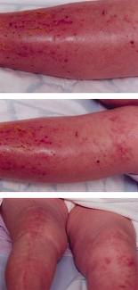
Poorly absorbed---Oral route only for Pseudomembranous colitis
IV for systemic infections
1gm every 12 hr
Renal elimination (1gm wkly)
Fever, chills, phlebitis at infusion site, rash with chronic administration, ototoxicity (cochlear damage above 80 mg/ml), nephrotoxicity
Slow IV administration because fast may cause histamine release (“Redman or redneck syndrome”); flushing, hypotension

Slide 20
Newer glycopeptide antibiotics
Teicoplanin
Similar to vancomycin in MOA & spectrum
It can be given intramuscularly
Dalbavancin
A lipoglycopeptide derived from teicoplanin
Improved activity on MRSA & vanc-intermediate SA
Telavancin
A lipoglycopeptide derived from vancomycin
active against gram +ve bacteria including strains with reduced susceptibility to vancomycin
Disruption of memb potential & increase memb. permeability

Slide 21
(Other) Cell Wall - or Membrane- Active Agents
Daptomycin
Fosfomycin
Cycloserine
Bacitracin

Slide 22
DAPTOMYCIN
Streptomyces roseosporus
Novel cyclic lipo-peptide
Similar to vancomycin but more rapidly bactericidal
Active against vancomycin-resistant strains of enterococci (VRE) & S. aureus (MRSA)

Slide 23
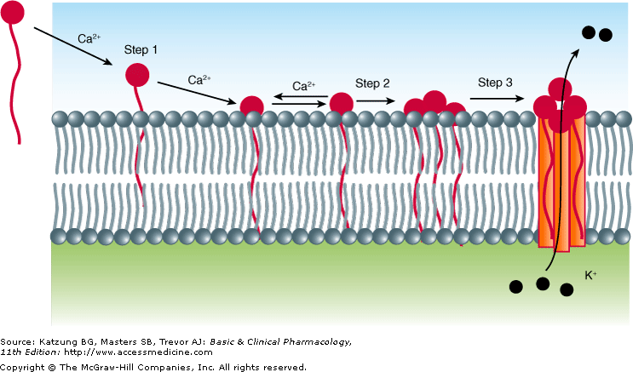
MOA of DAPTOMYCIN
After binding to the bacterial cytoplasmic membrane, it induces K+ efflux
depolarization of the cytoplasmic membrane
Arrest of DNA, RNA & protein synthesis
Antagonized by pulmonary surfactant
Myopathy

Slide 24
FOSFOMYCIN
Analog of phospho-enol-pyruvate
Inhibits cytoplasmic enzyme enolpyruvate transferase by covalently binding to the cysteine residue of the active site and blocking the addition of phosphoenolpyruvate to UDP-N-acetylglucosamine
First step in the formation of UDP-NAM

Slide 25
Active against both gram +ve & gram -ve
Single 3 gm dose for uncomplicated UTI in women

Slide 26
BACITRACIN
Bacillus subtilis
Effective against gram positive microorganisms
Inhibits cell wall formation by interfering with dephosphorylation in cycling of lipid carrier that transfers peptidoglycan subunits to the growing cell wall
No cross resistance

Slide 27
Topical applications used only due to nephrotoxicity
Often used for traumatic abrasions
Poorly absorbed
Combined with polymyxin or neomycin
Indicated for suppression of mixed bacterial flora in surface lesions of the skin
Irrigation of joints, wounds or pleural cavity

Slide 28
CYCLOSERINE
Streptomyces orchidaceus
Very unstable at acidic pH
Gm +ve and gm –ve
Tuberculosis caused by mycobacterium tuberculosis resistant to 1st line drugs
Structural analog of D-alanine
Inhibits incorporation of D-alanine into peptidoglycan pentapeptide by inhibiting alanine racemase which converts L-alanine into D-alanine & D-alanyl-Dalanine ligase

Slide 30
Widely distributed
Excreted into urine unchanged
0.5-1gm/day divided doses
Dose related CNS toxicity- headache, tremors, acute psychosis, convulsions

Slide 31
Thank You!

