Slide 1
CEPHALOSPORINS
Dr. Naila Abrar

Slide 2
LEARNING OBJECTIVES
After this session you should be able to:
know the source and chemistry of cephalosporins;
classify cephalosporins and comprehend the basis of classification;
describe salient pharmacokinetic properties of various cephalosporins;
describe the MOA
explain the spectrum of activity & clinical uses of different classes of cephalosporins; and
describe the adverse effects of cephalosporins.

Slide 3
HISTORY
Brotzu (1945) isolated a mold Acremonium chrysogenum in sewer water off coast of Sardinina
First introduced into clinical use in 1964 (cephalothin)

Slide 4
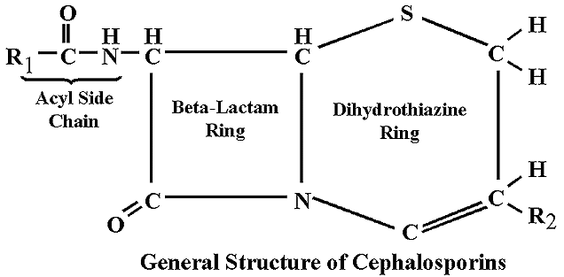
CHEMISTRY
Derivatives of 7-aminocephalosporanic acid
Water soluble; stable to pH & temperature changes
More stable than penicillins
Cephamycins: methoxy at position7
Oxycepems: sulfur replaced by oxygen at position 1
Carbacepteus: sulfur replaced by carbon atom at 1

Slide 5
CLASSIFICATION
Based on spectrum of activity
Divided into four “Generations” for convenience but many drugs in same “Generation” are not chemically related & having different spectrum of activity

Slide 6
Major criteria: spectrum of activity
As gm +ve decreases gm –ve increases
Minor criteria: β-lactamase resistance
1st gen most sensitive, 2nd gen have better tolerability, 3rd gen tolerate even better but susceptible to hydrolysis by inducible chromosomally encoded type 1 β-lactamases & induction during treatment of gm –ve infections, 4th gen have increased stability to hydrolysis by plasmid & chromosomally mediated β-lactamases
Third criteria:Ability to cross BBB
1st do not, 2nd only cefuroxime does, 3rd ceftriaxone & ceftazidime, 4th all
Fourth criteria: route of administration
All classes sub classified into oral and pareneteral

Slide 7
Classification
FIRST GENERATION
(G + ve sensitive)
Klebsiella, proteus (non indole positive only), E. coli
Parenteral:
Cephalothin, cefazolin
Oral:
Cefadroxil, cephalexin, cephradine

Slide 8
SECOND GENERATION
Gram positive organisms (including those resistant to 1st generation)
Klebsiella, proteus (including indole positive) H. Influenzae
Parenteral:
Cefuroxime, cefamandole, cefoxitin (good activity against anaerobes)
Oral:
Cefaclor, cefuroxime axetil, cefprozil, loracarbef

Slide 9
THIRD GENERATION
g-ve organisms including citrobacter, acinetobacter, serratia, providencia, enterobacter, salmonella}
pseudomonas sensitive only to ceftazidime & cefoperazone
Parenteral:
Ceftriaxone, cefotaxime, ceftazidime, ceftizoxime, cefoperazone
Oral: Cefixime
Bacteroides fragilis is sensitive to: Cefoxitin, Cefametazol, cefotetane

Slide 10
Fourth Generation
Cefepime
Gram +ve & gram -ve: Fourth-generation cephalosporins are “zwitterions” that can penetrate the outer membrane of gram-negative bacteria
Spectrum same but differ in resistance to β-lactamases
Cefclidine, Cefepime (Maxipime), Cefluprenam, Cefoselis, Cefozopran, Cefpirome (Cefrom), Cefquinome

Slide 11
Cont: 4th generation
Pseudomonas aeruginosa
Klebsiella pneumoniae or enterobacter spp.
Proteus mirabilis, escherichia coli
Streptococcus pyogenes
Bacteroides fragilis
Staphylococus aureus (methicillin-susceptible strains only)

Slide 12
FIFTH GENERATION (terminology not accepted widely)
Ceftobiprole
Ceftaroline
Ceftobiprole has powerful antipseudomonal characteristics and appears to be less susceptible to development of resistance.
Ceftaroline has also been described as "fifth-generation" cephalosporin, but does not have the anti-pseudomonal effect.

Slide 13
ORGANISMS RESISTANT TO CEPHALOSPORINS
Listeria monocytogenes
Atypicals (Mycoplasma, Chlamydia)
MRSA ? ( CEFEPIME)
Enterococci

Slide 14
MECHANISM OF ACTION
Cell wall synthesis inhibitors
Bactericidal
Similar to penicillins

Slide 15
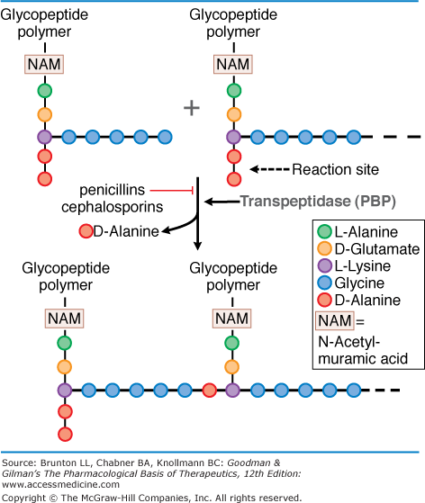

Slide 16
MECHANISM OF RESISTANCE
Changes in drug target proteins PBP
EFFLUX PUMPS (Pseudomonas aeruginosa)
Decreased permeability of cell wall ?
Hydrolysis by β-lactamases (plasmid mediated)
CROSS RESISTANCE
Resistance to other β Lactam antibiotic

Slide 17
PHARMACOKINETICS
ROUTE: Oral, IV, IM
Cephalothin, cephapirin pain by IM
DOSE: single shot therapy
Cefonicid, ceftriaxone, ceforanide
METABOLISM
Cephalothin, cephapirin, cefotaxime are deacetylated
Cefuroxime axetil is hydrolyzed by liver into cefuroxime

Slide 18
DISTRIBITION
Synovial, pericardial fluids
Cross BBB 3rd & 4th generations
EXCRETION
Kidney- tubular secretion
Bile (ceftriaxone, cefoperazone)

Slide 19
THERAPEUTIC USES of 1st Generation
Surgical prophylaxis (cefazolin)
UTI
Cellulitis
Soft tissue abcess
Alternative to antistaphylococcal penicillins in case of allergy

Slide 20
THERAPEUTIC USES of 2nd Generation
β−lactamase producing H influenza, moraxella catarrhalis
Sinusitis
Otitis media
LRTI
Peritonitis
Diverticulitis
CAP

Slide 21
Clinical Uses of 3rd Generation
Lower respiratory tract infections
Acute bacterial otitis media
Skin and skin structure infections
Urinary tract infections (complicated and uncomplicated)
Bacterial septicemia
Bone and joint infections intra-abdominal infections
Meningitis (H. influenzae, N. meningitidis , S. pneumoniae)

Slide 22
THERAPEUTIC USES of CEFEPIME (4th generation)
Empiric therapy for febrile neutropenic patients.
Pneumonia (moderate to severe) caused by Streptococcus pneumoniae , including bacteremia, Pseudomonas aeruginosa , Klebsiella pneumoniae, or Enterobacter species.
Uncomplicated and complicated UTIs (including pyelonephritis) caused by Escherichia coli or Klebsiella pneumoniae , Escherichia coli , Klebsiella pneumoniae , or Proteus mirabilis ,

Slide 23
Uncomplicated skin and skin structure infections caused by Staphylococcus aureus (methicillin-susceptible strains only) or Streptococcus pyogenes
Complicated intra-abdominal infections ( in combination with metronidazole) caused by Escherichia coli, streptococci, Pseudomonas aeruginosa, Klebsiella pneumoniae, Enterobacter species, or Bacteroides fragilis

Slide 24
1st | 2nd | 3rd | 4th
Gm +ve cocci Pneumococci Streptococci Staphylococci Oral cavity anerobes Peptococcus Peptostreptococcus EXCEPT; bacteroides Gm –ve cocci E.Coli Klebsiella Proteus (NI +ve) EXCEPT: enterobacter | Same as 1st gen but extended gm –ve esp with cephamycins bacteroides Proteus (I +ve) Klebsiella H.influenza Citrobacter | Less active against gm +ve but have more expanded gm –ve coverage Enterobacter spp Serratia Providencia Citrobacter Acinobacter Salmonella Klebsiella Hemophilus Neiserria Pseudomonas Bacteroides Meningococci | Spectrum same as 3rd but differ in resistance Enterobacter spp H. Influenza N. Gonorrhoea N. Meningitides Pseudomonas Streptococci Methicillin susceptible SA

Slide 25
1st | 2nd | 3rd | 4th
Skin & soft tissue infections due to staph aureus Prophylaxis of surgery in which skin flora are likely pathogens Cellulitis Soft tissue abcess Penicillin allergic pts UTI due to E. coli | Sinusitis Otitis media LRTIs (due to H.I, moraxella C) Peritonitis Diverticulitis Surgical prophylaxis of colorectal , abd. surgery (cephamycins) CAP-cefuroxime as it is active against HI, Klebsiella, Pen res pneumococci | Meningitis (HI, S.pneum, N. menin & gm –ve bacteria) Gonorrhea Lyme disease (ceftriaxone) Pseudomonas (cefperazone, ceftazidime) CAP (HI, PR pneum, ) Enteric fever (ceftriaxone) Prophylaxis /Rx immunocomp. Septicemia Neutropenia | Empirical treatment of nosocomial infections where antibiotic resistance owing to extended spectrum β-lactamases or chromosomally induced β-lactamases are anticipaated Nosocomial infections due to Enterobacter Citrobacter Serraatia Pseudomonal, Staphylococcal inf. Strept. pneum

Slide 26
ADVERSE EFFECTS
Hypersensitivity
Local irritation
Severe pain after IM inj
Thrombophlebitis after IV inj
Superinfection
Pseudomembranous colitis
Dose dependent nephrotoxicity
Interstitial nephritis
Disulfiram like effects
Bleeding disorders
Diarrhea

Slide 27
Thank You!

