Slide 1
DIURETICS
Dr. Naila Abrar

Slide 2
Learning Objectives
After this session, you should be able to:
recall the physiology of nephron & renal tubular transport mechanisms;
define diuresis, natriuresis & diuretics; and
classify diuretic drugs on basis of site and mechanism of action.

Slide 3
Anatomy & Physiology of THE Renal system
The nephron is the most important part of the kidney that regulates fluid and electrolytes.
Urine formation
Glomerular filtration rate = 180L/day
Tubular re-absorption (around 98%)
Tubular secretion

Slide 5
Sodium Reabsorption in the early PCT
Lumen
(urine)
Peritubular
(Blood)
Na⁺
Na⁺
H⁺
K⁺
Na⁺
Glucose,
Phosphate,
Amino acids,

Slide 6
Sodium reabsorption in the late PCT
Lumen
(urine)
Peritubular
(Blood)
+
Cl⁻
+
Na⁺
+
H⁺
H+
+
Na+
+
H-Anion
H-Anion
K+
+
Anion
Anion
+
Cl⁻
+
Na⁺
+

Slide 7
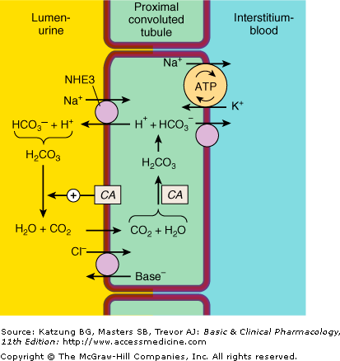

Slide 8
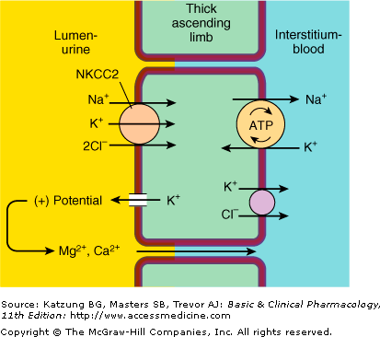

Slide 9
Sodium Reabsorption in the DCT
Lumen
(urine)
Peritubular
(Blood)
Na⁺
ATP
Na⁺
K⁺
Cl⁻
Ca⁺⁺
PTH
Na⁺
Ca⁺⁺
Ca⁺⁺
H₂O
ATP
H⁺

Slide 10
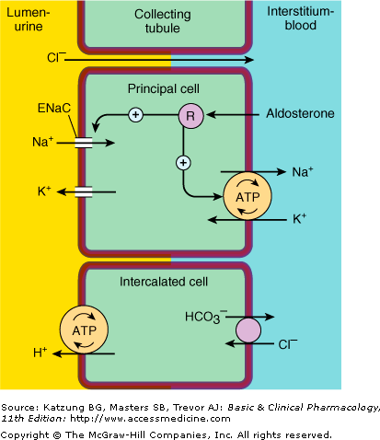

Slide 11
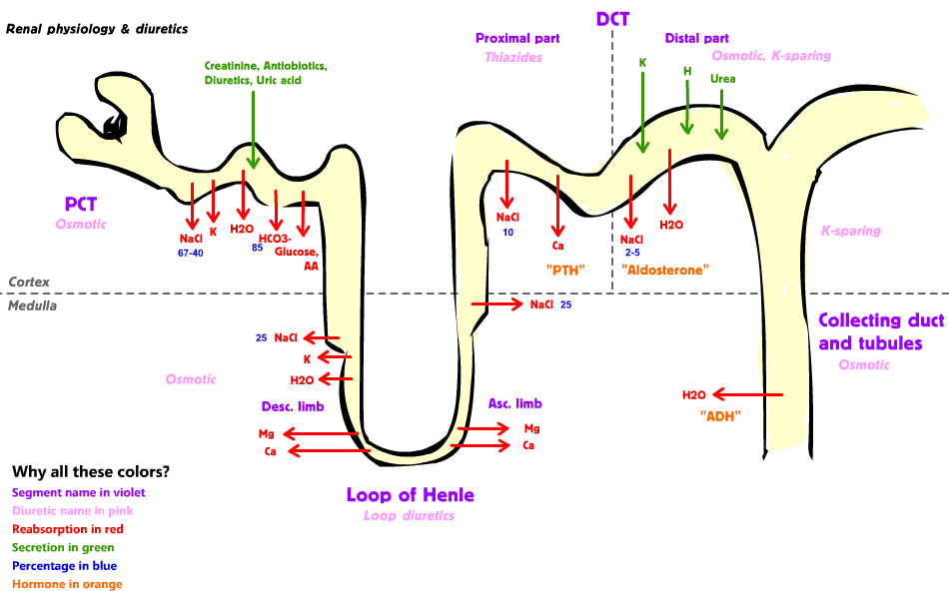
The filtrate here is isotonic
The filtrate here is hypertonic

Slide 12
How can urine output be increased?
↑ Glomerular filtration Vs ↓ Tubular reabsorption (the most important clinically)
Increase the glomerular filtration → increase tubular reabsorption (so you cant use glomerular filtration)

Slide 13
Purpose of Using Diuretics
To maintain urine volume (renal failure)
To mobilize edema fluid (heart failure, liver failure, nephrotic syndrome)
To control high blood pressure

Slide 14
Diuresis: increased urine flow
Diuretics: substances which elicit diuresis
In the kidney, water reabsorption is dependent primarily on Na⁺ reabsorption
Thus a diuretic is an agent which inhibits tubular Na⁺ reabsorption (along with Cl⁻, HCO₃⁻) resulting in increased excretion of these ions.

Slide 15
Natriuretic effect: enhance secretion of sodium and thus water
Mainly act by decreasing tubular reabsorption at one or more sites in nephron
Diuretics can have effects on:
- Sodium reabsorption
- Potassium loss
- Body fluids

Slide 18
Classification of Diuretics
Diuretics that inhibit transport in the Proximal Convoluted Tubule (Osmotic diuretics, Carbonic Anhydrase Inhibitors)
Diuretics that inhibit transport in the Medullary Ascending Limb of the Loop of Henle (Loop diuretics)
Diuretics that inhibit transport in the Distal Convoluted Tubule (Thiazides)
Diuretics that inhibit transport in the Cortical Collecting Tubule (Potassium sparing diuretics)

Slide 19
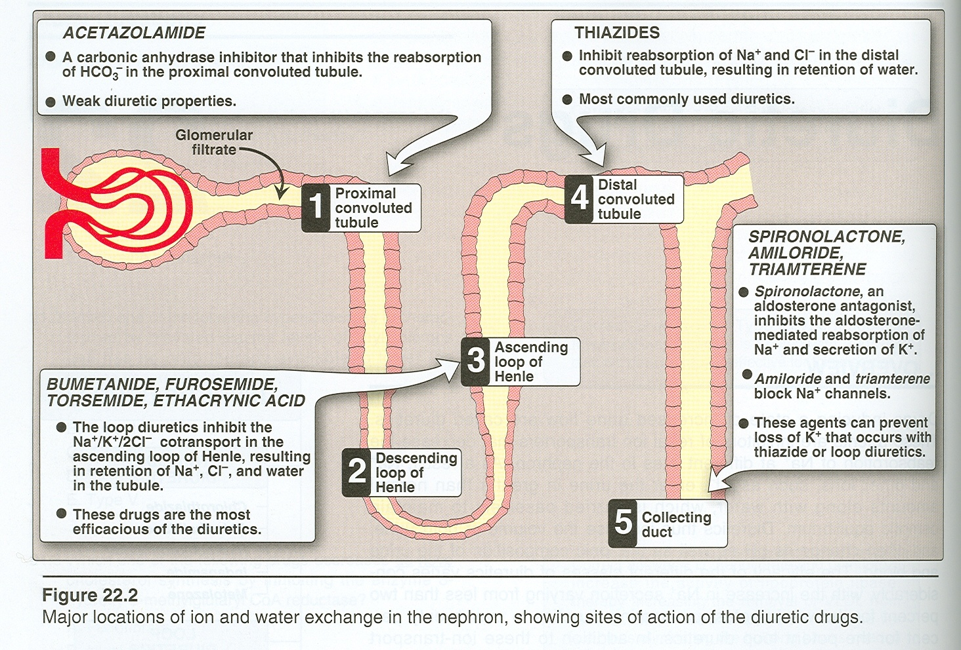

Slide 20
CLASSIFICATION Chemistry & Site
CARBONIC ANHYDRASE INHIBITORS (PCT)
Acetazolamide
Dorzolamide
Brinzolamide
Dichlorphenamide
Methazolamide

Slide 21
THIAZIDES & THIAZIDE LIKE COMPOUNDS (DT- Inhibitors of Na⁺ Cl⁻ symport)
Bendroflumethiazide
Chlorothiazide
Polythiazide
THIAZIDE -RELATED COMPOUNDS
Phthalimidine derivatives: chlorthalidone
Quinazoline derivatives: quinethazone
Chlorobenzamide derivatives: clopamide
Benzene disulfonamide: mefruside
Miscellaneous: indapamide, metolazone

Slide 22
HIGH-CEILING DIURETICS (LOOP DIURETICS-Inhibitors of Na⁺ K⁺ 2Cl⁻ symport)
Carboxylic acid derivatives: furosemide, bumetanide, torsemide (sulfonamide moiety)
Phenoxyacetic acid derivatives: ethacrynic acid

Slide 23
POTASSIUM SPARING DIURETICS (CT)
Aldosterone antagonist: spironolactone, potassium canrenoate, eplerenone, canrenone
Inhibitors of renal epithelial Na⁺ channels:
triamterene, amiloride

Slide 24
OSMOTIC DIURETICS (PCT)
Mannitol
Glycerin
Isosorbide
Urea
ADH Antagonist (PCT, DL)
Conivaptan

Slide 25
CARBONIC ANHYDRASE INHIBITORS
DRUGS
Acetazolamide
Dorzolamide
Brinzolamide
PHARMACOKINETICS
Well absorbed orally secreted in PCT
Urine alkaline within 30 mins, peaks at 2 hrs
Effect lasts for 12 hrs after single dose

Slide 26
MECHANISM OF ACTION
Site
Normal physiology

Slide 27
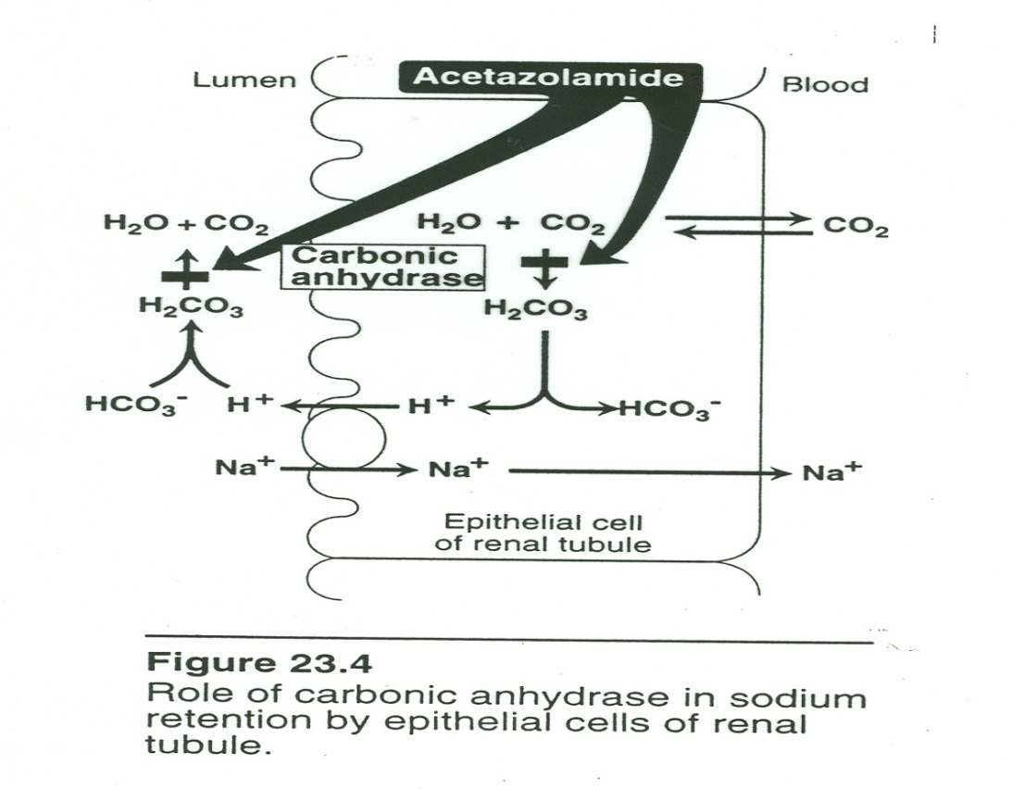
MECHANISM OF ACTION
What the CAI’s do?
Inhibit CA
enzyme
prevents the reabsorption of HCO₃ & Na

Slide 28
EFFECT ON URINARY EXCRETION
HCO₃⁻ excretion
Reabsorption of Na⁺ in distal portions of nephron so only 5% loss
K⁺ excretion

Slide 29
IONIC CHANGES
Increase in urine pH
Decrease in body pH
HEMODYNAMIC CHANGES
Fluid remains isotonic

Slide 30
OTHER CHANGES
Inhibition of extra-renal CI
Eyes, CNS, erythrocytes, gastric mucosa

Slide 31
CLINICAL USES
Open Angle Glaucoma
Urinary alkalinization
Metabolic alkalosis
Acute mountain sickness (HACE, HAPE)
Epilepsy
Hyperphosphatemia
Hypokalemic periodic paralysis
Benign intracranial hyper tension
Premenstrual tension

Slide 32
ADVERSE EFFECTS
Hyperchloremic metabolic acidosis
Renal stones (ppt of Ca phosphate salts)
Hypokalaemia
Nervous system toxicity in pts with renal failure
Hypersensitivity
Hyperammonemia and hepatic encephalopathy in pts with cirrhosis
CONTRAINDICATIONS
Hepatic cirrhosis, COPD

Slide 33
LOOP DIURETICS Thick Ascending Limb High ceiling
DRUGS
Carboxylic acid derivatives
Furosemide
Bumetanide
Torsemide
Phenoxyacetic acid derivative
Ethacrynic acid
sulfonamide
sulfonylurea

Slide 34
MECHANISM OF ACTION :
Site
Normal physiology

Slide 35
WHAT THE LOOP DIURETICS DO?
Inhibit the coupled Na/K/2Cl symporter in the Loop of Henle
They induce the synthesis of prostaglandins in kidney (NSAIDs interfere with this action)

Slide 36
EFFECT ON URINARY EXCRETION
Increased Na⁺ & Cl⁻ excretion
25% of filtered Na ⁺ load
Increased K⁺ excretion
Increased Mg²⁺ excretion
Reduced uric acid

Slide 37
IONIC CHANGES
Hypokalemia
Decrease Mg⁺⁺
Ca⁺⁺ not changed as it is absorbed distally

Slide 38
HEMODYNAMIC CHANGES
Volume depletion
Increase renal blood flow due to blockade of TGF (if fluids replaced)
OTHER EFFECTS
Potent pulmonary vasodilating effects (via prostaglandins) – decrease LV filling – beneficial in LV failure & CCF
Alteration in electrolyte composition of endolymph

Slide 39
CLINICAL USES
Acute pulmonary edema
Refractory edema (in heart failure, liver cirrhosis, nephrotic syndrome)
HTN
Acute renal failure
Hyperkalemia
Hypercalcemia (+isotonic saline)
Anion overdose (thalide over dosage)

Slide 40
ADVERSE EFFECTS
Metabolic alkalosis
Hypokalemia
Hyponatremia, Hypochloremia
Hypovolemia – dehydration-hypotension
Hypocalcemia and hypomagnesaemia
Hyperuricemia
Hyperglycemia
Increase LDL & decrease HDL
Ototoxicity
Hypersensitivity reactions (sulfonamides)

Slide 41
CONTRAINDICATIONS
Cross reactivity with sulfonamides
Hepatic cirrhosis
DRUG INTERACTIONS
NSAIDs
Digitalis
Aminoglycosides, cisplatin
Amphotericin B
Synergism with thiazides
K⁺ sparing diuretics
Sulfonylureas

Slide 42
THIAZIDES AND THIAZIDE-LIKE DIURETICS DISTAL CONVOLUTED TUBULE
DRUGS
Hydrochlorothiazide
Indapamide
Metolazone
PHARMACOKINETICS
Secreted in S2
Long DOA- OD dosing
Indapamide metabolized in liver

Slide 43
MECHANISM OF ACTION:
Site
Normal physiology
Peritubular
(Blood)
Lumen
(urine)
Na⁺
ATP
Na⁺
K⁺
Cl⁻
Ca⁺⁺
PTH
Na⁺
Ca⁺⁺
Ca⁺⁺
H₂O
ATP
H⁺

Slide 44
WHAT THE THIAZIDE DIURETICS DO?
Inhibit NaCl reabsorption via inhibition of Na⁺/Cl⁻ cotransporter in DCT

Slide 45
IONIC CHANGES
Natriuretic action
Hyponatremia
Hypochloremia
Hypercalcemia
HEMODYNAMIC CHANGES
Prostaglandins – vasodilation

Slide 46
CLINICAL USES
Hypertension- Drug of Choice (Hydrochlorthiazide; Indapamide -Indapamide is a potent vasodilator)
Refractory Edema together with the loop diuretics (Metolazone)
CCF

Slide 47
CLINICAL USES (contd.)
Nephrolithiasis (Renal stone) due to idiopathic hypercalciuria
Hypocalcemia
Nephrogenic Diabetes Insipidus. (volume depletion → more reabsorption in PT)
Lithium induced diabetes insipidus
Bromide intoxication

Slide 48
ADVERSE EFFECTS
Hypokalemic metabolic alkalosis
Hyponatremia
Hyperuricemia
Hypercalcemia
Hyperglycemia
Hyperlipidemia
Allergic reactions
Weakness, parasthesias, fatigue, impotence

Slide 49
CONTRAINDICATIONS
Cirrhosis
CCF
Renal disease
DRUG INTERACTIONS
Synergism with thiazides & K⁺ sparing diuretics
NSAIDs
Digoxin

Slide 50
POTASSIUM SPARING DIURETICS
COLLECTING TUBULE
CLASSIFICATION
Direct antagonist of mineralocorticoid receptors (Aldosterone Antagonists e.g. spironolactone)
Indirect via inhibition of Na⁺ influx in the luminal membrane (e.g. Amiloride, Triamterene)

Slide 51
CHEMISTRY
Spironolactone- synthetic steroid
Triamterene & amiloride are weak bases
PHARMACOKINETICS
Spironolactone is metabolized in the liver to canrenone
t ½ = 16hrs
Dose adjustment in renal & hepatic disease

Slide 52
MECHANISM OF ACTION
Site
Normal events

Slide 53
WHAT THE K⁺ SPARING DIURETICS DO?
Aldosterone causes K ⁺ and H⁺ secretion & Na ⁺ reabsorption.
Spironolactone bind to mineralcorticoid receptors & blunts aldosterone activity
Amiloride & triamterene directly interfere with Na entry through epithelial Na channels (ENaC) in the apical membrane of the collecting tubule

Slide 54
IONIC CHANGES
Excretion of Na⁺, Cl⁻
Decrease secretion of K⁺ and H⁺
HEMODYNAMIC CHANGES
No changes

Slide 55
CLINICAL USES
In states of primary & secondary aldosteronism
To overcome the hypokalemic action of diuretics
Hypertension
Refractory edema
Hirsutism- spironolactone
Eplerenone-decreases aldosterone associated fibrotic changes

Slide 56
ADVERSE EFFECTS
Hyperkalemia
Hyperchloremic metabolic acidosis
Anti-androgenic effects (e.g. gynecomastia, impotence) by spironolactone
Kidney stones- triametrene
ARF (triamterene+indomethacin)
CONTRAINDICATIONS
CRF, beta blockers, ACE inhibitors-increased risk of hyperkalemia

Slide 57
Osmotic Diuretics (Mannitol) Diuretics that inhibit transport in the Convoluted Proximal Tubule
DRUGS
Mannitol
Glycerine
Isosorbide
Urea
CHARACTERISTICS OF AN IDEAL OSMOTIC

Slide 58
MECHANISM OF ACTION
SITE
NORMAL PHYSIOLOGY
WHAT OSMOTIC DIURETICS DO?
hydrophilic compounds that are easily filtered through the glomerulus and not reabsorbed
increase urinary output via osmosis

Slide 59
CLINICAL USES
Raised intracranial pressure
Increased intraocular pressure
Renal failure

Slide 60
ADVERSE EFFECTS
Extracellular water expansion may produce pulmonary edema.
Dehydration, hyperkalemia & hypernatremia
Hyponatremia in pts with diminished renal function
CONTRAINDICATION
Heart failure

Slide 61
Thank You!

