Slide 2
And seek help in patience and prayer [Al-Baqarah 2:45]
Al Quraan

Slide 3
Prayer is not a "spare wheel "that you pull out when in trouble,
But it is a "steering wheel "that directs the right path throughout.

Slide 4
Drug - Receptor Binding
D + R DR Complex
Affinity
A measure of propensity of a drug to bind receptor; (the attractiveness of drug and receptor)
Covalent bonds are stable and essentially irreversible
Electrostatic bonds may be strong or weak, but are usually reversible
Affinity

Slide 5
Drug Receptor Interaction
DR Complex
Effect
Efficacy (or Intrinsic Activity)
Ability of a bound drug to change the receptor in a way that produces an effect; some drugs possess affinity but NOT efficacy

Slide 6
Drug-Receptor Interaction
At equilibrium:
[D] x [R] x k₁ = [DR] x k₂
so that: [DR] ₌ k₁
[D] [R] ₌ k₂
k₁/k₂ = Affinity constant (α)
K₂ /k₁ = Dissociation const.(k_{d})
the lower the k_{d} the more potent the drug

Slide 7
Drug-Receptor Interactions
Agonism………………(inverse Agonism ?) (partial agonism ?)
Synergism
Summation
Potentiation
Antagonism
chemical
physiological
pharmacological
In vitro
In Vivo
Competitive antagonism
Non-Competitive antagonism

Slide 8
Concept of Spare Receptors
Receptor occupancy Theory
OLDER CONCEPT
RECENT CONCEPT
SPARE RECEPTORS (Receptor reserve)
Temporal Spareness
Spatial Spareness
Thursday, May 10, 2012
Prof. Munir Khan/Pharmacology & Therapeutics
8

Slide 9
Drug-Receptor Interactions
Up-Regulation of Receptors
Down-Regulation of Receptors
Sensitization of Receptors
De-sensitization of Receptors
Tachyphylaxis
Tolerance

Slide 10
QUANTITATIVE ASPECTS OF DRUG ACTIONS

Slide 11
Dose response curves (drc) (Dose Response Relationship)
Thursday, May 10, 2012
11

Slide 12
A given dose of drug produces measurable degree of action in a biological system (smooth muscle or whole animal)
Types of DRC
Mainly Two types
1) Graded Dose-Response curve
II) Quantal Dose-Response Curve
Normal frequency distribution curve
Gaussian Distribution curve
Dose Cumulative response curve
Cumulative Percentage dose Response curve

Slide 13
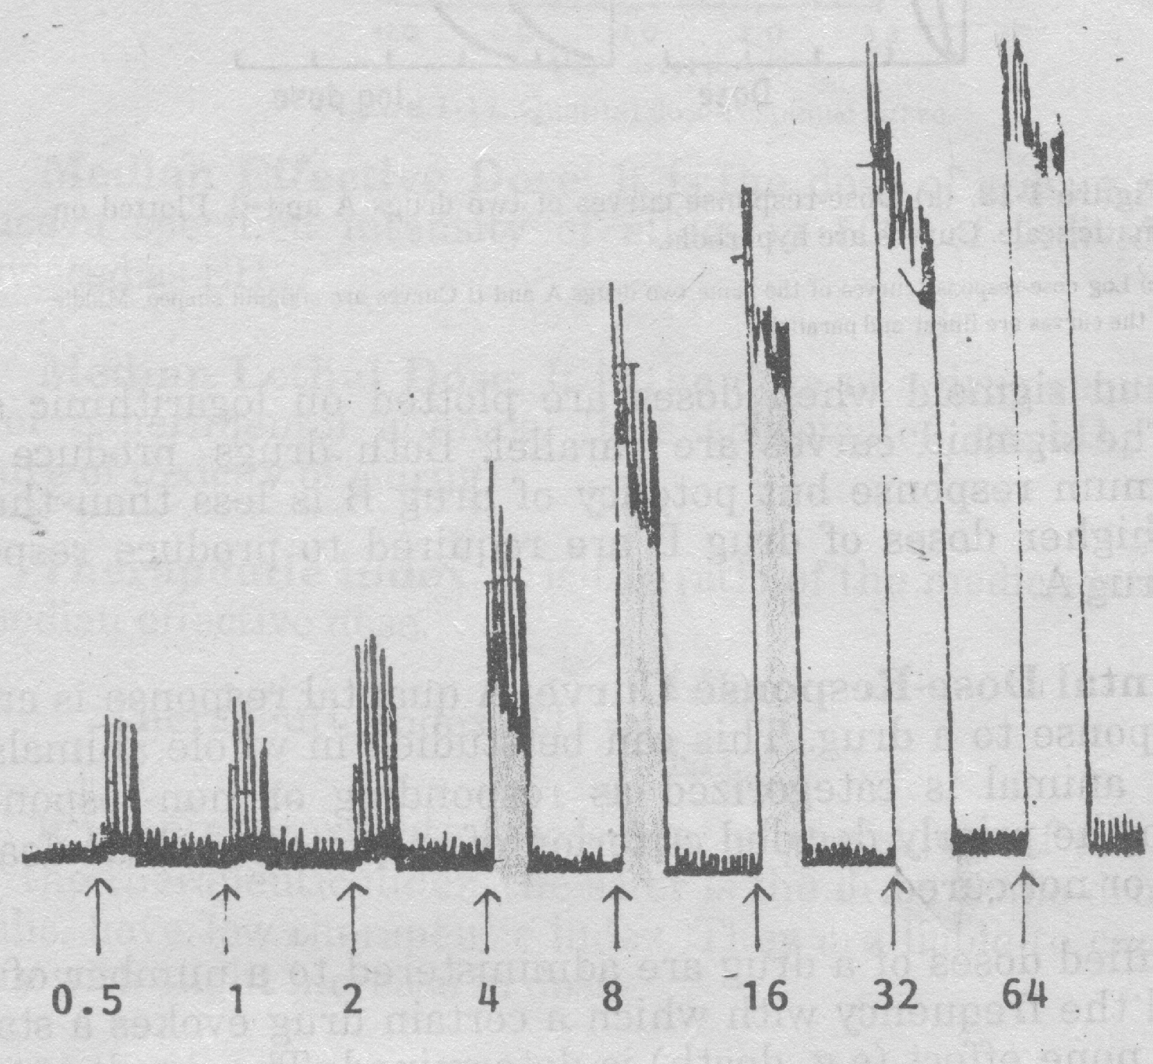
Effect of various conc. of ACh on isolated small intestine of rabbit showing Graded Response
(Actual tracing by kymograph)

Slide 14
Dose Response Curve (Hyperbola)
Response
Dose

Slide 15
Dose Response Curve
Biological Variation
Maximal Effect
( Ceiling effect)
Effect
Slope
Linear segment
Potency
Threshold effect
Three Segments:
Lower Segment
Middle Segment
Upper Segment
Dose
(Log)

Slide 16
Advantages of Sigmoid Curve
Parallel shift
Drug-A
Drug-B
RESPONSE
Log DOSE

Slide 17
Slant of linear Segment
Information:
Abruptness of action
Margin of safety
Shift towards left...Potent drug
Shift towards right... potent drug
OR antagonist acting

Slide 18
Graded Dose-Response Curve
Following valuable data can be drawn
Threshold dose: dose which produces first noticeable response
ED₅₀/EC₅₀ (median effective dose or concentration) Dose or conc. which produces 50% of maximal response
Drugs with same action at a receptor but with d/f potency show parallel DRC

Slide 19
Potencies of two drugs can be compared by ED₅₀
ED₁₀₀/ EDmax (ceiling effect)
Conc. which produces maximal response

Slide 20
Graded Dose-Response Curve

Slide 21
Arithmatic Dose Scale
Curve obtained is hyperbola
Rate of change is rapid at first and becomes progressively smaller as the dose is increased
Eventually, increments in dose produce no further change in effect i.e., maximal effect for that drug is obtained
Difficult to analyze mathematically

Slide 22
Log Dose Scale
Transforms hyperbolic curve to a sigmoid (Middle linear portion)
Compresses dose scale
Proportionate doses occur at equal intervals
Straightens line (Middle portion25-75% linear)
Easier to analyze mathematically
Two drugs can be compared easily
Easy comparison between agonists
Easy study of antagonists

Slide 23
Potency
Relative position of the dose-effect curve along the dose axis
Has little clinical significance for a given therapeutic effect
A more potent of two drugs is not clinically superior
Low potency is a disadvantage only if the dose is so large that it is awkward to administer

Slide 24
II- Quantal Dose-Response
Response follows “All or None Phenomenon”
(e.g.,analgesics, Antiarrhythmics, convulsants, anticonvulsant activity, death etc) OR
Dose of drug evokes a fixed pharmacological response
Studied in whole animal (in vivo); data derived from group of animals or population

Slide 25
Results can be plotted as Log dose-percentage curve
Gaussian Distribution Curve (sigmoid graded response) is obtained by keeping log doses on horizontal-axis and % response on vertical-axis

Slide 26
Quantal Dose Response Curve
Response
Dose

Slide 27
Following valuable data can be drawn from Quantal Dose Response curve
A) Median Effective Dose (ED₅₀)
Dose of a drug required to produce 50% of maximum response
B) Median lethal dose (LD₅₀)
Dose of a drug required to kill 50% of experimental animals; measurement of toxicity

Slide 28
C) Median toxic dose (TD50)
Dose producing toxicity in 50% animals or humans
D) Therapeutic Index
Ratio of the median lethal dose to median effective dose
TI = MLD ₅₀ / MED ₅₀

Slide 29
Therapeutic Index (TI) =LD₅₀ / ED₅₀
e.g. digoxin, lithium, barbiturates & warfarin have ⬇ TI; Penicillins & BDZs have ⬆ TI
Based on median doses; not about slope of DRC for therapeutic or toxic doses
TI is an Approximate assessment of safety of the drug
Greater the TI safer is drug &vice versa

Slide 30
Drug A
100
sleep
death
Percent
Responding
50
0
ED50
LD50
dose

Slide 31
Drug B
100
sleep
death
Percent
Responding
50
0
ED50
LD50
dose

Slide 32
e) Margin of safety
Ratio of LD _{0.1} / ED _{99.9}
LD_{0.1}= Minimum lethal dose for 0.1 % of population; ED_{99.9}%= Minimum effective dose for 99.9 % of population
[An index of a drug's effectiveness and safety. It is calculated as the amount of drug that is lethal to 1% of animals (LD1) divided by the amount of drug that causes a beneficial effect in 99% of the animals (ED99) ]
OR Simply
(The amount between a therapeutic dose and a lethal dose of a drug. Also “ Therapeutic Window)

Slide 33
Summary
The interaction between drug and receptor can be described mathematically and graphically
Agonists have both affinity (k_{d}) and intrinsic activity (α)
Antagonists have affinity only but not the Efficacy.

Slide 34
Summary Cont:
Antagonists can be competitive or
non-competitive when mixed with agonists
Agonists desensitize receptors.
Antagonists sensitize receptors.

Slide 35
Structure-Activity Relationship
Study of chemical structure of drug and its relationship with its pharmacological action
Both affinity & efficacy of drug are determined by its chemical structure
Minor change in drug molecule major change in pharmacological property
cont.

Slide 36
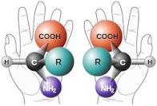
Steriochemistry
Study of how molecules are structured in 3 dimensions.
Chirality
A subset of stereochemistry, a chiral molecule has a carbon center with unique tetrahedral bonding.
Enantiomer
Substances of opposite shape that are mirror images of each other. Enantiomers are designated as being dextro (d) or levo (l) based on the direction they rotate polarized light in solution.

Slide 37
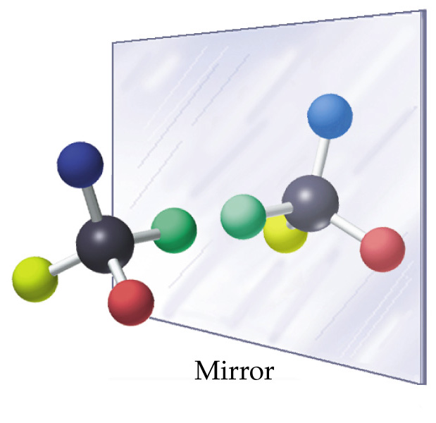

Slide 38
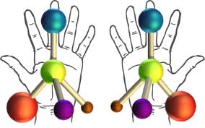
Racemic compounds
In chemistry, a racemic mixture, or racemate , is one that has equal amounts of left- and right-handed enantiomers of a chiral molecule.
The first known racemic mixture was "racemic acid", which Louis Pasteur found to be a mixture of the two enantiomeric isomers of tartaric acid.

Slide 39
Enantiopure Drugs
Owing to this discovery, drugs composed of only one enantiomer ("enantiopure") can be developed to enhance the pharmacological efficacy and sometimes do away with some side effects.
An example of this kind of drug is eszopiclone , which is enantiopure and therefore is given in doses that are exactly 1/2 of the older, racemic mixture called zopiclone.
In the case of eszopiclone, the S - enantiomer is responsible for all the desired effects, though the other enantiomer seems to be inactive; while an individual must take 2 mg of zopiclone to get the same therapeutic benefit as they would receive from 1 mg of eszopiclone, that appears to be the only difference between the two drugs.

Slide 40
Significance of structure-activity relationship
Synthesis of
Valuable therapeutic agent from parent compound
Drug with wide margin of safety
Drug with ⬆selectivity for tissues/ Receptors
Useful therapeutic antagonist of hormone or neurotransmitter
Improvement of PK property
Drug designing, identification of receptors, size, shape, position, orientation of charged groups or H⁺ bond donors

Slide 41
Improved affinity and selectivity for receptors
e.g; Chlorpromazine (antipsychotic) ➔ trifluoperazine
Procaine (resistant to hydrolysis) ➔ procainamide (antiarrhythmic)
Benzylpencillin (antibiotic) ➔ phenoxymthylpencillin, ampicillin, amoxycillin (resistant to HCl)
Atropine (mydriatic) ➔ Homatropine (less lasting effect)
L- isomer of adrenaline is more potent than its D-Isomer.

Slide 42
The End

