Slide 1
Drug therapy for Dyslipidemias
Dr. Naila Abrar

Slide 2
LEARNING OBJECTIVES
After this session, you should be able to:
recall the pathophysiology of hyperlipoproteinemias & atherogenesis;
identify various hyperlipoproteinemias;
classify drugs used to treat dyslipidemias; and
describe the salient pharmacokinetic characteristics, mechanism of action & adverse effects of statins, niacin, fibrates, bile acid binding resins & ezetimibe.

Slide 3
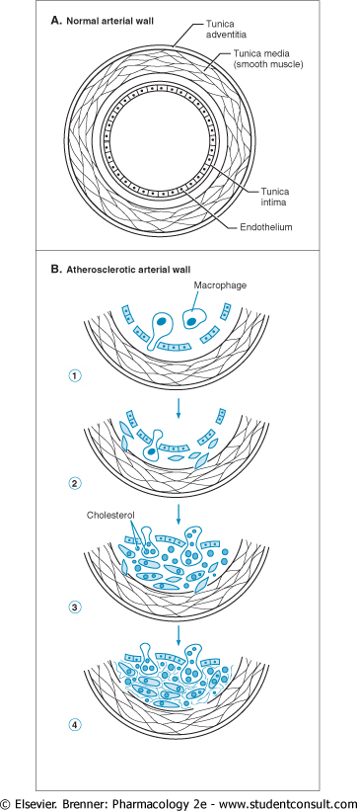
Progression of CHD
Damage to endothelium and invasion of macrophages
Smooth muscle migration
Cholesterol accumulates around macrophage and muscle cells
Collagen and elastic fibers form a matrix around the cholesterol, macrophages and muscle cells
Notes:
Endothelial dysfunction with altered PGI₂, prostacyclin & NO biosynthesis
Injury of dysfunctional endothelium leads to expression of adhesion molecules that lead to attachment of monocyte & monocyte migration from the lumen into the intima
LDL particles are transported into the vessel wall which are oxidized by free radicals generated by endothelial cells & monocyte/macrophages
oxLDL is taken up by macrophages via scavenger receptors forming foam cells & leading to activation of macrophages and release of cytokines
Cholesterol can be mobilized from the artery wall & transported in plasma in the form of HDL –C
Activated platelets, macrophages & endothelial cells release cytokines & growth factors, causing proliferation of smooth muscle
This inflammatory fibroproliferative response leads to formation of a dense fibrous cap overlying a lipid-rich core- atheromatous plaque
A plaque can rupture, forming a substrate for thrombosis. The presence of large numbers of macrophages predisposes to plaque rupture whereas vascular smooth muscle & matrix and matrix proteins stabilize the plaque

Slide 4
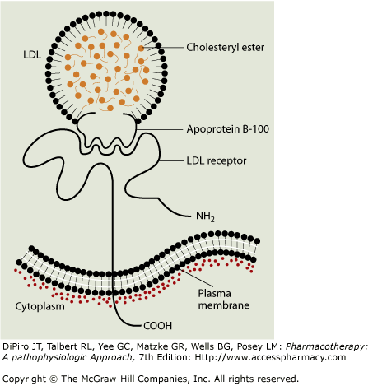
LIPOPROTEINS
Notes:
Lipoproteins have hydrophobic core regions containing ChE & TG surrounded by UnECh, phospholipids and apoproteins.
Apoproteins exist in two forms: B-48, formed in the intestine and found in chylomicrons & their remnants and B-100, synthesized in liver and found in VLDL, VLDL remnants (IDL), LDL and Lp(a) lipoproteins. HDL contains apolipoprotein A-I.

Slide 5
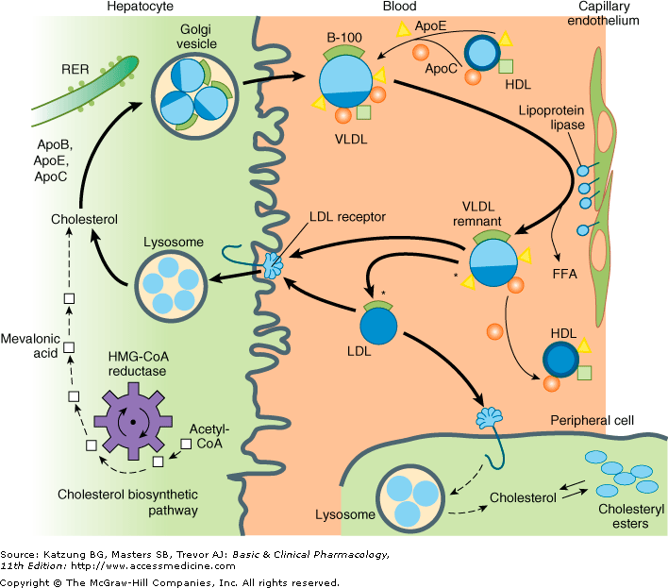
Notes:
Chylomicrons are formed in the intestine and carry TG of dietry origin, UnECh, and ChE. They enter the bloodstream from the thoracic duct.
TGs are removed in extra-hepatic tissues through a pathway shared with VLDL that involves hydrolysis by the lipoprotein lipase (LPL) system.
Decrease in particle diameter occurs as TGs are depleted. Surface lipids and small apoproteins are transferred to HDL. The resultant chylomicron remnants are taken up by receptor mediated endocytosis into hepatocytes.
VLDL are secreted by liver and export TG to peripheral tissues. VLDL TGs are hydrolyzed by LPL, yielding FFAs for storage in adipose tissue and for oxidation in tissues such as cardiac and skeletal muscle.
Depletion of TGs produces remnants (IDL), some of which undergoes endocytosis directly by liver. The remainder is converted to LDL by further removal of TGs mediated by hepatic lipase. This process explains the beta shift phenomenon, the increase of LDL(beta-lipoprotein) in serum as hypertriglyceridemia subsides. Increased levels of LDL can also result from increased secretion of VLDL and from increased LDL catabolism.
LDL is catabolized chiefly in hepatocytes and other cells by receptor mediated endocytosis. ChEs from LDL are hydrolyzed, yielding free Ch for the synthesis of membranes.
Cells also obtain cholesterol by synthesis via a pathway involving mevalonic acid by HMG CoA reductase. Production of this enzyme and LDL recptors is transcriptionally regulated by the content of Ch in the cell.
Normally, about 70% of LDL is removed from plasma by hepatocytes. Even more Ch is delivered to the liver via IDL and chylomicrons. Unlike other cells, hepatocytes can eliminate Ch by secretion in bile and by conversion to bile acids.
Lp(a) Lipoprotein is formed from LDL and the (a) protein, linked by a disulfide bridge. The Lp (a) levels vary and are genetically determined. Lp (a) can be found in atherosclerotic plaques and may also contribute to coronary disease by inhibiting thrombolysis.
HDL has apoA-I. these apoproteins are secreted by the liver and intestine. Much of the lipid comes from the surface monolayers of chylomicrons and VLDL during lipolysis. HDL also acquires Ch from peripheral tissues, protecting the Ch homeostasis of cells. Free Ch is transported from the cell membrane by a transporter, ABCA1, acquired by a small particle termed prebeta-1 HDL, and then esterified by lecithin:cholesterol acyltransferase (LCAT), leading to formation of larger HDL species. Ch is also exported from macrophages by the ABCG1 transporter to large HDL particles. The ChE are transferred to VLDL, IDL, LDL and chylomicron remnants with the aid of cholesterol Ester Transfer Protein (CETP).

Slide 6
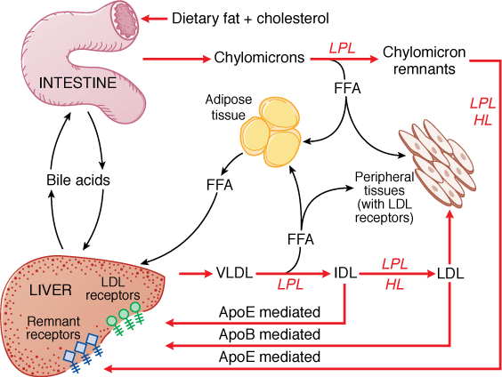

Slide 7
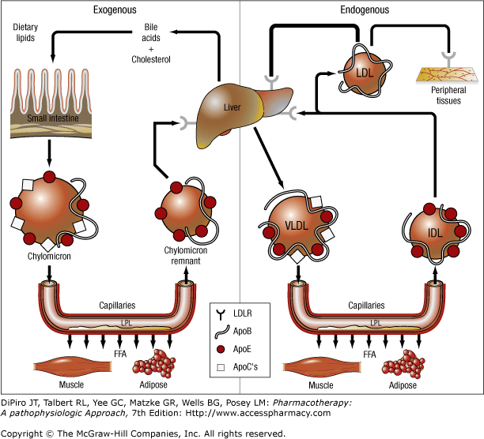

Slide 8
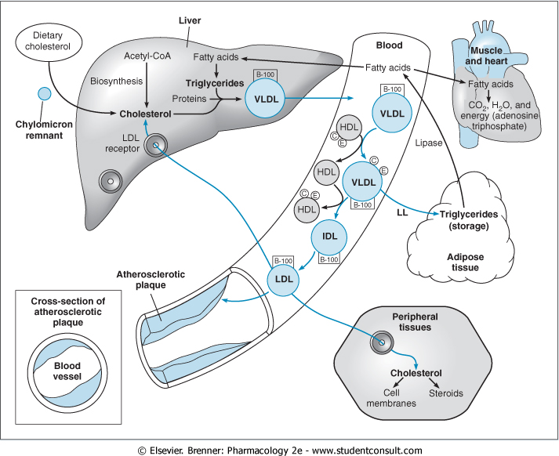
Chylomicrons- transport dietary lipids from the gut to the adipose tissue and liver
Chylomicron remnants- produced from Chylomicrons by lipoprotein lipases in endothelial cells and transport cholesterol to the liver
VLDL-made in the liver and secreted in to plasma deliver triglycerides to adipose tissue in the process get converted to IDL and LDL
LDL- (bad cholesterol) delivers cholesterol to peripheral tissues via receptors and is phagocytosed by macrophages thus delivering cholesterol to the plaques (atheromas)
HDL- (good cholesterol) produced in gut and liver cells, HDL transports cholesterol from atheromas to the liver (reverse cholesterol transport)

Slide 9
Hyperlipoproteinemia classification
Fredrickson-Levy-Lees Classification
Type | Lipoprotein Elevation
I | Chylomicrons | Familial hyperchylomicronemia
IIa | LDL | Familial hypercholesterolemia
IIb | LDL + VLDL | Familial mixed lipidemia
III | IDL | Familial dysbetalipoproteinemia
IV | VLDL | Familial hypertriglyceridemia
V | VLDL +Chylomicrons | Familial mixed hypertriglyceridemia
Notes:
Lipoprotein disorders are detected by measuring lipids in serum after a 10hr fast.
LDL 60mg/dl optimal for patents with coronary disease.
TG below 120mg/dl
PRIMARY HYPERTRIGLYCERIDEMIAS: primary chylomicronemia- normally after 10hrs of fasting chylomicrons are not present
Familial hypertriglyceridemia- mixed lipemia, chylomicrons & VLDL increases
Familial combined hyperlipoproteinemia- VLdl, LDL increased primarily VLDL
Familial dysbetalipoproteinemia- chylomicron remnants, VLDL accumulate, level of CH is high.
PRIMARY HYPERCHOLESTEROLEMIAS: familial hypercholesterolemia- Increase LDL
Familial ligand defective apolipoprotein B- Increase LDL
Familial combined hyperlipoproteinemia-increase LDL
Lp(a) hyperlipoproteinemia- increased Lp(a)
Deficiency of Ch 7alpha hydroxylase
HDL deficiency
SECONDARY HYPERLIPOPROTEINEMIA: DM, alcohol, severe nephrosis, estrogens, uremia, corticosteroid excess, myxedema, glycogen storage diseases, acromegaly, hypopituitariem, lipodystrophy, protease inhibitors, anorexia nervosa, hypothuroidism

Slide 10
Management of Hyperlipoproteinemia
Dietary
Pharmacological

Slide 11
Classification of Antihyperlipidemic drugs
Statins: Mevastatin, cerivastatin, lovastatin, simvastatin, fluvastatin, pravastatin, atorvastatin, rosuvastatin, pitavastatin
Bile-Acid sequestrants: Cholestyramine, colestipol, colesevelam
Fibric Acid derivatives: clofibrate, gemfibrozil, fenofibrate, ciprofibrate, bezafibrate

Slide 12
Nicotinamides: Nicotinic acid
Inhibitors of intestinal cholesterol absorption: Ezetimibe
Fish oils: Omega-3 marine triglyceride
Orlistat: Decrease absorption of triglycerides from intestines

Slide 13
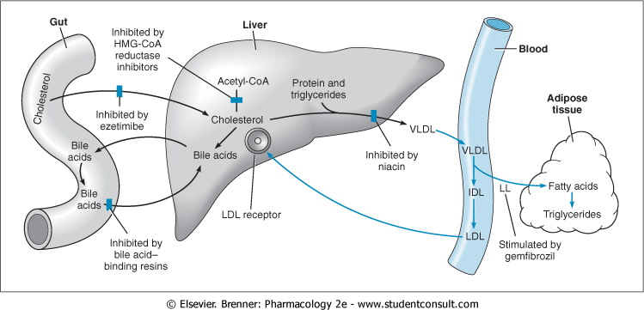
Sites & mechanism of drugs for hyperlipidemia

Slide 14
STATINS
SOURCE:
Penicillium citrinum: mevastatin
Aspergillus terreus: lovastatin
Lovastatin derivatives: pravastatin, simvastatin
Synthetic: Atorvastatin, fluvastatin, rosuvastatin
CHEMISTRY
Side group structurally similar to HMG-CoA
Lactone prodrugs: lovastatin, simvastatin
Atorvastatin, fluvastatin, rosuvastatin – fluorine containing

Slide 15
PHARMACOKINETICS:
Intestinal absorption: 40-75% except fluvastatin
Absorption increased with food
Extensive first pass metabolism: BA 5-30%
CYP3A4 - atorvastatin, lovastatin, simvastatin
CYP2C9 - fluvastatin, rosuvastatin
Sulfation – pravastatin
Excretion - bile mainly
t1/2 : 1-4 hrs except atorvastatin- 14hrs, pitavastatin 12hrs & rosuvastatin- 20hrs

Slide 16
MECHANISM OF ACTION:
Competitive inhibitors of HMG- CoA reductase
Reduce conversion of HMG- CoA to mevalonate, thereby inhibiting an early & rate limiting step in cholesterol biosynthesis
expression of LDL receptor gene
degradation of LDL receptor
removal of LDL from the blood thereby lowering LDL-C levels

Slide 17
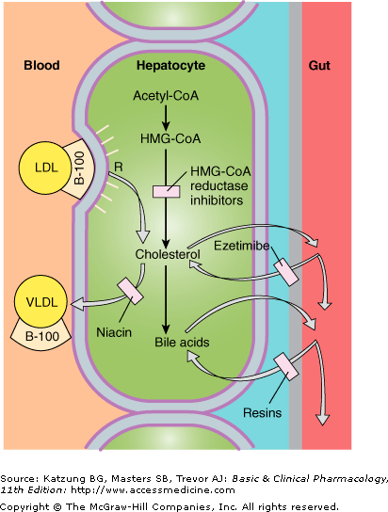

Slide 18
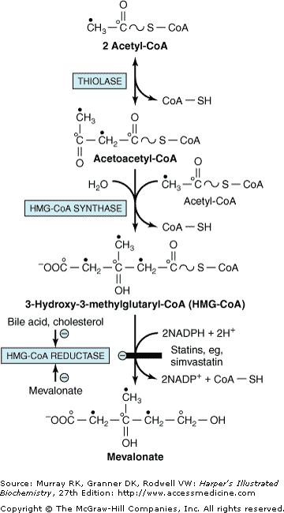

Slide 19
Also enhance removal of LDL precursors & decrease hepatic VLDL production
EFFECTS ON LIPOPROTEIN LEVELS
LDL-C reduction
Modest TG reduction
HDL-C increase: 5-10%

Slide 20
DOSE: 10-80mg
Simvastatin: 5-80mg
Lovastatin, atorvastatin: 10-80mg
Fluvastatin: 10-80mg
Rosuvastatin 5-40mg
USE:
used alone or in combination with resins, niacin, or ezetimibe to reduce LDL
At evening if single dose is used

Slide 21
CARDIOPROTECTIVE EFFECTS other than LDL LOWERING:
Enhance endothelial production of vasodilator NO
Plaque stability
Antiinflammatory role- decrease C-reactive protein
Reduce oxidative modification of LDL
Reduce platelet aggregation

Slide 22
ADVERSE EFFECTS:
Hepatoxicity
Myopathy
CONTRAINDICATION:
Pregnancy
Lactation
Children

Slide 23
DRUG INTERACTIONS:
PHARMACOKINETIC:
Increase plasma conc. of statins
CYP3A4 - macrolide antibiotics, azole antifungals, fibrates, cyclosporine, HIV protease inhibitors, paroxetine, venlafaxine
CYP2C9 – Ketoconazole, metronidazole, sulfinpyrazone, amiodarone, cimetidine
Decrease plasma conc. of statins
Phenytoin, griseofulvin, barbiturates, rifampin
Increase risk of myopathy with verapamil & amiodarone

Slide 24
Bile-Acid sequestrants
Cholestyramine
Colestipol
Colesevelam
CHEMISTRY:
Anion-exchange resins
Large polymers
Highly positively charged
Hygroscopic powders insoluble in water

Slide 25
PHARMACOKINETICS:
Not reabsorbed
Action begins within 1-4 days
Peak in 1-2 weeks
Resins should never be taken in dry form

Slide 26
MECHANISM OF ACTION:
Bind negatively charged bile acids
Not absorbed
Bound bile acids are excreted in feces
Depletion of bile-acids
Increase hepatic bile-acid synthesis
Decrease in hepatic cholesterol content
Stimulation of LDL receptors
Increase LDL clearance

Slide 27
EFFECTS ON LIPOPROTEIN LEVELS
Dose-dependent reduction in LDL-C levels
12-25%
HDL-C increase by 4-5%
Increase reduction when given in combination with statins or niacin 40-60%
DOSE:
16-36gm divided doses

Slide 28
ADVERSE EFFECTS:
Generally safe – not absorbed
Unpleasant taste
Bloating, dyspepsia, constipation
Hyperchloremic acidosis – chloride salts
Increase triglyceride levels
DRUG INTERACTIONS:
Bind & interfere with absorption of many drugs

Slide 29
NIACIN
Water soluble B-complex vitamin (B₃)
Functions as a vitamin after conversion to amide which is incorporated into NAD
Best agent available for raising HDL levels
Reduce LDL-C levels by 20-30%
Lowers TG as effectively as fibrates (35-45%)
Only drug that lowers Lp(a) levels

Slide 30
PHARMACOKINETICS:
Well absorbed
t1/2 60 mins - TDS dosing
Metabolized by the liver
Metabolite nicotinuric acid found in urine

Slide 31
MECHANISM OF ACTION:
Inhibits lipolysis by lipoprotein lipase in the adipose tissue
Reducing free fatty acids to the liver & decrease hepatic TG synthesis
Reduction of hepatic TG synthesis reduces VLDL production
Enhances LPL level promoting clearance of chylomicrons & LDL
Decrease catabolic rate of HDL

Slide 33
ADVERSE EFFECTS:
Cutaneous
Flushing,
Pruritis, rashes, acanthosis nigricans
Dyspepsia, rarely nvd
Hepatotoxicity
Insulin resistance
Elevate uric acid levels
Toxic ambylopia & toxic maculopathy
Potentiate the effect of antihypertensives
Birth defects in animals

Slide 34
FIBRATES
Clofibrate, Fenofibrate, Gemfibrozil
CHEMISTRY: Fibric acid derivative
PHARMACOKINETICS:
Rapidly & well absorbed with meals
99% protein bound – albumin
t1/2: gemfibrozil- 1hr, fenofibrate- 20hrs
Widely distributed
Excreted as glucuronide conjugates 90% in urine
Notes:
Decrease VLDL

Slide 35
MOA:
Interact with PPAR-α
upregulate LPL, apoA-I, A-II
Stimulate fatty acid oxidation
Increased LPL synthesis- clearance of TG-rich lipoprotein
Reduced expression of ApoC-III- clearance of VLDL
Increase HDL-C levels by PPAR mediated stimulation of ApoA -I & ApoA -II expression
Antithrombotic effect

Slide 36
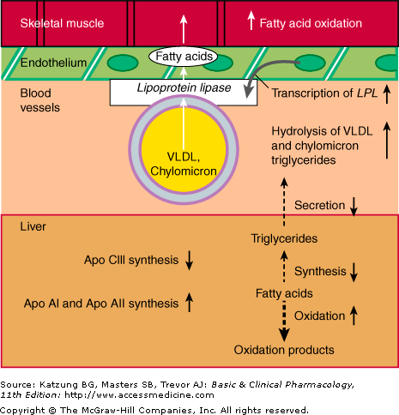

Slide 37
EFFECT ON LIPOPROTEIN LEVELS:
Decrease TG by 50%
Decrease LDL by 15-20%( 10-30% if TG>400)
Increase HDL by 15%
DOSE:
Gemfibrozil: 300-600mg OD or BD
Others 100mg OD or BD

Slide 38
ADVERSE EFFECTS:
Well tolerated
GI effects in 5% patients
Rash, urticaria
Myalgias, myopathy
Hypokalemia, arrhythmias
Increase lithogenicity of bile
DRUG INTERACTIONS:
Potentiate effects of warfarin
Myopathy syndrome with satins

Slide 39
EZETIMIBE
Lowers LDL-C levels by inhibiting cholesterol absorption by enterocytes in small intestines
Used primarily as adjunctives with statins
PHARMACOKINETICS:
Glucuronidated in intestinal epithelium
Enterohepatic recirculation
t1/2=22hrs
70% excretion in feces
Absorption inhibited by resins

Slide 40
MECHANISM OF ACTION
Inhibits NPC1L1
Reduced incorporation of cholesterol into chylomicrons, diminishing cholesterol delivery to the liver by chylomicron remnants
Stimulation of hepatic LDL receptors

Slide 41
EFFECT ON LIPOPROTEIN LEVELS:
LDL-C levels lowered by 15-20%
TG decrease by 5%
HDL-C increase by 1-2%
Further 15-20% reduction in LDL-C when given with statins

Slide 42
ADVERSE EFFECTS:
Steatorrhoea or flatulence
Rare allergic reactions
Slight increase in LFT’s
Fetal skeletal abnormalities in rodents
DOSE: 10 mg OD

