Slide 1
Heart Failure

Slide 2
Summary
Pathophysiology of Heart Failure

Slide 3
Heart Failure
Inadequate Pumping……..Inadequate Tissue Perfusion
Systolic failure… Mechanical pumping action reduced…….Ejection fraction reduced.
Diastolic failure… Stiffening & loss of relaxation of ventricle….. Reducing cardiac out put (ejection fraction may be normal)

Slide 4
Importance of calcium in cardiac contractility
a. Sensitivity of contractile proteins to Ca++………. Levosimedan increases Ca+ sensitivity.
b. The amount of calcium released from SR
A small rise in free cytoplasmic Ca++ …..incr AP………triggers the opening of Ryanodine – sensitive calcium channels.
c. The amount of Calcium stored in the SR
(SERCA) Sarcoplasmic endoplasmic reticulum Ca++ ATPase stores Ca++ in SR.

Slide 5
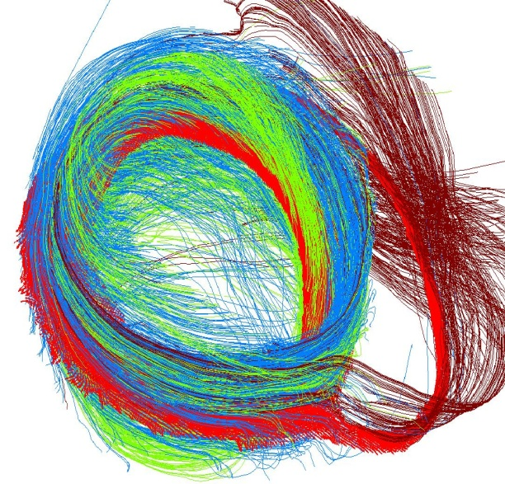
d. The Amount of triggered calcium
e. Activity of sodium-calcium exchanger
f. Intracellular sodium concentration and activity of Na+/K+ ATPase

Slide 6
Pathophysiology of heart failure
Left vent failure…….EF< 45%....CO Reduced….Due to MI
Rt Vent failure……….venous congestion
Diastolic failure …..does not respond to +ve inotropic drugs
“High out put Failure’ may also occur…..hyperthyroidism, severe anemia, pregnancy, AV shunts, Beri Beri

Slide 7
SIGNS & SYMP
Sympathetic activation, baro-receptor reflex activated, renin-angiotensin system activated…….leading to
Tachycardia, dyspnoea, intolerance to exercise, peripheral & pulmonary edema, cardiomegaly.

Slide 8
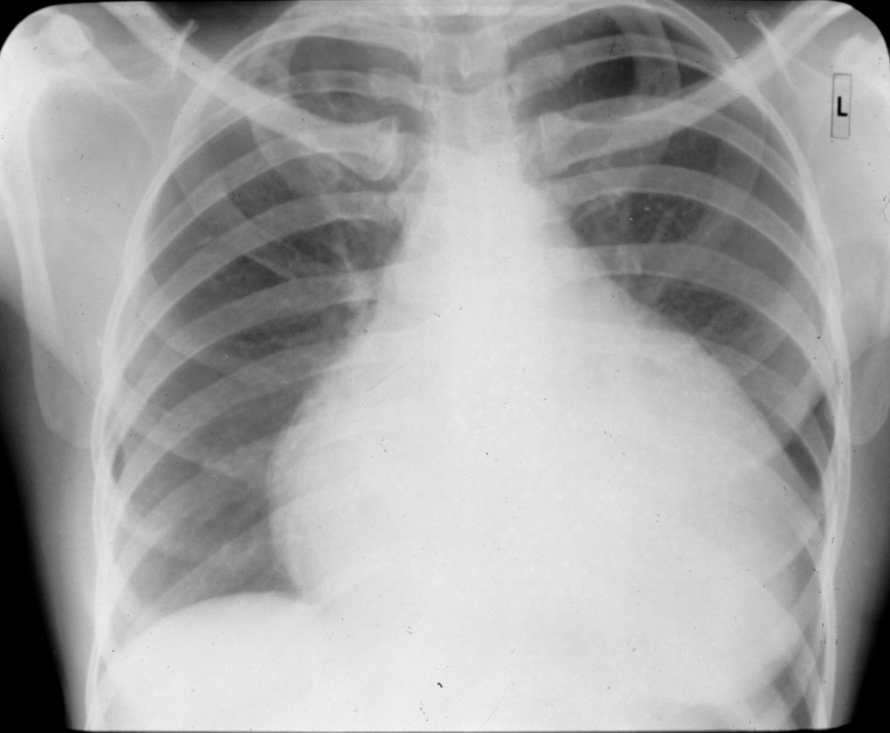
Enlarged ventricles

Slide 9
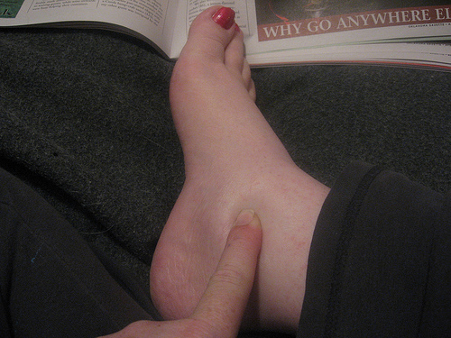
PITTING EDEMA

Slide 10
Myocardial Hypertrophy starts to compensate the circulatory failure. (but it can lead to ischemic changes, impaired diastolic filling,& alterations in ventricular geometery)………………ventricular dilatation.
Remodeling occurs………..dilation of vent……….(proliferation of connective tissue cells + abnormal myocardial cells (fetal myocytes)
Apoptosis occurs………. More stress on remaining myocytes leading to death of the myocytes left behind.

Slide 11
Cardiac performance
Four primary factors
Preload
Afterload
Contractility
Heart rate
Preload
< 15 mmHg filling pressure…..ok ( limit of Frank-Starling Law)
> 15 mmHg…………..plateau of performance
> 20-25 mmHg ……pulmonary congestion
( venodilators, salt restriction, diuretics can reduce preload)

Slide 12
AFTERLOAD
TPR……Increases due to reflex sympathetic activity & activation of Renin-angiotensin activity. Endothelin, potent vasoconstrictor may also be involved.
(Arteriolar dilators can reduce TPR)
CONTRACTILITY
Dec In Muscle Shortening
Leading To Dec Rate Of Intraventricular Pressure Development
(Inotrpic Drugs Can Improve)
HEART RATE
Compensatory incr in the heart rate occur.

Slide 13
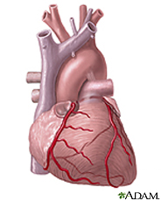
SUMMARY
COMPENSATORY PHYSIOLOGICAL
RESPONSES OF HEART MUSCLE IN CHF
Increased Sympathetic Activity.
Fluid Retention
Myocardial Hypertrophy
NOTE:
If The Mechanisms Listed Above Adequately Restore Cardiac Output, Then The Heart Failure Is Said To Be Compensated . If The Adaptive Mechanisms Fail To Maintain Cardiac Output, The Heart Failure Is Termed Decompensated.

Slide 14
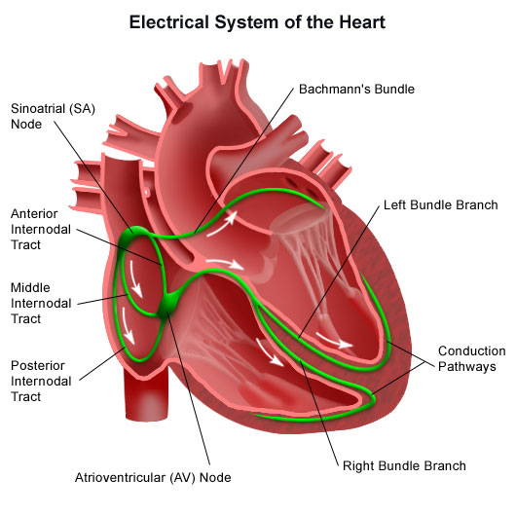
Electrophysiological
Properties of Heart
Automaticity
Rhythmicity
Excitability
Conductivity
Contractility

Slide 15
DRUGS USED IN CARDIAC FAILURE
DIURETICS
THIAZIDES
Bendrofluazide, Polythiazide etc
LOOP DIURETIC
Frusemide
ACE INHIBITORS/ARBs
Captopril, Enalapril etc/
Losartan, Valsartan

Slide 16
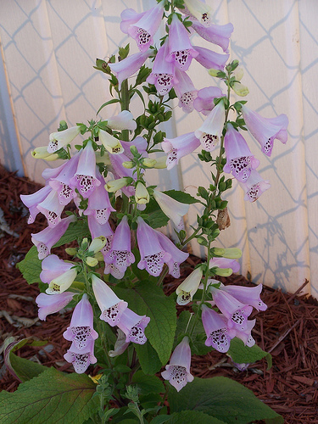
Cardiotonic Drugs
I- Cardiac Glycosides
Digoxin, Digitoxin, Ouabain
II- Bipyridine Derivatives
Amrinone, Milrinone
III- β 1 Selective Agonists
Dobutamine, Prenalterol
VASODILATORS
Nitrates
White Foxglove plant

Slide 17
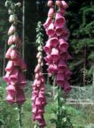
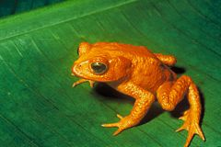
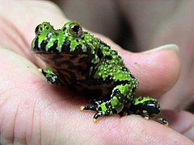
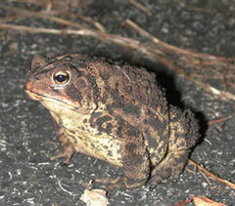
SOURCE OF CARDIAC GLYCOSIDE IS PLANT
DIGITALIS PURPUREA.
DIGITOXIN, GITOXIN, GITALIN
DIGITALIS LANATA
DIGOXIN, DIGITOXIN, GITOXIN
STROPHANTHUS KOMBE
STROPHANTHIN
STROPHANTHUS GRATUS
OUABAIN
WILLIAM WITHERING, 1785
Bufadienolides…From Toad’s skin

Slide 18
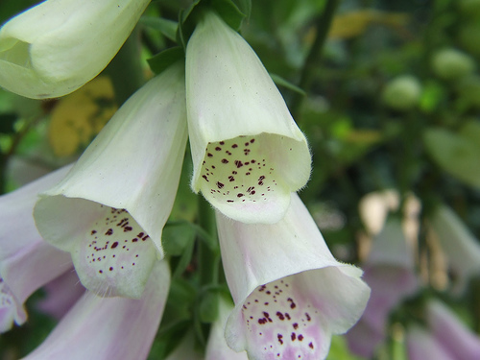
Fox Glove Plant

Slide 19
Lactone ring at 17 position
Steroid Nucleus
CH₃
12
17
O
11
13
16
H₃C
14
15
1
9
O
2
10
8
OH₃
3
5
7
Sugar
4
6
STRUCTURE OF CARDIAC GLYCOSIDES

Slide 20
PHARMACOKINETICS OF CARDIAC GLYCOSIDES
 | DIGOXIN | DIGITOXIN
ABSORPTION (ORAL) | 40 – 75% | 90 –100%
PROTEIN BINDING | LOW | EXTENSIVE
HALF LIFE | 39 HOURS | 168 HOURS
METABOLISM | LOW | EXTENSIVE
EXCRETION | PREDOMINANTLY RENAL | PARTLY RENAL
VOL OF DISTRIBUTION (L/Kg) | 6.3 | 0.6
THERAPEUTIC PLASMA CONCENTRATION | 0.5 – 2 ng/ml | 10 – 25ng/ml
TOXIC PLASMA CONC. | > 2ng/ml | > 35 ng/ml
DAILY DOSE (SLOW LOADING OR MAINT) | 0.125 – 0.5mg | 0.05 – 0.2mg
RAPID DIGITALIZING DOSE | 0.5 – 0.75mg 8 HRLY X 3 DOSES | 0.2 - .4mg 12 HRLY X 3 DOSES
TIME FOR PEAK EFFECT | 3 – 6 HOURS | 6 – 12 HOURS

Slide 21
Mechanism of Action of cardiac glycosides
At Molecular Level
1. The membrane bound tranporter Na+/K+ ATPase (sodium pump) is inhibited.
2. As a result intracellular Na+ is not expelled out hence increased intracellular conc; increases.
3. So Ca++ conc: in the cell is also increased due to sodium/ calcium exchanger.
4. increased cytoplasmic Ca++ is sequestered by SERCA in the SR for later release.

Slide 22
Mechanical Net Result is:
5. increased Ca++ conc; leads to significant increase in ionotropic activity of myocardial fibres. ( rate of contraction & rate of relaxation of the fibres both in normal & failing heart will increase.

Slide 23
Electrical effects produced are
Direct effects
Brief Prolongation of action potential
followed by shortening of AP ( by inc K+ conductance)
AT HIGHER CONC:
Resting memb potential is made less –ve (reduced)
IF TOXICITY PROGRESSES
Oscillatory depolarizing after potentials appear following normal AP. (DADs) or Delayed after depolarizations (when reach threshold) leading to “ectopic beats” or premature beats( PVCs). (due to overloading of intracellular Ca++)

Slide 24
If After Potential In Purkinge Fibers Regularly reach Threhold “Bigeminy” Appear.
Further Toxicity………tachycardia……….Vent Fibrillation…… Death
INDIRECT EFFECTS (SYMP & PARASYMPATH)
LOW DOSE-----Parasympathetic effects dominate…Baroreceptor sensitization …vagal stimulation………HR Slows down
TOXIC DOSE……. Sympathetic flow increases…………increases digitalis toxicity.
Atriovent junctional rhythm, PVCs, Bigeminal rhythm, 2nd degree AV block….. Any type of Arrhythmia can occur.

Slide 25
Effects on other organ
GIT: Anorexia, Nausea, Vomiting, Diarrhoea
CNS: CTZ Stimulation, Vagal Stimulation, disorientation, hallucinations,
visual disturbance, color perception disturbance.
ENDO: Gynaecomastia
INTERACTION WITH K+, Ca++ & Mg++
a. Potassium & digitalis inhibit eachothers binding to sodium pump. SO Hyperkalemia inhibits its binding to the enzyme (Na+/ K+ ATPase ) and reduces cardiac effects of digitalis and in hypokalemia toxicity worsens.
b. Abnormal cardiac automaticity is reduced by hyperkalemia.
CALCIUM ION increases the toxicity……………abnormal automaticity……..Arrhythmia.
MAGNESIUM ION ………..opposite effect to Ca++.

Slide 26
OTHER INOTROPIC DRUGS
Phosphodiestrase inhibitors (PDE-3)
Inamrinone
Milrinone
Levosimendan
MOA: inhibit PDE-3……….. Inc cAMP………. INCR INWARD INFLUX OF Ca ++………… incr in contarctility & Vasodialtion.
CLINICAL USES;
Acute heart failure
Beta- Adrenoreceptor Stimulants
Dobutamine
dopamine

Slide 27
DRUGS WITHOUT IONTROPIC EFFECTS USED IN CCF
Diuretics
Reduce Blood Volume……….Dec Pre Load….. Reduce edema
Reduce in cardiac size….
Spironolactone & eplerenone has additional benifits
ACE inhibitors:
Reduce TPR----------After load decreased
Salt and water retention reduced
Reduce angiotensin levels………..reduce sympathetic activity
Reduce remodelling of heart and vessels
AT1 recptor blockers have similar effects but limited.
VASODILATORS
Reduce pre and after load
Prevent remodelling
Hydralazine, isosorbide dinitrate, nesiritide (brain natriuretic peptide)
Bosentin 9 a competitive inhibitor of endothelin)

Slide 28
BETA BLOCKING DRUGS
Bisoprolol
Carvedilol
Metoprolol
Beneficial effects can be due to the fact that they
Reduce mitogenic effect of catecholmine------prevent remodelling
Attenuation of adverse effects of high conc; catecolamines (apotosis, up-regulation of beta –receptors)
Decrease heart rate

Slide 29
1
Activated K⁺ Channels
2
Activated Ca⁺⁺ Channels
Activated Na⁺ Channels
0
3
Leaky Na⁺ Channels
4
RMP-70 mv
Activated K⁺ Na⁺ AT Pase
Cardiac Glycosides Inhibits
K⁺
Excitability
Cardiac Muscle
Action
Troponin
Myosin
Refractory Period
Na⁺ Ca⁺⁺
NEGATIVE CHRONOTROPIC EFFECT
POSITIVE INOTROPIC EFFECT
Vagal Stimulation
Sympathetic Activity
Cardiac Output
Systolic time
End systolic volume
Cardiac size
Diastolic filling
Congestion in veins

Slide 30
ACTIONS OF CARDIAC GLYCOSIDES
Variable | Tissue
 | Atrial Muscle | AV Node | Purkinje System, Ventricles
Effective refractory period | (PANS) | (PANS) | (Direct)
Conduction Velocity | (PANS) | (PANS) | Negligible
Automaticity | (Direct) | (Direct) | (Direct)
Electrocardiogram before arrhythmias | Negligible | PR Interval | QT interval, T Wave Inversion; ST Segment depression

Slide 31
Adverse Effects
Nausea
Vomiting
Disturbed colour vision
Bigeminy
Paroxysmal atrial tachycardia
Ventricular tachycardia
MANAGEMENT
STOP DRUG ADMIN
Check serum K+ levels
Digoxin immune fab admin
Ventricular arrhythmia treated by lignocaine or phenytoin

Slide 32
DIGITALISATION
RAPID DIGITALIZATION
INDCATIONS
ATRIAL FIBRILLATION
SLOW DIGITALIZATION
Indications
CCF

