Slide 1
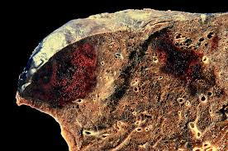
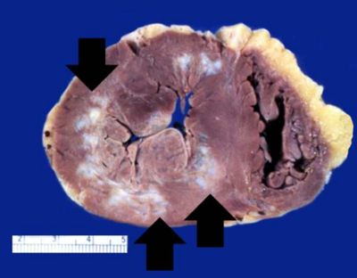
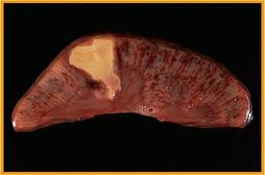
EMBOLISM AND INFARCTION
Dr Zahra Rashid Khan
Assistant Professor, Haematology
Department of Pathology

Slide 2
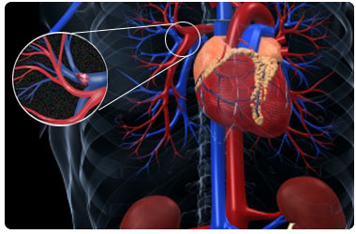
EMBOLUS
detached intravascular solid, liquid, or gaseous mass
carried by the blood to a site distant from its point of origin
causes partial/complete vascular occlusion

Slide 3
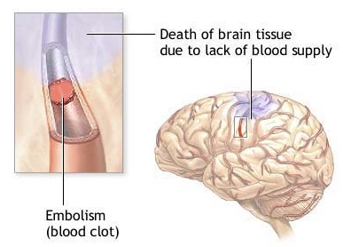
ORIGIN OF EMBOLI
99% of all emboli arise form thrombus (hence the term thromboembolism)
OTHERS: fat droplets, bubbles of air or nitrogen, tumor fragments, bits of bone marrow, or foreign bodies

Slide 4
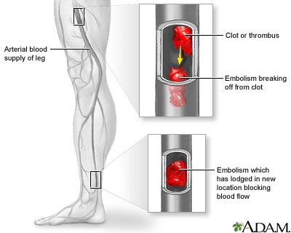
CONSEQUENCES
Pulmonary thromboembolism
Systemic thromboembolism

Slide 5
PULMONARY EMBOLISM
venous emboli originate from deep leg vein thrombi above the level of the knee
pass through the right side of the heart before entering the pulmonary vasculature
may occlude the main pulmonary artery, or pass out into the smaller, branching arterioles
frequently, there are multiple emboli

Slide 7
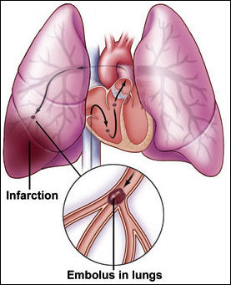
CLINICAL OUTCOMES
Most pulmonary emboli (60% -80%) are clinically silent
sudden death,
right ventricular failure (cor pulmonale)
pulmonary infarction
pulmonary hemorrhage
*(dual blood supply of lung offsets infarction in some cases)

Slide 8
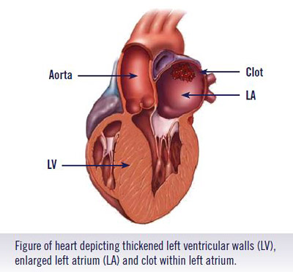
SYSTEMIC THROMBOEMBOLISM
emboli in the arterial circulation; usually result in infarction
(80%) arise from intracardiac mural thrombi

Slide 9
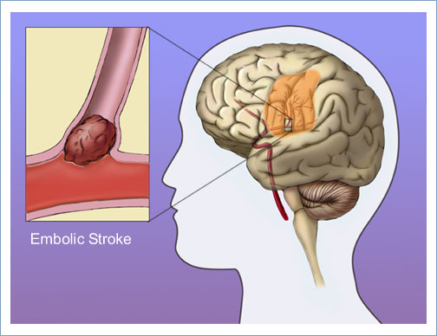
SYSTEMIC THROMBOEMBOLISM
in contrast to venous emboli, arterial emboli can travel to a wide variety of sites
common sites: lower extremities (75%) and the brain (10%)
*paradoxical emboli

Slide 10
FAT EMBOLISM
Microscopic fat globules enter the circulation after fractures of long bones or after soft-tissue trauma

Slide 11
FAT EMBOLISM
Although fat and marrow embolism occurs in some 90% of individuals with severe skeletal injuries, only 10%
patients have clinical findings
Fat embolism syndrome (pulmonary insufficiency, neurologic symptoms, anemia, and thrombocytopenia; fatal in about 10% of cases)

Slide 13
FAT EMBOLISM

Slide 14
AIR EMBOLISM
air may enter the circulation during obstetric procedures or as a consequence of chest wall injury
more than 100 mL of air are required
to produce a clinical effect
decompression sickness occurs when
individuals are exposed to sudden changes
in atmospheric pressure

Slide 15
AIR EMBOLISM
Decompression Sickness
When air is breathed at high pressure, increased amounts of gas (particularly nitrogen) become dissolved in the blood and tissues
If the diver then ascends (depressurizes) too rapidly, the nitrogen expands in the tissues and bubbles out of solution in the blood to form gas emboli
Bends, Chokes, Caison’s disease

Slide 17
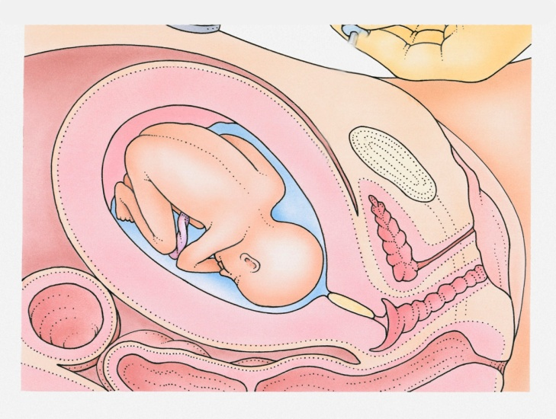
AMNIOTIC FLUID EMBOLISM
entry of amniotic fluid into maternal circulation via a tear in the placental membranes and rupture of uterine veins
grave but fortunately uncommon complication of labor and the immediate postpartum period
mortality rate of 20% - 40%

Slide 18
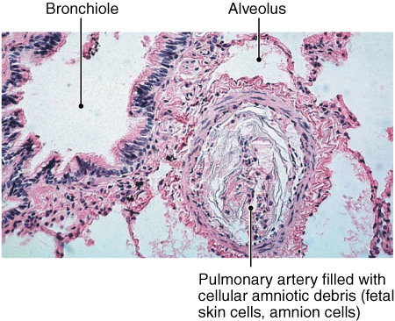
AMNIOTIC FLUID EMBOLISM
severe dyspnea,hypotensive shock, seizures and coma
ultimately, the patient develops pulmonary edema and DIC

Slide 19
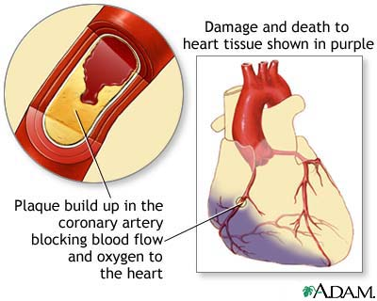
INFARCTION
area of ischemic necrosis caused by occlusion of either the arterial supply or the venous drainage in a particular tissue
cardiovascular, cerebral, pulmonary, bowel infarction

Slide 20
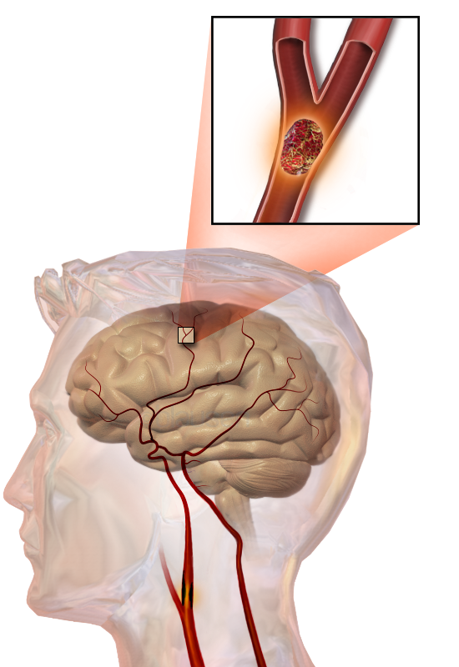
INFARCTION
99% of all infarcts result from thrombotic
or embolic events, and almost all result
from arterial occlusion
other mechanisms, such as local
vasospasm,extrinsic compression
of a vessel (e.g., by tumor

Slide 21
INFARCTION: HISTOLOGY
RED INFARCTS occur
with venous occlusion
in loose tissues
tissue with dual blood supply
WHITE INFARCTS occur
with arterial occlusion
in solid organs

Slide 22
INFARCTION: HISTOLOGY
ischemic coagulative necrosis
(inflammation followed by scar tissue)
brain is an exception
Septic infarctions occur when bacterial vegetations from a heart valve embolize or when microbes seed an area of necrotic tissue

Slide 23
INFARCTION: HISTOLOGY

Slide 24
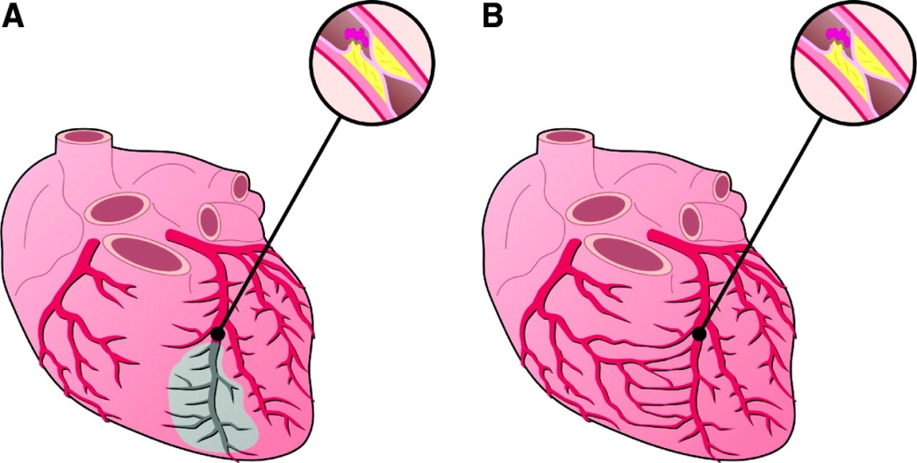
FACTORS THAT INFLUENCE DEVELOPMENT OF AN INFARCT
Nature of blood supply
(renal/splenic vs heaptic/pulmonary)
Rate of development of occlusion
(collaterals/anastamosis)
Vulnerability to hypoxia
(e.g, neurons)
Oxygen content of blood
(anemia, cardiac disease)

