Slide 1
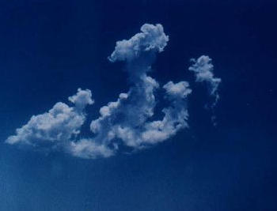
In the Name of Allah, The Most Beneficent and
The Most Merciful

Slide 2
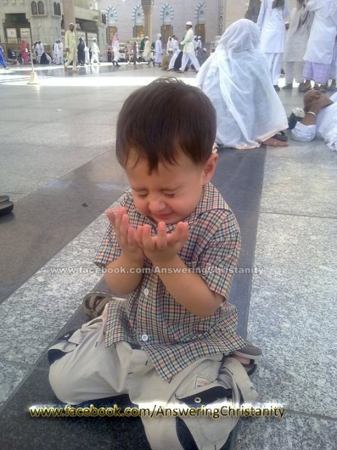
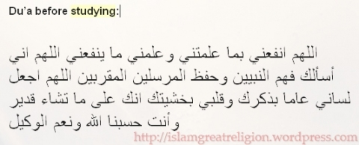
Prayers – Dua for studies and exams!!
“Oh Allah! Make useful for me what you have taught me and teach me knowledge that will be useful to me. Oh Allah! I ask you for the understanding of the prophets and the memory of the messengers, and those nearest to you. Oh Allah! Make my tongue full of your remembrance and my heart with consciousness of you. Oh Allah! You do whatever you wish, and you are my availer and protector and best of aid.”

Slide 3
“Oh Allah! I entrust you with what I have read and I have studied. Oh Allah! Bring it back to me when I am in need of it. Oh Allah! You do whatever you wish, you are my availer and protector and the best of aid.”

Slide 4
“Oh Allah! Nothing is easy except what you have made easy. If you wish, you can make the difficult easy.”

Slide 5
“Blessings of god be upon Muhammad and his progeny. O God, I ask you, the one who mentions goodness and actualizes it and commands it, remind me of that which the shaytan makes me forget.”

Slide 6
“O Allaah, there is no ease except what You make easy. And if You wish, You make the difficult easy.” [recorded in Hisnul-Muslim]

Slide 7
Al- Quraan
“And Allaah would never make your faith to be lost. Truly Allaah is full of Kindness, the Most Merciful towards mankind"
[2:143].

Slide 8
Hadith Shareef
"You will definitely see your Rabb with your own eyes."
Reporter: Hadhrat Jarir bin Abdullah (r)
Source: Sahih al-Bukhari, Vol. 9, #530

Slide 9
A Saying
The weak can never forgive;
forgiveness
is the attribute of the strong.

Slide 10
Angina Pectoris

Slide 11
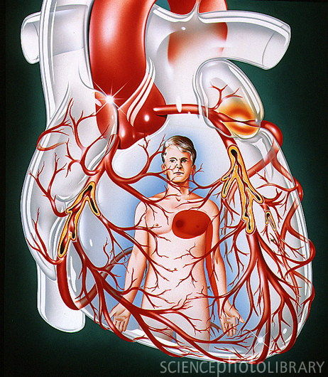

Slide 12
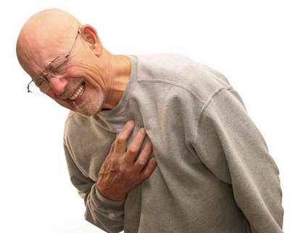
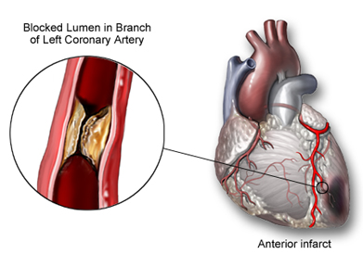

Slide 13
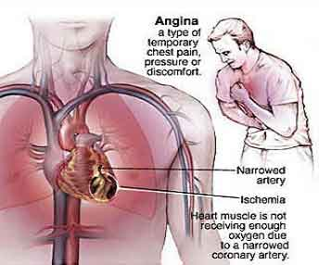

Slide 14
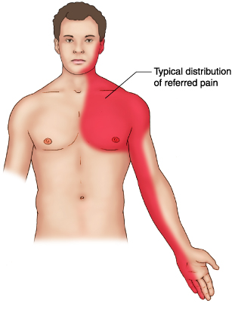
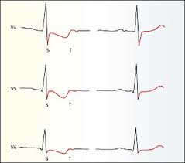

Slide 15
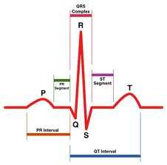
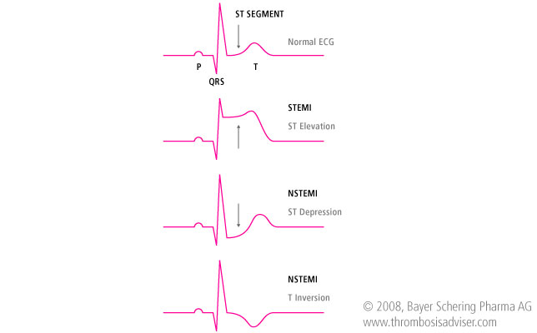
NORMAL ECG

Slide 18
ANGINA PECTORIS
(The word angina comes from the Latin verb angere meaning "to choke or throttle" .)
Central chest pain due to insufficient blood supply to myocardium. (Ischemic chest pain). May radiate to left arm & shoulder or jaw.
Angina of effort ….Classical Angina …..Stable angina
Variant angina( Prinzmetal angina)….Unstable angina
Vasospastic angina
Decubitus angina ? ?.............Unstable angina

Slide 19
Occluded Coronary Arteries

Slide 20
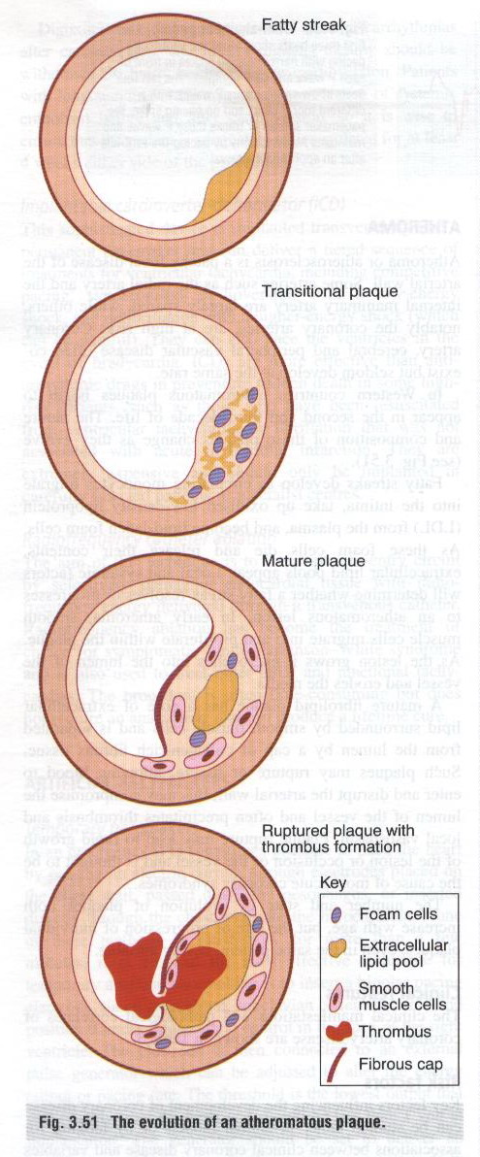
Circulating monocytes migrate into intima and take up LDL and form foam cells.
Foam cells die and release their lipid content forming extra cellular lipid pool.
A mature plaque is formed having a central lipid core surrounded by smooth muscle cells .
Rupturing of plaque allows blood to disrupt arterial wall thus promoting platelet aggregation and forming thrombus.

Slide 21
Classical Presentation

Slide 24
Anti Anginal Drugs
Anti anginal Drugs
24

Slide 25
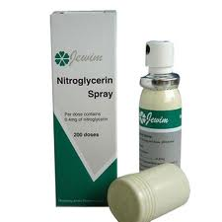
Classification
I- Organic Nitrates & Nitrites
Glyceryl trinitrate
Isosorbide nitrate
Isosorbide dinitrate
Isosorbide mononitrate
Pentaerythrital tetranitrate
Amylnitrite
II- Calcium Channel Blockers
Verapamil
Deltiazem

Slide 26
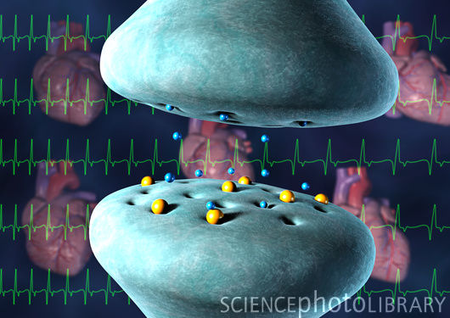
III- Beta Adrenergic blockers
Propranolol
Acebutalol
Atenolol
Bisoprolol
Carvidolol
IV- Potassium Channel Opener
Nicorandil

Slide 27
Newer drugs
Metabolic modulators
Direct bradycardic agents
Potassium channel activators
Rho-kinase inhibitors
Sulphonylureas
Thiazolidinediones
Vasopeptidase inhibitors
Nitric-acid donors eg; L-arginine
Capsiacin
Amiloride
I- fatty acid oxidation inhibitors
Renolazine
Trimetazidine (pFOX inhibitors)
II- bradycardic Drugs
Ivabradine

Slide 28
NITRATES & NITRITES
Nitrates & Nitrites

Slide 29
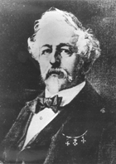
Nitrates & Nitrites
HISTORY OF NITRATES
EXPLOSIVE FACTORIES
Ascanio Sobrero Synthesized Nitroglycerine in 1846

Slide 30
CHEMISTRY
Nitric acid and nitrous acid esters of polyalcohols
Nitroglycerine considered prototype
Volatile
Adsorbs to plastic surfaces
Not sensitive to light

Slide 31
Pharmacokinetics
High first pass metabolism in liver due to “nitrate reductase”
Oral bioavailability <10-20%
Sublingual route
Isosorbide-5-mononitrate is exception
Duration of action 15-30 mins
Kidney excretion

Slide 32
Various Routes Of Administration Of
Glyceryl Trinitrate
SUBLINGUAL
Peak Action 4-8 Mins
Duration Of Action 10-30 Mins
BUCCAL
Peak Action 4-10 Mins
D.O.A. 3-30 Mins
TRANSDERMAL
Peak Action 1-3 Mins
D.O.A. Upto 24 Hours

Slide 33
Mechanism Of Action Anti-anginal Drugs
NITRATES ENDOTHELIAL CELLS
NO
GUANYLYL CYCLASE GUANYLYL CYCLASE
GTP cGMP
1 MLCK*
MYOSIN – LC MYOSIN – LC – PO4 MYOSIN - LC
ACTIN
CONTRACTION RELAXATION

Slide 34
MECHANISM OF ACTION
Release of nitric oxide (“NO”)
Activation of guanylyl cyclase
Increase in cGMP
Dephosphorylation of myosin light chains
Prevention of actin-myosin interaction
Smooth muscle relaxation

Slide 35
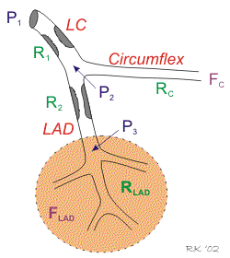
EFFECTS
On Arteries And Veins
On Total And Regional
Coronary Blood Flow
On Platelets
CORONARY
Steal Phenomenon ? ?

Slide 36
Haemodynamic Mechanisms that Relieve ANGINA
Decreased Oxygen Demand
Decreased Preload
Decreased Afterload
Leads to Decreased Heart Contraction force
Do not Have Direct Effect On Heart Rate Or Contractility
Increased Blood Supply
Dilatation Of Coronary Arteries
Decreased Platelet Aggregation
Decreased Clot Formation

Slide 37
Clinical Uses:
Treatment & prophylaxis of classical angina pectoris
2. Treatment of Variant/Prinzmetal ANGINA
3. Treatment of Angiospatic Angina
4. Treatment of Unstable Angina

Slide 38
OTHER USES
During myocardial infarction
Heart failure
After stenting (decreased incidence of myocardial necrosis)
Pulmonary hypertension

Slide 39
ADVERSE EFFECTS
Throbbing headache
Dizziness
Unusual drowsiness, weakness
Tachycardia
Fainting due to orthostatic hypotension
Dry mouth
Weak pulse
Vomiting
Cyanosis
Tolerance
Dependence
( Monday Morning Syndrome)

Slide 40
CONTRAINDICATIONS AND Conditions of concern
Contraindicated in raised intracranial pressure, recent stroke or head injury
Care Should Be Taken in:
Pericarditis
Recent heart attack
Cardiac tamponade
Severe anemia
Glaucoma ??
Kidney or liver disease
Hyperthyroidism

Slide 41
DRUG INTERACTIONS
CARDIAC MEDICATION
VASODILATORS
ANTIHYPERTENSIVES
ANTIARRHYTHMICS
ERECTILE MEDICATIONS
VIAGRA(SILDENAFIL)
ALCOHOL
Grapefruit
Marijuana, cocaine, nicotine
N-acetyl cysteine

Slide 42
SUMMARY
Main goal is to either increase oxygen supply or decrease oxygen consumption or both
Increase in oxygen supply mainly by surgical intervention and partly by drugs
Decrease in oxygen consumption by Drugs

Slide 43
CLASSIFICATION OF BETA BLOCKERS
NON - SELECTIVE (β1,β2) BLOCKERS
PURE BLOCKERS
SOTALOL
TIMOLOL
NADOLOL
WITH MEMBRANE STABILIZING ACTIVITY (MSA)
PROPRANOLOL
PENBUTOLOL
WITH INTRINSIC SYMPATHETIC ACTIVITY (ISA)
PINDOLOL (MSA ±)
CARTEOLOL
WITH ISA & MSA
OXPRENOLOL
ALPRENOLOL

Slide 44
CARDIOSELECTIVE (β1) BLOCKERS
PURE BLOCKERS
ATENOLOL
BISOPROLOL
ESMOLOL
BETAXOLOL
WITH MSA
METOPROLOL
TOLAMOLOL
WITH ISA
PRACTOLOL
CELIPROLOL
WITH ISA & MSA
ACEBUTOLOL
DRUG THAT BLOCK BOTH α & β RECEPTORS
LABETALOL
CARVEDILOL

Slide 45
OH
CH₃
CH₂ CH CH₂ NHCH
CH₃
PROPRANOLOL
OH
CH₃
CH₃ OCHCH₂
OCH₂ CH CH₂NHCH
CH₃
METOPROLOL

Slide 46
BETA ADRENOCEPTOR BLOCKERS
Pharmacokinetic Properties
LIPID / WATER SOLUBILITY
LIPID SOLUBLE
PROPRANOLOL
TIMOLOL
METOPROLOL
PENBUTOLOL
WATER SOLUBLE
NADOLOL
ATENOLOL
ACEBUTOLOL

Slide 47
DURATION OF ACTION
ULTRA SHORT ACTING
ESMOLOL t ^{½} = 9 min
INTERMEDIATE ACTING
PROPRANOLOL 3-5 HOURS
TIMOLOL 3-5 HOURS
PINDOLOL 3-4 HOURS
METOPROLOL 3-4 HOURS
LONG ACTING
NADOLOL 10-20 HOURS
ATENOLOL 05-08 HOURS

Slide 48
Adrenergic Blockers:
Mechanism:
a. Block β1 receptors in heart decrease cardiac output,
b. ↓ heart rate Work load of heart is reduced so is the O2 consumption and requirement.
c. Anti-anginal effect due to its haemodynamic effects.

Slide 49
THERAPEUTICS USES
CARDIOVASCULAR DISEASES
Hypertension (Cardio protective)
Angina pectoris (Prophylaxis only)
Myocardial infarction
Primary prevention
Limit the size of infarct
Secondary prevention
Mechanisms ?
Cardiac arrhythmias
More effective in atrial arrhythmias
Obstructive Cardiomyopathies
Hypertrophic sub aortic stenosis
Fallot’s tetrology
Dissecting aneurysm of aorta
Portal hypertension
Sub arachnoid haemorrhage

Slide 50
CONDITIONS ASSOCIATED WITH SYMP ACTIVITY
Thyrotoxicosis
Acute anxiety states (Panic syndromes)
Childhood phobias
Acute porphyrias.
Drug withdrawal syndrome
pheochromocytoma (alongwith alpha blockers)
Miscellaneous
Glaucoma (Simple open angle, aphakic) Levobunolol, Betaxotol, Timolol
Migraine (Prophylaxis)
Familial Tremors
Torticollis

Slide 51
β- Adrenoceptor Blockers
Therapeutic Uses (Repeated / Summary)
Hypertension
Angina Pectoris (Prophylaxis)
Myocardial Infarction
Cardiac Arrhythmias
Obstructive Cardiomyopathies
Thyrotoxicosis
Migraine (Prophylaxis)
Glaucoma (Betaxolol, Levobunolol, Timolol)
Acute Anxiety (Panic Syndrome)

Slide 52
Childhood Phobias
Essential Tremor
Drug Withdrawal Syndrome
Acute Porphyria
Pheochromocytoma (Always Combined With Alpha Blocker)
Subarachnoid Haemorrhage
Portal Hypertension?

Slide 53
Adverse effects of beta-blocking drugs
HYPOTENSION
BRADYCARDIA
HEART BLOCKS
BRONCHOSPASM
HYPERGLYCEMIA
Masking effect of hypoglycemic symptoms
HYPERLIPIDEMIA
HYPERKALEMIA
LASSITUDE
LOSS OF LIBIDO
IMPOTENCE
MENTAL DEPRESSION
NIGHT MARES
DIARRHEA
1.hypotension
2.bradycardia
3. heart block
4. bronchoconstriction
5. Misc:

Slide 54
CONTRAINDICATIONS
Bronchial asthma
Bradycardia
Heart blocks
Hypotension
RELATIVE CONTRAINDICATIONS
Insulin dependent diabetes
Mental depression

Slide 55
CALCIUM CHANNEL
BLOCKERS

Slide 56
CALCIUM CHANNEL BLOCKERS I- Dihydropyridines
Nifedipine (Adalat)
Nicardipine
Nimodipine
Amlodipine
Nisoldipine
Nitrendipine
Felodipine
Isradipine

Slide 57
II- Phenylalkylamines
Verapamil (Calan)
Gallopamil
III- Benzothiazepines
Diltiazem

Slide 58
Types of Voltage gated or voltage Dependent Calcium Channels
L Type
· Heart more sensitive to verapamil
· B.V
T Type
Exocrine glands
N Type
Neurons

Slide 59
Mechanism of action.
In Blood Vessels
Blocking of voltage gated-calcium channels
↓
Reduced Ca⁺⁺ in smooth muscle cells
↓
Reduced formation of Ca++/calmodulin complex
↓
No activation of myosin Light chain kinase
↓
Dephosphorylation of myosin Light chain
↓
Vasodilatation
↓
Reduced after & Preload in heart
↓
Reduced O2 requirement

Slide 60
MOA
Block L- type channels
decrease transmembranes Ca++ channels
decrease myocardial activity
decrease SA node activity
decrease A.V node conduction
Relaxation of smooth muscle

Slide 61
On Heart
Blockade of voltage gated calcium channels
↓
Reduced Ca⁺⁺ influx into cardiac cells
↓
No breaking of troponin bridge
↓
Less contraction
↓
Less O₂ consumption

Slide 62
Ph. Kinetics :
Nifedipine
Complete oral absorption
Peak plasma levels 20-45 Min
Detectable plasma levels 6 Min D.O.A 8-12 hrs
Verapamil orally active, almost complete absorption extensive P.P.B (80-90%)
Elimination half life 3-6 hrs.
Extensive metabolism in liver.
Verapamil and Nifedipine excreted in urine
Diltiazem excreted in faeces.

Slide 63
Pharmacological Actions / Effects Group Actions
On Heart
Anti Anginal
Anti hypertensive
Anti arrhythmic
Useful in Myocardial infarction

Slide 64
Other Effects
Anti-Platelet effect
Effect on other smooth muscles
Action on Skeletal muscles
Decreased release of insulin
Decrease secretion of exocrine glands.
Verapamil blocks reverse transporter p-170 glycoprotein

Slide 65
THERAPEUTIC USES
Hypertension
Angina
Supraventricular arrhythmias
Hypertorophic cardiomyopathy
Prevent incease in infarct size
Migraine Prophylaxis
Raynaud’s phenomenon
Atherosclerosis
Subarachnoid haemorrhage (Nimodipine)

Slide 66
Toxicity:
Cardiodepression,
AV blocks,
cardiac failure,
hypotension.
Constipation
Edema of dependent parts
Skin rashes

Slide 67
ANGIOTENSIN CONVERTING ENZYME INHIBITORS
1. Captopril
2. Enalapril
3. Lisinopril
4. Fosinopril
5. Benazepril
6. Moexipril
7. Perindopril.
8. Quinapril
9. Ramipril
10.Trandolapril

Slide 68
CAPTOPRIL
MOA: Angiotensin –I Angiotensin-II
Peptidyl dipeptidase (Potent v. const)
Inactivates Bradykinin (Potent V. dilator)
Experimental/Icatibant (bradykinin receptor antagonist) blunts B.P lowering effect.
PHARMACOKINETICS
Rapid absorption orally
Bioavailability 75% on empty stomach
Penetrates all times except CNS
Biotransformed in liver to sulfides
< 50% excreted through kidneys (Moxipril & fosinopril)
not excreted by kidney
- t ½ 3 hrs action remains longer
Captopril
68

Slide 69
PHARMACODYNAMICS
(Prevent re-modeling of myocardium)
Decreases PVR
CO & HR not changed
Do not cause reflex tachycardia
Decreases resetting of baroreceptors or increased sympathetic activity
Diabetic nephropathy
CCF
69

Slide 70
ADVERSE EFFECTS
Dry cough
Hyperkalemia
Hypotension
Angioedema
Drug fever
Metallic taste
Neutropenia
Proteinuria
renal failure

Slide 71
CONTRAINDICATED in
2ND & 3RD TRIMESTER
Fetal hypotension
Anuria
Renal failure
Fetal malformations & death
DRUG INTERACTIONS
K⁺ sparing diuretics
NSAIDs
71

Slide 72
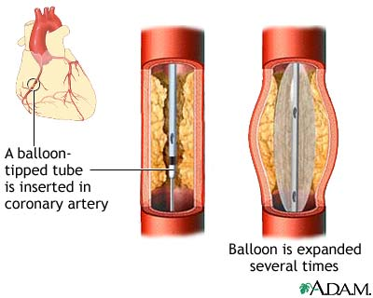
Angioplasty

Slide 73
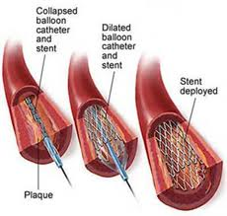
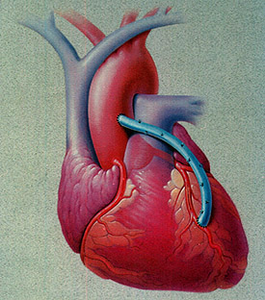
Stenting of Coronary
Coronary bypass

Slide 74
That's All For Today

Slide 75
Tips for Exams And Students
The Muslim student puts his trust in Allaah when facing the tests of this world, and he seeks His help whilst following the prescribed means, in accordance with the words of the Prophet (peace and blessings of Allaah be upon him):
“The strong believer is better and is more beloved to Allaah than the weak believer, although both are good. Strive to attain that which will benefit you and seek the help of Allaah, and do not feel helpless.” (Saheeh Muslim, hadeeth no. 2664)
Among those means are the following:
Turning to Allaah by making du’aa’ in any way that is prescribed in Islam, such as saying, “Rabbiy ishrah li sadri wa yassir li amri (O my Lord, expand my chest and make things easy for me).”
.
.

Slide 76
Tips
Getting used to sleeping early and going to exams on time.
Preparing all required or permitted equipment such as pens, rulers and setsquares, calculators and watches, because being well prepared helps one to answer questions.
Reciting the du’aa’ for leaving the house: “Bismillaah, tawakkaltu ‘ala Allaah, wa laa hawla wa laa quwwata illa Billaah. Allaahumma inni a’oodhu bika an adilla aw udalla, aw azilla aw uzalla, aw azlima aw uzlama, aw ajhala aw yujhala ‘alayya (In the name of Allaah, I put my trust in Allaah, and there is no strength and no power except with Allaah. O Allaah, I seek refuge with You lest I should stray or be led astray, lest I slip (commit a sin unintentionally) or be tripped, lest I oppress or be oppressed, lest I behave foolishly or be treated foolishly).”Do not forget to seek your parents’ approval, for their du’aa’ for you will be answered.
Mention the name of Allaah before you start, for mentioning the name of Allaah is prescribed when beginning any permissible action; this brings blessing, and seeking the help of Allaah is one of the means of strength

Slide 77
Tips
Fear Allaah with regard to your classmates, and do not be affected by their anxiety or fear just before the exam, for anxiety is a contagious disease. Instead, make them feel optimistic by saying good words as prescribed in Islam. The Prophet (peace and blessings of Allaah be upon him) was optimistic when he heard the name of Suhayl (which means “easy”) and he said: “Things have been made easy for you.” He used to like to hear the words ‘Yaa Raashid, when he went out for any purpose. So be optimistic that you and your brothers will pass this exam.
Remembering Allaah (dhikr) dispels anxiety and tension. If something is too difficult for you, then pray to Allaah to make it easy for you. Whenever Shaykh al-Islam Ibn Taymiyah (may Allaah have mercy on him) found something too difficult to understand, he would say, “O You Who taught Ibraaheem, teach me; O You Who caused Sulaymaan to understand, cause me to understand.”
Choose a good place to sit during the exam, if you can. Keep your back straight, and sit on the chair in a healthy manner.
Look over the exam first. Studies advise spending 10% of the exam time in reading the questions carefully, noting the important words and dividing one’s time between the questions

Slide 78
Tips
Plan to answer the easy questions first, then the difficult ones. Whilst reading the questions, write notes and ideas which you can use in your answers later.
Answer questions according to importance.
by answering the easy questions which you know. Then move on to the questions which carry high marks, and leave till the end the questions to which you do not know the answers, or which you think will take a long time to produce an answer or which do not carry such high marks.
Take your time to answer, for the Prophet (peace and blessings of Allaah be upon him) said: “Deliberation is from Allaah and haste is from the Shaytaan.” (A hasan hadeeth. Saheeh al-Jaami, 3011).
Think carefully about the answer and choose the right answer when answering multiple-choice questions. Deal with them in the following manner. If you are sure that you have chosen the right answer, then beware of waswasah (insinuating whispers from the Shaytaan). If you are not sure, then start by eliminating the wrong or unlikely answers, then choose the correct answer based on what you think is most likely to be correct. If you guessed at a correct answer then do not change it unless you are sure that it is wrong – especially if you will lose marks for a wrong answer. Research indicates that the correct answer is usually that which the student thinks of first.

Slide 79
Tips
In written exams, collect your thoughts before you start to answer.Write an outline for your answer with some words which will indicate the ideas which you want to discuss. Then number the ideas in the sequence in which you want to present them.
Write the main points of your answer at the beginning of the line, because this is what the examiner is looking for, and he may not see what he is looking for if it is in the middle of the page and he is in a hurry.
Devote 10% of the time for reviewing your answers. Take your time in reviewing, especially in mathematical problems and writing numbers. Resist the desire to hand in the exam papers quickly, and do not let the fact that some people are leaving early bother you. They may be among the people who have handed in their papers too early.
If you discover after the exam that you answered some questions incorrectly, then take that as a lesson in the importance of being well prepared in the future, and not rushing to answer questions. Accept the will and decree of Allaah and do not fall prey to frustration and despair. Remember the hadeeth of the Prophet (peace and blessings of Allaah be upon him), “If anything befalls you, do not say, ‘If only I had done such and such.’ Rather say, ‘Qadar Allaah wa maa sha’a kaan (the decree of Allaah and what He wills happened),’ for saying ‘if only’ opens the door for the Shaytaan.” (Saheeh Muslim, and the first part of this hadeeth was mentioned above).

Slide 80
Tips
Note that cheating is haraam whether it is in foreign language tests or any other tests. The Prophet (peace and blessings of Allaah be upon him) said, “Whoever cheats is not one of us.” It is wrongdoing and it is a haraam means of attaining a degree or certificate, etc., that you have no right to. The consensus is that cheating is a kind of cooperation in sin and transgression. So do without that which is haraam, and Allaah will suffice you from His bounty. Reject all offers of haraam things that come to you from others. Whoever gives up a thing for the sake of Allaah, Allaah will compensate him with something better. You have to denounce and resist evil, and tell the authorities about any such thing that you see during the exam, or before or after it. This is not the forbidden kind of slander rather it is denouncing evil which is obligatory.
Advise those who buy or sell questions or post them on the Internet etc., or who prepare cheat notes. Tell them to fear Allaah, and tell them of the ruling on what they are doing and on the money they earn from that. Tell them that the time they are spending in preparing these haraam things, if they spent it in studying, or answering previous exams, or helping one another to understand the subject before the exam, that would be better for them than doing these haraam things.

Slide 81
Tips
- Remember what you have prepared for the Hereafter, and the questions of the examination in the grave, and how to be saved on the Day of Resurrection. Whoever is saved from the Fire and admitted to Paradise will indeed have succeeded.
We ask Allaah to make us succeed in this world and cause us to be among those who are victorious and saved in the Hereafter, for He is the All-Hearing Who answers prayer.

