Slide 1
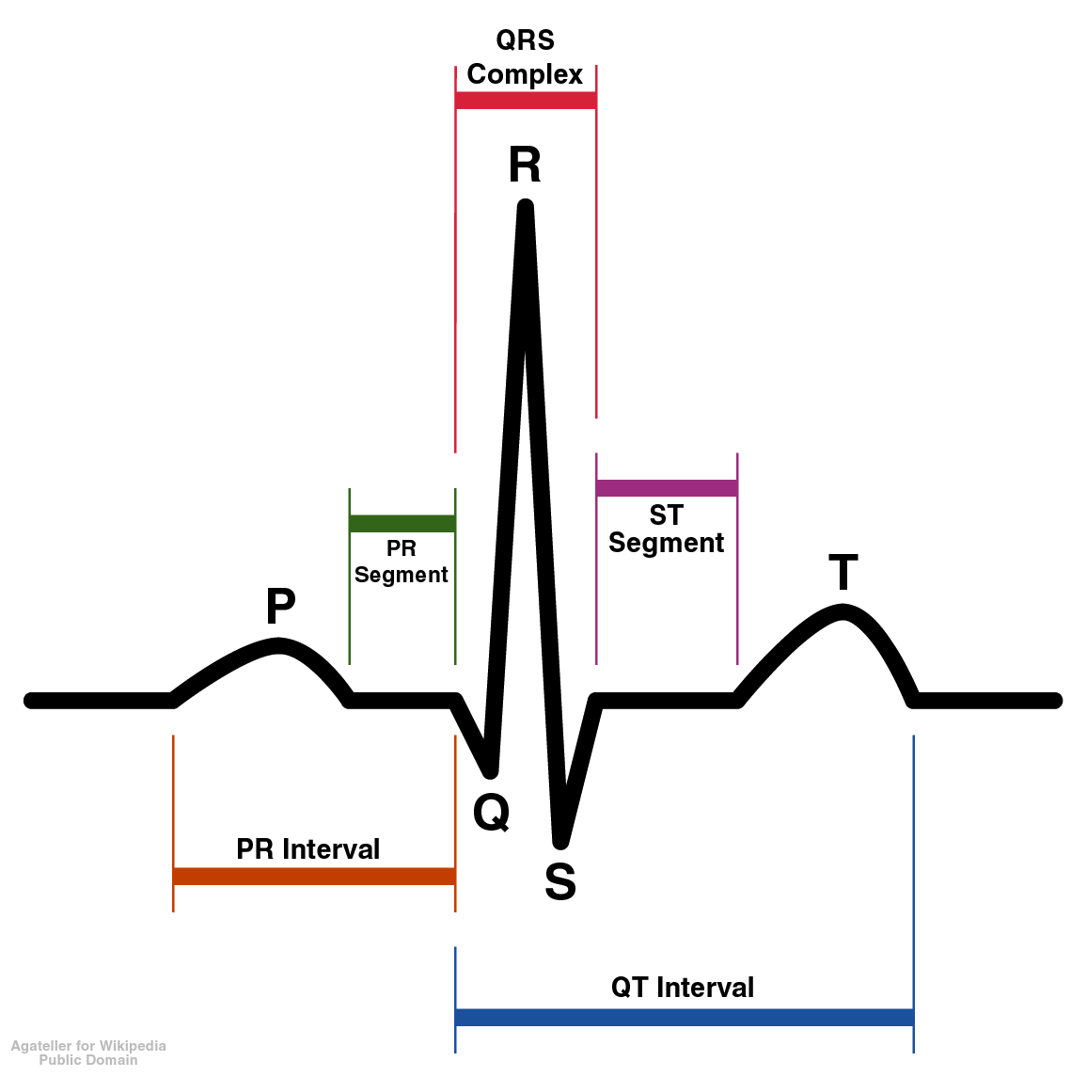
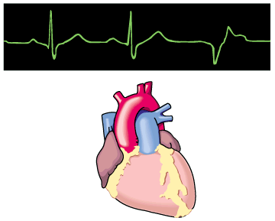
CARDIAC ARRHYTHMIA

Slide 2
CLINICAL INCIDENCE
80% cardiac arrhythmia → after M.I
50% cardiac arrhythmia → during anesthesia
25% cardiac arrhythmia → treatment with digitalis
Cardiac arrhythmia need to be treated when serious haemodynamic derangement expected
2

Slide 3
Available Methods of Treatment
Pharmacological
Drugs
Non-Pharmacological
Artificial Pace makers
Electro-cardioversion
Implanted cardioverter- defibrillators (ICDs)
Radiofrequency catheter ablation / cryoablation
Surgery

Slide 4
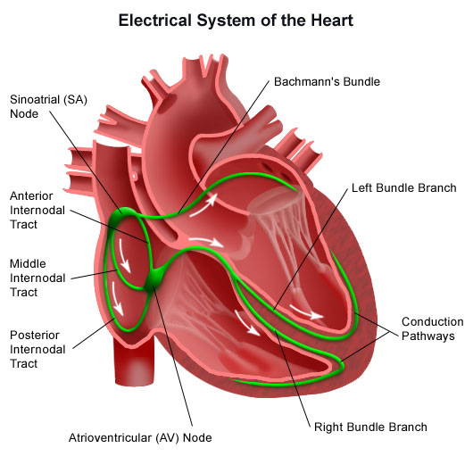
Normal Pathway Of Cardiac Impulse
Propagation

Slide 5
Electrophysiological Properties of Heart
Automaticity
Rhythmicity
Excitability
Conductivity
Contractility

Slide 6
Arrhythmia
consist of cardiac depolarization’s that deviate from normal electro physiological events (impulse) occurring in the cardiac tissues
Abnormalities regarding impulse can be:
Site origin of impulse formation
Rate of impulse formation
Regularity of impulse formation
Conduction of impulse

Slide 7
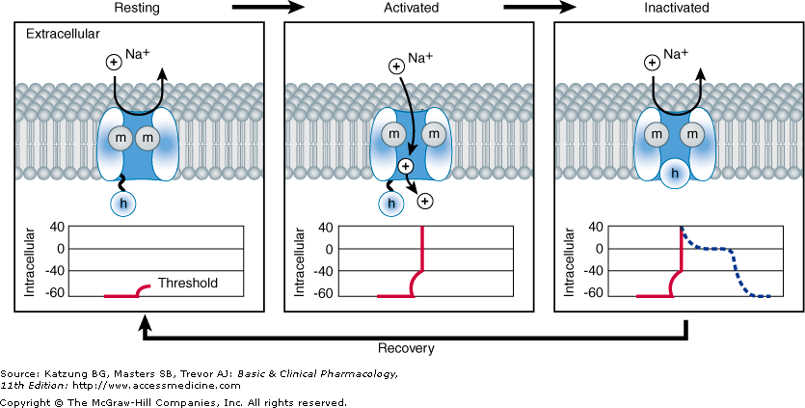
Sodium channels in different states

Slide 8
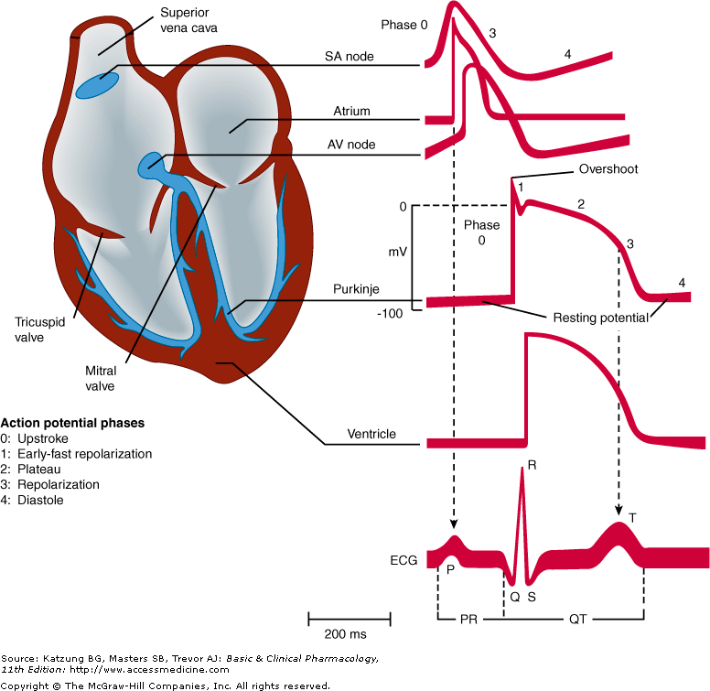
Action Potential Phases In Various Tissues Of Heart

Slide 9
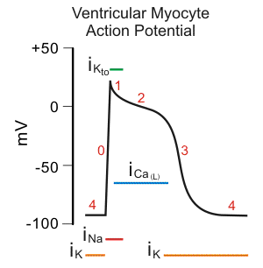
Action Potential in non Pacemaker Tissue
Phase 0 = rapid depolarization
Phase 1 = Initial depolarization
Phase 2 = Action potential plateau
Phase 3= Final depolarization

Slide 10
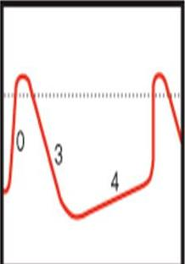
Action potential in pacemaker Tissues
0
1
2
3
4
Action potential in S.A node
Action potential in other conducting
tissues
0 Phase = Rapid depolarization
3 Phase = Plateau depolarization
4 Phase = Slow diastolic depolarization (Pace maker potential )

Slide 11
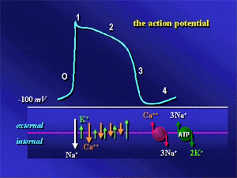
The Action potential
CVS
Pacemaker potential
11

Slide 12
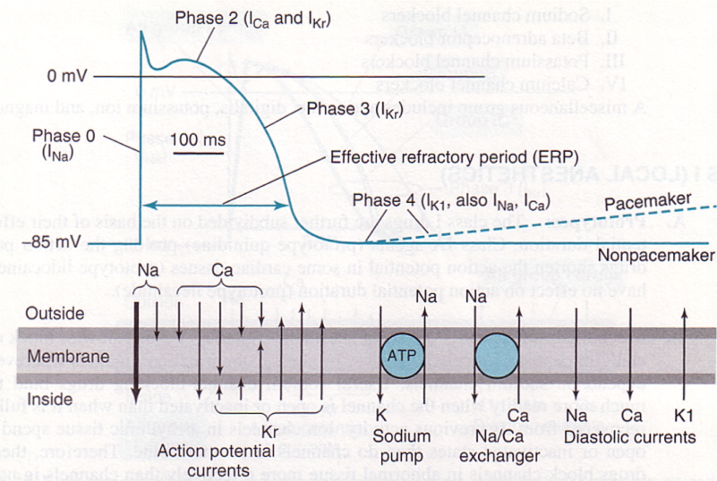
The Action potential (Repeated)

Slide 13
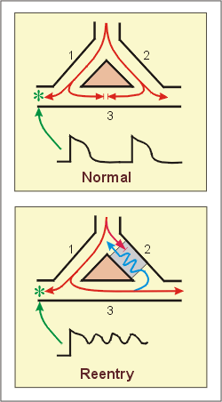
Pathway Of Normal & Re-entry Propagation Of Cardiac Impulse

Slide 14
Arrhythmia Precipitating Factors
Ischemia
Hypoxia
Acidosis or Alkalosis
Electrolyte abnormalities
↑ catecholamine levels (Pheochromocytoma)
↑ Autonomic influences
Certain foods ---- coffees, tea & Alcohol
Drug toxicity
Emotional stress →↑ Catecholamines
Hyperthyroidism ( ↑ T3 & T4 levels)

Slide 15
Various Mechanisms Underlying Arrhythmias
I. Disorders Of Impulse Formation
a. Normal pacemaker site
Sinus Tachyarrhythmia
Sinus Bradyarrhythmia
b. Abnormal Pacemaker sites
Atrial (EADs & DADs)
Ventricular
Causes:
Latent pace makers
Ischemic or infarcted areas produce ( current of injury)
Oscillatory after depolarization (digitalis & Catecholamines)

Slide 16
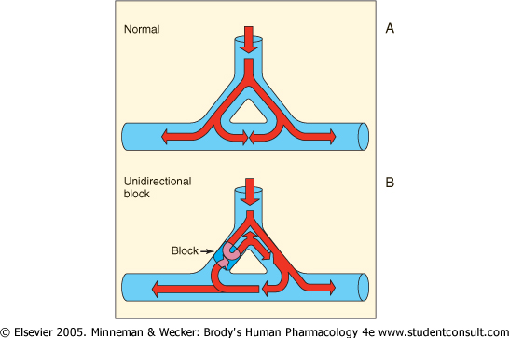
II. Disorders Of Impulse Conduction
Without re-entrant phenomenon
With re-entrant (circus) Phenomenon

Slide 17
Aims of Anti-arrhythmia Therapy
To prevent abnormal pacemaker (ectopic) activity
To modify conduction / refractoriness in re-entry
Major Mechanisms (Pharmacologic) currently available
Sodium channel blockade
Blockade of sympathetic autonomic effects on heart
Prolongation of the effective refractory Period (ERP)
Calcium channel blockade

Slide 18
Properties of Anti-arrhythmic Drugs in General
Anti-arrhythmic drugs (AD) ↓ automaticity of ectopic pacemaker more than that of SA node
A.D also ↓ conduction & excitability in depolarized tissue
A.D ↑ refractory period to a greater extent in depolarized tissue
This all is due to selective blockade of Na⁺ & Ca⁺⁺ in depolarized tissue
Antiarrhythmic drugs have high affinity for activated channels or inactivated channels (Phase 2) but low affinity for resting channel

Slide 19
As a Result of these Properties
A.Ds block electrical activity in fast tachycardia when more frequently channels activate & inactivate
(use dependant or state dependent type of drug action)
Normal cell will lose drug more quickly
In abnormal automaticity → drug acts on Phase 4 by blocking Na+ or Ca++ channels (↓ ratio of Na+ permeability to K+ permeability)

Slide 20
In re-entry arrhythmia (already depressed conduction), most drugs further slow conduction, as a result effective refractory period ↑ & extrasystole are unable to propagate.
Anti-arrhythmic drugs in high doses themselves become “pro-arrhythmic” because conduction slows down in normal cells also “DRUG INDUCED ARRHYTHMIA” then results.
Anti-arrhythmic drugs in therapeutic doses can also become “Pro-arrhythmic” during fast heart rates, acidosis, hyperkalemia & ischemia

Slide 21
ANTI ARRHYTHMIC DRUGS
ANTI-ARRHYTHMIC AGENTS

Slide 22
CLASSIFICATION

Slide 23
CLASS –I
Sodium Channel Blockers
Ia: lengthen the duration of A. potential
(Dissociate from channel with intermediate kinetics)
Quinidine
Procainamide
Disopyramide
Ib: Shorten the duration of A. potential
(Dissociate from channel with rapid kinetics)
Lignocaine
Mexiletine
Tocainide
Phenytoin

Slide 24
Ic: Minimally increase A. Potential
(Dissociate from channel with slow kinetics)
Flecainide
Propafenone
Ecainide
Morizicine

Slide 25
CLASS -II
Beta-Adrenergic Blocking Drugs ( sympatholytic action)
Propranolol
Oxypranolol
Sotalol
Pindolol
CLASS – III
Potassium Channel Blockers (Prolongation of A. Potential duration)
Amiodarone
Dronedarone
Vernakalent
Dofetilide
Ibutilide
Bretylium
Sotalol

Slide 26
CLASS – IV
Calcium channel blockers
(slows down conduction in SA & AV node, where upstroke is Ca⁺⁺ dependent)
Verapamil (phenyalkylamine)
Diltiazem ( Benzothiazepine)
MISC:
Adenosine
Mg⁺⁺ Magnesium
K⁺ Potassium
Digitalis

Slide 28
CARDIAC SODIUM CHANNELS

Slide 29
QUINIDINE
Sources
Cinchona bark
Dextroisomer of quinine
Weak anti-malarial analgesic & anti-pyretic
Weak N.M blocker & oxytotocic
Prominent action on cardiac tissue
MOA
Sodium channel blocker during Phase 0
More affinity for “activated” channels
Sodium channel blockade is more pronounced in depolarized than the normal tissue
Also blocks K+ efflux & ↓ depolarization & long term A.P duration.

Slide 30
EFFECTS ON CARDIAC TISSUE
Supresses Pace maker rate (normal & Ectopic)
Conduction & excitability of depolarized tissue ↓ more
Quinidine lengthens the “refractory period”
QT interval on ECG ↑
As “refractory period” ↑, it ↓ re-entry →↓ tachycardia
Myocardial contractility (inotropic) ↓
Anti-muscarinic effect can ↑ heart rate

Slide 31
EXTRA CARDIAC EFFECTS
Alpha – adrenergic blocking effect → V.D → ↓B.P → reflex tachycardia
Vagolytic action
Weak N. Muscular Blockade
TOXICITY
Sudden ↑ in heart rate
Quinidine syncope (due to T.Dose)
Sick sinus syndrome exacerbate
Hypotension
N.V.D
Cinchonism
Rashes, fever, hepatitis etc

Slide 32
THERAPEUTIC USES
Atrial fibrillation
Atrial flutter
Ventricular tachycardia
I/V treatment of malaria (?)
All types of arrhythmia (?)
PHARMACOKINETICS
Orally given rapid absorption
Parental Severe hypotension
80% plasma protein bound
t ½ 6 – 8 hours
Metabolized in liver
20% excreted unchanged in urine
Excretion in acidic urine

Slide 33
PROCAINAMIDE
Chemically it is an amide of local anesthetic “Procaine”
MOA
Similar to that of Quinidine except less antimuscarinic effects.
CARDIAC EFFECTS
Vagolytic action
Less effective in suppressing “Ectopic Pace maker”
But more effective in blocking channels in depolarized tissue.

Slide 34
Extracardiac effects
Ganglion blocking activity →↓vessel tone ↓ B.P
TOXICITY
Cardiac
Anti-muscarinic effects may occur
Depression of myocardium
New arrhythmia
Extracardiac
SLE like syndrome
Rash
Arthralgia
Arthritis
Pancarditis & pleuritis
N.V.D fever & hepatitis

Slide 35
PHARMACOKINETICS
Oral --- 75% bioavailability → NAPA is major metabolite → has class III activity…Torsade de pointes
I/M ---- also well absorbed.
I/V t ½ = 3 – 4 hours
Acetylated in liver & eliminated by kidneys.
CLINICAL USES
Atrial & ventricular arrhythmia
Drug of 2nd choice (After lignocaine) in sustained ventricular arrhythmia after lidocaine after AMI.

Slide 36
LIGNOCAINE (LIDOCAINE)
Local anesthetic
I/V anti-arrhythmic
Very effective against AMI associated arrhythmia
Digitalis induced arrhythmia
MOA
Blocks both activated & inactivated channels
In each action potential more unblocked channels are blocked
So potent suppresser of abnormal cardiac activity
Normal tissue is least affected

Slide 37
TOXICITY
Least cardiotoxic
Can depress myocardial contractility in already failing heart → ↓B.P
Parasthesia, tremors,
PHARMACOKINETICS
Orally inactive – due to ↑ 1st pass effect
given I/v
t ½ = 1 – 2 hours
150mg – 200mg bolus I/V
2-4 mg/min I/V infusion
Uses
Ventricular tachycardia
Ventricular fibrillation after cardioversion
Digitalis induced arrhythmia

Slide 38
MEXILETINE & TOCAINIDE
Resistant to quick degradation
Orally active
MOA
Like that of lignocaine
Used in chronic pains due diabetic neuropathy and nerve injury as well
FLACAINIDE
Potent Na+ K+ channel blocker
Used in normal hearts with supraventricular arrhythmia -----very effective in suppressing PVCs.
Does not prolong A.P & QT interval
No antimucarinic effects

Slide 39
PROPAFENONE
Na+ channel blocker
Structurally similar to Propranolol
Act like quinidine
Used for supraventricular arrhythmia
MORICIZINE
Na+ channel blocker
Anti-arrhythmic phenothiazine
For ventricular arrhythmia
Can exacerbate arrhythmia

Slide 40
CLASS – II β – BLOCKING DRUGS
MOA
Beta- blocking action
Membrane stabilizing effect
Uses
Prevent ventricular ectopic aft AMI
Esmolol (short acting) beta blocker.
ADVERSE EFFECTS OF b-BLOCKERS
Hypotension
Bradycardia
heart block
Anti-arrhythmia

Slide 41
CLASS – III (By prolonging A.P R. PERIOD)
Prolong A.P by blocking K⁺ channels or
ENHANCE Inward current (Na⁺ & Ca⁺)
AMIODARONE
Na⁺ channel blocker in inactivated state
K⁺ channel blocked & ↑ A.P duration effective against tachycardia
Weak Ca⁺⁺ channel blocker
Weak b-blocker
Powerful inhibitor of abnormal automaticity
↑ QT interval but rarely cause T.D pointes

Slide 42
MOA
Slow sinus rate & A.V conduction
Markedly ↑ QT interval & QRS duration
↑ atrial, anti-ventricular nodal and ventricular refractory
Has anti-angina effects( may be due to a, b & Ca++ channel blocking activity in vascular smooth muscle)
Cause: peripheral vasodilatation
Pharmacokinetics
Long t ½ (13 – 103 days)

Slide 43
ADVERSE EFFECTS
Cardiac
Bradycardia or hear block
Cardiac failure
Ext. Cardiac
Pulmonary fibrosis
Deposition in cornea
Photodermatitis
Parasthesias
Tremors
Ataxia
Headache
Hypo & hyperthsoidusim
Constipation & gamdice

Slide 44
DRUG INTERACTIONS
↓Clearance of
Warfarin
Procarramide
Flacainide
Quinidine
Theophylluin
Short term
I/V Therapy lead to bradycardia & hypotension
PORETYLIUM
Winter fever with neural release of catcho
Previously used as “antihypertensive”
Now used as “anti-arrhythmic”

Slide 45
MOA
↑Duration of A.P & refractory period in ventricular cells
Effect is more prominent in ischemic cells
Sympathoplegic action → hypotension
USES
To prevent ventricular fibrillation, in emergency after cardiversion when lignocain fails
DRUG INTERACTIONS & ADVERSE EFFECTS
Postural hypotension
Tricyclic anti-depressant block its antihypertensive effect
Nausea & vomiting after I/V admin

Slide 46
SOTALOL
Now selective b-blocker
Depolarization , ↑ A.P duration
Used both in ventricular & suprraventricular arrhythmia
ADVERSE EFFECTS
In higher doses more risk of T.D pointes in renal failure
Uses
Re-entrant tachycardia
ventricular rate in A. Fib & flutter

Slide 47
DILTHIAZEM & BEPRIDIL
Cardiac effects are similar to those of varapamil
Used for supraventricular arrhythmia
BEPRIDIL
↑A.P duration & QT
But not used in ventricular arrhythmia
Used in “refractory angina”
ADENOSINE
K⁺ conduction marked
Inhibition of AMP induced Ca⁺⁺ influx hyperpoterisatin
↓
blocks A.V nodal
conduction
MAGNESIUM
POTASSIUM

Slide 48
IBUTILIDE
↓Depolarization & ↑ A.P duration
↓ K⁺ currents & ↑ Na⁺ inward currents
Orally inactive (↑ 1st pass)
I/V route → sinus arrhythmia
DOFETILIDE
Potent K⁺ channel blocker
Orally active
Effective in maintain sinus rhythm in A. Fib or A. Flutter, after cardioversion
ADVERSE EFFECT
Both of then may cause T.D pointer

Slide 49
CLASS IV CALCIUM CHANNEL BLOCKERS
VERAPAMIL
Blocks both activated & inactivated channels
A.V nodal conduction
S.A nodal rate
Suppress both EADs & DADs
Peripheral →V.D B.P
ADVERSE EFFECTS
Constipation, lassitude, peripheral oedema
Should not given in vent. Tachycardia otherwise ventricular fobrillative start

Slide 50
DYSOPYRAMIDE
Electrophysiological effects are similar to those of quinidine
Atropine like effects are more prominent
TOXICITY
Cardiac depression precipitate heart failure
Sudden tachycardia
Urinary reduction glaucoma, blurred vision
Constipation & dry mouth
USES
paroxyrwal atrial tachycardia
Ventricular arrhythmia
WPW (Wolff – Parkinson-white) syndrome

Slide 51
LIGNOCAINE
I/V route only
Low toxicity
High efficacy against ventricular arrhythmia associated with acute myocardial infarction
CARDIAC EFFECTS
It exclusively blocks Na+ channels in activated state & in inactivated state
Blocks channels more in depolarized tissue
As a result, after AMI suppresses electrical activity of depolarized tissue more than normal tissue
Less effective against arrhythmia (A. Fib & A. Flutter)

Slide 52
Toxicity
Least toxic
Exacerbates ventricular arrhythmia in 10%
Larger dose B.P
Convulsion, tremor, parasthesias
Slurred speech, light headedness
Pharmacokinetics
Undergoes extensive 1st pass metab.
t ½ 1-2hrs
150-200mg as a bolus over 15min as loading dose d. Then 2-4 mg/min (2 – 4μg/ml)

