Slide 1
IN THE NAME OF ALLAH THE MOST MERCIFUL
THE MOST BENEFICENT

Slide 2
By
Dr Romana

Slide 3
Learning Objectives:
Define toxicology, forensic toxicology, poisons,toxinology
Action& Fate of poisons.
Collection of samples.
Preservatives.
Ideal suicidal &homicidal poisons
Fatal dose and fatal period

Slide 4
Poison
…..capable of acting deleteriously
on the human body,when inhaled,
ingested,etc.
“almost anything is a poison.”
In law, the difference b/w medicine
and poison is the intent with which
it is given.

Slide 5
Toxicology
science which deals with poisons
source,
properties,
mode of action,
symptoms,
lethal dose,
treatment,
method of detection/estimation & autopsy findings.

Slide 6
Forensic toxicology
…..medical & legal aspect of
harmful effects of poisons on
human body.

Slide 7
Toxinology:
science which deals with toxins produced by plants, animals, bacteria and fungi which are harmful to man.

Slide 8
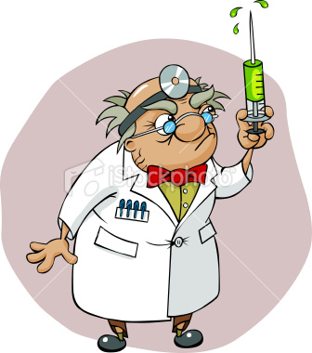
Routes Of Administration
Enteral route: a)rectum b) mouth
Parenteral route: by injection
intradermal / subcutaneous
intramuscular
intravenous
intra arterial
intra peritoneal
intra thecal
bone marrow

Slide 9
Natural orifices :
rectum
vagina
urethra
nose
eyes
By sublingual route:
By inhalation: air passages.
By external application: wounds,
unbroken skin.

Slide 10
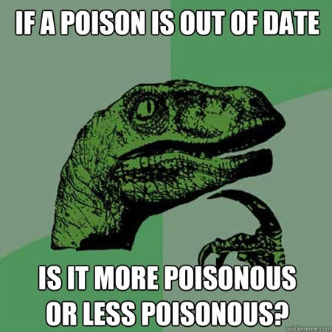

Slide 11
ACTIONS OF POISONS
1.Local
2.General
3.Local &Remote(combined)
4.Remote
Remote:specific:strychnine,digitalis
non-specific:corrosive.

Slide 12
General : arsenic , mercury, lead,
barbiturates and
paraquet.(when more ---
one system is involved)
Combined:oxalic &carbolic acid.
Local: strong minerals &acids,
irritants.
.

Slide 13
FATE OF POISONS
In large amount poison is vomited or passed out in stools ( diarrhea) .
If absorbed
excreted unchanged
partly or completely metabolized
converted to another active compound prior to metabolism (biotransformation)
may be detected in original form

Slide 14
may be detected in intermediate product in tissues e.g liver & bile .
may be detected in excreta e.g urine.
may be present in epidermis,nails, hair, e.g arsenic.
bony skeleton may hold poisons like arsenic ,lead, radioactive isotopes.

Slide 15
COLLECTION OF SPECIMENS
FROM LIVING:
Blood( 5-10cc) ~ ~ ~ sodium fluoride
Urine(30cc) ~ ~ ~ thymol crystals
Stools( 15-30gm) ~ ~ ~ rectified spirit
Stomach wash(30-50cc) ~ ~ ~ first washing without antidote \preservative
Nail\ hair ~ ~ ~ no preservative

Slide 16
FROM DEAD:
Hair 10gm
Brain 500gm
Liver 500gm
Kidney one whole
Lung one whole
Stomach whole with contents

Slide 17
Blood 50-100cc
Urine all available
Spleen whole
Gall bladder whole
Small intestine initial two feet with contents
Bone marrow 2-3gm
Bone 3-5cm shaft of long

Slide 18
PRESERVATIVES
Rectified spirit
Saturated soln of sodium chloride 33%
Thymol crystals
Sodium fluoride

Slide 19
A suicidal poison of Choice.
Cheap,
easily available,
Pleasant taste, no bad smell,
lethal dose (small)
lethal period (short)
Painless(opium,
hydrocynic acid)

Slide 20
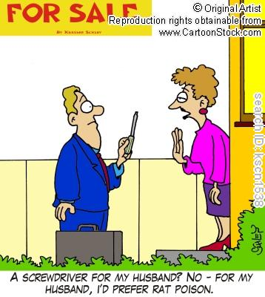

Slide 22
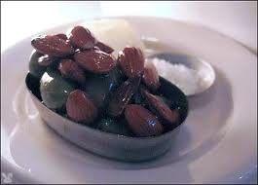

Slide 23
An Ideal Homicidal poison
Cheap,
easily available,
colorless,
Odorless,
tasteless,
resemble some natural disease,
Lethal dose (small)
Lethal period (long)
No antidote
Not detected autopsy/lab
(arsenic,aconite)

Slide 24
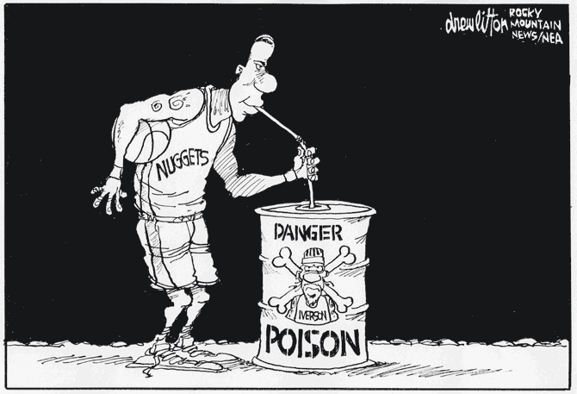

Slide 25
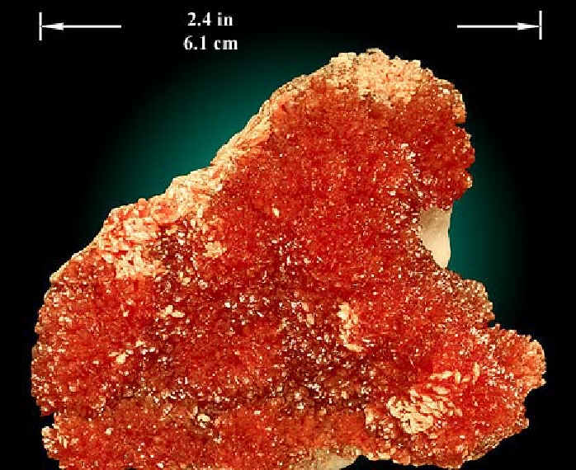

Slide 26
Fatal Dose:
“Dose which kills”
Fatal period:
“period b/w ingestion of
poison and death”

