Slide 1
General Toxicology 3
By
Dr Romana

Slide 2
Learning Objectives:
General principles of treatment
of Acute Poisoning

Slide 3
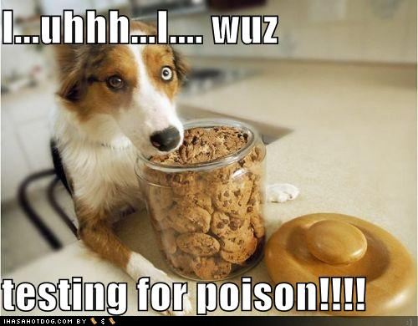

Slide 4
General Principles of Treatment of
Acute Poisoning
A. Removal of unabsorbed poison
from body.
B. Antidotes.
C. Elimination of absorbed poison.
D. Treatment of general symptoms.
E. Maintenance of pt’s general cond.

Slide 5
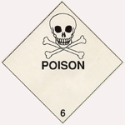
A.Removal of unabsorbed poison
Inhaled poison
Injected poison
Contact poison
Ingested poison
vomiting
stomach wash
Vomiting:
tickling fauces
emetics

Slide 6
Emetics:
Warm water
Common salt in water
Mustard powder in water
Ipecac (1 to 2gms) or Ipecac syp(30ml)
Apomorphine,6mg subcutaneous inj
followed by 5-10mg im/iv naloxone
hydrochloride to counteract its
narcotic effect.

Slide 7
B.Antidotes:
“Antidotes counteracts the action of a
poison by either neutralizing it or
making it insoluble or inert”
Types of antidotes:
1.Mechanical or Physical antidote
2.Chemical antidote
3.Physiological or pharmacological
4.Receptor antidote

Slide 8
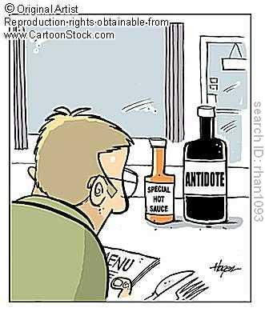

Slide 9
1. Mechanical
“They impede the absorption of poison.
e.g demulcents,bulky food and activated
charcoal”.
Demulcents : fats, oils, milk, egg, albumin
Bulky food: banana.
Activated charcoal.
it is prepared by burning wood,
coconut shell,bone etc.followed
by treatment with steam,CO2.

Slide 10
2.Chemical
“act either by direct chemical action /
oxidising the poison to form a non toxic
or an insoluble compound.”
dilute alkalis will neutralise acids
dilute acids will neutralise alkalis
potassium permanganate is effective against all oxidisable poisons eg alkaloids.

Slide 11
3.Physiological or Pharmacological:
“ These subs produce effects opposite
to that of the poison.”
Example naloxone for morphine, atropine for pilocarpine.
diazepam for strychnine.
4.Receptor :
“It competes with the poison at the
same receptor site and reduces un-
desired effects.”
Example: naloxone

Slide 12
Chelating Agents:
“These are subs which produce a firm non
ionized cyclic complex(chelate) with cations.”
chelation means a claw.
these include: BAL,EDTA,Penicillamine,
& Desferrioxamine.
BAL :(dimercaprol) used in the treatment of
heavy metal poisoning.
It is contraindicated if liver is extensively damaged.
BAL stands for British anti- lewisite

Slide 13
EDTA :(ethylene diamine tetra-acetic
acid).
It is used in lead,mercury, & copper
poisoning.Contraindicated in renal
damage.
Penicillamine:(cuprimine).can be given
orally & is much less toxic than
EDTA. It is treatment of choice in
Cu,lead, Hg poisoning.
Desferrioxamine: chelates iron.

Slide 14
Universal Antidote:
“ It is used in those cases where the
nature of the ingested poison is un-
known or where it is suspected that a
combination of two or more poisons
has been taken.”
Tannic acid 1part ppt.alkaloids,metals
&glycosides
Charcoal 2parts adsorbs alkaloid
Mag.oxide 1parts neutralizes acid

Slide 15
C.Elimination of Absorbed poisons:
increase excretion in urine
more fluids are given
peritoneal dialysis
hemodialysis
hemoperfusion
exchange transfusion
whole bowel irrigation

Slide 16
D. Treatment of general symptoms:
pain
oxygen
cardiac stimulants
dehydration
E. Maintenance of patients general condition
warm, comfortable,URTI,psychiatrist,
antibiotics,physiotherapy.
.

Slide 17
Thank you

