Slide 1
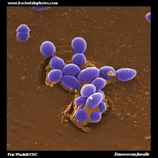
Gram-Positive Cocci

Slide 2
There are two medically important genera of gram-positive cocci:
Staphylococcus
Streptococcus

Slide 3
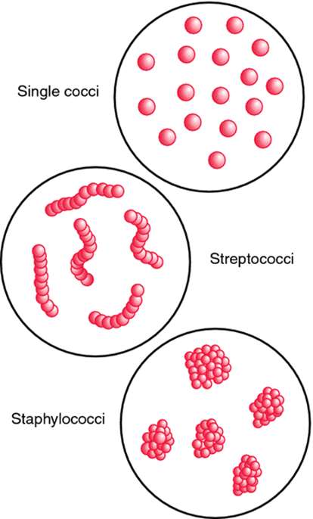
Staphylococci and streptococci are nonmotile and do not form spores
They are distinguished by two main criteria:
Microscopically, staphylococci appear in grapelike clusters, whereas streptococci are in chains
Biochemically, staphylococci produce catalase (i.e., they degrade hydrogen peroxide), whereas streptococci do not

Slide 4
Staphylococcus

Slide 5
Diseases
Abscesses
Various pyogenic infections (e.g., Endocarditis, septic arthritis, and osteomyelitis)
Food poisoning
Scalded skin syndrome
Toxic shock syndrome
Hospital-acquired pneumonia
Septicemia
Surgical-wound infections
Skin infections, such as folliculitis, cellulitis, and impetigo
Bacterial conjunctivitis

Slide 6
Staphylococcus epidermidis - endocarditis and prosthetic joint infections
Staphylococcus saprophyticus - urinary tract infections
Kawasaki syndrome caused by certain strains of Sta. aureus

Slide 7
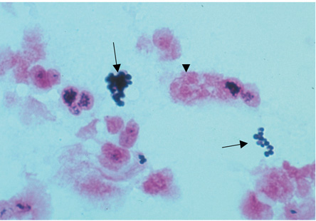
Important Properties
Spherical
Gram-positive cocci
Arranged in irregular grapelike clusters
Staphylococcus aureus—Gram stain. Arrows point to two "grapelike" clusters of gram-positive cocci. Arrowhead points to neutrophil with pink segmented nuclei

Slide 8
All staphylococci produce catalase, whereas no streptococci do
(catalase degrades H₂O₂ into O₂ and H₂O)
Catalase is an important virulence factor because H₂O₂ is microbicidal and its degradation limits the ability of neutrophils to kill

Slide 9
Three species of staphylococci are human pathogens:
Sta. aureus -the most important
Sta. epidermidis
Sta. saprophyticus

Slide 10
Staphylococci of Medical Importance
Species | Coagulase Production | Typical Hemolysis | Important Features | Typical Disease
Sta. aureus | + | Beta | Protein A on surface | Abscess, food poisoning, toxic shock syndrome
Sta. epidermidis | - | None | Sensitive to novobiocin | Infection of prosthetic heart valves and hips; common member of skin flora
Sta. saprophyticus | - | None | Resistant to novobiocin | Urinary tract infection

Slide 11
coagulase production
Coagulase is an enzyme
Causes plasma to clot by activating prothrombin to form thrombin
Thrombin then catalyzes the activation of fibrinogen to form the fibrin clot
Sta. epidermidis and Sta. saprophyticus are often referred to as coagulase-negative staphylococci

Slide 12
Coagulase test—Upper tube inoculated with Staphylococcus aureus; lower tube inoculated with Staphylococcus epidermidis.
Arrow points to clotted plasma formed by coagulase produced by Sta. aureus

Slide 13
STAPHYLOXANTHIN
A carotenoid pigment produced by staph. Which imparts a golden color to its colonies
This pigment enhances the pathogenicity of the organism by inactivating the microbicidal effect of superoxides and other reactive oxygen species within neutrophils
Sta. epidermidis does not synthesize this pigment and produces white colonies

Slide 14
The virulence of Sta. epidermidis is significantly less than that of Sta. aureus
Two other characteristics further distinguish these species, namely,
ferments mannitol
hemolyzes red blood cells

Slide 15
methicillin-resistant Sta. aureus (MRSA)
More than 90% of Sta. aureus strains contain plasmids that encode -lactamase
Enzyme that degrades many, but not all, penicillins
Some strains of Sta. aureus are resistant to the -lactamase–resistant penicillins, such as methicillin and nafcillin, by virtue of changes in the penicillin-binding protein (PBP) in their cell membrane
Genes on the bacterial chromosome called mecA genes encode these altered PBPs
Known as methicillin-resistant Sta. aureus (MRSA) or nafcillin-resistant Sta. aureus (NRSA)
More than 50% of Sta. aureus strains are MRSA isolated from hospital patients in the United States
"USA300" strain most common strain in USA

Slide 16
(VISA) & (VRSA)
Strains of Sta. aureus with
intermediate resistance to vancomycin (VISA)
full resistance to vancomycin (VRSA)
The cassette of genes that encodes vancomycin resistance in Sta. aureus is the same as the cassette that provides vancomycin resistance in enterococci
These genes are located in a transposon on a plasmid and encode the enzymes that substitute D-lactate for D-alanine in the peptidoglycan

Slide 17
cell wall components and antigens
Protein A
Major protein in the cell wall
An important virulence factor because it binds to the Fc portion of IgG at the complement-binding site, preventing the activation of complement-no c3b is produced- opsonization and phagocytosis of the organisms are greatly reduced
Coagulase-negative staphylococci do not produce protein A
Teichoic acids
Mediate adherence of the staphylococci to mucosal cells
Play a role in the induction of septic shock

Slide 18
Polysaccharide capsule
An important virulence factor
There are 11 serotypes based on the antigenicity of the capsular polysaccharide, but types 5 and 8 cause 85% of infections
Some strains of sta. aureus are coated with a small amount of polysaccharide capsule called a microcapsule
The peptidoglycan of sta. aureus has endotoxin-like properties, not possess endotoxin

Slide 19
Transmission
Humans are the reservoir for staphylococci
The nose is the main site of colonization of Sta. aureus and approximately 30% of people are colonized at any one time
People who are chronic carriers of Sta. aureus in their nose have an increased risk of skin infections caused by Sta. aureus
The skin, especially of hospital personnel and patients, is also a common site of Sta. aureus colonization. Hand contact is an important mode of transmission and handwashing decreases transmission

Slide 20
Sta. aureus is also found in the vagina of approximately 5% of women- toxic shock syndrome
Additional sources human lesions and fomites such as towels and clothing contaminated by these lesions
Heavily contaminated environment (e.g., family members with boils) and a compromised immune system
Sta. epidermidis -on the human skin and can enter the blood stream at the site of intravenous catheters that penetrate through the skin
Sta. saprophyticus is found primarily on the mucosa of the genital tract in young women -urinary tract infections

Slide 21
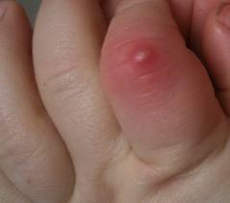
Pathogenesis
Sta. aureus causes disease
by producing toxins
by inducing pyogenic inflammation
Abscess - typical lesion of Sta. aureus infection
Abscesses undergo central necrosis and usually drain to the outside (e.g., furuncles and boils), but organisms may disseminate via the bloodstream as well
Foreign bodies, such as sutures and intravenous catheters, are important predisposing factors

Slide 22
The three clinically important exotoxins are
Enterotoxin
Toxic shock syndrome toxin
Exfoliatin

Slide 23
Enterotoxin
Six immunologic types of enterotoxin, types A–F
Causes food poisoning ,characterized by prominent vomiting and watery, nonbloody diarrhea
Acts as a superantigen within the gastrointestinal tract to stimulate the release of large amounts of interleukin-1 (IL-1) and interleukin-2 (IL-2) from macrophages and helper T cells, respectively
Vomiting appears to be caused by cytokines released from the lymphoid cells, which stimulate the enteric nervous system to activate the vomiting center in the brain
Heat-resistant -not inactivated by brief cooking
Resistant to stomach acid and to enzymes in the stomach and jejunum

Slide 24
Toxic shock syndrome toxin (TSST)
Causes toxic shock, especially in tampon-using menstruating women or in individuals with wound infections
Toxic shock also occurs in patients with nasal packing used to stop bleeding from the nose
TSST is produced locally by Sta. aureus in the vagina, nose, or other infected site
The toxin enters the bloodstream, causing a toxemia
Blood cultures typically do not grow Sta. aureus
TSST is a superantigen and causes toxic shock by stimulating the release of large amounts of IL-1, IL-2, and tumor necrosis factor (TNF)

Slide 25
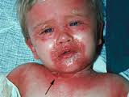
Exfoliatin
Causes "scalded skin" syndrome in young children
"Epidermolytic"
Acts as a protease that cleaves desmoglein in desmosomes, leading to the separation of the epidermis at the granular cell layer

Slide 26
Leukocidins
Several toxins can kill leukocytes and cause necrosis of tissues
Alpha toxin- causes marked necrosis of the skin and hemolysis. It causes formation of holes in the cell membrane and the consequent loss of low-molecular-weight substances from the damaged cell
P-V leukocidin, a second important toxin, is a pore-forming toxin that kills cells, especially white blood cells, by damaging cell membranes. A severe necrotizing pneumonia is also caused by strains of Sta. aureus that produce P-V leukocidin. Approximately 2% of clinical isolates of Sta. aureus produce P-V leukocidin

Slide 27
enzymes
Coagulase- by clotting plasma, serves to wall off the infected site, thereby retarding the migration of neutrophils into the site
Fibrinolysin
Hyaluro-nidase
Proteases
Nucleases
Lipases
Staphylokinase - fibrinolysin that can lyse thrombi

Slide 28
Staphylococcus epidermidis & Staphylococcus saprophyticus
Do not produce exotoxins
Do not cause food poisoning or toxic shock syndrome
Cause pyogenic infections
For example, sta. epidermidis is a prominent cause of pyogenic infections on prosthetic implants such as heart valves and hip joints

Slide 29
Clinical Findings
The important clinical manifestations caused by Sta. aureus can be divided into two groups:
pyogenic
toxin-mediated

Slide 30
Pyogenic Diseases
Skin infections include impetigo, furuncles, carbuncles, paronychia, cellulitis, folliculitis, hydradenitis suppurativa, conjunctivitis, eyelid infections (blepharitis and hordeolum), and postpartum breast infections (mastitis)
Lymphangitis can occur, especially on the forearm associated with an infection on the hand
Severe necrotizing skin and soft tissue infections
Septicemia (sepsis) can originate from any localized lesion, especially wound infection, or as a result of intravenous drug abuse
Endocarditis may occur on normal or prosthetic heart valves

Slide 31
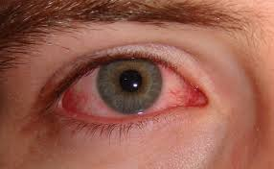
Osteomyelitis and arthritis
Postsurgical wound infections
Pneumonia can occur in postoperative patients or following viral respiratory infection, especially influenza. Staphylococcal pneumonia often leads to empyema or lung abscess
Conjunctivitis -unilateral burning eye pain, hyperemia of the conjunctiva, and a purulent discharge
Abscesses can occur in any organ when the organism circulates in the bloodstream (bacteremia)

Slide 32
Toxin-Mediated Diseases
Food poisoning (gastroenteritis) -vomiting is typically more prominent than diarrhea
Toxic shock syndrome is characterized by fever; hypotension; a diffuse, macular, sunburn-like rash
Scalded-skin syndrome -fever, large bullae, and an erythematous macular rash

Slide 33
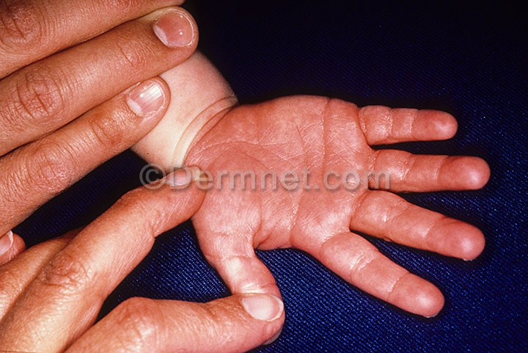
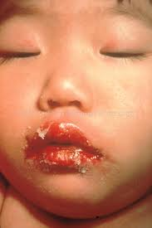
Kawasaki Syndrome
Unknown etiology resemble toxic shock syndrome caused by the superantigens of sta. aureus (and str. pyogenes)
KS is a vasculitis involving small and medium-size arteries, especially the coronary arteries
Characterized by a high fever of at least 5 days' duration; bilateral nonpurulent conjunctivitis; lesions of the lips and oral mucosa (such as strawberry tongue, edema of the lips, and erythema of the oropharynx); a diffuse erythematous, maculopapular rash; erythema and edema of the hands and feet that often ends with desquamation; and cervical lymphadenopathy

Slide 34
Kawasaki Syndrome
Characteristic clinical finding of KS is cardiac invol-vement, especially myocarditis, arrhythmias, and regurgitation involving the mitral or aortic valves. The main cause of morbidity and mortality in KS is aneurysm of the coronary arteries
It is a disease of children younger than 5 years of age, often occurring in mini outbreaks
No definitive diagnostic laboratory test for KS
Effective therapy - high-dose immune globulins (IVIG)

Slide 35
Sta. epidermidis
Part of the normal human flora on the skin and mucous membranes but can enter the bloodstream (bacteremia) and cause metastatic infections, especially at the site of implants
Commonly infects intravenous catheters and prosthetic implants, e.g., Prosthetic heart valves (endocarditis), vascular grafts, and prosthetic joints (arthritis or osteomyelitis)
Major cause of sepsis in neonates and of peritonitis in patients with renal failure who are undergoing peritoneal dialysis through an indwelling catheter
Most common bacterium to cause cerebrospinal fluid shunt infections
Strains of sta. epidermidis that produce a glycocalyx are more likely to adhere to prosthetic implant materials

Slide 36
Sta. saprophyticus
Causes urinary tract infections
Second to Escherichia coli as a cause of community-acquired urinary tract infections in young women

Slide 37
Laboratory Diagnosis
Smears from staphylococcal lesions reveal gram-positive cocci in grapelike clusters
Cultures of Sta. aureus typically yield golden-yellow colonies that are usually -hemolytic
Sta. aureus is coagulase-positive
Mannitol agar is a commonly used screening device for Sta. aureus
Cultures of coagulase-negative staphylococci typically yield white colonies that are nonhemolytic
The two coagulase-negative staphylococci are distinguished by their reaction to the antibiotic novobiocin: Sta. epidermidis is sensitive, whereas Sta. saprophyticus is resistant
There are no serologic or skin tests used for the diagnosis of any acute staphylococcal infection

Slide 38
Treatment
90% or more of Sta. aureus strains are resistant to penicillin G - nafcillin or cloxacillin, some cepha-losporins, or vancomycin
Treatment with a combination of a -lactamase–sensitive penicillin, e.g., amoxicillin, and a -lactamase inhibitor, e.g., clavulanic acid
MRSA or NRSA,- vancomycin, to which gentamicin is sometimes added. Daptomycin is also useful. Trimethoprim-sulfamethoxazole or clindamycin can be used .Note that these MRSA strains are resistant to all -lactam drugs, including both penicillins and cephalosporins
Strains of Sta. aureus with intermediate resistance to vancomycin (VISA strains) and with complete resistance to vancomycin (VRSA strains)- Quinupristin-dalfopristin (Synercid)

Slide 39
Mupirocin is very effective as a topical antibiotic in skin infections caused by Sta. aureus
Sta. epidermidis -drug of choice is vancomycin, to which either rifampin or an aminoglycoside can be added. Removal of the catheter or other device is often necessary
Sta. saprophyticus urinary tract infections can be treated with a quinolone, such as norfloxacin, or with trimethoprim-sulfamethoxazole

Slide 40
Prevention
Cleanliness
Frequent handwashing
Aseptic management of lesions

