Slide 1
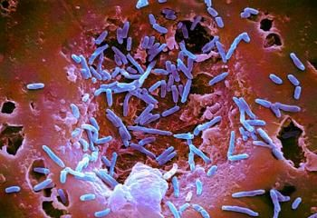
Gram-Positive Rods

Slide 2
Introduction
There are four medically important genera of gram-positive rods:
Bacillus
Clostridium
Corynebacterium
Listeria

Slide 3
Gram-Positive Rods of Medical Importance
Genus | Anaerobic Growth | Spore Formation | Exotoxins Important in Pathogenesis
Bacillus | - | + | +
Clostridium | + | + | +
Corynaebacterium | - | - | +
Listeria | - | - | -

Slide 4
These gram-positive rods can also be distinguished based on their appearance on Gram stain
Bacillus and Clostridium species are longer and more deeply staining than Corynebacterium and Listeria species
Corynebacterium species are club-shaped, i.e., they are thinner on one end than the other
Corynebacterium and Listeria species characteristically appear as V- or L-shaped rods

Slide 5
Non–Spore-Forming Gram-Positive Rods
There are two important pathogens in this group:
Corynebacterium diphtheriae
Listeria monocytogenes

Slide 6
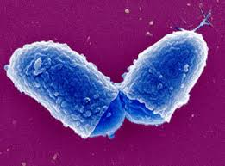
Corynebacterium diphtheriae

Slide 7
Disease
Diphtheria
Other Corynebacterium species (diphtheroids) - opportunistic infections

Slide 8
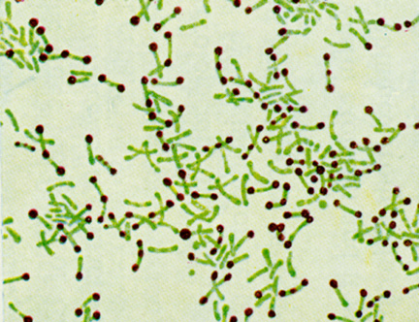
Important Properties
Gram-positive rods that appear club-shaped (wider at one end) and are arranged in palisades or in V- or l-shaped formations
The rods have a beaded appearance
The beads consist of granules of highly polymerized polyphosphate—a storage mechanism for high-energy phosphate bonds
The granules stain metachromatically, i.e., a dye that stains the rest of the cell blue will stain the granules red

Slide 9
Corynebacterium diphtheriae—Gram stain. Arrow points to a "club-shaped" gram-positive rod. Arrowhead points to typical V- or L-shaped corynebacteria

Slide 10
Transmission
Humans are the only natural host of Cor. diphtheriae
Both toxigenic and nontoxigenic organisms reside in the upper respiratory tract and are transmitted by airborne droplets
The organism can also infect the skin at the site of a preexisting skin lesion
This occurs primarily in the tropics but can occur worldwide in indigent persons with poor skin hygiene

Slide 11
Pathogenesis
Exotoxin production Diphtheria toxin
inhibits protein synthesis by ADP-ribosylation of elongation factor 2 (EF-2)
The toxin affects all eukaryotic cells regardless of tissue type
The toxin is a single polypeptide with two functional domains
One domain mediates binding of the toxin to glycoprotein receptors on the cell membrane
The other domain possesses enzymatic activity that cleaves nicotinamide from nicotinamide adenine dinucleotide (NAD) and transfers the remaining ADP-ribose to EF-2, thereby inactivating it

Slide 13
The host response to Cor. diphtheriae consists of
A local inflammation in the throat, with a fibrinous exudate that forms the tough, adherent, gray pseudomembrane
Antibody that can neutralize exotoxin activity by blocking the interaction of fragment B with the receptors, thereby preventing entry into the cell

Slide 14
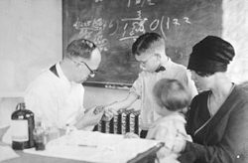
Schick's test
The test is performed by intradermal injection of 0.1 mL of purified standardized toxin
If the patient has no antitoxin, the toxin will cause inflammation at the site 4 to 7 days later
If no inflammation occurs, antitoxin is present and the patient is immune

Slide 15
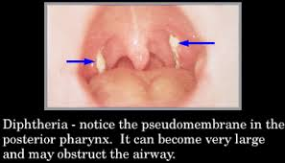
Clinical Findings
The thick, gray, adherent pseudomembrane over the tonsils and throat
Nonspecific: fever, sore throat, and cervical adenopathy
Cutaneous diphtheria causes ulcerating skin lesions covered by a gray membrane. These lesions are often indolent and often do not invade surrounding tissue
Systemic symptoms rarely occur

Slide 16
There are three prominent complications:
Extension of the membrane into the larynx and trachea, causing airway obstruction
Myocarditis accompanied by arrhythmias and circulatory collapse
Nerve weakness or paralysis, especially of the cranial nerves

Slide 17
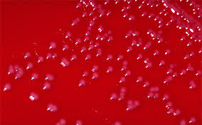
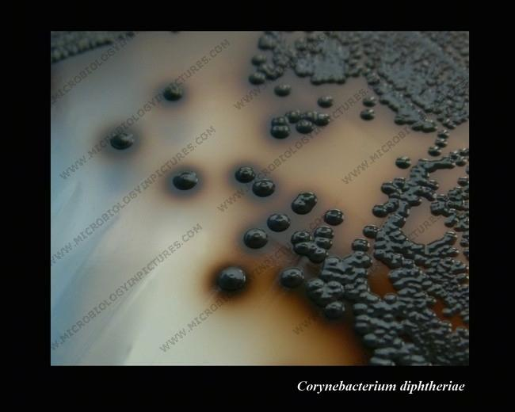
Laboratory Diagnosis
Smears of the throat swab should be stained with both Gram stain and methylene blue. The methylene blue stain is excellent for revealing the typical meta-chromatic granules
A throat swab should be cultured on Löffler's medium, a tellurite plate, and a blood agar plate
The typical gray-black color of tellurium in the colony is a telltale diagnostic criterion

Slide 18
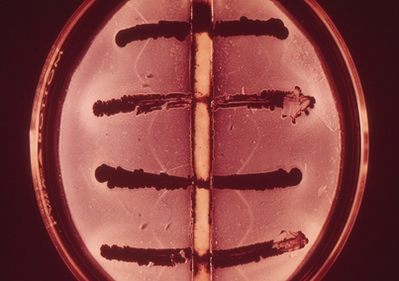
An antibody-based gel diffusion precipitin test is performed to document toxin production
A PCR assay for the presence of the toxin gene in the organism can also be used

Slide 19
Treatment
Antitoxin-to neutralize unbound toxin in the blood
Treatment with penicillin G or an erythromycin is also recommended, but neither is a substitute for antitoxin

Slide 20
Prevention
Diphtheria toxoid (usually given as a combination of diphtheria toxoid, tetanus toxoid, and acellular pertussis vaccine, often abbreviated as DTaP)
Immunization consists of three doses given at 2, 4, and 6 months of age, with boosters at 1 and 6 years of age
Because immunity wanes, a booster every 10 years is recommended
Immunization does not prevent nasopharyngeal carriage of the organism

