Slide 1
In the Name of Allah , The Most Merciful & The Most Beneficent
1

Slide 2
Congratulations
&
WELCOME
TO
3RD YEAR MBBS

Slide 3
Success is a journey,
not
a destination.

Slide 4
Quranic Verse
Allah loves those who act fairly
(49:9)

Slide 6
Hadith Shareef
Do not Desire for others what you
Desire
Not for yourself
(Musnad Ahmed)

Slide 7
Introduction Faculty
HOD & Professor
Dr. Muhammad Munir Ahmad Khan
BSc. (Med); MBBS(Pb); MCPS; M.Phil (Pb)
Associate Professor
----------------
Assistant Professors
Dr. Naila Abrar ( MBBS; M.Phil )
Dr. Javeria Arshad ( MBBS; M.Phil)
Senior lecturers
-----------

Slide 8
Lecturers
Dr. Col (R) Mansoor Ahmad ( MBBS; MSc.)
Dr. Sara Zahid ( MBBS; MCPS)
Dr. Uzma Umar ( MBBS )

Slide 9
Introduction LAB STAFF
Head Lab Assistant
Mr. Farhan Mubashar ( MSc. Maths)
Lab Assistant
Mr. Taseer Ahmad
Lab Attendant
Mr. Khushi Muhammad

Slide 10
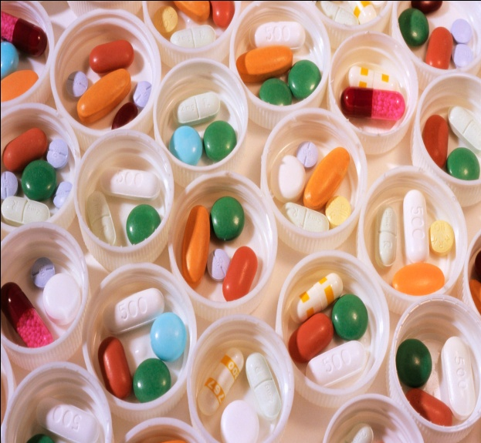
INTRODUCTION
Pharmacology
&
Therapeutics

Slide 11
Pharmacology
“Phamakon” & “Logy”
Pharmacon: A drug: Logy: “to study”
“It is the science to study effects of drugs.” OR
It is the study of MOA, effects produced used to prevent, diagnose & treat diseases.
Drug “Drogue” (drug herb)
Substance or mixture of substances to prevent, diagnose, mitigate or cure.
Definition (WHO)
A substance, product, material used or intended to be used to modify or explore the physiological system or pathological state for the benefit of recipient.

Slide 12
Therapeutics
It is an art and science to treat a disease.
Pharmacy
It deals with “Manufacturing, dispensing and standardization of drugs.

Slide 13
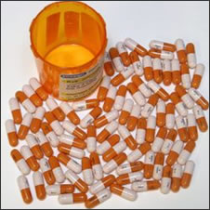
Pharmacokinetics:
Study of:
Absorption
Distribution
Biotransformation
Elimination
Pharmacodynamics:
Study of Therapeutic or
MOA Wanted
Pharmacological Effects
Unwanted
Adverse effects or
Side effects

Slide 14
Brief History
As old as man himself.
Superstitions & beliefs also played an important role in treating illnesses.
Primitive people use to try all sorts of herbs, roots, shrubs etc. “Hit and Trial” Method (Even by observing ill animals)
Sometimes beneficial, sometimes harmful and toxic.
Babylo-Assyrian era is the earliest civilization revealed by the history which gives the clues to the use of certain drugs in the form of tablets, made up of plants, herbs, roots, seeds, wood, minerals and stones.

Slide 15
Religion & gods has always been the part of healing art.
In Egypt mythology, Apollo created “materia medica” dates back about 1550 BC, contains more than 700 drugs.
Greek medicine started emerging and still is in practice.
Hippocrates, Aristotle

Slide 16
History Cont:
Chinese medicine dates back to 2735 BC.
Arabs introduced oils (olive, castor) musk, camphor, senna, sandal wood, picrotoxin, Nux vomica etc.
Razi was famous physician (850 – 93) even in the west.
Al – Zahrawi (936 – 1013)
Al – Majusi (994) a persian physician.

Slide 17
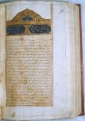
Ibne-Sena
Al Qanoon Fi Tibb ul Shifa” (CANON) or Qanun
(CANON)
Ibn Sina (980 – 1037) “Al Qanoon Fi Tibb ul Shifa” (CANON or Qanun)
Finally Arab medicine was taken/adopted by Europe and regulatory laws were first established.
With the advent/advancement in chemistry, medicinal knowledge improved & confirmed/development in the field of Pharmacology occurred.

Slide 18
Chronological Development Of Pharmacology
ANCIENT CHINESE MEDICINE EMPEROR SHEN NUNG (2730 BC) | PAN TSAO (Materia Medica)
ANCIENT INDIAN MEDICINE (2500-3000 BC) CHARAKA, SUSHRUTA, VAGBHATA (Renowned Hindu Physicians) | AYURVEDA & RIGVEDA (Religious books of Hindus containing medical information)
BABYLO – ASSYRIAN CIVILIZATION | Clay Tablets (1900 BC)
ANCIENT EGYPTIAN CIVILIZATION | EBERS PAPYRUS (1500 BC)
ANCIENT GREEK MEDICINE HIPPOCRATES (450 BC) Father Of Medicine THEOPHRATUS | Introduced the concept of pathologic process in disease. Promoted use of plants as drugs
18

Slide 19
ROMAN INFLUENCES CELSUS (25 BC- 50 AD) DIOSCROIDES GALEN (130-200 AD) | Wrote A Book On Therapeutics. Pedacius. (Book On Plant Medicine) Author Of 30 Books On Drugs Emphasized On The Use Of Pure Drugs. Introduced Pharmaceutical Preparations CALLED AS “GALENICALS”
ISLAMIC INFLUENCES ABU BAKR MUHAMMAD IBN ZAKRIA AL RAZI (RAZES 850-893) AL ZAHRAWI (936-1013 AD) ALI IBN AL ABBAS AL MAJUSI (994 AD) ABU ALI AL HUSSAIN IBN SINA (AVECENA 980-1037 AD) | Author Of Several Books Of Medicine, Introduced Mercurial Ointment. Al Tasrif (Book On Medicine) Al Kitab Al Maliki (Encyclopaedia Containing A Section On Drugs. Al Qanun Fitibb (Qanun) Kitab Al Shifa
19

Slide 20
EUROPEAN INFLUENCES
Emperor Frederic II (1240 Ad) | Legislation For Drugs Control
Francois Magendie(1783-1855) | Experiments On Animals
William Withering (1785) | Digitalis In Cardiac Failure
Serturner (1806) | Isolation Of Morphine.
Claude Bernard (1838-1878) | Experiments With Curare On Isolated Nerve-muscle Prep
Paul Ehrlich | Concept Of Chemotherapy
Oswald Schmeid Berg (1838-921 Ad) | Fate Of Drugs In Body (Pharmacokinetics)
Best & Banting 1921 | Discovery Of Insulin
Alexander Flemming (1928) | Discovery Of Penicillin
THALIDOMIDE TRAGEDY (1950s) | Drug Safety Concern/ Regulation

Slide 21
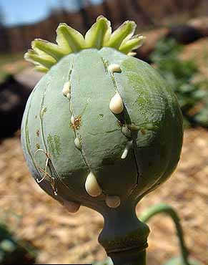
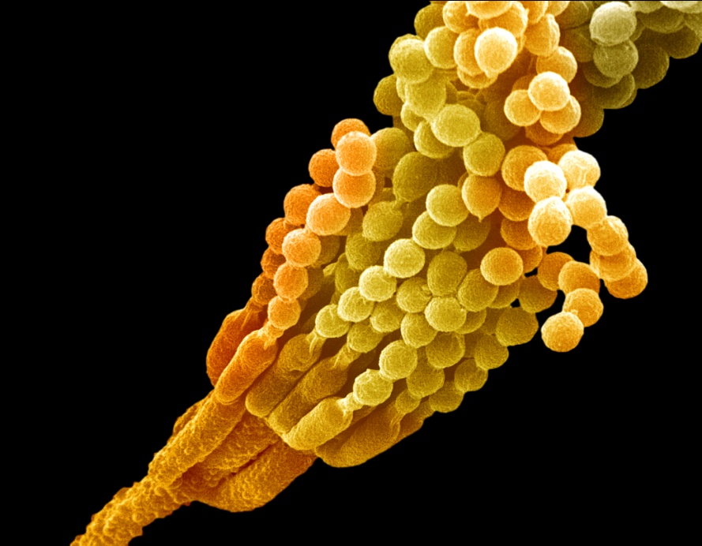
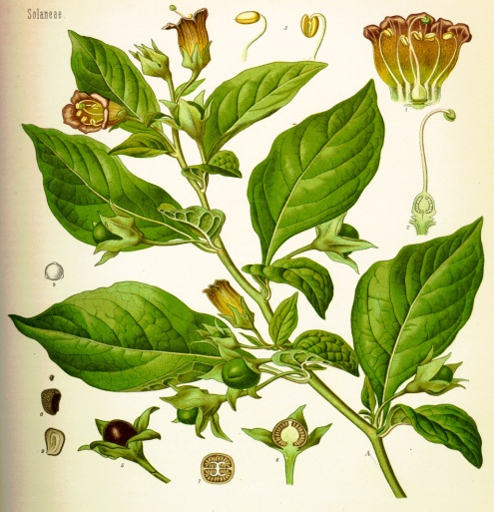
Some Examples of Medicinal Plants
Penicillium
Opium
Hyocyamus

Slide 22
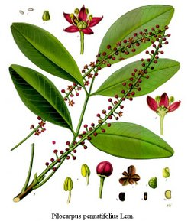
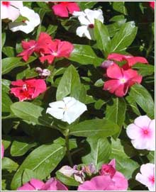
Poppy
Pilocarpus jaborandi
Vinca rosea
H. Niger

Slide 23
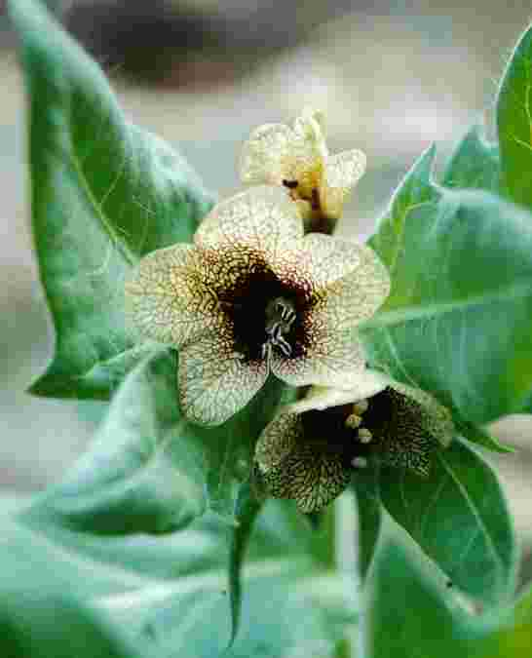
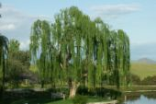
H. Niger
Willow Tree
Digitalis Purpurea

Slide 24
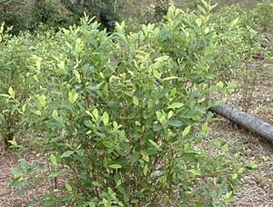
cannabis
Opium
Ispaghula
Cocaine

Slide 25
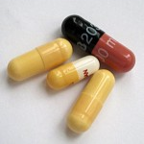
Amanita muscaria
Branches of Pharmacology
Datura Stramonium

Slide 26
PHARMACOKINETICS
PHARMACODYNAMICS
PHARMACY
PHARMACOGENETICS
PHARMACOGENOMICS
THERAPEUTICS
ANIMAL PHARMACOLOGY
CLINICAL PHARMACOLOGY
EXPERIMENTAL PHARMACOLOGY
COMPARATIVE PHARMACOLOGY
CHEMOTHERAPY
TOXICOLOGY
PHARMACOGNOSY
POSOLOGY
PHARMACO-ECONOMICS
PHARMACO-EPIDEMIOLOGY

Slide 27
PHARMACO-VIGILENCE

Slide 28
Pharmacotheraputics:
“Application of knowledge of pharmacology to the treatment of disease & amelioration of symptoms.
Pharmcogenetics:
“Deals with variation in drug treatment response due to genetic factors”
Example: “Idiosyncrasy”, succinylcholine induces prolonged apnea
Pharmacogenomics
Toxicology:
“Science of Poisons”
Teratogencity: “Monster Producing Effects”
Teratos = Monster
Thalidomide Disaster = 1960 in Germany.
Immunopharmacolgy:
Study of Immunological aspects of drug interaction including effects of drugs on immune response & production of antibodies in response to drugs.

Slide 29
Chronopharmacology
Investigation of drug effects as a function of biological timing as well as its effects upon “rhythm” characteristics e.g.
A
Peak Effects of Histamine Induced skin Reaction
Airway reactivity at midnight.
B
Peak Acetylcholine induced bronchial reaction about noon
C
Alteration body temperature circadian rhythm by reserpine.
D
Alteration in plasma glucose & GH circadian rhythm by insulin
Pharmcometrics:
Science of Identification & Comparative evaluation, both qualitative & quantitative of drug activities. Animal tests, bioassay & biostandardization are followed by human trials.
Iatrogenic Disease “IATROS = Physician”
Physician induced or drug induced diseases like:-
Cushing’s Disease
INH + Rafampin induced hepatitis.
choramphenicol induced “Aplastic anaemia”

Slide 30
Modern Pharmacology
Pharmacology of today studies the interaction of drug molecule at sub-cellular level i.e; Organelle, receptors, enzymes and chemical mediators of the cells. The concept of drug has been expanded to include gene therapy and antisense drugs.
Development of nano-medicine is expected to open new vistas in treatment of diseases.

Slide 31
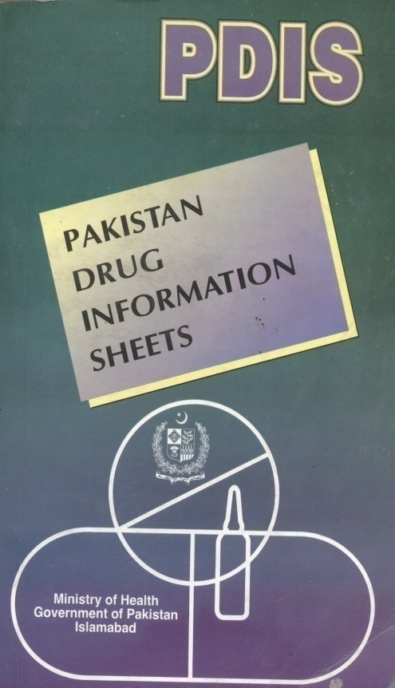
PHARMACOPOEIA: “Pharmakon = Drug” “Poeia = To make”
“ An official document containing all information about drugs regarding their sources, formulae, chemical structure, Phamacodynamic properties, Pharmacokinetics, Standardization tests, doses etc ’’
BP 2 . BPC 3. USP 4. BNF 5. PNF
6. Eu Ph
NATIONAL
FORMULARY
ESSENTIAL
DRUG LIST
PDIS (Pakistan drug
information sheets)

Slide 32
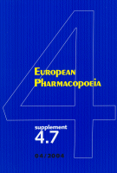

Slide 33
DRUG
Drug is a substance or a mixture of substances that is manufactured, sold, stored, offered for sale or presented for internal or external use in the treatment mitigation, prevention or diagnosis of disease in human beings or in animals.
Adulterated Drug
Spurious Drug.
Counterfeit Drug.
Misbranded Drug.
Substandard Drug.
Drugs Act
Drug Act 1940
Drugs Act 1972 (Generic Drug Act)
Drugs Act 1976
⁺All drugs are poisons, if not used in proper doses, clinical indication, time, route of administration and in a specific patient.

Slide 34
* FREQUENTLY ASKED QUESTION (FAQs) BY THE STUDENTS OF 3RD YEAR MBBS.
HOW TO STUDY PHARMACOLOGY ?

Slide 35
Important (08) points
Listen to the lecture Carefully. 2. Note down salient points 3. Revise at home the same day 4. Study your Text-Book
(Basic & Clinical Pharmacology, By B. G. Katzung)

Slide 36
5. Note down the points which you are unable to understand
6. Participate actively in tutorials- Clarify your ambiguities from your tutor
7. Listen carefully to the presentations in seminars and actively participate in Q & A
8. Revise before Chapter test, Term Test, Pre-Annual and Professional Examination

Slide 37
Some Books of Pharmacology
1. Basic & Clinical Pharmacology by Bertram G. Katzung
2. Goodman & Gilman “The Pharmacological Basis of therapeutics” Hardman & Joel G (Editors)
3. Pharmacology by Rang H.P & Dale
4. Clinical Pharmacology by Laurence

Slide 38
5. Lippincott’s Illustrated Review Pharmacology: Harvey (editor)
6. Essentials of Medical Pharmacology by Tri Pathi KD
7. Integrated Pharmacology by Page.
8. Brody’s Human Pharmacology: Molecular to Clinical

Slide 39
Any Question ?

Slide 40
Thanks

Slide 41
Marks Distribution Prof. Exam Pharmacology

Slide 42
Internal Assessment (I.A) 30%
MCQs 40%
SEQs 30%
THEORY (Time Allowed 3 Hours )
Written Paper Max Marks 135 (40%MCQs & 30% SEQs)
Internal Assessment 15 Marks
Sub-total 150 Marks
ORAL and Practical
Max Marks 135
Internal Assessment 15 Marks
Sub-total 150 Marks
Grand Total: 300 Marks

Slide 43
Internal Assessment
1-Attendance: 06 Marks (20% of Internal Assessment )
a- 75% attendance is mandatory
b- >75% to 80% attendance 02 Marks
c- >80% to 85% attendance 03 Marks
d- >85% to 90% attendance 04 Marks
e- >90% attendance 06 Marks
2- Attitude/Behavior/Discipline 03 Marks (10% 0f Internal Assessment)
a- Average 01 Marks
b- Good 02 Marks
c- Very good 03 Marks

Slide 44
3-Continuous Academic Assessment 21 Marks
(70% of Internal Assessment)
a- Send up examination 07 Marks
b- Two term examinations (2×4) 08 Marks
c-Two mid term examinations (2×3) 06 Marks
OR
Three monthly examinations (3×2)

Slide 45
PROPOSED FORECAST OF TRAINING EVENTS – 3RD YEAR (2009-14)
Module-1 Foundation Module
16-04-2012 to 20-04-2012 (1 week)
Students Week 23-04-2012 to 28-04-2012 (1 week)
Foundation Module (contd) 30-4-2012 to 18-05-2012 (3 weeks)
Module Test 21-05-2012 to 26-05-2012 (1 week)

Slide 46
Module-2 ANS and Respiratory System
28-05-2012 to 06-07-2012 (6 weeks)
Module Test 09-07-2012 to 14-07-2012 (1 week)
Module 1 & 2 Seminar 16-07-2012 to 20-07-2012 (1 week)

Slide 47
Contd: 3rd Year Training Events
Module-3 Renal, CVS and Haematology 23-07-2012 to 27-07-2012 (1 week)
Summer & Eid Vacations 28-07-2012 to 26-08-2012 (4 weeks)
Module-3 (contd) 27-08-2012 to 06-10-2012 (6 weeks)
Module Test 08-10-2012 to 13-10-2012 (1 week)

Slide 48
Module- 4
Neuroscience, Skin and Musculoskeletal, Immunology
15-10-2012 to 30-11-2012 (7 weeks)
Winter Holidays 01-12-2012 to 08-12-2012 (9 Days)
Module Test 10-12-2012 to 15-12-2012 (1 week)
Seminar (Module 3 & 4 ) 17-12-2012 to 22-12-2012 (1 week)

Slide 49
Module -5 Endocrinology / Reproduction / Neoplasia 24.12.12 to 01.02.2013 (06 weeks)
-
Pre-Annual Pre Leave 02-02-2013 to 11-02-2013 (10 Days)
Pre-Annual Exam 12-02-2013 to 23-02-2013 (2 weeks)
Prep Leave 2nd Professional 24-02-2013 to 17-03-2013 (2 weeks)
2nd Professional Exam
18-03-2013 - onwards

