Slide 1
Irritants
By Dr Romana

Slide 2
Learning Objectives
Non-Metallic poisons:s/s,treatment,
PM appearance.

Slide 3
Irritant Poison
1 Inorganic Poisons
metalic
non- metallic
2 Organic Poisons
vegetables
animals
3 Mechanical Poisons

Slide 4
Non-metallic poisons
Phosphorus(Diwali)
Iodine

Slide 5
Phosphorus
It exists in two forms
Yellow phosphorus
Red phosphorus
Phosphorescence
exposure to air----fumes of phosphoric
and phosphorus acid, garlic smell,
------luminous in dark

Slide 6
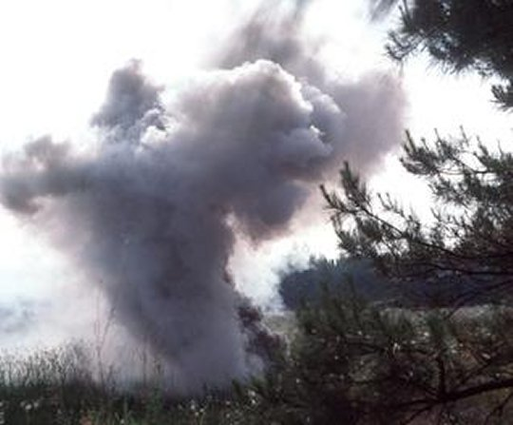

Slide 7
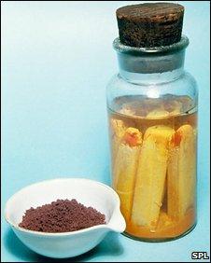

Slide 8
Red phos.mixed with powdered glass
is used on the side of the match box.
Mechanism of action:
a protoplasmic poison,Cell metabo-
-lism is decreased,this is known as
“necrobiosis”seen in the liver.Glycogen
decreases and fat increases.

Slide 9
Acute poisoning; S/S: GIT
garlic taste in mouth, garlic smell in
breath and vomitus
luminosity of vomit and faeces is
diagnostic
Skin:slow healing burns.

Slide 10
Treatment:
Demulcents contraindicated
Stomach wash
Antidote
PM appearance:
luminous
smell

Slide 11
Necrobiosis Ac.Yellow Atrophy
enlarged, later small, wrinkled
shrunken liver capsule
Uniformly yellow dirty yellow
Soft,greasy hard,brittle
Fatty deg.ne Necrosis---most
-crosis of few cells cells
early poisoning late poisoning

Slide 12
Viscera preserved for chemical analysis in saturated soln of common
salt and not in spirit as luminosity is lost.

Slide 13
Chronic poisoning
Phossy jaw
fumes
Lower jaw in the region of decaying
tooth.
Toothache,swelling jaw,loosening
of teeth,necrosis of gum,multiple
sinuses,pus,sequestration of bone.

Slide 14
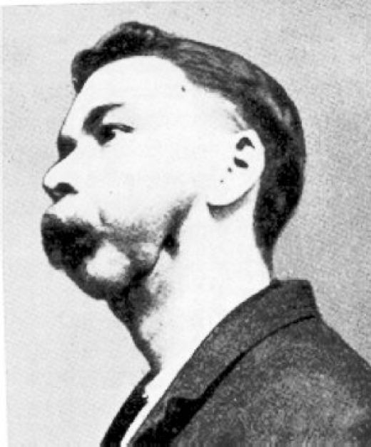

Slide 15
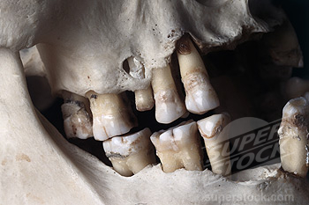

Slide 16
Iodine Poisoning
Iodine is present as brown crystals with characteristic odour.
Acute poisoning:
Lips and mouth are stained yellow,
brown.Vomit and stools are dark,
yellow,brown,or blue.

Slide 17
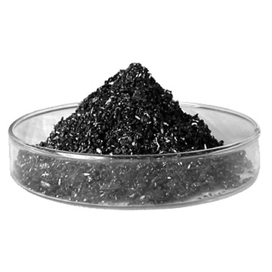

Slide 18
Chronic poisoning:
Prolonged use leads to chronic poisoning called “iodism”.Classical
features are headache,acute coryza,
bronchial catarrh,conjunctivitis and
oedema of face,eyelids which clear
up when drug is withdrawn.

Slide 19
Treatment:
Stomach wash
Demulcents
PM appearance:skin rashes,oedema
eyes,muc.membrane,lips yellow/brown
corrosion of mouth,esop,stomach,
oedema glottis.

Slide 20
Medicolegal:
suicide
vitriolage
Water can be made potable by adding 5drops of 2%tinture of iodine
per litre of water.If cloudy double or
four times tinture will be required.

Slide 21
THANK YOU

