Slide 1
LAB DIAGNOSIS OF infectious and non INFECTIOUS DISEASES

Slide 2
Laboratory diagnosis of infectious and non infectious diseases
The methods employed in the laboratory for diagnosing infectious (bacterial, viral, fungal, parasitic) and non infectious diseases fall broadly into following categories
  Phenotypic methods
  Serological analysis
  Nucleic acid tests
  Biologic assays

Slide 3
Phenotypic methods:
Direct Viewing
Microscopic examination
Specimen: Blood, body fluids, tissues
Smear \ slide preparation
Wet mounts
Staining with appropriate stain
Identification on the basis of staining, size, shape, arrangement
Notes:
There are two ways to prepare a specimen to be observed under a light compound microscope. These are a smear and a wet mount.You prepare a smear using the heat fixation process:Use a clean glass slide.Take a loop of the culture.Place the live microorganism on the glass slide.
The slice is air dried then passed over a Bunsen burner about three times.

Slide 4
Culture
A culture is a method of multiplying the microorganisms by growing them under controlled laboratory conditions
More sensitive than microscopy
Limitations
Not all organisms can be cultured, example most viruses
Some bacterial take long time to grow on culture example Mycobacterium tuberculosis
Cultures can show negative growth if antibiotic has been started
Notes:
Culture media are contained in test tubes, flasks, or Petri dishes. Media are extremely varied in nutrient content and consistency and can be specially formulated for a particular purpose. There are different levels of media such as liquid, semisolid, and solid. The most widely used media is agar, a complex polysaccharide. The benefits of using agar as the media include that is is solid at room temperature, and melts at the boiling temperature of water. It is flexible and moldable and provides a basic framework to hold moisture and nutrients, though it is not itself a digestible nutrient for most microorganisms/In order to grow microbes out of their natural habitats and in pure form in the laboratory, certain nutrients are required. Nutritional requirements of microbes vary, and at least 500 different types of media are used in culturing and identifying microorganisms

Slide 5
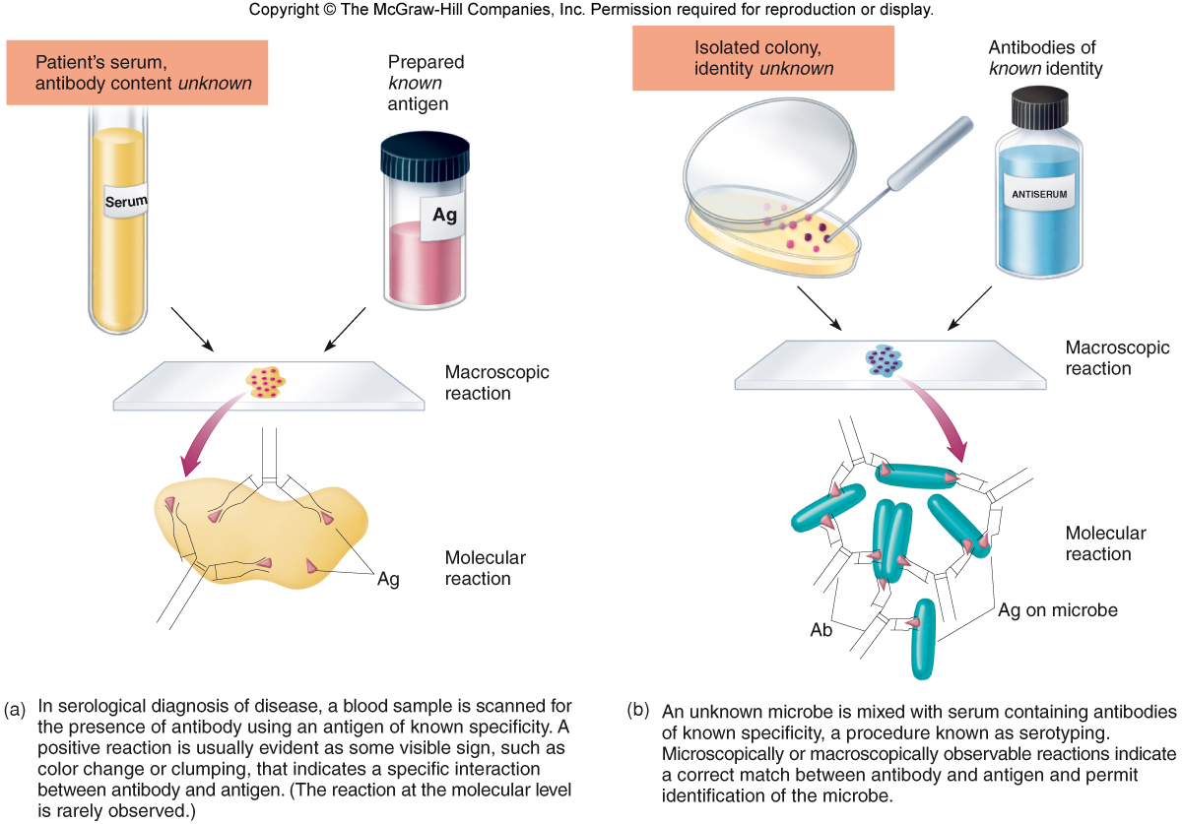
Serologic tests
Tests based on the in vitro interaction of antigens and antibodies
Two approaches
Using known antibody to identify an unknown antigen
Using known antigens to detect antibody in patient’s serum

Slide 6
How to detect antigen antibody reactions
Various techniques detect antigen antibody reactions in the laboratory for diagnosis:
Precipitation
Agglutination
Complement fixation
Immunochromatography
Label immunoassays

Slide 7
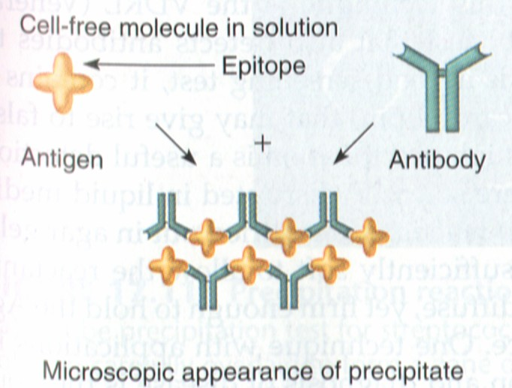
Precipitation Reactions
Precipitation is the interaction of a soluble antigen with an antibody resulting in the formation of an insoluble complex
The complex formed is an aggregate of antigen and antibody

Slide 8
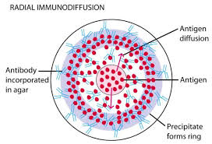
Immunodiffusion

Slide 9
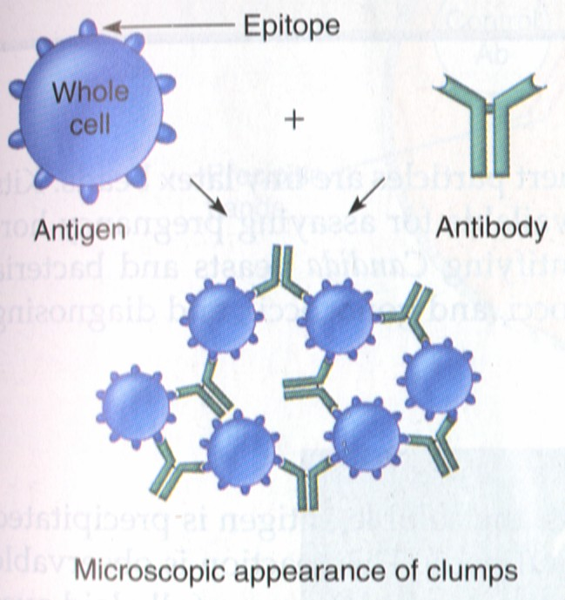
Agglutination Reactions
Agglutination is the clumping of an antigen when mixed with a specific antibody

Slide 10
Applications
1. Identification using known antibodies
Slide agglutination test
Antisera can be used to identify Salmonella or Shigella antigen in the sample

Slide 11
Latex agglutination test
bacterial Ag
Antibodies specific to
Bacterial polysaccharide Ag
Latex beads
(= polystyrene particles)

Slide 12
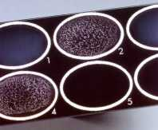
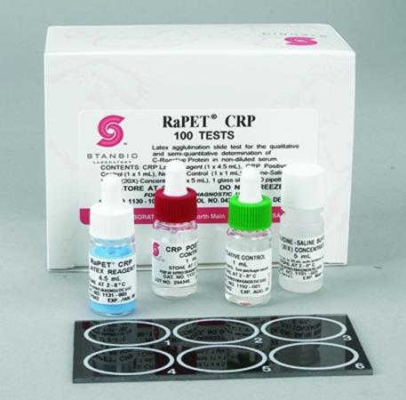
Latex agglutination test:
Latex beads coated with specific antibody are agglutinated in the presence of specific antigens. This test is used to determine the presence of H. influenzae, N. meningitidis, several species of streptococci and Cryptococcus neoformans.

Slide 13
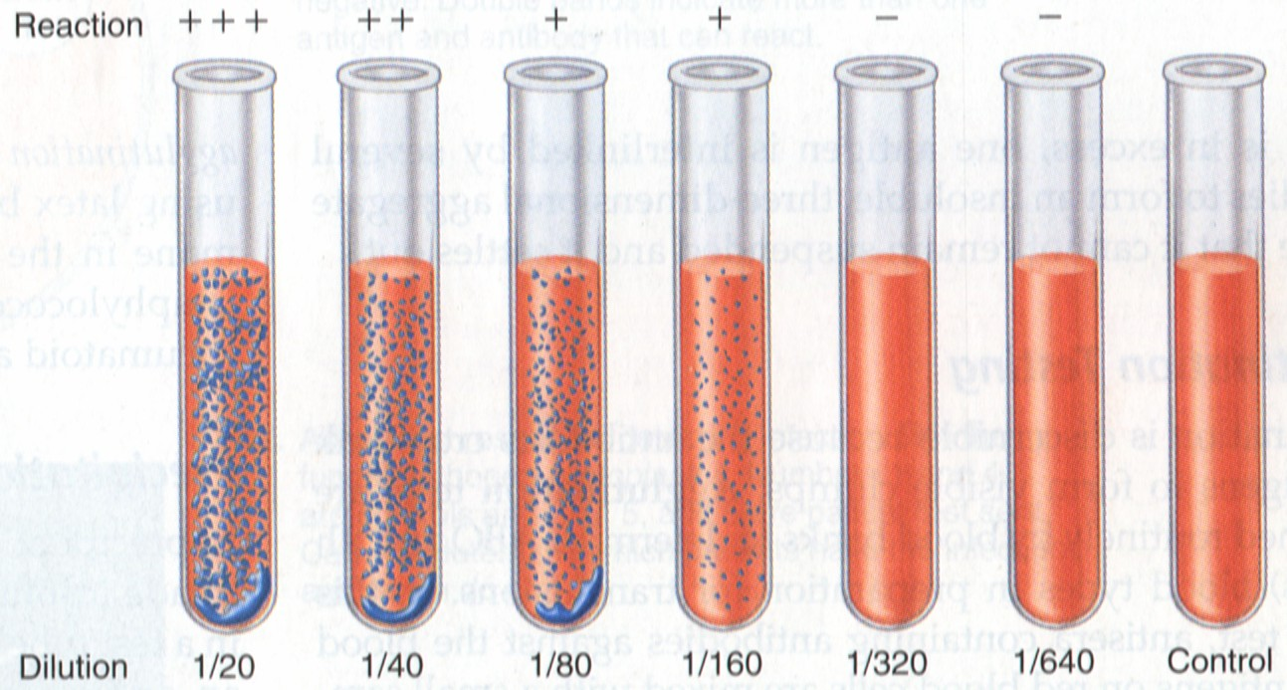
2. Identification of serum antibodies with known antigens
Tube agglutination: Patients serum mixed with standard bacterial suspensions example: detection of agglutinins (antibodies) for H and O antigen for Salmonella in patients with enteric fever.
Procedure: Serial dilutions of the patients serum is taken from 1:10 to 1:640. To each equal volumes of Salmonella antigens are added. The tubes are incubated overnight and read.
Result: The highest dilution of the serum in which agglutinations occurs is noted.

Slide 14
Agglutination reactions also employed in hematology labs for:
Blood grouping
Cross match
hemolytic anemias diagnosis

Slide 15
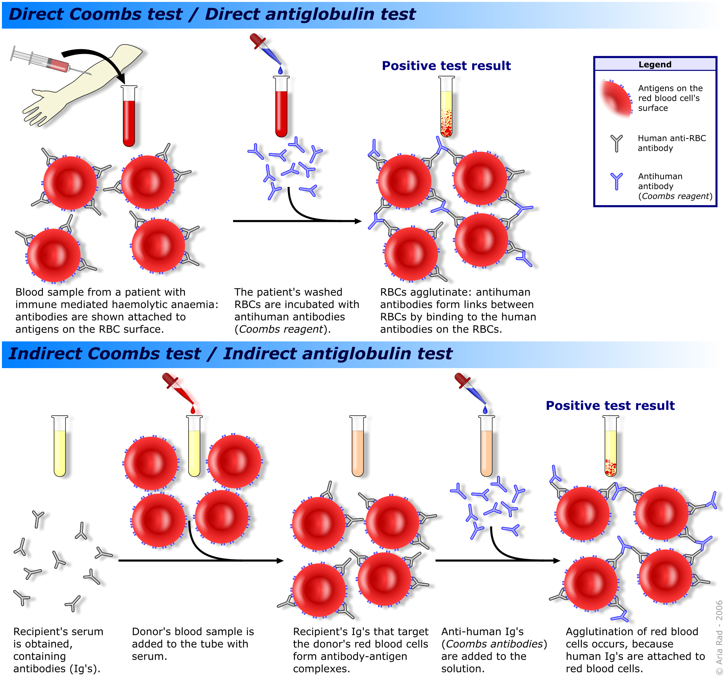

Slide 16
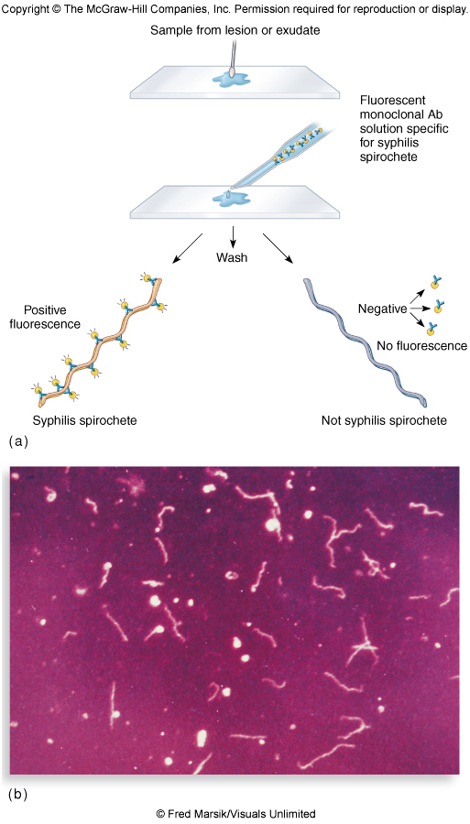
Fluorescent Antibodies and Immunofluorescence Testing

Slide 17
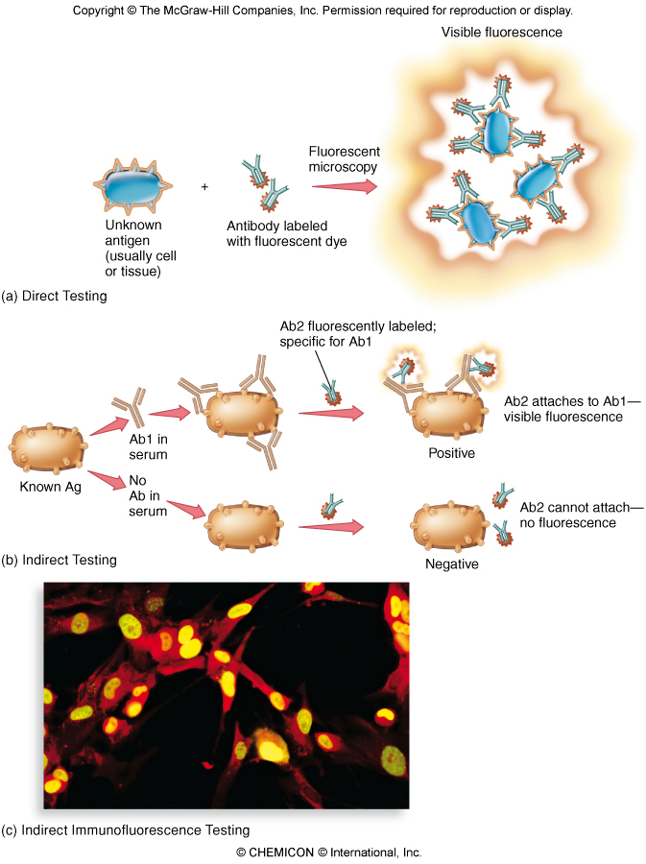
Figure 17.15

Slide 18
Immunochromatography
Lysing agend
Labled AB.
Test band
(bound AB)
Control band
(bound AB)
Bound
AB
Free labled
AB
Nitrocellulose strip
Dye-labelled antibody, specific for target antigen, is present on the lower end of nitrocellulose strip
Antibody, also specific for the target antigen, is immobilised to the strip in a test line, and antibody specific for the labelled antibody is immobilised at the control line

Slide 19
Immunochromatography
Parasitized
Blood
Test band
(bound AB)
Control band
(bound AB)
Parasite antigen (AG.)
Captured by labled AB.
Blood and labled Ab flushed along the strip
Blood sample is placed on the strip, the antigen binds with labelled antibody and the complex is drawn up the strip by capillary action
Notes:
http://www.wpro.who.int/rdt
Graphic reproduced using info from above website

Slide 20
Immunochromatography
Captured Ag-labled Ab-complex
Captured labled Ab
Labled AB-AG-complex
Captured by bound AB of
test band
Labled AB-AG-complex
Captured by bound AB of
control band
If antigen is present, some labelled antibody will be trapped on the test line. Excess-labelled antibody is trapped on the control line
Notes:
http://www.wpro.who.int/rdt
Graphic reproduced using info from above website

Slide 21
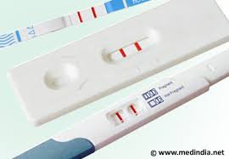
Pregnancy test

Slide 22
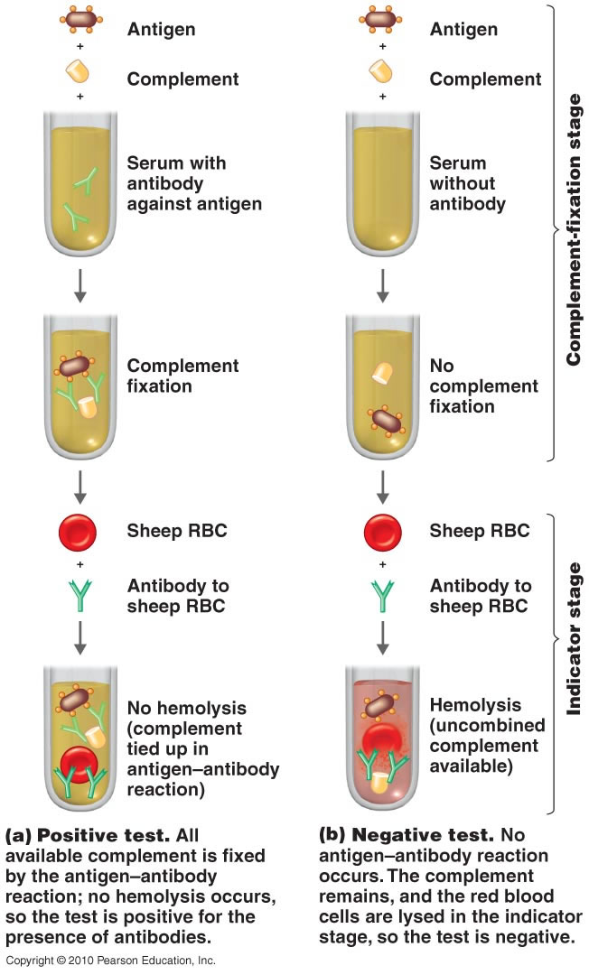
Complement Fixation:
Notes:
The complement system is a system of serum proteins that react with antigen-antibody complexes. If this reaction occurs on a cell surface, it will result in the formation of trans-membrane pores and therefore destruction of the cell. The basic steps of a complement fixation test are as follows:
Serum is isolated from the patient.
Patients naturally have different levels of complement proteins in their serum. To negate any effects this might have on the test, the complement proteins in the patient's serum must be destroyed and replaced by a known amount of standardized complement proteins.
The serum is heated in such a way that all of the complement proteins—but none of the antibodies—within it are destroyed. (This is possible because complement proteins are much more susceptible to destruction by heat than antibodies.)
A known amount of standard complement proteins are added to the serum. (These proteins are frequently obtained from guinea pig serum.)
The antigen of interest is added to the serum.
Sheep red blood cells (sRBCs) ^{[2]} which have been pre-bound to anti-sRBC antibodies are added to the serum. The test is considered negative if the solution turns pink at this point and positive otherwise.
If the patient's serum contains antibodies against the antigen of interest, they will bind to the antigen in step 3 to form antigen-antibody complexes. The complement proteins will react with these complexes and be depleted. Thus when the sRBC-antibody complexes are added in step 4, there will be no complement left in the serum. However, if no antibodies against the antigen of interest are present, the complement will not be depleted and it will react with the sRBC-antibody complexes added in step 4, lysing the sRBCs and spilling their contents into the solution, thereby turning the solution pink

Slide 23
Applications:
Diagnosis of fungal, viral and parasitic infections
Studying complement levels

Slide 24
Immunofixation (Western Blot)
Involves electrophoretic separation of proteins followed by an immunoassay to detect those proteins
Test material is electrophoresed in a gel to separate out particular bands
Gel transferred to a special blotter that binds the reactants in place
Blot developed by incubating it with a solution of antigen or antibody labeled with radioactive, fluorescent, or luminescent labels
Used to confirm the presence of antibody to specific antigens (HIV)

Slide 25
Indicator\ label Immunoassays
This immunoassay system detects antigen antibody binding by a label /indicator bound antigen or antibody
The indicators or labels used are enzymes, radioactive, chemiluminescent or florescent molecules
Examples include
Radioimmunoassay (RIA)
ELISA

Slide 26
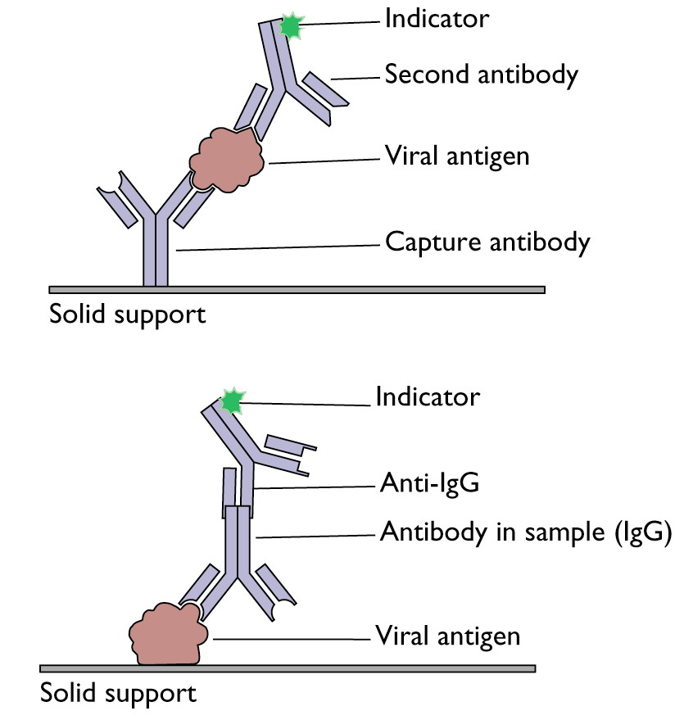
ELISA

Slide 27
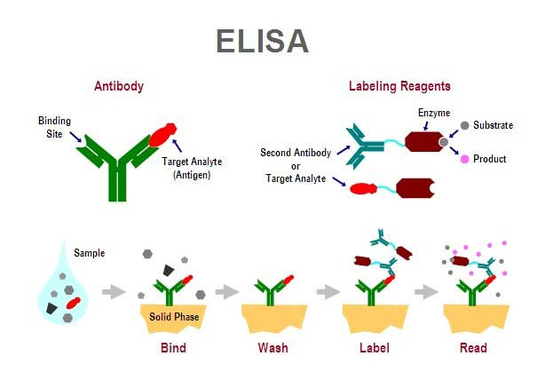
ELISA

Slide 28
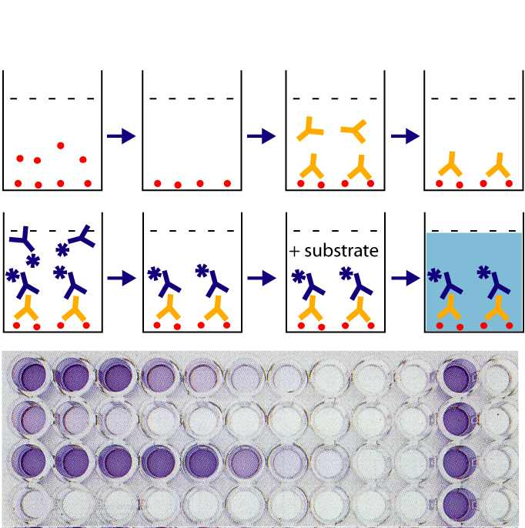
A spectrophotometer is used to measure the color change

Slide 29
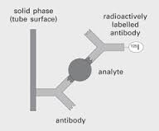
Radioimmunoassay

Slide 30
Applications:
Label immunoassays form the basis of highly sophisticated
tests for both infectious and non infectious conditions.
Some of the applications include:
Diagnosis of viral infections like hepatitis, dengue fever
Diagnosis of bacterial infections
Parasitic infections
Hormone analysis
Therapeutic drug monitoring
Tumor markers etc

Slide 31
Immunohistochemistry
Immunohistochemistry (IHC) combines histological, immunological and biochemical techniques for the identification of specific tissue components by means of a specific antigen/antibody reaction tagged with a visible label.

Slide 32
Neutralization tests
These tests use the ability of the antibodies to block the effect of toxins or infectivity of viruses
A serum sample is diluted in steps and each is incubated with the same quantity of virus
If there are enough antibodies in the serum the viruses are neutralized. In order to make the neutralization effect visible, susceptible cells are added to the samples. If neutralization is successful the cells remain intact, i.e. a cytopathic effect is not recognized or an immune staining remains negative.

Slide 33
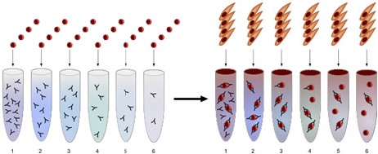
Serum neutralisation test
1. A specific amount of virus is added to progressively diluted serum probes.
2. Susceptible cells are added to the virus-antibody mixture.
3. The neutralisation effect is made visible (cytopathic effect or immunostaining).

Slide 34
Nucleic Acid Tests
Use of nucleic acid probes
Tests that use nucleic acid probes
Nucleic acid sequence analysis

Slide 35
Tests that use nucleic acid probes
Tests that use nucleic acid probes are designed to detect DNA or RNA directly (without amplification) using a labeled DNA or RNA probe that will hybridize specifically to the target nucleic acid
( Southern blot or northern blot)
These tests are simpler to perform than amplification tests but are less sensitive

Slide 36
Southern Blot
DNA is digested with a restriction enzyme and separated by gel electrophoresis.
The DNA is transferred to a membrane which is a sheet of special blotting paper. The DNA fragments retain the same pattern of separation they had on the gel.
The blot is incubated with many copies of a probe which is single-stranded DNA. This probe will form base pairs with its complementary DNA sequence and form a double-stranded DNA molecule.
The probe is either radioactive or has an enzyme bound to it.

Slide 37
Polymerase Chain Reaction
The PCR requires the following components:
DNA template - The sample DNA that contains the target sequence.
DNA polymerase – an enzyme that synthesizes new strands of DNA complementary to the target sequence.
Primers - short pieces of single-stranded DNA that are complementary to the target sequence. The polymerase begins synthesizing new DNA from the end of the primer.
Nucleotides - single units of the bases A, T, G, and C which are the "building blocks" for new DNA strands.
RT-PCR (Reverse Transcription PCR) is PCR preceded by conversion of sample RNA into DNA with enzyme reverse transcriptase .

Slide 38
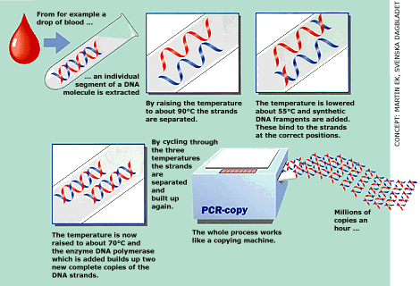

Slide 39
Biological assays
Biological assay (bioassay), or biological standardization is a type of scientific experiment by which the presence, nature or effect of a substance is estimated by studying its effects on living matter.
A bioassay involves the use of a live animal (in vivo) or tissue (in vitro) to determine the biological activity of a substance, such as a hormone, drug or infectious agent.

Slide 40
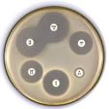
Antimicrobial Susceptibility
Antimicrobial susceptibility tests are performed by either
disk diffusion or
dilution method
Notes:
The test is performed by applying a bacterial inoculum of approximately to the surface of a large agar plate. Up to 12 commercially-prepared, fixed concentration, paper antibiotic disks are placed on the inoculated agar surface. Plates are incubated for 16–24 h at 35°C prior to determination of results. The zones of growth inhibition around each of the antibiotic disks are measured to the nearest millimeter. The diameter of the zone is related to the susceptibility of the isolate and to the diffusion rate of the drug through the agar medium. The zone diameters of each drug are interpreted using the criteria published by the Clinical and Laboratory Standards Institute (CLSI, formerly the National Committee for Clinical Laboratory Standards or NCCLSThe responsibility of the microbiology laboratory includes not only microbial detection and isolation but also the determination of microbial susceptibility to antimicrobial agents. Many bacteria, in particular, have unpredictable susceptibilities to antimicrobial agents, and their susceptibilities can be measured in vitro to help guide the selection of the most appropriate antimicrobial agent.

Slide 41
General tests
Blood complete picture
ESR
Urine analysis
CRP levels

