Slide 1
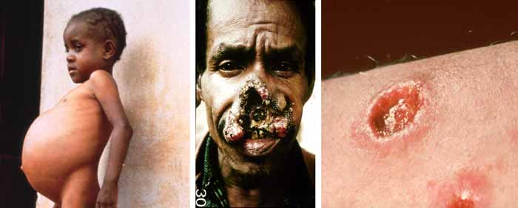
LEISHMANIASIS
Dr Zahra Rashid Khan
Assistant Professor, Haematology Department of Pathology

Slide 2
LEISHMANIA
Obligate intracellular parasite
Leishmania donovani (visceral)
Leishmania tropica (cutaneous)
Leishmania mexicana (cutaneous)
Leishmania brazilensis (mucocutaneous)

Slide 3
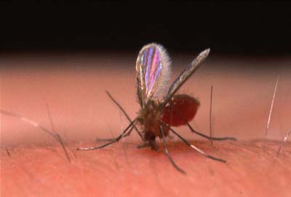
LEISHMANIASIS
Vector-borne disease (sandfly bite)
Endemic in tropics, subtropics
Rodents, canids are reservoirs

Slide 4
GLOBAL BURDEN

Slide 5
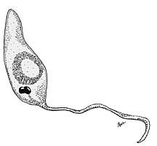
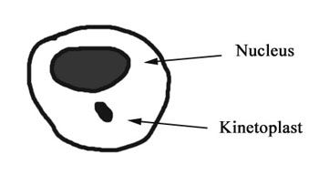
LIFECYCLE
Promastigote form (in sandfly)
Amastigote form (in man)

Slide 6
LIFECYCLE

Slide 7
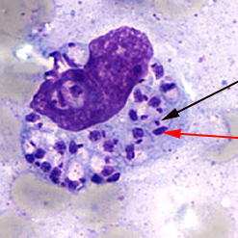
LIFECYCLE

Slide 8
LIFE CYCLE

Slide 9
LIFECYCLE
Promastigotes injected into human by sandfly
Promastigotes engulfed by macrophages
Transform to amastigotes
Amastigotes infect other macrophages

Slide 10
LIFECYCLE
Sandfly ingests amastigotes during blood meal
Transformation to promastigotes in sandfly gut
Migration to sandfly pharynx
Transmitted to human during next blood meal

Slide 11
LIFE CYCLE

Slide 12
VISCERAL LESHMANIASIS

Slide 13
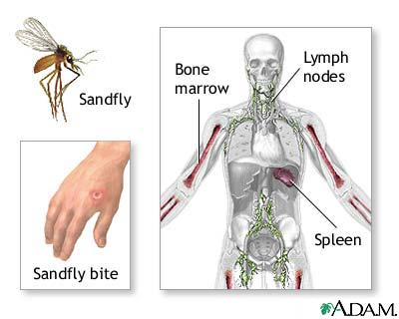
VISCERAL LEISHMANIASIS
KALA-AZAR
affects reticuloendothelial system

Slide 14
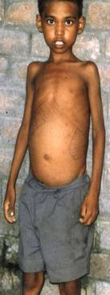
CLINICAL FEATURES
Fever
Weakness/weight loss
Ashen skin
Splenomegaly
Secondary infection usual cause of death
Bleeding

Slide 15
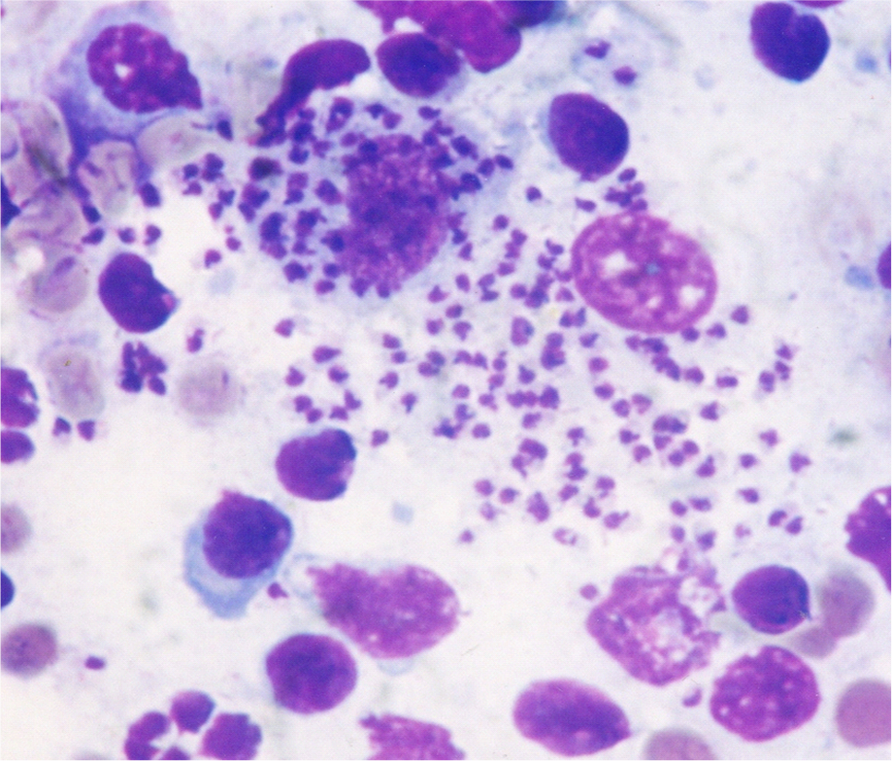
DIAGNOSIS
Blood complete picture
Bone marrow/splenic/lymph node biopsy & culture
Leishman specific PCR
Serology (IgG)

Slide 16
CUTANEOUS/ MUCOCUTANEOUS LEISHMANIASIS

Slide 17
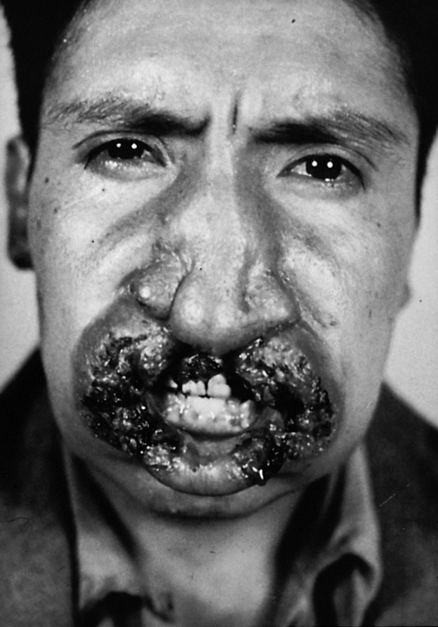
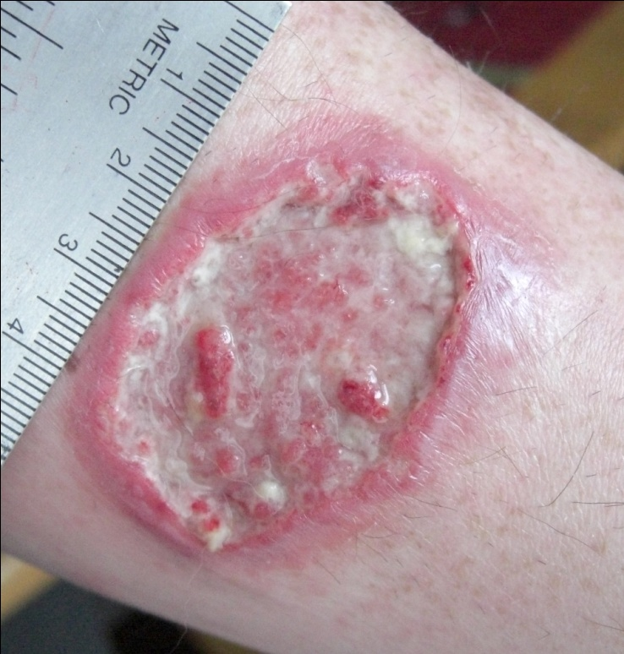
CUTANEOUS/MUCOCUTANEOUS LEISHMANIASIS
Lesions in skin (L.tropica, L.mexicana)
Lesions in mucous membranes, cartilage (L.brazilensis)

Slide 18
CLINICAL FEATURES
Slow healing ulcer
Lesion may heal spontaneously but may ulcerate for months
Death can occur from superinfection of skin lesions
Disfigurement of face can occur in mucocutaneous leishmnaisis

Slide 20
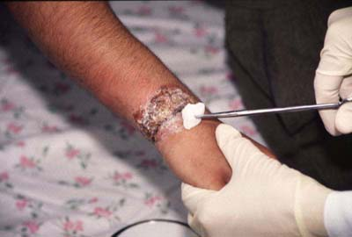
DIGNOSIS
Skin biopsy & culture
PCR
Montenegro skin test

Slide 21
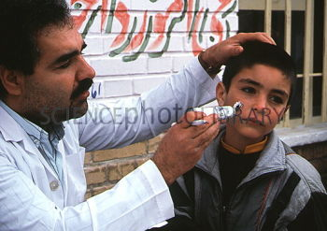
MANAGEMENT
PREVENTION
Use of netting
Protective clothing/insect repellents
Insecticide spraying
TREATMENT
Sodium stibogluconate
Treating complications/superinfection

