Slide 1
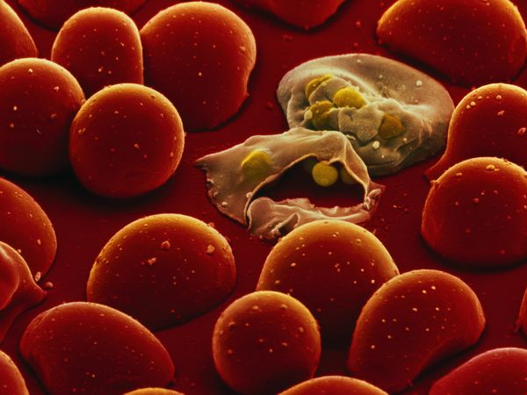
Malarial parasite
Dr Zahra Rashid Khan
Assistant Professor, Hematology
Department of Pathology

Slide 2
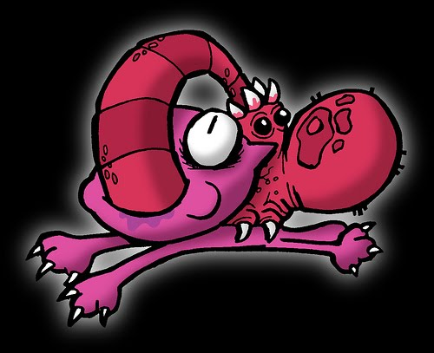
PARASITE
An organism that lives in or on another organism (its host) from which it obtains nourishment. The host does not benefit from the association and is often harmed by it

Slide 3
PARASITE NOMENCLATURE
Phylum
Class
Order
Family
Genus
Species

Slide 4
THE MALARIAL PARASITE
Phylum PROTOZOA
Subphylum SPOROZOA
Class TELOSPOREA
Order COCCIDIIDIA
Genus PLASMODIUM
Species VIVAX, OVALE, etc

Slide 5
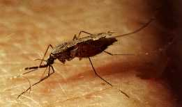
THE MALARIAL PARASITE
Plasmodium vivax (benign tertian)
Plasmodium ovale (benign tertian)
Plasmodium falciparum (malignant tertian)
Plasmodium malariae (benign quartan)

Slide 6
HISTORY
Symptoms first described in ancient Chinese medical writings
1880- Charles Laveran discovered malarial parasite in blood
1898- Ronald Ross described life cycle
1934-Hans Andersag discovered chloroquine

Slide 7
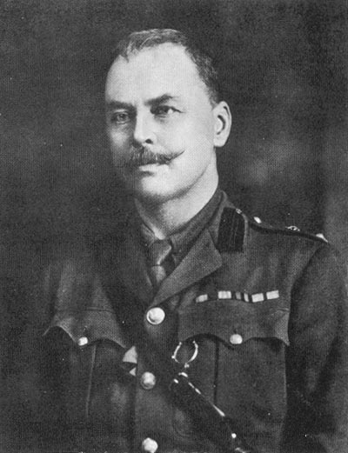
HISTORY

Slide 8
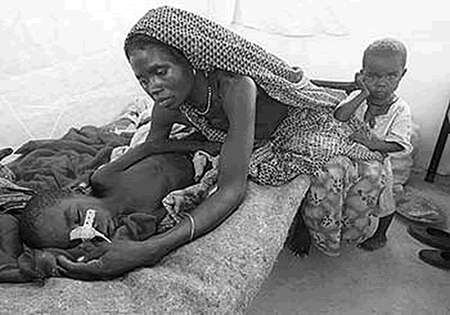
MALARIA
Mal (bad) , aria (air)
Vector- borne disease
Intermediate host (man)
Definitive host (mosquito)

Slide 10
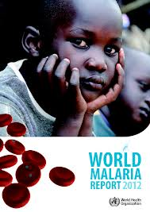
EPIDEMIOLOGY
World’s most devastating parasitic infection
Endemic in tropic and subtropical zones
In 2010, 219 million cases of malaria (World Health Organization)
In 2010, 90% of malaria deaths occurred in Africa (children under 5)
80% cases occur in 17 endemic countries

Slide 11
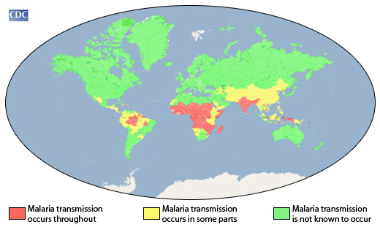
EPIDEMIOLOGY

Slide 13
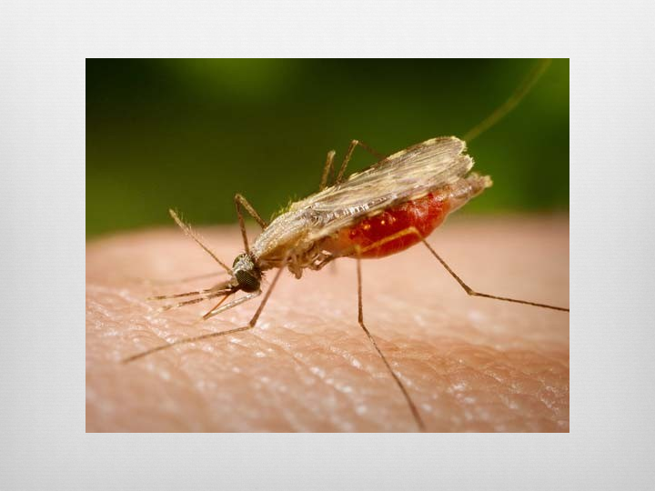
HABITAT
MAN ( red blood cells & heptocytes)
MOSQUITO (female anophelese)

Slide 14
THE VECTOR

Slide 15
MALARIA
REPRODUCTION
Asexual (man) Sexual (mosquito)
SCHIZOGONY SPOROGONY

Slide 16
IMPORTANT TERMS
TROPHOZOITE: The growing form of parasite in blood of man; includes all forms except gametocyte and schizont
SCHIZONT: A form in the process of dividing asexually
GAMETOCYTE: The stage of the parasite containing the gamete

Slide 17
IMPORTANT TERMS
SCHIZOGONY: A process of asexual reproduction by which the nucleus and cytoplasm divide into many subsidiary parts simultaneously (merozoites). It occurs in man.
SPOROGONY: A process of asexual reproduction that results in formation of sporozoites. It occurs in the mosquito.

Slide 20
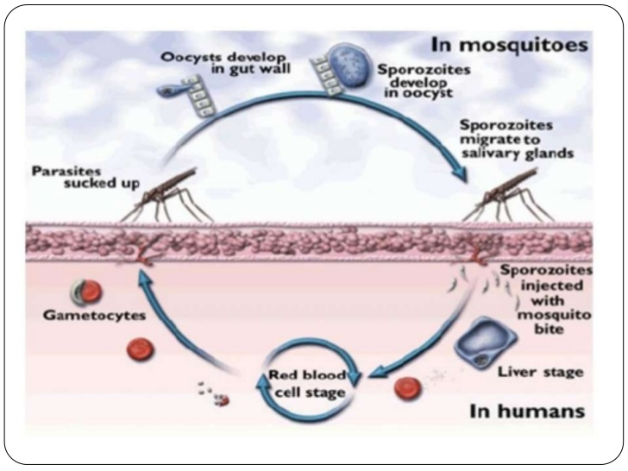
LIFE CYCLE
Parasite (sporozoite) transmitted from mosquito to man
Parasite reaches liver and starts multiplying
Infects red blood cells- further reproduction occurs

Slide 21
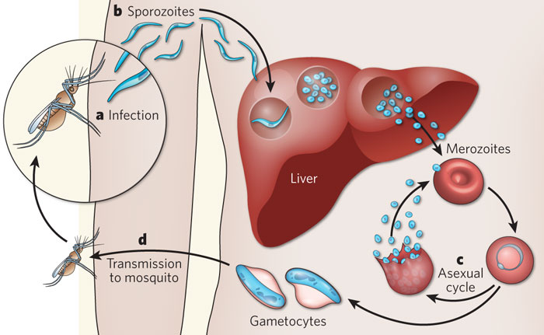
LIFE CYCLE

Slide 22
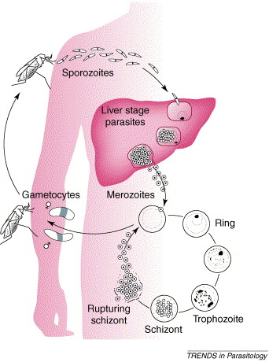
LIFE CYCLE
Dormant (gametocyte) transmited
from man to mosquito
Travels to mosquito midgut and
reproduces sexually
Sporozoites formed travel to
mosquito salivary glands
Sporozoites transmitted to man

Slide 24
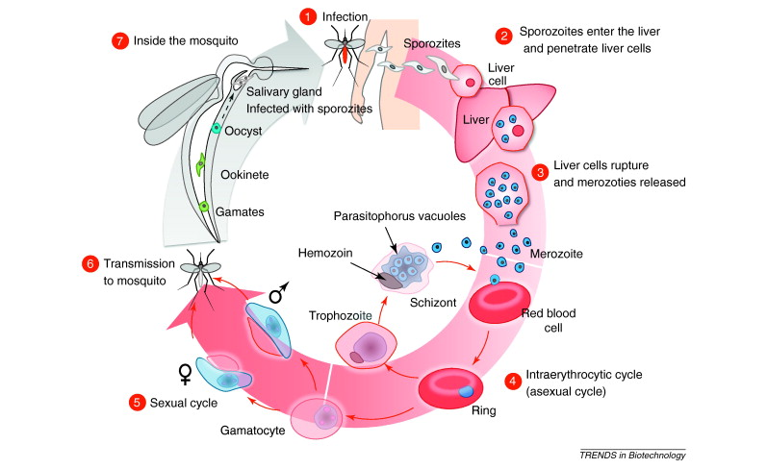

Slide 25
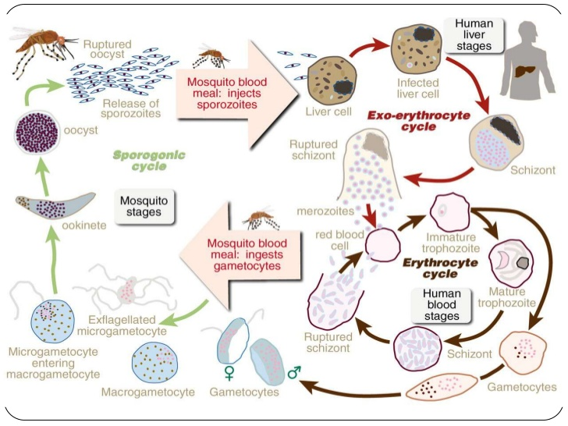

Slide 26
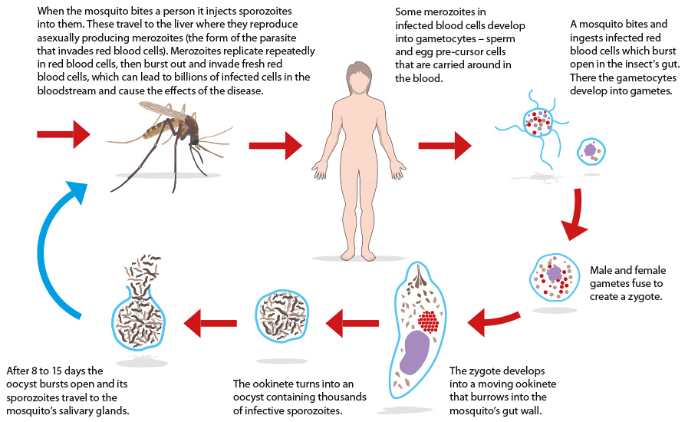

Slide 27
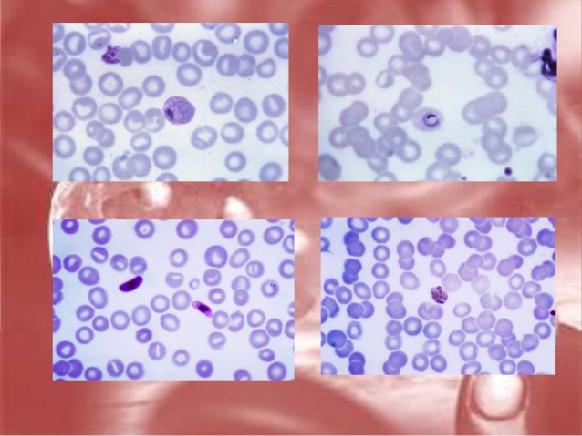
MORPHOLOGY
Peripheral blood film stained with Leishman’s
Different species have different characteristics

Slide 28
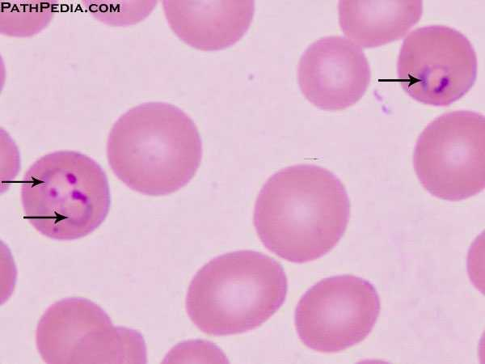
MORPHOLOGY (trophozoite)
Chromatin dot
Rim of cytoplasm
Clear looking area

Slide 29
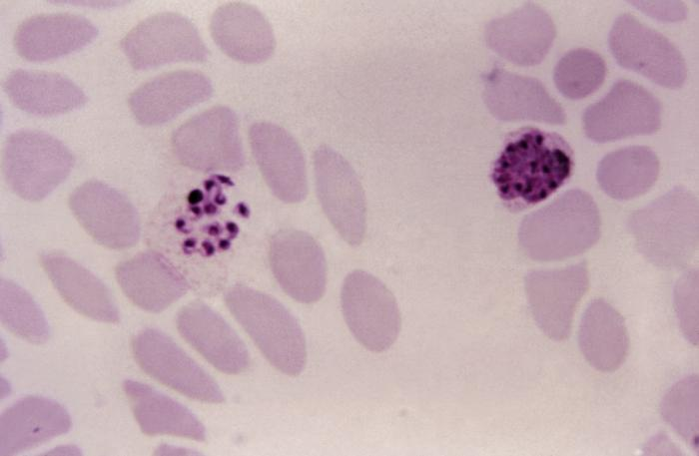
MORPHOLOGY (schizont)
Large trophozoite becomes schizont
Contains many merozoites
Haematin

Slide 30
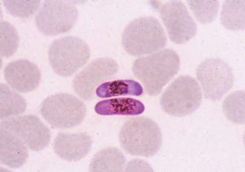
MORPHOLOGY (gametocyte)
Derived from merozoites
Characteristic shape (eg, cresent shaped in falciparum)

Slide 31
MORPHOLOGY

