Slide 1
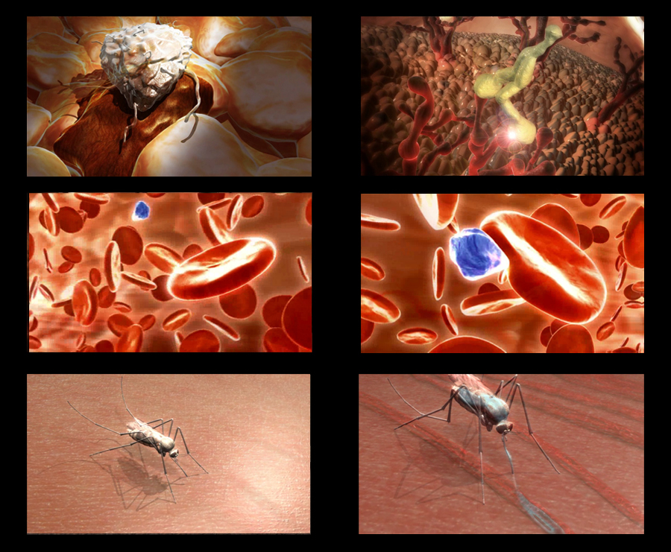
MALARIAL PARASITE
Dr Zahra Rashid Khan,
Assistant Professor, Hematology
Department of Pathology

Slide 3
EPIDEMIOLOGY

Slide 4
INTRODUCTION

Slide 6
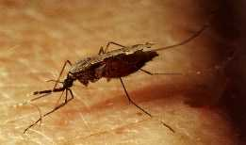
THE MALARIAL PARASITE
Plasmodium vivax (benign tertian)
Plasmodium ovale (benign tertian)
Plasmodium falciparum (malignant tertian)
Plasmodium malariae (benign quartan)

Slide 7
MALARIA

Slide 8
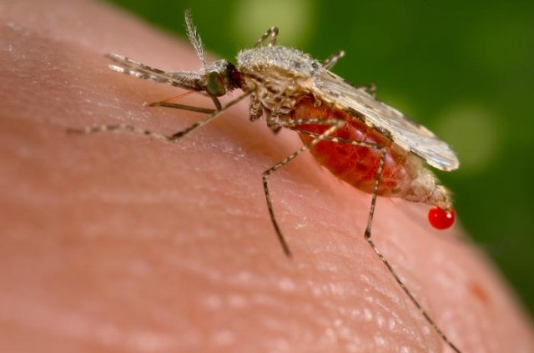
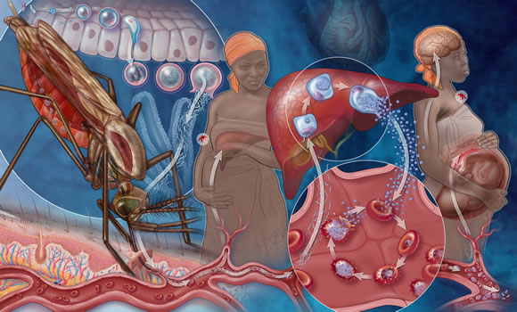
TRANSMISSION
Mosquito bite
Transplacental
Transfusion
IV drug abuse

Slide 9
INCUBATION

Slide 10
CLINICAL FEATURES

Slide 11
“INTERMITTENT FEVER”

Slide 13
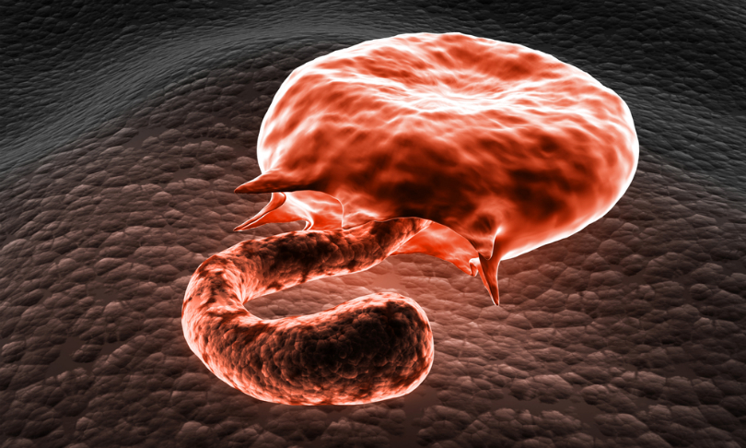
P.FALCIPARUM MALARIA
Occlusion of capillaries with aggregates of parasitized RBC
Cerebral malaria
Acute renal failure
Extensive hemolysis
Anemia

Slide 14
MORPHOLOGY

Slide 16
PLASMODIUM VIVAX

Slide 17
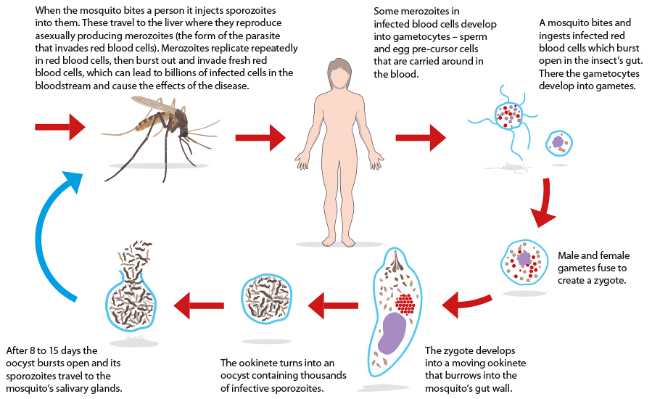

Slide 18
PLASMODIUM VIVAX

Slide 20
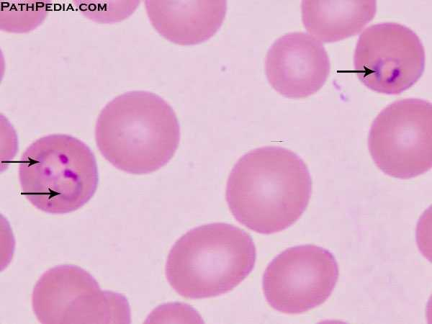
PLASMODIUM FALCIPARUM

Slide 21
PLASMODIUM FALCIPARUM

Slide 22
DIAGNOSIS

Slide 23
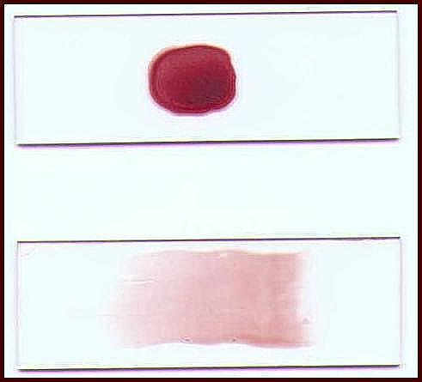
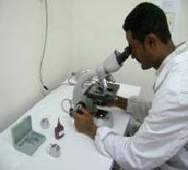
MICROSCOPY
Thick blood film
Thin Blood film

Slide 25
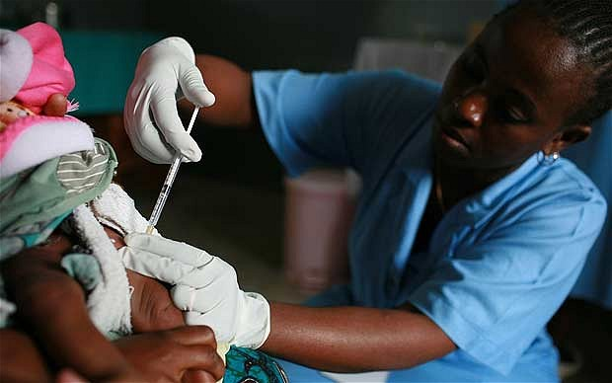
MOLECULAR METHODS
Polymerase Chain Reaction (PCR)
Highly specific and sensitive (1-5 parasite/mL of blood))

Slide 26
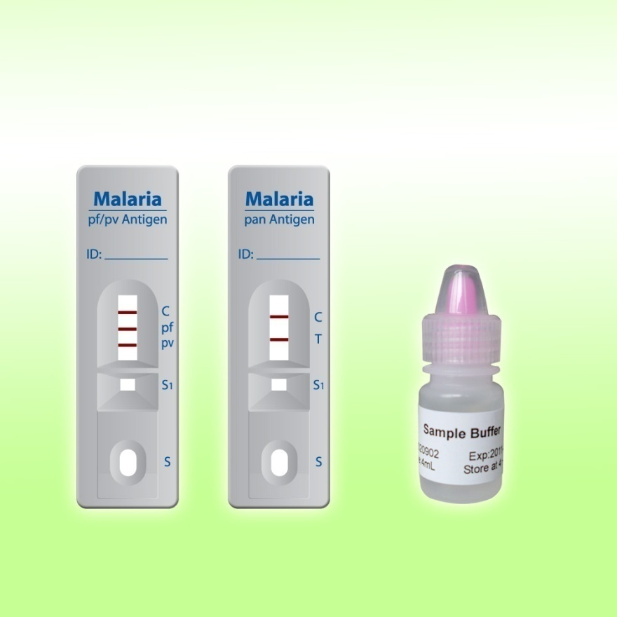
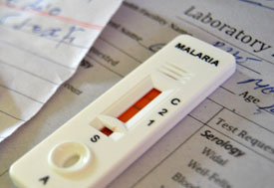
RAPID TESTING(ICT)

Slide 27
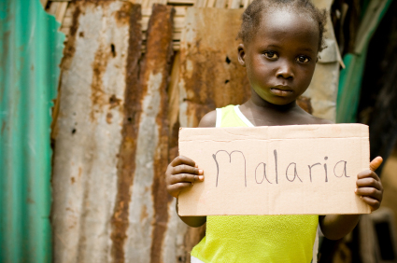
SEROLOGICAL METHODS
Not useful for diagnosis of acute infection
Epidemiological tool

Slide 28
MANAGEMENT

Slide 29
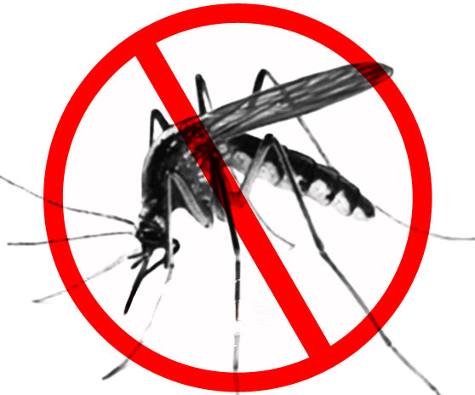
PREVENTIVE MEASURES
Mosquito nets
Window screens
Protective clothing
Insect repellents
Drainage of stagnant water

Slide 30
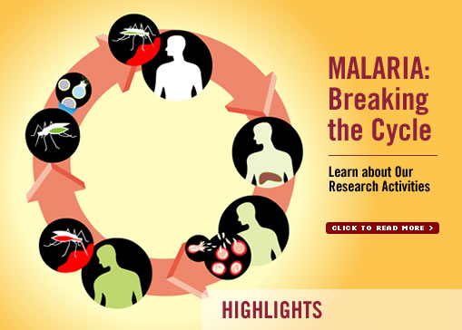
PREVENTIVE MEASURES
Chemoprophylaxis for travelers
(chloroquine / mefloquine or doxycycline)

Slide 31
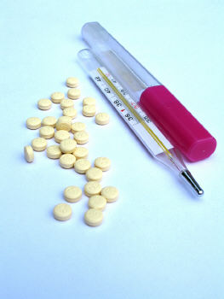
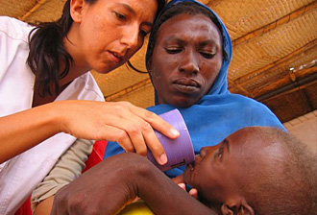
TREATMENT OPTIONS
Sensitive cases
Chloroquine
Primaquine
Resistant cases
Quinine & Doxycycline
Quinine & Fansidar
Artemisinins

Slide 32
RESISTANCE

Slide 33
PREVENTION BETTER THAN CURE!

Slide 34
