Slide 2
A 30 year old male presents to you with complaints of easy fatigability, lack of concentration, breathlessness on performing normal daily activities & ataxic gait since last 6 months. On examination there is pallor of the skin & inflammation at the corner of the mouth. The patient has heard about you being a good doctor & wants your advice. How will you proceed ???…

Slide 3
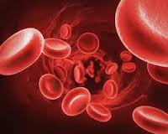
Management Of Megaloblastic Anemia

Slide 4
Anemia
Normocytic
B12 Deficiency Anemia
Folate Deficiency Anemia
Microcytic
Macrocytic

Slide 5
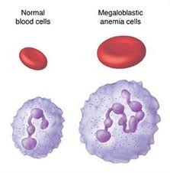
Megaloblastic Anemias
Large abnormal appearing RBCs (megaloblasts) in the bone marrow.

Slide 6
Folic Acid/B12 Deficiency
Impaired DNA synthesis
Delayed nuclear maturation , normal cytoplasmic maturation
Nuclear-cytoplasmic asynchrony
Impaired RBC production/RBC Destruction/ pancytopenia

Slide 7
Vitamin B12 deficiency Anemia

Slide 8
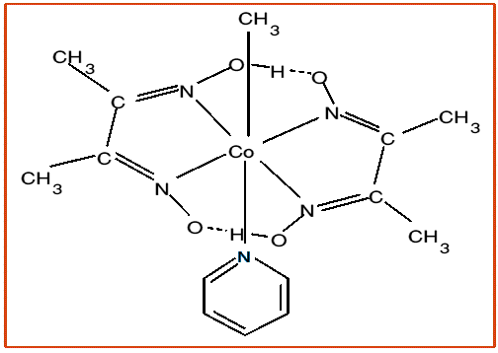
B12(extrinsic factor)
Structure
Notes:
cobalamin, is a water-soluble vitamin with a key role in the normal functioning of the brain and nervous system, and for the formation of blood. It is one of the eight B vitamins. It is normally involved in the metabolism of every cell of the human body, especially affecting DNA synthesis and regulation. Vitamin B 12 consists of a porphyrin-like ring with a central cobalt atom attached to a nucleotide. Various organic groups may be covalently bound to the cobalt atom, forming different cobalamins.

Slide 9
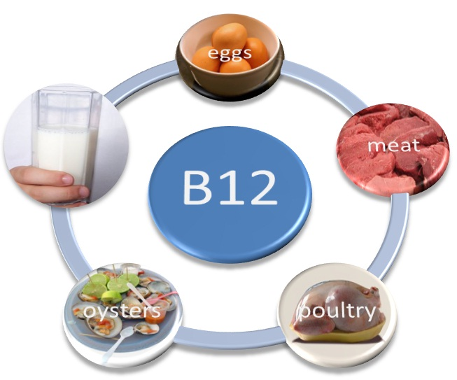
B12 liver storage pool is 3000-5000 µg
Minimal loss in urine & stool
Daily requirement is about 2 µg
Active forms— Deoxyadenosylcobalamine &
methylcobalamines
Sources— Microbial synthesis
Meat, eggs & Dairy products

Slide 10
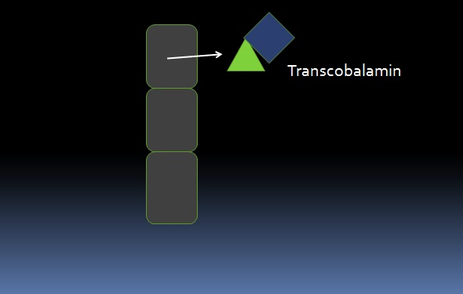
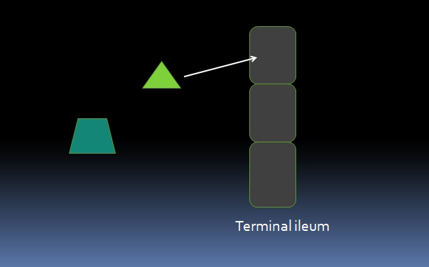
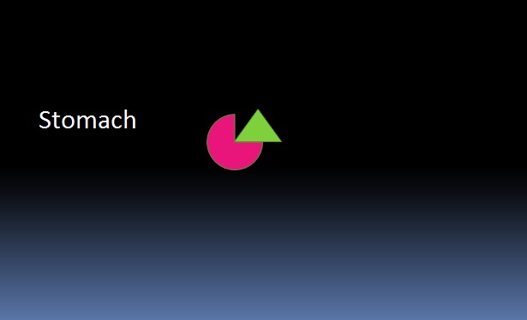
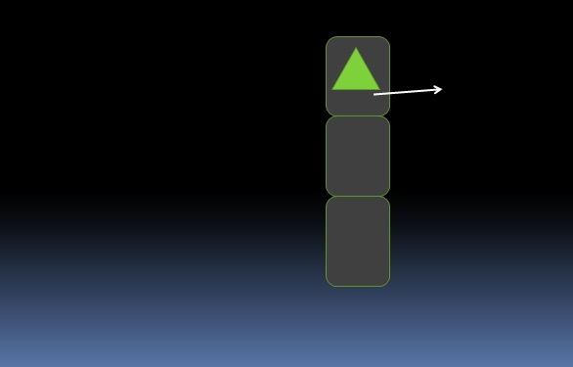
Pharmacokinetics

Slide 11
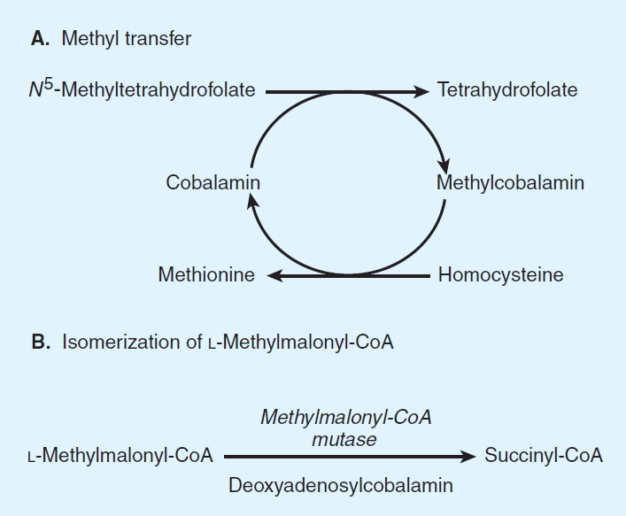
Pharmacodynamics
Notes:
A high level of homocysteine makes a person more prone to endothelial injury, which leads to vascular inflammation, which in turn may lead to atherogenesis, which can result in ischemic injury.^{[2]} Hyperhomocysteinemia is therefore a possible risk factor for coronary artery disease
In b12 absense methyl coa accumulates in the body.raised serum and urinary levels can beused to support the diagnosis
Methionine is an intermediate for the biosynthesis of phosphoolipids.

Slide 12
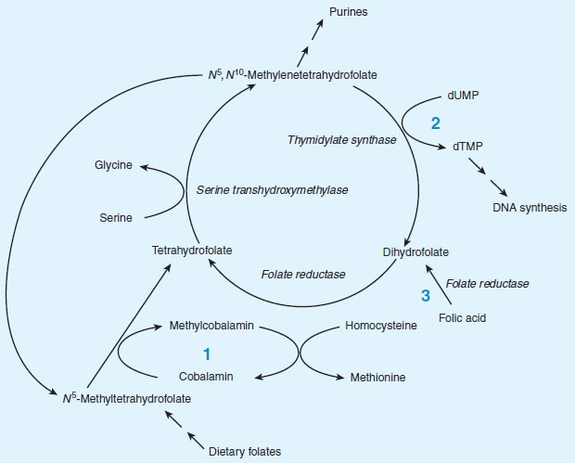
Methylfolate Trap
Notes:
Depletion of tetrahydrofolate prevents the synthesis of deoxythymidylate and purines required for DNA synthesis

Slide 13
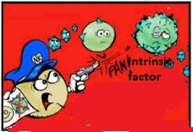
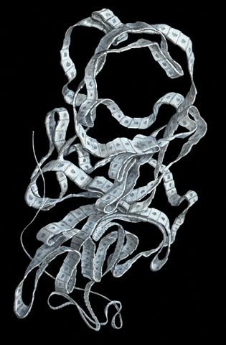
Causes of B12 Deficiency
Pernicious anemia
Total gastric resection
Disorders of terminal ileum
Strict vegetarian diet
Antibiotic use
Parasitic infestation (Diphyllobothrium latum)

Slide 14
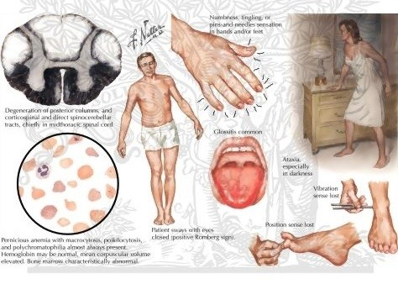
Clinical Findings
Pallor
Stomatitis & Glossitis
Subacute Combined Degeneration Of The Spinal Cord (lichtheim’s disease)
Demyelination of posterior & lateral columns
Ataxia,hyperreflexia,impaired position & vibration sensation
Notes:
Adequate methionine (which, like folate, must otherwise be obtained in the diet, if it is not regenerated from homocysteine by a B₁₂ dependent reaction) is needed to make S-adenosyl-methionine (SAMe), which is in turn necessary for methylation of myelin sheath phospholipids

Slide 15
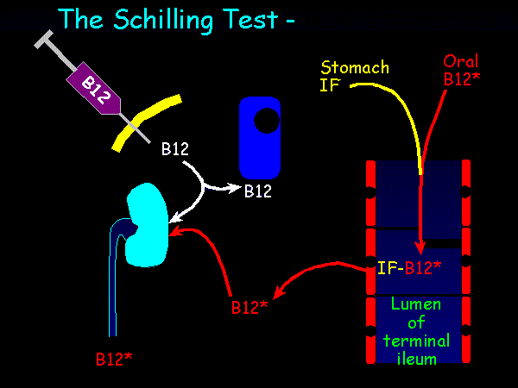
Investigations
CBC
Peripheral smear
Vit B12 & folic acid
levels
Schilling test

Slide 16
B12 Therapy
Parenteral B12 –Hydroxocobalamin, Cyanocobalamin
Initial therapy
100 – 1000 µg – I/M per Day
or on alternate days for 1-2weeks
Maintenance therapy
100 – 1000 µg – I/M- once a month
In case of neurologic manifestations 100-1000 µg I/M every 1-2 week for 6months
Notes:
Hydroxocobalamin is prefered as it is highly protein bound and stays longer in the circulation

Slide 17
Folate Deficiency Anemia

Slide 18
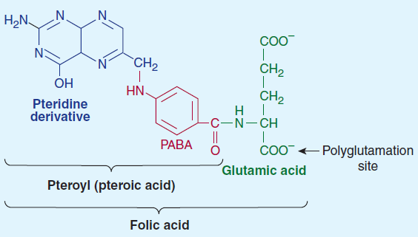
structure
Notes:
Vit b9.cannot be synthesized de novo by the body. Folic acid (pteroylglutamic acid) is composed of a heterocycle
(pteridine), p -aminobenzoic acid, and glutamic acid
Various numbers of glutamic acid moieties are attached to thepteroyl portion of the molecule, resulting in monoglutamates,triglutamates, or polyglutamates.

Slide 19
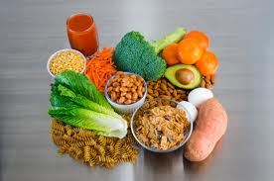
Pharmacokinetics
Sources
Yeast,liver,Green vegetables
Liver stores 5-20 mg
Loss in urine & stool,catabolism

Slide 20
Monoglutamate
Methyltetrahydrofolate
Polyglutamate Methyltetrahydrofolate
Diet
Brush border of intestine
α-1-glutamyl transferase
Transported to the cells by active
& passive transport
B12
Cells
Methyltetrahydrofolate
Tetrahydrofolate

Slide 21
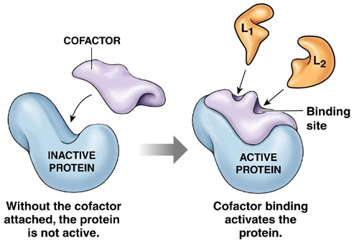
Pharmacodynamics
Required as a co-factor for the synthesis of,
DNA
Purines
Amino Acids

Slide 22
Causes Of Folate Deficiency
Dietary deficiency
Liver Disease
Relative folate deficiency
(pregnancy, Hemolytic Anemia)
Malabsorption Syndromes
(Sprue, Giardia Lamblia infection)
Dialysis
Drugs
( MTX,trimethoprim,phenytoin)

Slide 23
Clinical Findings
Neurologic abnormalities are associated with Vitamin B12 deficiency but NOT folic acid deficiency
Notes:
Microscopically indistinguishable from b12 deficiency

Slide 24
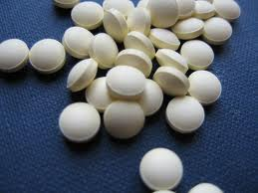
Folic Acid Therapy
Orally 1 mg folic acid daily
reverse the anemia
restore serum folate
replenish body stores of folate
Folic acid supplementation to prevent the deficiency should be considered in high risk patients

Slide 25
Hematopoietic Growth Factors
Glycoprotein hormones that regulate the proliferation of progenitor cells in the bone marrow.
Erythropoietin
G-CSF
GM-CSF
Interlukin-II

Slide 26
So Doctors now try helping your patient…
A 30 year old male presents to you with complaints of easy fatigability, lack of concentration, breathlessness on performing normal daily activities & ataxic gait since last 6 months. The patient has heard about you being a good student & wants your advice. On examination there is pallor of the skin & inflammation at the corner of the mouth.

Slide 27
???
What do you think is the most probable diagnosis of this patient ???
What labs would you advice ???
What treatment would you prescribe ???

