Slide 2
NEOPLASIA I

Slide 3
Neoplasia
Learning objectives :
Define neoplasia
Concept of Benign & malignant tumors
Nomenclature of tumors

Slide 4
NEoplasm
New growth - Neoplasm
“A neoplasm is an abnormal mass of tissue , the growth of which exceeds and is uncoordinated with that of normal tissues and persists in the same excessive manner after cessation of the stimuli which evoked the change”

Slide 5
Introduction
Oncology - study of tumors
(Greek oncos – tumor )
Medical Oncologist
Chemotherapy
Radiation Oncologist
Radiotherapy

Slide 6
NORMAL CELL
GENETIC ALTERATIONS
MALIGNANT TRANSFORMATION
EXCESSIVE UNREGULATED PROLIFERATION
CLONE OF TRANSFORMED CELLS
TUMOR

Slide 7
TYPES OF TUMOR
Benign tumors – innocent
localized
amenable to surgical removal
Malignant tumors – Cancers
( Latin word for crab - cancer)
invade adjacent tissues
metastasize
fatal outcome frequent
`

Slide 8
COMPONENTS OF TUMORS
2 basic components of tumors:
Parenchyma
Clonal neoplastic cells
Determine tumor’s behavior
Reactive stroma`
Connective tissue & blood vessels
Provide structural framework
Requsite blood supply
Soft & fleshy tumors – scant stroma
Desmoplastic – Schirrous – abundant collagenous stroma

Slide 9
nomenclature
Means of identifying tumors
Determines best course of treatment
Nomenclature & biological behavior is based primarily on the parenchymal component

Slide 10
nomenclature
BENIGN TUMORS:
Suffix – oma to the cell of origin
Benign Tumors of mesenchymal tissues :
Fibroma -benign tumor of fibrous tissue
Chondroma – benign tumor of cartilage
Leiomyoma - benign tumor of smooth muscle

Slide 11
nomenclature
Benign epithelial tumors – nomenclature is
based on cell of origin
or microscopic pattern
or macroscopic architecture
Adenoma
Papilloma
Cystadenomas
Papillary cystadenoma
Polyp – tumor forming macroscopically visible projection above mucosal surface

Slide 12
nomenclature
MALIGNANT TUMORS :
Sarcomas – tumors of mesenchymal tissues
(Greek Sarc – Fleshy) e.g Fibrosarcoma , Liposarcoma, Chondrosarcoma
Carcinomas – tumors of epithelial origin furtherqualified like
Squamous cell carcinoma
Adenocarcinoma
Undiffrentiated Malignant Tumor

Slide 13
nomenclature
Malignant tumors of blood-forming tissue
suffix – emia (Greek – Blood ) – leukemia
Tumors named after the doctor who first described
Hodgkin lymphoma – Thomas Hodgkin
Burkitt Lymphoma - Denis Parsons Burkitt
Ewing Sarcoma - James Ewing
Wilms Tumor - Max Wilms

Slide 14
nomenclature
MIXED TUMORS
Cells representative of single germ layer
Single neoplastic clone differentiating along divergent lines – e.g Mixed Parotid Tumor
TERATOMAS
Benign
Malignant
Originate from totipotential cells
Tissues representative of more than one or all germ cell layers

Slide 15
Misnomers
Benign sounding designations for malignat tumors :
Lymphoma
Melanoma
Semnoma
Ominous terms for trivial lesions :
Hamartoma
Choristoma
Heterotopic rests of cells

Slide 16
Table of nomenclatur
Misnomers
Diagrams of diff tumors

Slide 17
Mixed Parotid Tumor
Teratoma

Slide 18
CHARACTERISTICS OF BENIGN & MALIGNANT
Differentiation and Anaplasia
Rates of Growth
Cancer stem cells & cancer cell lineages
Local invasion
Metastasis

Slide 19
Differentiation and Anaplasia
Differentiation – extent to which neoplastic parenchymal cells resemble the corresponding normal parenchymal cells both morphologically & functionally
Anaplasia – lack of differentiation ; considered a hallmark of malignancy
Benign tumors – cells differentiated , closely resemble normal cells
Malignant tumors – well diff, moderately diff, poorly diff

Slide 20
other features of malignancy/anaplasia
Lack of differentiation is associated with many other morphologic changes :
Pleomorphism : both cells & nuclei
Abnormal nuclear morphology : hyperchromatic nuclear :cytoplasm ratio altered 1:1 (1:4 or 1:6)
Mitosis : ↑mitosis , atypical mitosis
Loss of polarity :orientation is disturbed inmalig
Tumor giant cells
Necrosis

Slide 21
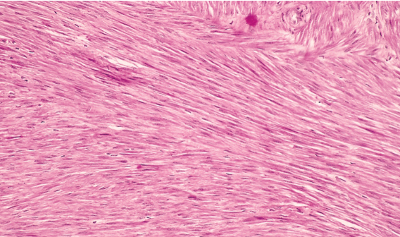
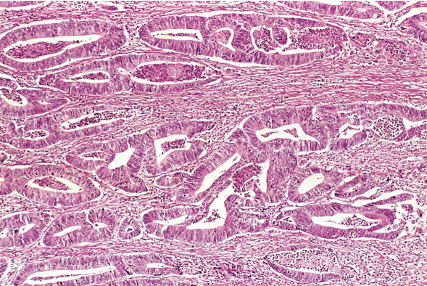
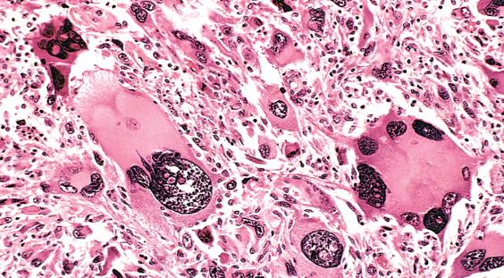
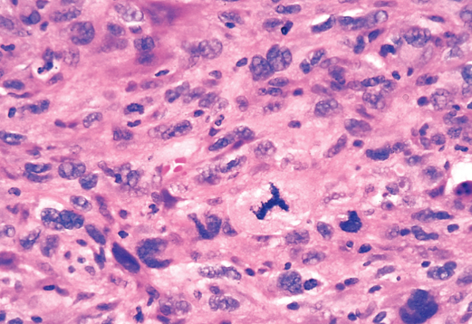
Benign tumor of myometrium
Malignant tumor - Adenocarcinoma
Anaplastic tumor of skeletal muscle - tumor giant cells & pleomorphism
Anaplastic tumor – marked pleomorphism & atypical mitosis

Slide 22
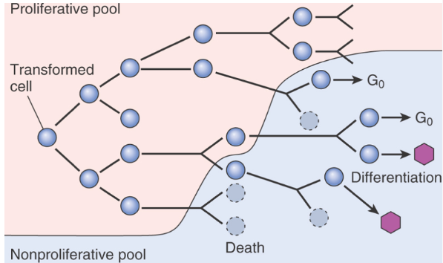
rates of growth
3 major factors:
Doubling time of tumor cells
Fraction of tumor cells in replicative pool
Rate of cell death
Schematic representation of tumor growth

Slide 23
rates of growth
Growth fraction : the proportion of cells in replicative pool
Rate of growth of tumors is determined by an excess of cell production over cell loss
Fast growing tumors have a high cell turnover
Growth fraction of tumor cells has profound effect on their susceptibility to chemotherapy
Tumor with low growth fraction : 1st shift tumor cells from G_{O} into cell cycle – debulking the tumor by radiotherapy or surgery & then chemo
Growth rate of tumors correlate with their level of differentiation

Slide 24
cancer stem cells & ca cell lineages
Resident population of tissue stem cells that are longlived and capable of self-renewl
Cancers have limitless proliferative capacity indicating that they also must contain cells with “stemlike”properties
Practical implication is that if Ca stem cells are “essential” for tumor progression they must be eliminated by therapy; like normal stem cells cancer stem cells have high intrinsic resistance to conventional therapy
T- ICs : Cells that allow a human tumor to grow and maintain itself indefinitely when transplanted into an immunodeficient mouse. In future it will be imp to identify T-Ics in each tumor to direct therapy against tumor stemcel

Slide 25
local invasion
Nearly all benign tumors grow as cohesive expansile masses,have a rim of fibrous capsule
Malignant tumors are accompanied by infiltrat- ion, invasion & destruction of surrounding tissue – a crab-like pattern of growth
Invasiveness makes surgical resection difficult

Slide 26
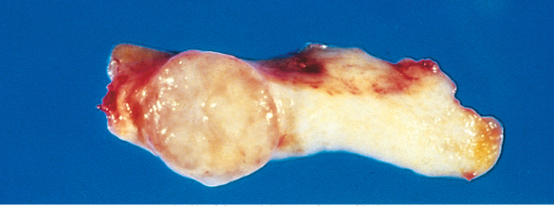
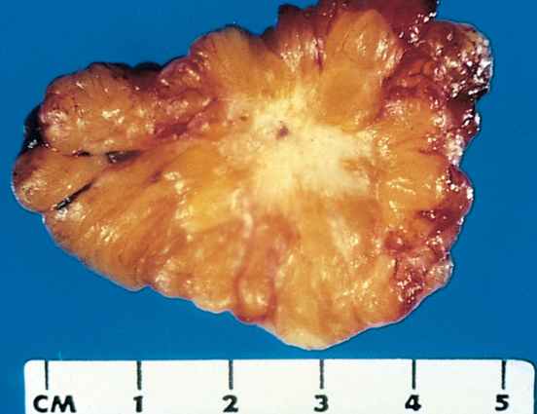
Fibroadenoma – encapsulated
small tumor
Invasive ductual carcinoma – infiltrating tumor

Slide 27
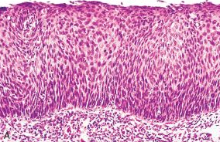
local invasion
In-situ epithelial cancers have cytologic features of malignancy without invasion of basement membrane

Slide 28
metastasis
Tumor implants discontinuous with the primary tumors
Unequivocal sign of malignancy ; benign tumors donot metastasize
Malignant neoplasms of glial cells in CNS and basal cell carcinoma skin are exceptions –they invade locally but rarely metastasize
Pathways of spread :
Direct seeding of body cavities and surfaces
Lymphatic spread
Hematogenous spread

Slide 29
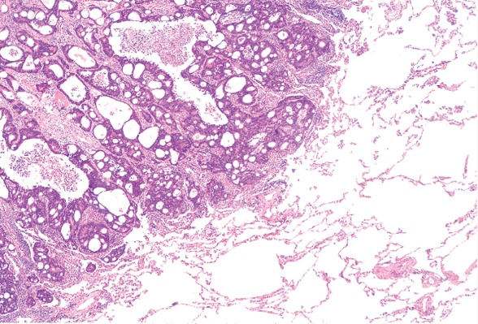
Seeding of body cavities and surfaces :
May occur whenever a malignant tumor penetrates into a natural “open field”
Peritoneal cavity is most oftenly involved
Particularly characteristic of Ca ovaries
Pseudomyxoma peritonei
Colon carcinoma invading pericolonic adipose tissue

Slide 30
Lymphatic spread
Most common pathway for initial spread of tumor
Lymphatic vessels located at tumor margin
Pattern of L node involvement follows the natural routes of lymphatic spread
“Sentinel lymph node” biopsy
“Skip metastasis” – local lymph nodes are bypassed
Regional L nodes serve as effective barriers to further dissemination, at least for sometime.
Nodal ↑is due to
growth of tumor
reactive changes

Slide 31
Hematogenous Spread :
Typical of sarcoma, also seen with Ca
Arteries less readily penetrated than veins
Arterial spread may occur when tumor cells pass pul-monary capillary bed, or pulm A/V shunts ;or when pul mets give rise to additional tumor emboli
With venous invasion blood-borne cells follow venus flow draining the site of neoplasm , and usually settle in the 1st capillary bed they encounter

Slide 32
METASTATIC CASCADE
2 Phases of cascade:
Invasion of ECM
Vascular dissemination

Slide 33
INVASION OF ECM :
Loosening of I/cellular junction
E – cadherins
Β – catenin
Degradation of ECM
Proteases
MMPs
ECM sequestered growth F
Ameboid migration
Attachment of tumor cells to novel ECM components
Migration of tumor cells
Tumor cell aggregates
PLATELETS
CD44

Slide 34
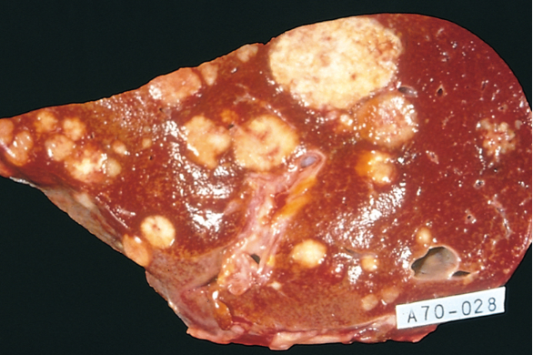
Liver and lung are the most
frequently involved
Tumors in close proximity
to vertebral column
(Ca thyroid & prostate)
embolise through
paravertebral plexus
Skeletal muscle and
spleen are rarely the site of metastasis despite enormous blood flow
Certain tumors have propensity for invasion of veins : Renal cell carcinoma & Hepatocellular Ca

Slide 36
EPIDEMIOLOGY

Slide 37
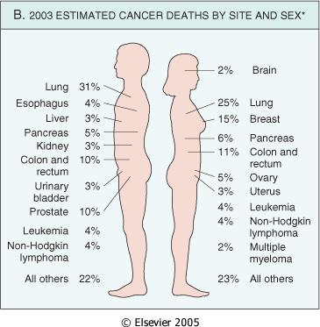
CANCER INCIDENCE

Slide 38
GEOGRAPHIC AND ENVIRONMENTAL FACTORS
Environmental factors are considered to be more significant contributors in most common sporadic Cas
Remarkable differences found in the incidence and death rates of specific forms of cancers around the world also suggest a role for environmental factors
Environment we live in, has lot of carcinogenic factors in the work place, food ,in personal practices
Ciggarette smoking is the single most imp environmental factor contributing to premature deaths in USA ; increased risk of CA in upper aerodigestive tract particularly Ca lung

Slide 39
Death rate from ca in japan & california

Slide 40
age
Rising incidence of cancer with increasing age
May be explained by the accumulation of somatic mutations associated with emergence of malignant neoplasms ; decline in immune compitence with age
Most carcinomas occur in later age (> 55yrs)
Ca is main cause of death in; women 40-79 yrs & men 60-79yr

Slide 41
age
Children are not spared, however the type of cancers that predominate in children are significantly different from those in adults
Acute lukemia & primitive neoplasms of CNS are the commonest ; Small round blue cell tumors
( neuroblastoma , Wilms tumour , lukemia , retinoblastoma , rhabdomyosarcoma )

Slide 42
genetic predisposition to cancer
For a large no of cancer types there exists not only environmental influences but also hereditary predispositions
Genes that are causally associated with cancer that have strong hereditary predisposition are also involved in much more common sporadic forms of the same tumor
Genetic predisposition to cancer can be divided into 3 categories :

Slide 43
Autosomal dominant inherited cancer syndromes:
Inheritence of a single autosomal dominant mutant gene greatly ↑risk of developing tumor
A point mutation in a single allele of tumor suppressor gene e.g
Retinoblastoma (40% are inherited)- RB gene
Familial adenomatous polyposis coli (APC) – APC gene
Li- Fraumeni syndrome – p53 gene
In each syndrome tumors tend to arise in specific sites /tissues
Tumors are often associated with a specific marker phenotype

Slide 44
Defective DNA-repair syndromes:
A group of cancer predisposing conditions characterized by defects in DNA repair with resultant DNA instability
Autosomal recessive inheritance
Xeroderma pigmentosum , Bloom syndrome , Ataxia telangiectasia,
HNPCC (hereditary nonpolyposis colon cancer) increases the susceptibility of Ca colon , small intestine , endometrium and ovary

Slide 45
Familial Cancers :
Cancers may occur at higher frequency in certain families
Transmission pattern is not clear
Features include ; early age at onset, tumors arising in 2 or more close relatives of indexcase, multiple or bilateral tumors
Siblings have a risk 2-3 times > unrelated individuals
10 -20% patients with breast or ovarian Ca have 1st or 2nd degree relative with one of these Ca
Examples – Ca colon, breast, ovary, brain , lymphoma

Slide 46
Interaction between genetic and nongenetic factors:
Generally difficult to sort out hereditary and acquired basis of tumor
Complex interaction between genetic and environmental factors when tumor development depends on action of multiple contributory genes
In tumors with welldefined hereditary componant,the risk of developing Ca can be influenced by nongenetic factors
The genotype can significantly influence the likely-hood of developing environmentally induced Cas e.g
variation at one of the p-450 loci confers inherited susceptibility to lung Ca in cigarrette smokers

Slide 47
nonhereditary predisposing conditions
Chronic inflammation and cancer :
Virchow proposed that Ca develops at sites of chronic inflammation
Precise mechanisms that link inflammation and Ca development are not established ; recent work demonstrated that in the setting of unresolved ch inflammation , the immune response may become maladaptive and promote tumorigenesis e.g
Cystitis → Bladder carcinoma
Hepatitis B & C →→ Hepatocellular carcinoma
H. pylori gastriris →→Adenocarcinoma stomach ,MALT
Expression of COX-2 is induced by inflammatory stimuli & is increased in colon & other Cas

Slide 48
Precancerous conditions :
Non-neoplastic disorders having welldefined association with cancer are termed precancerous conditions
In the great majority of these lesions no malignant neoplasm emerges but it calls attention to the increased risk
Solar keratosis of skin - Ca skin (mostly squamous cell)
Chronic ulcerative colitis - Ca colon
Leukoplakia of oral cavity - oral cancer
Chronic atrophic gastritis of pernicious anemia – Ca stomach

