Slide 2
neoplasia III tumour genetics MOLECULAR BASIS OF CANCER

Slide 3
FUNDAMENTAL PRINCIPLES of carcinogenesis
1. Nonlethal genetic damage lies at the heart of carcinogenesis
2. Tumor is formed by the clonal expansion of a single precursor cell
3. The principal targets of genetic damage are the 4 classes of normal regulatory genes
4. Carcinogenesis is a multistep process resulting from accumulation of multiple mutations

Slide 4
four classes of normal regulatory genes
Growth-promoting - proto-oncogenes
Growth-inhibiting - tumor suppressor genes
Genes that - regulate apoptosis
Genes involved in - DNA repair

Slide 5
fundamental principles
Proto- oncogenes - mutant alleles are dominant
Tumor suppressor genes - both normal alleles must be damaged to transform cell
Genes regulating apoptosis - may behave like proto-oncogenes or tumor supressor genes
DNA repair genes - affect indirectly influence the ability to repair nonlethal damage in other genes

Slide 6
Tumor progression and heterogeneity
result from multiple mutations that accumulate independently in diff cells generating subclones with varying abilities to
grow, invade, metastasize and resist /respond to therapy

Slide 7
Tumor progression & generation of hetrerogeneity

Slide 8
7 Key changes in cell physiology for malignant transformation :
Self-sufficiency in growth signals
Insensitivity to growth-inhibitory signals
Evasion of apoptosis
Limitless replication potential
Sustained angiogenesis
Ability to invade and metastasize
Defects in DNA repair

Slide 9
Simplified Scheme of Molecular basis of Cancer

Slide 10
CaNCER – ASSOCIATED GENES
Proto-oncogenes – normal cellular genes , multiple roles participating in cellular functions related to growth and proliferation
Poteins encoded by proto-oncogenes may act as :
Growth factors
Growth factor receptors
Signal transducers
Transcription factors
Cell cycle components

Slide 11
Oncognes – genes that promote autonomous cell growth in cancer cells
Created by mutations in proto-oncogenes - constitutively active oncogenes
Oncoproteins – produts of oncogenes , resemble products of proto-oncogene except
devoid of imp internal regulatory elements
Endow the cell with self-sufficiency in growth

Slide 12
The sequential steps of normal cell proliferation :
The binding of a growth factor to its specific receptor
Transient & limited activation of the growth factor receptor, in turn activates signal-transducing proteins on the inner leaflet of the plasma membrane

Slide 13
The sequential steps of normal cell proliferation.
Transmission of the transduced signal across the cytosol to the nucleus via second messengers or by a cascade of signal transduction molecules
Induction and activation of nuclear regulatory factors that initiate DNA transcription
Entry and progression of the cell into the cell cycle, ultimately resulting in cell division

Slide 14
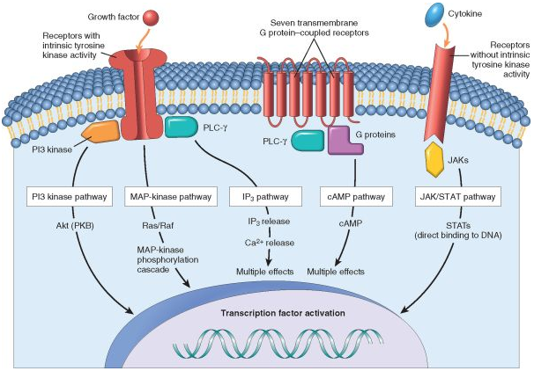
Overview of the main types of cell surface receptors and their principal signal transduction pathways

Slide 15
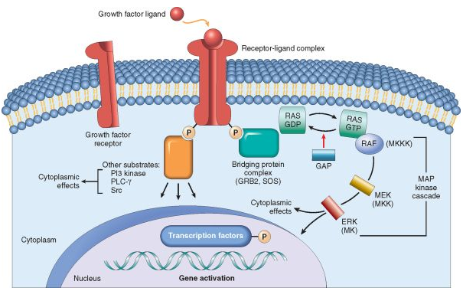
Signaling from tyrosine kinase receptors. Binding of the growth factor (ligand) causes receptor dimerization and autophosphorylation of tyrosine residues.

Slide 16
Cell cycle landmarks. The figure shows the cell cycle phases (G0, G1, G2, S, and M), the location of the G1 restriction point, and the G1/S and G2/M cell cycle checkpoints

Slide 17
Self-sufficiency in growth signals : Oncogenes
Oncoproteins encoded by oncogenes endow the cell with self-sufficiency in growth.
Now, we will discuss that
What are the functions of oncogene products, the oncoproteins?
How do the normally “civilized” proto-oncogenes turn into “enemies within”?

Slide 18
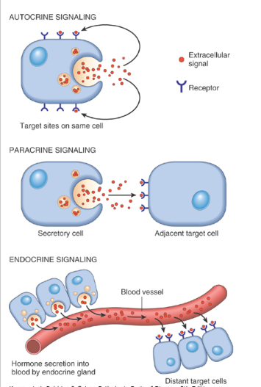
growth factors
Normal cells require
stimulation by growth
factors to undergo
proliferation.
Most soluble growth
factors have
paracrine signaling
.

Slide 19
growth factors
Cancer cells
Acquire the ability to synthesize the same growth factors to which they are responsive, generating an autocrine loop; e.g
Many glioblastomas secrete platelet-derived growth factor (PDGF) and express the PDGF receptor
Many sarcomas make both transforming growth factor α (TGF-α) and its receptors

Slide 20
growth factors
Overexpression of growth factor genes ; forcing cells to secrete large amounts of growth factors
Increased cell proliferation contributes to malignant change by increasing the risk of mutations (spontaneous/induced)

Slide 21
Selected Oncogenes, Their Mode of Activation, and Associated Human Tumors

Slide 22
growth factor receptors
Oncogenic versions of receptors have constitutive dimerization and activation without binding to growth factor
Mutant receptors deliver continuous mitogenic signals to cells, even in the absence of growth factor
These receptors can be constitutively activated
in tumors by multiple mechanisms including
mutations , gene rearrangements, overexpression
c-KIT , HER-2/NEU - Targeted therapy

Slide 23
Selected Oncogenes, Their Mode of Activation, and Associated Human Tumors

Slide 24
Signal-Transducing Proteins
Several oncoproteins mimic the function of normal cytoplasmic signal-transducing proteins ; strategically located on the inner leaflet of the plasma membrane
Biochemically, the signal-transducing proteins are heterogeneous.
The most well-studied example of a signal-transducing oncoprotein is the RAS family of guanine triphosphate (GTP)-binding proteins (G proteins).

Slide 25
The RAS Oncogene
Three RAS genes in humans (HRAS, KRAS, NRAS).
Point mutation of RAS family genes is the single most common abnormality of proto-oncogenes in human tumors
Approximately 15% to 20% of all human tumors contain mutated versions of RAS proteins
Carcinomas colon (50%) and pancreas (90%) have mutations of KRAS, bladder tumors have HRAS mutations, and hematopoietic tumors bear NRAS mutations.
RAS mutations are infrequent in certain other Cas such as Ca cervix or breast.

Slide 26
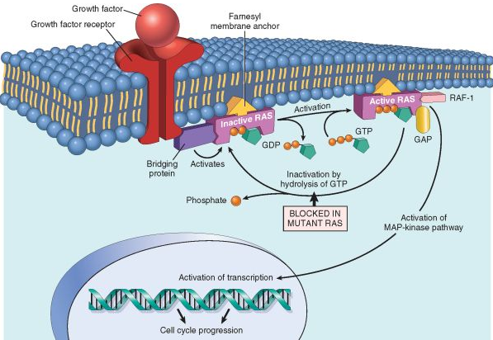
The RAS Oncogene
. GTP hydrolysis by GTPase converts RAS into inactive form ; this is markedly accelerated by GAPs. Thus GAPs function as “brakes” to prevent uncontrolled activation of RAS. The mutated RAS is trapped in active form because it cannot hydrolyse GTP.
Model for action of RAS genes

Slide 27
Alterations in Nonreceptor Tyrosine Kinases
Mutations that unleash latent oncogenic activity occur in several non-receptor-associated tyrosine kinases, which normally function in signal transduction pathways
Chromosomal translocation or rearrangements that create fusion genes encoding constitutively active tyrosine kinases.
In CML and some acute lymphoblastic leukemias, the ABL gene is translocated from its normal abode on chromosome 9 to chromosome 22, where it fuses with the BCR gene.

Slide 28
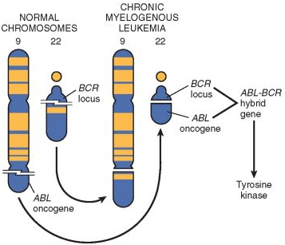
Chromosomal translocation & associated oncogenes
The resultant chimeric gene encodes a constitutively active, oncogenic BCR-ABL tyrosine kinase.
Treatment of CML has been revolutionalized by development of “designer” drug that inhibits BCR-ABL kinase

Slide 29
Transcription Factors
The ultimate consequence of signaling through oncogenes like RAS or ABL is inappropriate and continuous stimulation of nuclear transcription factors that drive growth-promoting genes.
Transcription factors contain specific amino acid sequences or motifs that allow them to bind DNA or to dimerize for DNA binding.
Binding of these proteins to specific sequences in the genomic DNA activates transcription of genes.

Slide 30
Transcription Factors
Growth autonomy may occur as a consequence of mutations affecting genes that regulate transcription.
A host of oncoproteins, including products of the MYC, MYB, JUN, FOS, and REL oncogenes, are transcription factors that regulate the expression of growth-promoting genes, such as cyclins.
MYC is the most commonly involved in human tumors.

Slide 31
The MYC Oncogene
MYC protooncogene is expressed in all eukaryotic cells and is rapidly induced when cell gets signal to divide. After transient ↑ of MYC mRNA the expression declines to basal level
MYC interacts with components of the DNA-replication machinery, and plays a role in the selection of origins of replication.
Overexpression of MYC may drive activation of more origins than needed for normal cell division, or bypass checkpoints involved in replication, leading to genomic damage and accumulation of mutations.
.

Slide 32
The MYC Oncogene
Finally, MYC is one of a handful of transcription factors that can act in concert to reprogram somatic cells into pluripotent stem cells
MYC may also enhance self-renewal, block differentiation, or both.
Amplification of this gene is associated with a variety of tumors, e.g Burkit lymphoma

Slide 33
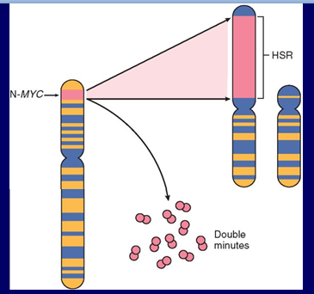
The MYC Oncogene
Amplification of the N-MYC gene in human neuroblastomas. The N-MYC gene, normally present on chromosome 2p, becomes amplified and is seen either as extra chromosomal double minutes or as a chromosomally integrated, homogeneous staining region (HSR). The integration involves other autosomes, such as 4, 9, or 13.

Slide 34
CYCLIN AND CYCLIN DEPENDENT KINASES
The orderly progression of cells through various phases of cell cycle is orchestrated by cyclin-dependent kinases –CDKs , which are activated by binding to cyclins ;( cyclin D,E ,A & B appear sequentially);
CDK- cyclin complexes phosphorylate crucial target proteins that drive the cell through cell cycle ;on completion of this task cyclin levels decline rapidly
Cyclin D genes are overexpressed in many cancers (breast, esophagus , liver, some lymphomas)
Amplification of CDK4 gene occurs in melanomas sarcomas , glioblastomas

Slide 36
While cyclins activate CDKs, CDK inhibitors (CDKIs) silence CDKs , exert negative effect over the cell cycle
Expression of these inhibitors is down regulated by mitogenic signaling pathways, thus promoting progression of cell cycle
CDKIs are mutated or silenced in many human malignancies

