Slide 2
NEOPLASIA II CHARACTERISTICS OF BENIGN & MALIGNANT tumors

Slide 3
CHARACTERISTICS OF BENIGN & MALIGNANT
Differentiation and Anaplasia
Rates of Growth
Cancer stem cells & cancer cell lineages
Local invasion
Metastasis

Slide 4
Differentiation and Anaplasia
Differentiation – extent to which neoplastic parenchymal cells resemble the corresponding normal parenchymal cells both morphologically & functionally
Benign tumors – cells differentiated , closely resemble normal cells

Slide 5
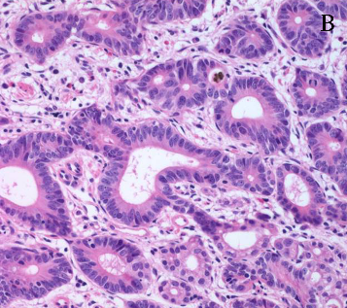
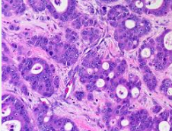
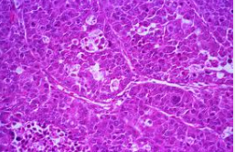
Differentiation and Anaplasia
Malignant tumors – well diff, moderately diff, poorly diff

Slide 6
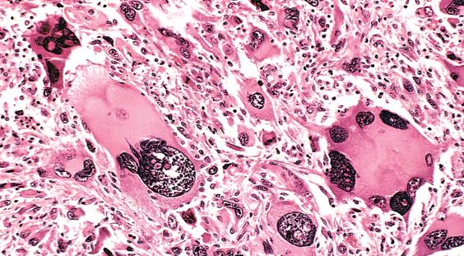
Differentiation and Anaplasia
Anaplasia – “to form backwards”
Anaplasia – lack of differentiation ; considered a hallmark of malignancy
Associated morphologic features:
Pleomorphism
Abnormal nuclear
morphology
(N:C ratio 1:1)

Slide 7
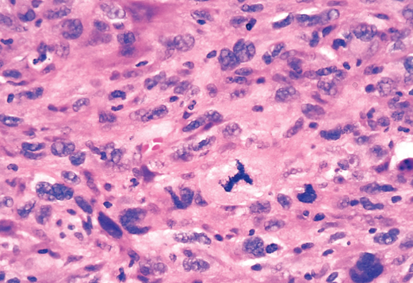
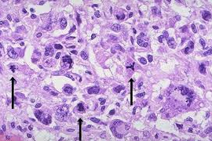
ANAPLASIA
Mitoses : ↑mitosis , atypical mitosis

Slide 8
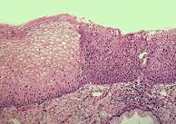
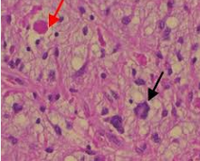
other features of malignancy/anaplasia
Loss of polarity
Tumor giant cells
Necrosis

Slide 9
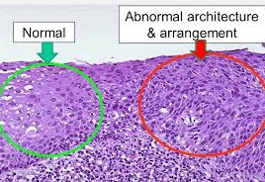
Dysplasia : disordered growth
loss in
uniformity of individual cells
their architectural orientation

Slide 10
Functional capabilities:
Benign tumors & well diff Cas – retain
Poorly diff & Anaplastic Cas – don’t retain
New Unanticipated functions may emerge
Fetal proteins
Hormone production by Nonendocrine Ca

Slide 11
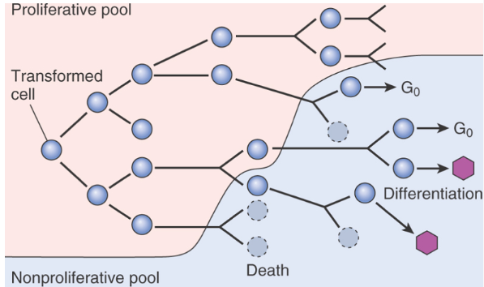
rates of growth
3 major factors:
Doubling time of tumor cells
Fraction of tumor cells in replicative pool
Rate of cell death
Schematic representation of tumor growth

Slide 12
rates of growth
Growth fraction : the proportion of cells in replicative pool
Rate of growth of tumors is determined by an excess of cell production over cell loss
Fast growing tumors have a high cell turnover
Growth fraction of tumor cells has profound effect on their susceptibility to chemotherapy
Tumor with low growth fraction : 1st shift tumor cells from G_{O} into cell cycle – debulking the tumor by radiotherapy or surgery & then plan chemo

Slide 13
rates of growth
Growth rate of tumors correlate with their level of differentiation
Rate of growth may not be constant
Hormonal influencies
Adequacy of blood supply
Emergence of aggressive subclones

Slide 14
cancer stem cells & ca cell lineages
Resident population of tissue stem cells that are longlived and capable of self-renewl
Cancers also must contain cells with “stemlike”properties
Practical implication : if Cancer stem cells are “essential” for tumor progression they must be eliminated by therapy;

Slide 15
cancer stem cells & ca cell lineages
T- ICs : Cells that allow a human tumor to grow and maintain itself indefinitely when transplanted into an immunodeficient mouse. In future it will be imp to identify T-Ics in each tumor to direct therapy against tumor stemcells

Slide 16
local invasion
Benign tumors - cohesive expansile masses
a rim of fibrous capsule
Malignant tumors –
a crab-like pattern of growth
infiltration, invasion & destruction of tissues
No capsule
Invasiveness makes surgical resection difficult

Slide 17
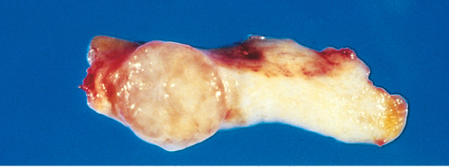
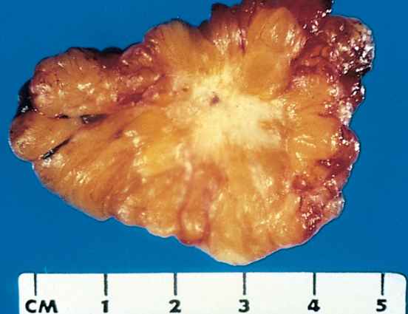
Fibroadenoma – encapsulated
small tumor
Invasive ductual carcinoma – infiltrating tumor

Slide 18
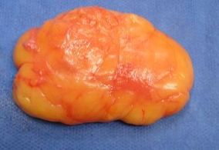
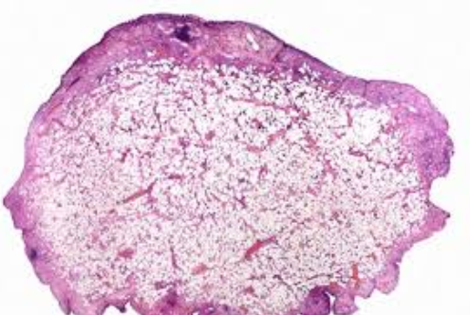
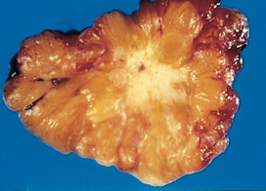

Slide 19
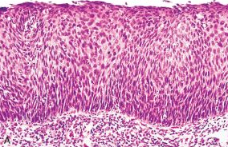
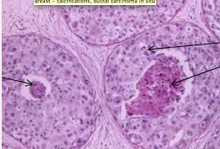
local invasion
In-situ epithelial cancers have cytologic features of malignancy without invasion of basement membrane

Slide 20
metastasis
Tumor implants discontinuous with the primary tumors
Unequivocal sign of malignancy
Exceptions – locally invasive rarely metastasize
Malignant neoplasms of glial cells in CNS
Basal cell carcinoma skin

Slide 21
metastasis
Pathways of spread :
Direct seeding of body cavities and surfaces
Lymphatic spread
Hematogenous spread

Slide 22
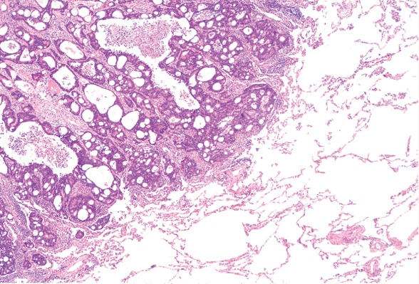
Seeding of body cavities and surfaces :
May occur whenever a malignant tumor penetrates into a natural “open field”
Peritoneal cavity most oftenly involved
Particularly characteristic of Ca ovaries
Pseudomyxoma peritonei
Colon carcinoma invading pericolonic adipose tissue

Slide 23
Lymphatic spread :
Most common pathway for initial spread of tumor
Lymphatic vessels located at tumor margin
Pattern of L node involvement follows the natural routes of lymphatic drainage

Slide 24
Metastatic Ductal Carcinoma Breast

Slide 25
Lymphatic spread
Regional L nodes - effective barriers to further dissemination, at least for sometime
“Sentinel lymph node” biopsy
“Skip metastasis” – local lymph nodes are bypassed
Nodal ↑is due to
growth of tumor
reactive changes

Slide 26
Hematogenous Spread :
Typical of sarcoma, also seen with Ca
Arteries less readily penetrated than veins
Arterial spread may occur
tumor cells pass pul-monary capillary bed
or pulm A/V shunts
pul mets give rise to additional tumor emboli

Slide 27
Hematogenous Spread :
With venous invasion blood-borne cells follow venus flow draining the site of neoplasm , and usually settle in the 1st capillary bed they encounter

Slide 28
METASTATIC CASCADE
2 Phases of cascade:
Invasion of ECM
Vascular dissemination & Homing of tumor cells

Slide 29
INVASION OF ECM :
Loosening of I/cellular junction
E – cadherins
Β – catenin
Degradation of ECM
Proteases
MMPs
ECM sequestered growth F
Ameboid migration
Attachment of tumor cells to novel ECM components
Migration of tumor cells
Tumor cell aggregates
PLATELETS
CD44

Slide 30
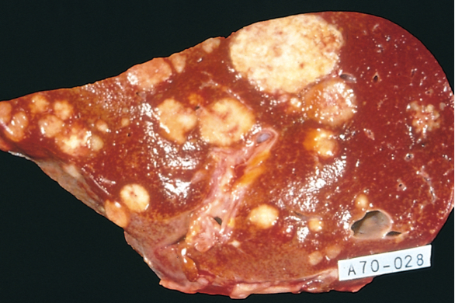
Liver and lung are the most
frequently involved
Tumors in close proximity
to vertebral column
(Ca thyroid & prostate)
embolise through
paravertebral plexus
Skeletal muscle and
spleen are rarely the site of metastasis despite enormous blood flow
Certain tumors have propensity for invasion of veins : Renal cell carcinoma & Hepatocellular Ca

Slide 31
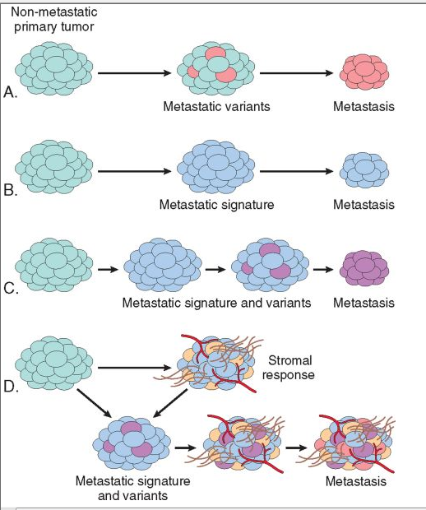
Molecular genetics of metastasis
Mechanisms of metastasis development in primary tumour

