Slide 2
NEOPLASIA iii epidemiology

Slide 3
metastasis
Pathways of spread :
Direct seeding of body cavities and surfaces
Lymphatic spread
Hematogenous spread

Slide 4
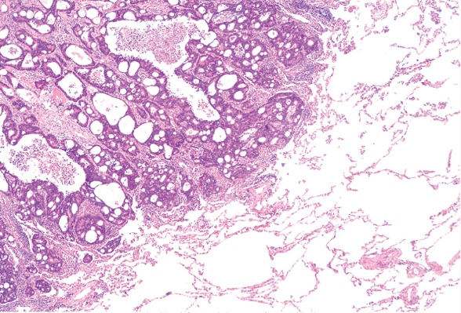
Seeding of body cavities and surfaces :
May occur whenever a malignant tumor penetrates into a natural “open field”
Peritoneal cavity most oftenly involved
Particularly characteristic of Ca ovaries
Pseudomyxoma peritonei
Colon carcinoma invading pericolonic adipose tissue

Slide 5
Lymphatic spread :
Most common pathway for initial spread of tumor
Lymphatic vessels located at tumor margin
Pattern of L node involvement follows the natural routes of lymphatic drainage

Slide 6
Lymphatic spread
Regional L nodes - effective barriers to further dissemination, at least for sometime
“Sentinel lymph node” biopsy
“Skip metastasis” – local lymph nodes are bypassed
Nodal ↑is due to
growth of tumor
reactive changes

Slide 7
Hematogenous Spread :
Typical of sarcoma, also seen with Ca
Arteries less readily penetrated than veins
Arterial spread may occur
tumor cells pass pul-monary capillary bed
or pulm A/V shunts
pul mets give rise to additional tumor emboli

Slide 8
Hematogenous Spread :
With venous invasion blood-borne cells follow venus flow draining the site of neoplasm , and usually settle in the 1st capillary bed they encounter

Slide 9
METASTATIC CASCADE
2 Phases of cascade:
Invasion of ECM
Vascular dissemination & Homing of tumor cells

Slide 10
INVASION OF ECM :
Loosening of I/cellular junction
E – cadherins
Β – catenin
Degradation of ECM
Proteases
MMPs
ECM sequestered growth F
Ameboid migration
Attachment of tumor cells to novel ECM components
Migration of tumor cells
Tumor cell aggregates
PLATELETS
CD44

Slide 11
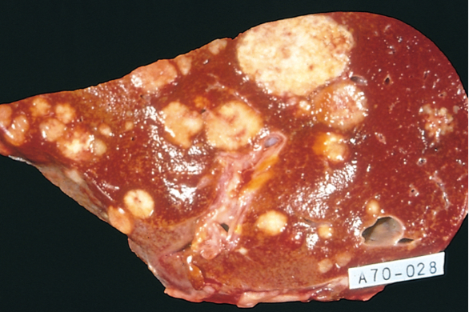
Liver and lung are the most
frequently involved
Tumors in close proximity
to vertebral column
(Ca thyroid & prostate)
embolise through
paravertebral plexus
Skeletal muscle and
spleen are rarely the site of metastasis despite enormous blood flow
Certain tumors have propensity for invasion of veins : Renal cell carcinoma & Hepatocellular Ca

Slide 12
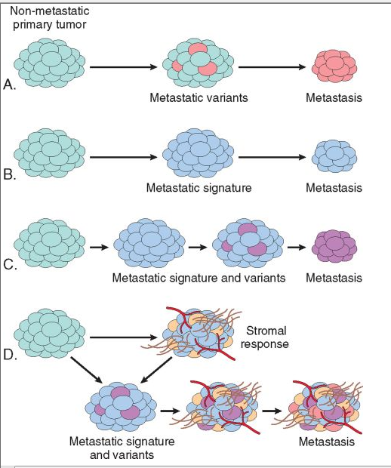
Molecular genetics of metastasis
Mechanisms of metastasis development in primary tumour

Slide 13
epidemiology

Slide 14
CANCER INCIDENCE
In US population > 50% CA are
Ca lung ,Breast, prostate , Colon/rectum
The most common tumors in men:
Prostate
Lung
Colorectum
The most common tumors in women:
Breast
Lung
Colorectum

Slide 15
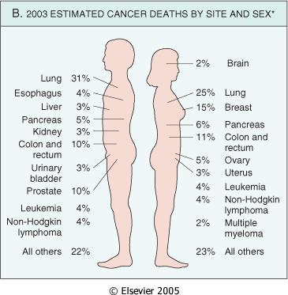
CANCER INCIDENCE

Slide 16
GEOGRAPHIC AND ENVIRONMENTAL FACTORS
Environmental factors - significant contributors in most sporadic Cas
Remarkable differences in the incidence and death rates of specific forms of cancers around the world
Environment we live in, has lot of carcinogenic factors in the work place, food in personal practices

Slide 17
GEOGRAPHIC AND ENVIRONMENTAL FACTORS
Ciggarette smoking is the single most imp environmental factor contributing to premature deaths in USA ;
increased risk of CA in upper aerodigestive tract particularly Ca lung

Slide 18
Death rate from ca in japan & california

Slide 19
age
Rising incidence of cancer with increasing age
Accumulation of somatic mutations associated with emergence of malignant neoplasms ; decline in immune compitence with age
Most carcinomas occur in later age (>55yrs)

Slide 20
age
Ca is main cause of death in ;
women 40-79 yrs & men 60-79 yr
Paediatric age & predominant tumors
Acute lukemia & primitive neoplasms of CNS are the commonest ;
Small round blue cell tumors (neuroblastoma , Wilms tumor, lukemia retinoblastoma , rhabdomyosarcoma)

Slide 21
genetic predisposition to cancer
For a large no of cancer types there exists hereditary predispositions
Genes causally associated with cancers having strong hereditary predisposition are also involved in sporadic forms of the same tumor
Genetic predisposition to cancer can be divided into 3 categories :

Slide 22
Autosomal dominant inherited cancer syndromes:
Inheritence of a single autosomal dominant mutant gene greatly ↑risk of developing tumor
A point mutation in a single allele of tumor suppressor gene e.g
Retinoblastoma (40% are inherited ) - RB gene
Familial adenomatous polyposis coli (APC) – APC gene
Li- Fraumeni syndrome – p53 gene
In each syndrome tumors tend to arise in specific sites /tissues
Tumors are often associated with a specific marker phenotype

Slide 23
Defective DNA-repair syndromes:
A group of cancer predisposing conditions characterized by defects in DNA repair with resultant DNA instability
Autosomal recessive inheritance
Xeroderma pigmentosum , Bloom syndrome , Ataxia telangiectasia,
HNPCC (hereditary nonpolyposis colon cancer) increases the susceptibility of Ca colon , small intestine , endometrium and ovary

Slide 24
Familial Cancers :
Cancers may occur at higher frequency in certain families
Transmission pattern not clear
Features include ;
early age at onset
tumors arising in 2 or more close relatives of indexcase
multiple or bilateral tumors

Slide 25
Familial Cancers :
Siblings have a risk 2-3 times > unrelated individuals
10 -20% patients with breast or ovarian Ca have 1st or 2nd degree relative with one of these Ca
Examples – Ca colon, breast, ovary, brain lymphoma

Slide 26
Interaction between genetic and nongenetic factors:
Generally difficult to sort out hereditary and acquired basis of tumor
Complex interaction between genetic and environmental factors when tumor development depends on action of multiple contributory genes

Slide 27
Interaction between genetic and nongenetic factors:
In tumors with welldefined hereditary componant the risk of developing Ca can be influenced by nongenetic factors
The genotype significantly influences the likely-hood of developing environmentally induced Cas e.g
variation at one of the p-450 loci confers inherited susceptibility to lung Ca in cigarrette smokers

Slide 28
nonhereditary predisposing conditions
Chronic inflammation and cancer :
Virchow proposed that Ca develops at sites of chronic inflammation
Precise mechanisms that link inflammation and Ca development are not established

Slide 29
Recent work - in the setting of unresolved ch inflammation , the immune response may become maladaptive and promote tumorigenesis e.g
Cystitis → Bladder carcinoma
Hepatitis B & C → Hepatocellular Ca
H. pylori gastriris → Adenocarcinoma stomach , MALT

Slide 30
Precancerous conditions :
Non-neoplastic disorders having welldefined association with cancer are termed precancerous conditions
It calls attention to the increased risk
Solar keratosis of skin - Ca skin (mostly squamous cell)
Chronic ulcerative colitis - Ca colon
Leukoplakia of oral cavity - oral cancer
Chronic atrophic gastritis of pernicious anemia – Ca stomach

