Slide 1
NON-STEROIDAL
ANTI-INFLAMMATORY
DRUGS
(NSAID’s)
Dr. Naila Abrar

Slide 2
LEARNING OBJECTIVES
After this session, you should be able to:
recall the pathophysiology of inflammatory response;
classify NSAID’s;
know the common features of NSAID’s;
describe mechanism of action of NSAID’s; and
discuss pharmacokinetic features, mechanism of action, pharmacological effects, adverse effects and clinical pharmacology of aspirin.

Slide 3
THE INFLAMMATORY RESPONSE
Immune response
INFLAMMATION
Normal / Abnormal
Calor
Dolor
Rubor
Tumor
Loss of function

Slide 4
FUNCTIONS OF COX
COX-1
Constitutively expressed
Housekeeping functions
Present in every organ stomach, intestine, kidney, platelets, vascular endothelium
COX-2
Inducible
Inflammatory & neoplastic sites
Also present in kidney, uterus. ovary brain, small intestine

Slide 5
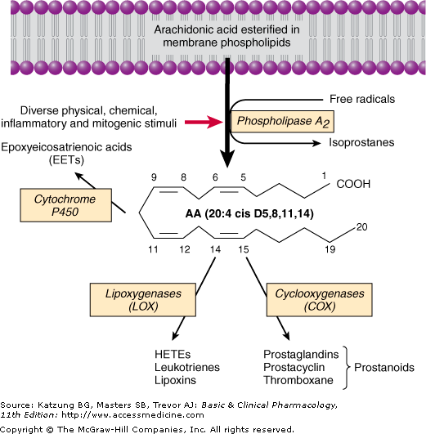
Notes:
Hydroxytecosatetraenoic acid

Slide 6
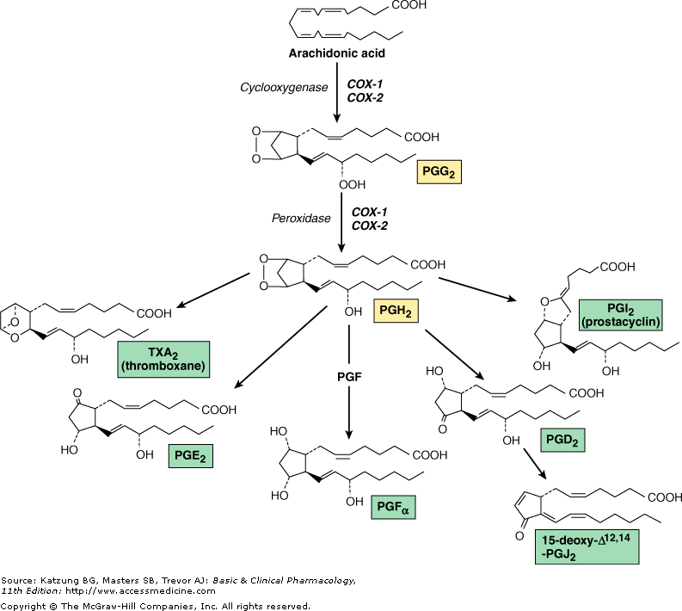

Slide 7
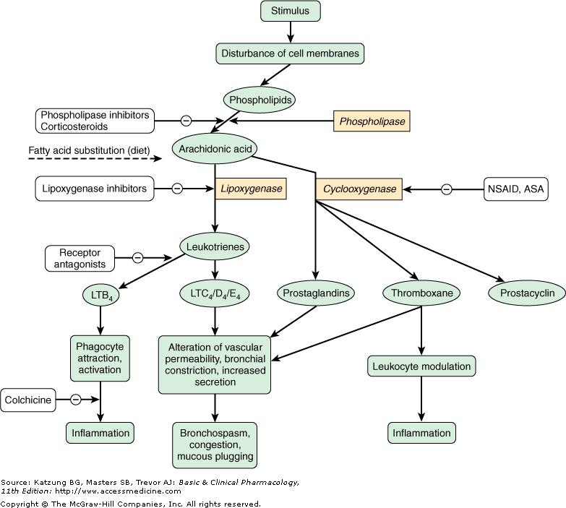

Slide 8
PGE₂
Protection of GI mucosa
PGI₂
(prostacyclin)
Vasodilation
Inhibit platelet aggregation
PGF₂
Uterine function, labor
Broncho-constriction
PGD₂
Regulation of sleep wake cycle
Broncho-contriction
Temperature homeostasis: Mediator of fever
Renin release & natriuresis
Vasodilation
Vasodilation
TXA₂
Platelet aggregation
Vaso-constriction
Broncho-constriction
Contraction of uterus
Lower threshold of nociceptors
Lower threshold of nociceptors

Slide 9
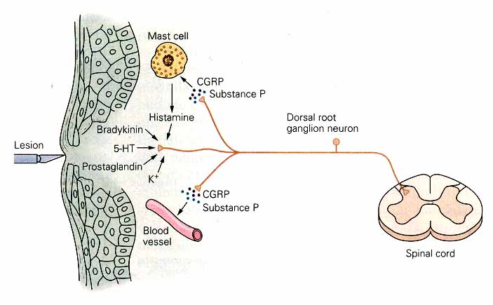
Mechanisms associated with peripheral sensitization to pain

Slide 10
PAIN: an unpleasant sensory or emotional experience
2 clinical states of pain:
Physiological (nociceptive) pain → direct stimulation of nociceptors
Neuropathic (intractable) pain → result from injury to the peripheral or central nervous system that causes permanent changes in circuit sensitivity and CNS connections

Slide 11
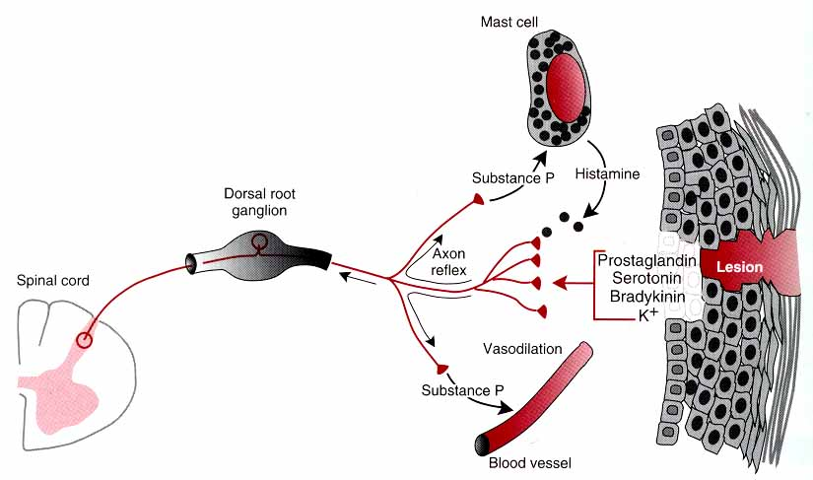
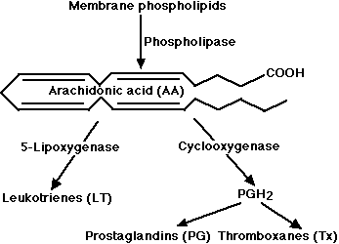
PERIPHERAL SENSITIZATION TO PAIN
CGRP
CGRP

Slide 12
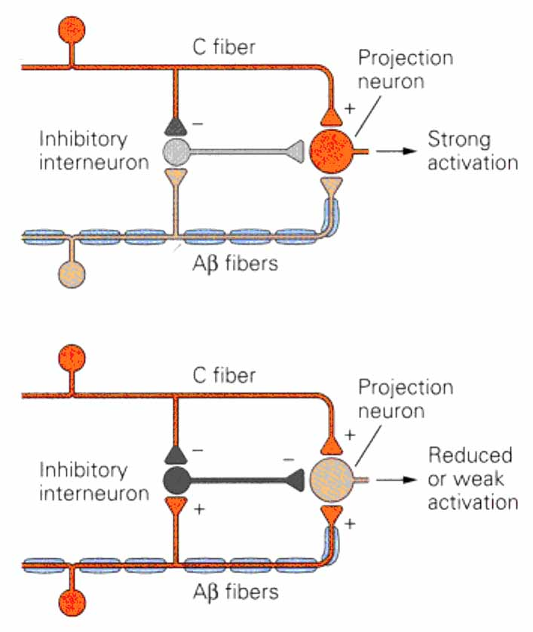
Gate Control Hypothesis:
Interneurons activated by Aβ fibers act as a gate, controlling primarily the transmission of pain stimuli conveyed by C fibers to higher centers.
Rubbing the skin near the site of injury to feel better
Transcutaneous electrical nerve stimulation (TENS)
Dorsal column stimulation
Acupuncture

Slide 13
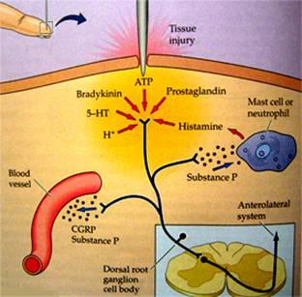

Slide 14
ANALGESICS
Act at the site of injury and decrease the pain associated with an inflammatory reaction (e.g. NSAIDs)
Alter nerve conduction (e.g. local anesthetics): block action potentials by blocking Na channels
Modify transmission in the dorsal horn (e.g. opioids)
Affect the central component and the emotional aspects of pain (e.g. opioids, antidepressant)

Slide 15
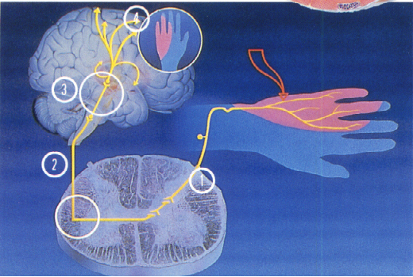
SITE OF ACTION
Sensation of pain
Local release of inflammatory mediators
Injury
Signal transmitted via spinothalamic pathways to contralateral thalamus & cortex
Activation of AMP receptors in dorsal horn of SC
Increased sensitivity of peripheral nociceptors
NSAID’s

Slide 16
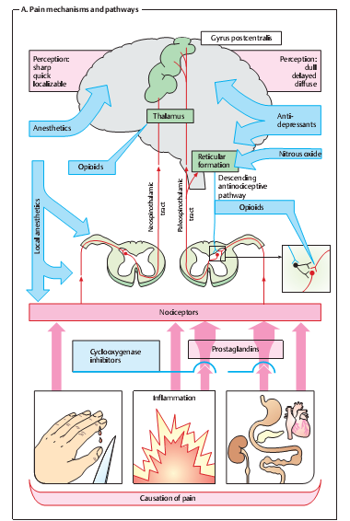

Slide 17
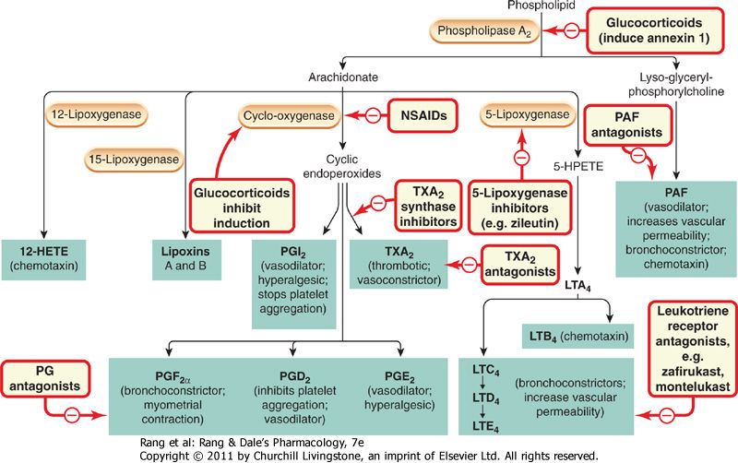

Slide 18
WHO Analgesic ‘Ladder’
Severe
Moderate
Mild
Step 3
Strong opioids (e.g., morphine)
with or without non-opioids
Step 2
Weak opioids (e.g., codeine)
with or without non-opioids
Step 1
Non- opioids (e.g., NSAIDs,
Acetaminophen)

Slide 19
CLASSIFICATION (chemical)
SALICYLIC ACID DERIVATIVES
  Aspirin
  Sodium salicylate
  Methyl salicylate
  Choline salicylate
  Magnesium salicylate
  Diflunisal
  Benorylate

Slide 20
CLASSIFICATION (contd.)
PARA-AMINO PHENOL DERIVATIVE
Paracetamol
ACETIC ACID DERIVATIVES
Indomethacin
Diclofenac
Etodolac
Sulindac
Ketorolac
Tolmetin
Nabumetone

Slide 21
CLASSIFICATION (contd.)
FENAMIC ACID DERIVATIVES
Mefenamic acid, meclofenamate sodium
PROPIONIC ACID DERIVATIVES
Ibuprofen, naproxen, fenbufen, fenoprofen, flurbiprofen, ketoprofen
ENOLIC ACID DERIVATIVES
Piroxicam, meloxicam (oxicams),

Slide 22
CLASSIFICATION (contd.)
PYRAZOLON DERIVATIVES
Phenylbutazone, azapropazone, oxyphenbutazone
COX 2 SELECTIVE
Celecoxib, etoricoxib, rolicoxib, lumaricoxib, valdecoxib,

Slide 23
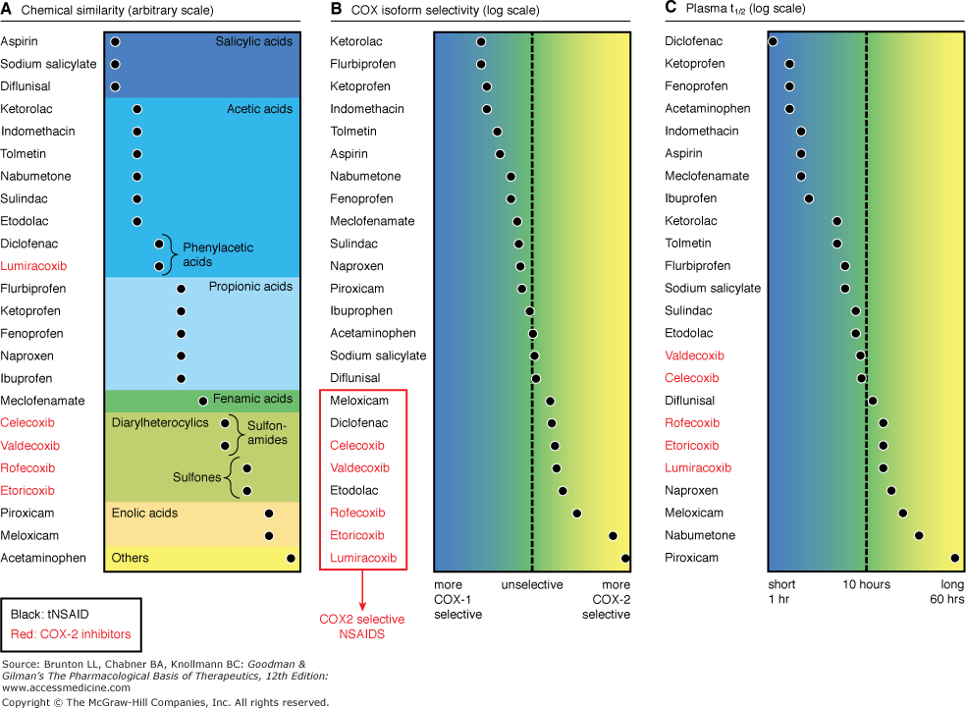

Slide 24
PROPERTIES OF NSAID’s
Common general properties
Common mechanism of action (cyclooxygenase inhibition)
Common therapeutic indications
Common adverse effects
Different pharmacokinetics and potency
Different chemical families
Different selectivity's to COX I and II
Similarities more striking than differences

Slide 25
General properties in common:
Organic acids EXCEPT nabumetone
Well absorbed
Strongly protein bound
Highly metabolized
Renal excretion mainly
Varying enterohepatic circulation
Distributed in synovial fluid

Slide 26
MECHANISM OF ACTION
Membrane phospholipids
Corticosteroids
Phospholipase
Arachidonic acid
Lipoxygenase
COX
NSAIDS
Leukotienes
Prostaglandins
Thromboxane
Prostacyclin

Slide 27
ADVERSE EFFECTS OF NSAID’S
CNS
CVS
GIT
HEMATOLOGIC
HEPATIC
PULMONARY
RASHES
RENAL

Slide 28
Aspirin
(Acetylsalicylic acid; ASA)
Willow bark- Salicin
Synthesized in 1853
Organic acid
Ester of acetic acid
COOH
OOCCH₃

Slide 29
HISTORY
Salicylic acid-natural product, present in the bark of willow and poplar trees
18th century – Salicin - oxidized to Salicylic acid
In 1828 a Swizz pharmacist, Lowig, distilled meadowsweet flowers and got salicylaldehyde
1897, a chemist at the Bayer Company worked on acetylsalicylic acid effect profile to improve adverse
The name Aspirin was coined by adding an a for acetyl to spirin from the name of the plant meadowsweet (Spiraea ulmaria) from which salicylic acid was first isolated

Slide 30
Pharmacokinetics
Rapidly absorbed from stomach and upper small intestine
Hydrolyzed to acetic acid and salicylate by esterases in tissue and blood
Bound to albumin
ZERO ORDER KINETICS
Conjugated in liver and cleared by kidney
Excretion: 25 % excreted unchanged & 75 % as metabolites in urine ,enhanced by ALKALINIZATION
t1/2 15mins but antiplatelet action 8-10 days

Slide 31
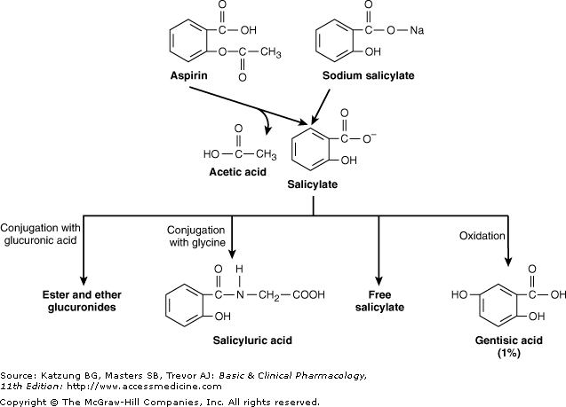

Slide 32
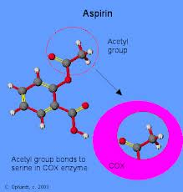
Mechanism of Action
Inhibits both COX-I and COX-II
  Anti-inflammatory
  Analgesic
  Antipyretic
Aspirin irreversibly inhibits platelet COX
  Anti-platelet effect (lasts 8-10 days)

Slide 33
Anti –inflammatory effect
Inhibits PG synthesis at the periphery
Inhibition of granulocytes adherence to damaged vasculature
Stabilizes lysosomes
Inhibit migration of polymorphs and macrophages at site of inflammation
Interferes with chemical mediators of kalikrein system
Inhibition of antibody production

Slide 34
Analgesic Effect
Reduces mild to moderate pain of varying cause (pain of musculoskeletal structures) relieved better than of visceral origin
Mainly acts at periphery at nociceptive level so effective in pain associated with inflammation (pain of muscular, vascular & dental origin, postpartum states, arthritis & bursitis is relieved)
Also inhibits pain stimuli at a sub-cortical level

Slide 35
Antipyretic
Aspirin reduces only elevated temperature & has no effect on normal temperature
Aspirin resets the temperature regulating centre to normal by inhibition of PGE₂ synthesis
Blocks the action of IL-1 released from macrophages by action of bacterial endotoxins / inflammation
Vasodilatation of superficial blood vessels causing inc. dissipation of heat

Slide 36
Antiplatelet effect
Aspirin in small doses decreases platelet aggregation by suppressing the synthesis of thromboxane A2
It irreversibly acetylates the COX
Effect lasts for 8 – 10 days till new platelets are regenerated
High doses suppress prostacyclins also & platelet inhibitory effect is lost

Slide 37
Effect on GIT
Vomiting-- Stimulation of CTZ
Dose related gastric ulceration & hemorrhage, due to inhibition of protective PGI₂
  Ischemia of gastric mucosa
  Increased gastric acid secretion
  Inhibition of gastric mucous secretion
  Misoprostol –may prevent GI ulceration

Slide 38
Other effects
Uricosuric action: In high doses above 4 gms
CVS
In therapeutic doses, no effect
In large doses--- Peripheral vasodilatation
In toxic doses--- Vasomotor paralysis
Edema , HTN in pts with activated renin-angiotensin sytem
Respiration:
In therapeutic doses, Increased depth of resp.
In large doses-Compensated resp. alkalosis
In toxic doses - Uncompensated resp. acidosis

Slide 39
Renal
Nephropathy
Pregnancy
Prolongation of gestation & inhibition of labor
Hypersensitivity (not immunologic but due to PG inhibition)

Slide 40
DOSAGE
Analgesic –antipyretic effect :324 to1000 mg 4-6 hourly
Antiplatelet effect: Prevention of stroke and MI 75-150 mg inhibits platelet aggregation
Anti-inflammatory effect: 3-4gm/d
Acute rheumatic fever, 0.9-1.2 g every 4 hourly max of 8 gm

Slide 41
THERAPEUTICS USES OF ASPIRIN
ANALGESIA (moderate dose)
Aspirin is one of the most frequently used analgesic
For mild to moderate pain
Severe pain is not controlled by aspirin
a. Used alone in pain like:
Headache, myalgia, arthralgia, neuralgia, osteomyelitis, osteoarthritis, toothache, dysmenorrhea
b. With opioids – synergistic action
In pain of cancer metastases in bone
Post operative pain- ⬇ requirement of opioids

Slide 42
ANTI-INFLAMMATORY (in large doses)
Rheumatoid arthritis
Acute rheumatic fever along ē benzyl penicillin
ANTI-PYRETIC
All fevers but not effective in raised body temp. due to heat stroke or malignancy
AS ANTI-PLATELET (in low doses 75 – 300mg/day)
For TIA & cerebrovascular stroke
Prophylaxis of unstable angina, MI
Thrombosis after coronary artery by pass grafting

Slide 43
URICOSURIC AGENT (large doses >4 gm /d)
CLOSURE OF PDA
LOWERS INCIDENCE OF COLON CANCER
Niacin- flushing
Bartter syndrome
Astringent action to remove warts, corns
Methylsalicylate (oil of wintergreen)
Systemic mastocycosis

Slide 44
ADVERSE EFFECTS OF ASPIRIN
Gastric upsets:
Erosive gastritis & Gastric ulceration
  Hematemesis
  Melena
  Occult Blood In stool
Dyspepsia and heart burn
Nausea & vomiting

Slide 45
2) Effects on CNS
Salicylism:
(In large doses): Tinnitis, deafness, dimness of vision, dizziness, ataxia, mental confusion, vertigo, nausea & vomiting, sweating, thirst
(In Toxic Doses): Hyperpyrexia, CV collapse, convulsions, ketosis, coma
3) Related to Kidney:
Analgesic Nephropathy

Slide 46
4. Respiratory system
Hyperventilation –respiratory alkalosis
Compensated respiratory alkalosis (high doses)
Respiratory acidosis
Uncompensated metabolic acidosis (toxic doses)
5. Blood
Hypoprothrombinaemia
Increase bleeding tendency
6. Allergic / Hypersensitivity Reactions
Bronchospasm
Urticaria
Rhinitis
Hay Fever

Slide 47
Aspirin Toxicity
Salicylism
Neurological effects
Acid-base balance & electrolytes
CV effects
Metabolic effects

Slide 48
Management of aspirin/salicylate overdose toxicity/poisoning
Gastric lavage
Activated charcoal
Correct fluid, electrolyte & acid base balance
Maintain high urine out put
Keep airway patent
⬇ Body temp. by cold sponging
Vit. K I/V to correct hypopthrombinemia
Diazepam I/V for convulsions
Promote excretion of salicylates by NaHCO₃ I/V to
alkalinize urine ,maintain pH at 8.0
Hemodialysis in pts. with severe acidosis & coma

Slide 49
DRUG INTERACTIONS
Concomitant NSAID’s & low dose aspirin
ACE inhibitors
Warfarin
Sulfonylurea hypoglycemics
Methotrexate

Slide 50
DICLOFENAC
Phenylacetic acid derivative
More selective for COX-2
Short t1/2
Combinations are available (+ misoprostol)
150 mg/d impair renal blood flow & GFR
GI ulceration less frequent
Elevation of serum aminotransferases
Preparations: eye drops, topical gel, suppository
Dose: 50-75mg qid

Slide 51
IBUPROFEN
Phenylpropionic acid derivative
Anti inflammatory effect start at 2400 mg/dl (equivalent to 4gm aspirin anti-inflammatory effect)
Lower dose has analgesic effect
Closure of patent ductus arteriosus in preterm infants
Less decrease in urine output, less fluid retention
Decreases antiplatelet effect of aspirin
Oral I/V, topical

Slide 52
INDOMETHACIN
Indole derivative
Potent non-selective COX inhibitor and may also inhibit phospholipase A and C
Reduce neutrophil migration and decrease T-cell and B-cell proliferation
Effective in joint pain, swelling & tenderness
Gout
Accelerate closure of patent ductus arteriosus
Relaxes smooth muscles
Pancreatitis, frontal headache
t1/2 prolonged by probenicid

Slide 53
ACETAMINOPHEN
Active metabolite of phenacetin
Weak COX-I and COX-2 inhibitor
Inhibits COX-3
No significant anti-inflammatory effects
Pharmacokinetics:
Peak blood level is reached in 30-60 min
Metabolized by hepatic microsomal enzymes and form acetaminophen sulfate and glucronide
N-acetyl-p-benzo-quinoneimine(NAPQI)-Toxic to liver and kidneys

Slide 54
Indications
325 – 1000mg (total dose not > 4000mg)
Headache, myalgia, postpartum pain
In rheumatoid arthritis with anti-inflammatory agent
Preferred to aspirin in peptic ulcer, in children with viral infections

Slide 55
Adverse effects
Mild increase in hepatic enzymes
Dizziness, excitement & disorientation at larger doses
Toxic dose: 10-15gm
20-25 gm potentially fatal (? tablets)
NAPQI reacts with sulfhydryl gps in GSH normally & then excreted as mercapturic acid in urine but in toxic dose GSH is depleted and toxic metabolite accumulates
Treatment
Supportive therapy
N-Acetylcysteine

Slide 56
COX-2 SELECTIVE INHIBITORS
Celecoxib, rofecoxib, valdecoxib, parecoxib, etoricoxib, lumaricixib
Inhibit prostaglandin synthesis by the COX-2 isozyme
Analgesic, antipyretic and anti inflammatory effects
No effect on platelet aggregation
No cardioprotective effect

Slide 57
CELECOXIB
Highly selective COX- 2 inhibitor
Half life is 11 hrs
Metabolized mainly in the liver
Effective in rheumatoid arthritis and osteoarthritis
Less production of peptic ulcer
Inhibit COX 2 mediated prostacyclin synthesis in vascular endothelium- platelet aggregation

Slide 58
Differences
Non-selective vs COX 2 Selective
Lesser GI adverse effects
No impact on platelet aggregation
Increased risk of thrombotic events;MI & stroke
Increased likelihood for hypertension & edema

Slide 59
Thank U!

