Slide 1
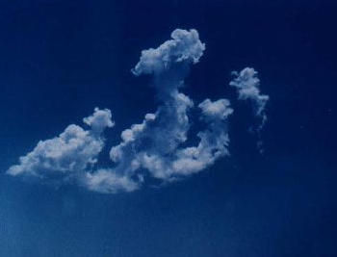

Slide 2
Hadith Shareef
Do not laugh too much
For this
Deadens the heart
(Tirmidhi)
2

Slide 3
β-Lactam Antibiotics
Penicillins
Cephalosporins
Monobatams
Carbapenems

Slide 4
Penicillins
Short History

Slide 5
Brief History
Paul Ehrlich (1854 – 1915) coined the word ‘Chemotherapy’ and said that in order to use chemotherapy successfully we must search for a substance which has affinity for the cells of the parasites and a power of killing or suppressing their growth without harming the host.
Alexander Fleming (1928) discovered penicillium fungi which suppressed the bacterial growth in culture.
Gerherd Domagk 1935 linked sulphonamide to prontosil dye.

Slide 6
Antibiotics
are substances produced by microorganisms that are antagonistic to the growth or life of other microorganisms. At present many antibiotics in use are either fully synthetic or are produced by chemical modification of natural products and are hence known as antimicrobial agents (AMA).
Antimicrobial agents can be
a) Antibacterial agents/drugs
b) Antiviral agents/drugs
c) Antifungal agents/drugs

Slide 7
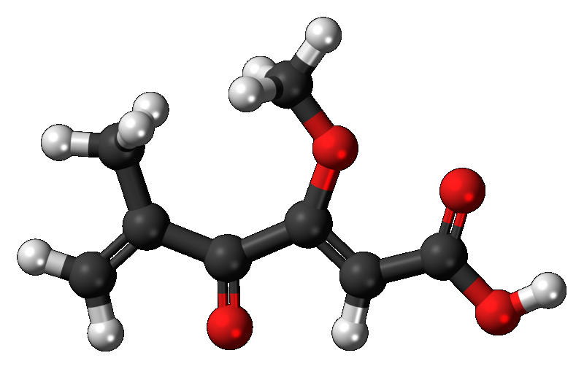
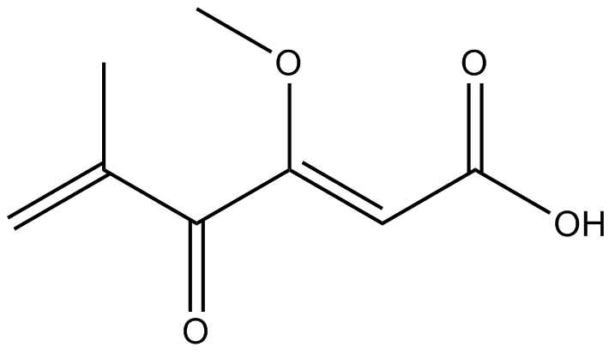
Pencillinic Acid
7

Slide 8
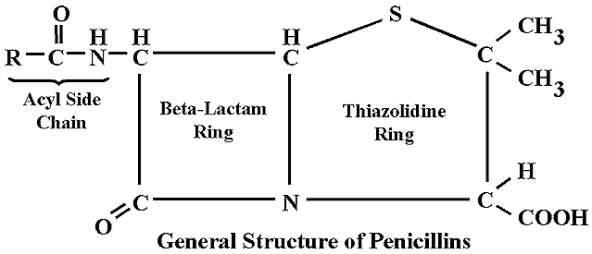
GENERAL STRUCTURE OF PENICILLINS

Slide 9
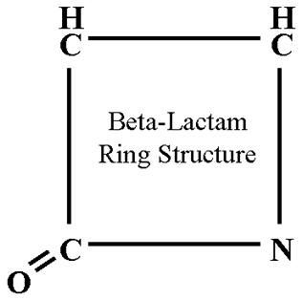
β – lactam ring
Anti-bact activity
Instability in acid medium
Side chain group determines:
Acid stability
Susceptibility to penicillinases
Other pharmacological characteristics
Diff. Semisynth. Penicillins are formed → by diff . groups at
Free “COOH” carboxyl group:
Replaced by amines e.g.
Procaine → procaine Penicillin
Benzathine → benzathine Penicillin

Slide 10
Classification of Penicillins
a) Natural
Benzyl penicillin (Pen – G) ---- Acid labile
Congeners of Pen. G
Short acting:
Phenoxymethyl penicillin (Pen-V) ---- Acid stable
Long acting:
Procaine Penicillin ---- Acid Labile
Benzathine Penicillin ---- Acid labile
Pen G 1600 units/mg
……………………….
1unit =0.6μg
1 million units =0.6 g

Slide 11
b) Semi synth Penicillin
i) Penicillinase resistant penicillins:- (Anti-staph. penicillins)
Methicillin ------------------ Acid Labile
Isoxazolyl Penicillins: ---- Acid stable
Oxacillin
Cloxacillin
Dicloxacillin
Flucloxacillin
Nafcillin ---- Acid stable

Slide 12
b) Extended spectrum Penicillins
i) Amino – Penicillins ---- acid stable
Ampicillin
Amoxicillin
Bacampicillin
Talampicillin
Pivamipicillin
Hetacillin
Cyclacillin

Slide 13
c) Anti pseudomonal Penicillins
i) Carboxy Penicillins.
Carbenecillin ----- acid labile
Ticarcillin ----- acid labile
Carfecillin ------ acid stable
ii) Ureido – Penicillins ------ acid labile
Azlocillin
Mezlocillin
Piperacillin

Slide 14
e) Reversed spectrum Penicillins
Mecillinam (amidinocillin) ----- acid labile
Pivmecillinam ----- acid stable

Slide 16
Structure of bacterial cell wall
Composed of complex cross-linked polymer of polysacharides and polypeptides (peptidoglycan……murein mucopeptide).
Polysacharide …. Alternating aminosugars, N- acetyleglucosamine and N-acetylmuramic acid
A five aminoacid peptide linked to N-acetylmuramic acid sugar.
Peptide terminates in D-alanyl-D alanine
PBP (an enzyme) removes the terminal alanine in the process of forming a cross link with nearby peptide.
Beta- lectam A.biotics are structural analogs of the natural D-Ala –D-Ala substrate, bind covalently to the active site of PBPs

Slide 17
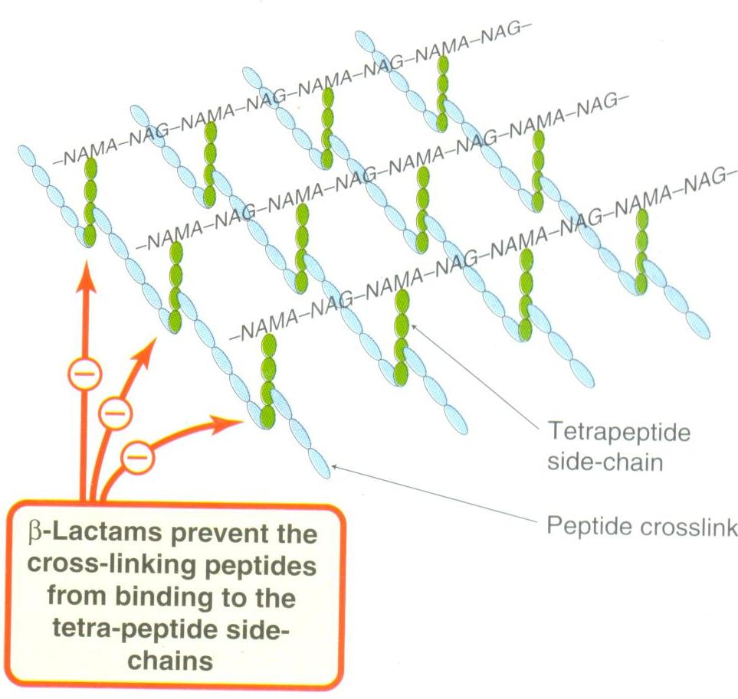

Slide 18
So block transpeptidation…….hence peptidiglcan synthesis.
leading to Cell death
Very effective on rapidly replicating bacterial cells

Slide 19
Summary of Mechanism of action of Penicillins
Binds with Penicillin binding proteins (PBP). (seven or more types in diff. m.o.)
Inhibit transpeptidation & thus inhibit the cross linking of the peptide chains attached to the backbone of the peptidoglycan
Inactivation of inhibitor of autolytic enzyme in the cell wall causing lysis of bact

Slide 20
Resistance to Penicillins
Production of B – lacatamases (50 types)
Reduced permeability of outer memb. (G –ve organisms)
Modification of penicillin binding proteins.
Lack of cell wall (myoplasma ).
Efflux pump
β – lactamase production
Organisms:
Staph aureus
N. gonorrhea
Haemophilus SPP
E. coli
Proteus
Klebsiella (all known SPP)

Slide 21
Mechanism of Resistance

Slide 22
Types:
About fifty
MOA:
Breaks β – lactam ring
Penicillin → penicilloic acid (inactive)
Control of β – lactamase production:-
Genetics: Genes reside in
Chromosomes (less common)
Plasmid (more common)
Transmission:- Mostly transduction
(Staph. Enz → inducible ( 50 – 80 fold ↑ after exposure to sub. MIC)

Slide 23
G –ve bact:
Chromosomal Enz →inducible
Plasmid Enz → constitutive production
Resistance to broader spectrum Penicillin
Remains attached with cell wall
Prevent access to target site.
G +ve bact:-
May diffuse & inactivate drug in the surrounding medium
Solution lies with:
a) β- lactamase resistant Penicillins
b) Beta – lactamase inhibitors
Clavulanic Acid
Sulbactam
Trazobactam

Slide 24
Anti – bacterial spectrum of Penicillins:
a) Narrow spectrum penicillins
i) Pen. G & Pen. V (Non – B lactamase producing microorg)
G +ve bacteria (cocci & bacilli) except β – lactamase producing staph. Aureus
Also active against Neisseria species & G –ve anaerobes NBLP (except bacteroides fragilis which is BLP).
Not active against G –ve enteric organisms. (because of nature of their cell wall)
Active against spirochetes
ii) β – lactamase resistant penicillins:
( Antistaphylococcal Pen.)
Highly active against Pencillinase. producing staph. aureus
Much less active against other G +ve bact
Totally inactive → G –ve enteric organisms

Slide 25
b) Extended spectrum penicillins.
Aminopenicillins (amoxicillin & ampicillin)
G +ve organisms
↑activity against group – D streptococci
Haemophilus sp. ( Non β – lactamase producing)
G –ve enteric organisms → E. Coli & proteus
Amoxicillin + clavulanic acid → Also cover β - lactamase producing enteric org.
Anti- pseudomonal penicillins
Active → pseudomonas & enterobacter
Less → G +ve org.
c) Reversed SP. (Mecillinam):- G –ve organisms

Slide 26
Clavulanic acid (A suicide inhibitor)
Isolated from streptomyces clavuligerus
Is a suicide inhibitor of Enz
Has β – lactam ring
Attracts & binds the enz. Covalently (At or near active site)
Complex is slowly cleaved
Some enz molecules are irreversibly inactivated.
t½ → 1 hr. Excr → Gl. Filt.

Slide 27
Combination with amoxicillin:
β – lactamase producing:
Staph aureus
H– influenza
Gonococci
E – coli
Proteus Mirabilis
N. meningitides

Slide 28
Clinical indications of combination
Lower resp. tract inf. caused by H . Infl & Catt (BLP)
Otitis media ---- H. infl & N. Cat (BLP)
Sinusitis
Skin, Soft tissue, Lungs & blood infection (BLP) caused by E. coli kelibsiella
UTI …….. E. Coli, Klebsiella & enterobacter (BLP)

Slide 29
Available prep:
Augmentin:
Amoxicillin = 250 mg & 500mg P.O & I/V
Clavulanic acid = 125 mg
Caution
a. Should not be adm with antabuse
b. False +ve glucose test in urine using clinitest, Benedict’s sol & fehling's sol, So glucose test should be passed on enzymatic glucose oxidase reaction & “ clinistix”

Slide 30
Fortacin
Amoxicillin = 500 mg
Clavulanic acid =125 mg
Timentin:
Ticarcillin = 300 mg
Clavulanic acid = 100 mg
Sulbactam:
Similar to Clavulanic Acid
Unasyn:
Ampicillin = 1 – 2 gm
Sulbactam = 0.5 – 1 gm

Slide 31
Pharmacokinetics:- a) Absorption
i) Acid stable
P.O absorption
Amoxicillin & Pen .V → 50%
Abs. of amoxicillin →↑ “OH” in side chain
Oxacillin →↑ Cloxacillin ↑↑ Dicloxacillin
Should be given before meals
ii) Acid labile → poor abs.
iii) Parentral adm:
iv) Repository prep:
v) Esters

Slide 32
b) Distribution:-
Plasma protein binding 20% → ampicillin & amoxicillin more than 90% → nafcillin & isoxazolyl penicillins
Poor penetration of cell & BBB
Well distrib → body fluids & spaces
t½ =15 min – 1.3 hrs ↑20 hrs → in anuric pts.

Slide 33
Metabolism & Exc:-
No significant metabolism
Exc – kidney ---- 90 % tub. Sec & 10”% Glomerular Fil
Liver (Bile → Ampicillin)
Milk
Renal exc →↓↓ by probenicid
.

Slide 34
Clinical uses:-
a) Streptococcal inf:-
i) Ac. Tonsillitis & Pharyngitis :-
St. pyogenes – pen. G of Pen. V (10 days)
ii) Bact. Endocarditis (SBE):- (Strept. viridans)
Benzyl Pen I/V 2.5 – 5 mega units QID for o4 wks
Or 2 wks I/V pen + 2 wks oral Pen -V
iii) Enterococcal endocarditis
Pen - G or ampicillin + an aminoglycoside (gentacyn) for 4 wks (synergistic effect)

Slide 35
b) Staph. inf:-
Local abscess, osteomyelitis, bacteremia etc
Penicillinase resistant penicillins → Flucloxacillin.
or Penicillin (Amoxycillin) + clavulanic acid
c) Pneumococcal inf:-
i) Pn. Pneumonia:-
Pen - G, Pen- V or Amp/ amoxycilln
ii) Otitis media & CH. bronchitis:- ( H. infl → contaminant)
Ampicillin or amoxicillin

Slide 36
d) Gonococcal inf:-
4.8 mega units procaine Pen → divided & given at two sites i/m + 1gm probenicid ½ hr before
Complications:-
Prolong treatment or amp – 3.5g or amoxicillin 3g P.O

Slide 37
f) Syphilitic inf:-
Primary, secondary of latent. Inf:-
Single I/M inj 2.4mega units benzathine Pen
Or 600,000 units of procaine Pen daily x 08 days
Cardiovasc or neurosyph:- longer duration
g) Anaerobic inf:- (Pen – G)
Actinomycosis
Clostridial inf
Trench mouth (Fuso bact)

Slide 38
h) Haemophilus influenzae inf:- (Ampicillin I/V 400mg /kg / day)
Meningitis
Osteomyelitis
Pneumonia
Arthritis
Epiglotitis
Otitis media ----- Ampicillin or Amoxicillin
Sinusitis ----- Ampicillin or Amoxicillin
if org is β – lactamase producing → amoxicillin + clavulanic acid
or chloramphenicol or cefuroxime.
i) Diphtheria:-
j) Typhoid & Paratyphoid:-
Shigellosis → Ampicillin

Slide 39
k) UTI + lungs & blood inf:-
E. Coli → Amp
Proteus mirabilis → Amp
Enterococci → Amp
Pseudomonas inf → Carbenicillin indanyl – Na ( Ester of
Indole positive proteus → Carbenicillin indanyl – Na ( Ester of
More serious inf:- mezlocillin & piperacillin
Pseudomonas inf outside urinary tract → anti-pseudomonal Pen in comb. with Aminoglycoside or Fluoroquinolone

Slide 40
l) Other inf:-
Leptospirosis → Pen - G
Pasteurella → Pen - G
Rat bite fever → Pen - G
Listeria → Ampicillin
Prophylactic uses:-
Rh. Fever
Bact. Endocarditis
Prosthetic heart valves
Joint prosthesis
Leg amputation ---- risk of gas gangrene

Slide 41
Drug interactions
Penicillins & Aminoglycosides
Penicillin & bacteriostatic drugs
Probenicid, indomethacin, sulfinpyrzaone
Ampicillin & allopurinol → increased incidence of rashes

Slide 42
Adverse eff of Penicillins
a) Hypersensitivity reactions
b) Toxic effects
a) Hypersensitivity
i) Immediate (with in 20 – 30 min)
Acute anaphylaxis (incidence 0.01% of Pen administered pts)
Acute Urticaria
Angioedema
ii) Accelerated:- (1 -48 hrs)
Urticaria & angioneurotic oedema

Slide 43
iii) Late ( after 48 hrs)
Skin rashes
Comb +ve hemolytic anemia
Eosinophilia
Interstitial nephritis
Contact dermatitis

Slide 44
b) Toxic effects
Neurotoxicity → Convulsions (1/th adm)
Super inf → Amp. → colitis Sec inf. Like oropharangeal & Vaginal Candidiasis, Psendomembranous colitis
GIT upset → Diarrhoea & NV
Hepatitis → Oxacillin
Hypokalemia → Carbenecillin
Na + overloading → Carbenecillin + other Na salts
Granucocytopenia → Nafcillin
Interstitial nephriti → Methicillin
Decr. platelet agg. → Bleeding diathesis more with Carbenecillin & Ticarcillin.

Slide 45
Thanks for Penicillins. Now switch over to Cephalosporins May Allah (js) bless you with Sound Health & Eternal Peace

Slide 46
Reverse spectrum Penicillins
• Inhibit PBP-2 instead of PBP-1 and PBP-3 inhibited by other penicillins
• Mecillinam (Amdinocillin) and Pivmecillinam (Prodrug – can be given orally) are examples
• Prevents cell elongation causing spherical forms of bacteria.
• Active mainly against gram-negative bacilli

