Slide 1
PENICILLINS
Dr. Naila Abrar

Slide 2
LEARNING OBJECTIVES
After this session you should be able to:
know the source & chemistry of penicillins;
recall the morphology of bacterial cell wall;
classify penicillins;
familiar with the unit of penicillin;
describe the salient pharmacokinetic features of various penicillins; and
describe the spectrum of activity, clinical uses of penicillins and adverse effects of penicillins.

Slide 3
Beta-Lactam Antibiotics
Penicillins
Cephalosporins
Monobactams
Carbapenems
β- lactamase inhibitors

Slide 4
HISTORY
Alexander Fleming - 1928
Deep fermentation -

Slide 5
SOURCE
Penicillium notatum
Penicillium chrysogenum
Semisynthetic

Slide 6
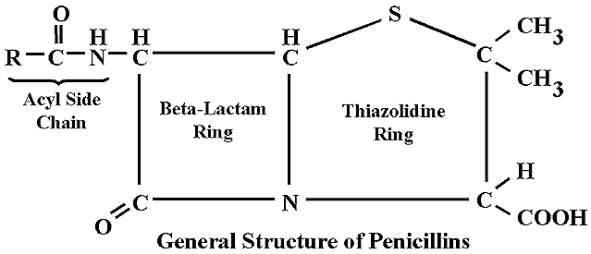
CHEMISTRY

Slide 7
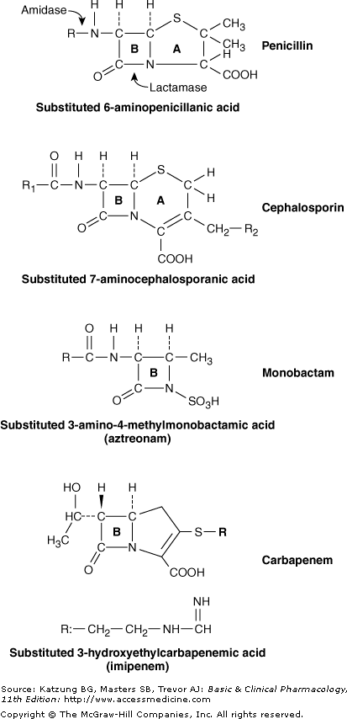
CHEMISTRY
Thiazolidine ring (A)
β-lactam ring (B)
Secondary amino group (RNH-)
Substituent (R) can be attached to amino group

Slide 8
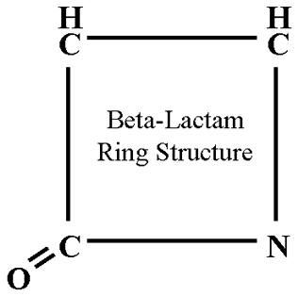
β – lactam ring
Anti-bact activity
Instability in acid medium
Side chain group determines:
Acid stability
Susceptibility to penicillinases
Other pharmacological characteristics
Different semisynthetic penicillins are formed by different groups at the side chain
Free “COOH” carboxyl group:
Replaced by amines e.g.
Procaine → procaine penicillin
Benzathine → benzathine penicillin

Slide 9
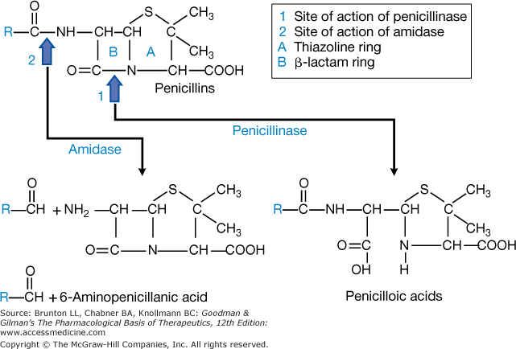

Slide 10
PENICILLIN UNITS & FORMULATIONS
Penicillin G – units
Specific penicillin activity contained in 0.6μg of the crystalline sodium salt of penicillin G
1mg of pure penicillin G Na = 1667 units
1unit = 0.6μg
1 million units = 0.6g
1 gm of penicillin-1.6 million units of penicillin G

Slide 11
CLASSIFICATION
Penicillins
Natural
Short acting
Long acting
Semisynthetic
Antistaphylococcal penicillins
Extended spectrum penicillins
Aminopenicillins
Carboxypenicillins
Ureidopenicillins
Reverse spectrum penicillins
Antipseudomonal Penicillins

Slide 12
CLASSIFICATION
Penicillins
A) Natural
Benzyl penicillin or crystalline penicillin (Pen - G) ---- Acid labile
Congeners of Penicillin G
Short acting:
Phenoxymethyl penicillin (Pen-V) ---- Acid stable
Long acting:
Procaine Penicillin ---- Acid Labile
Benzathine Penicillin ---- Acid labile

Slide 13
B) Semi synthetic Penicillin
i) Anti-staphylococcal penicillins (Penicillinase resistant penicillins)
Nafcillin --------------------- Acid stable
Methicillin ------------------ Acid Labile
Isoxazolyl Penicillins: -----Acid stable
Oxacillin
Cloxacillin
Dicloxacillin
Flucloxacillin

Slide 14
ii) Extended spectrum penicillins
a) Aminopenicillins ---- acid stable
Ampicillin
Amoxicillin
b) Carboxypenicillins
Carbenecillin ----- acid labile
Ticarcillin ----- acid labile
Carfecillin ------ acid stable
c) Ureidopenicillins ------ acid labile
Azlocillin
Mezlocillin
Piperacillin
Antipseudomonal penicillins

Slide 15
iii) Reversed spectrum Penicillins
Mecillinam (amidinocillin) ----- acid labile
Pivmecillinam--------------------- acid stable

Slide 16
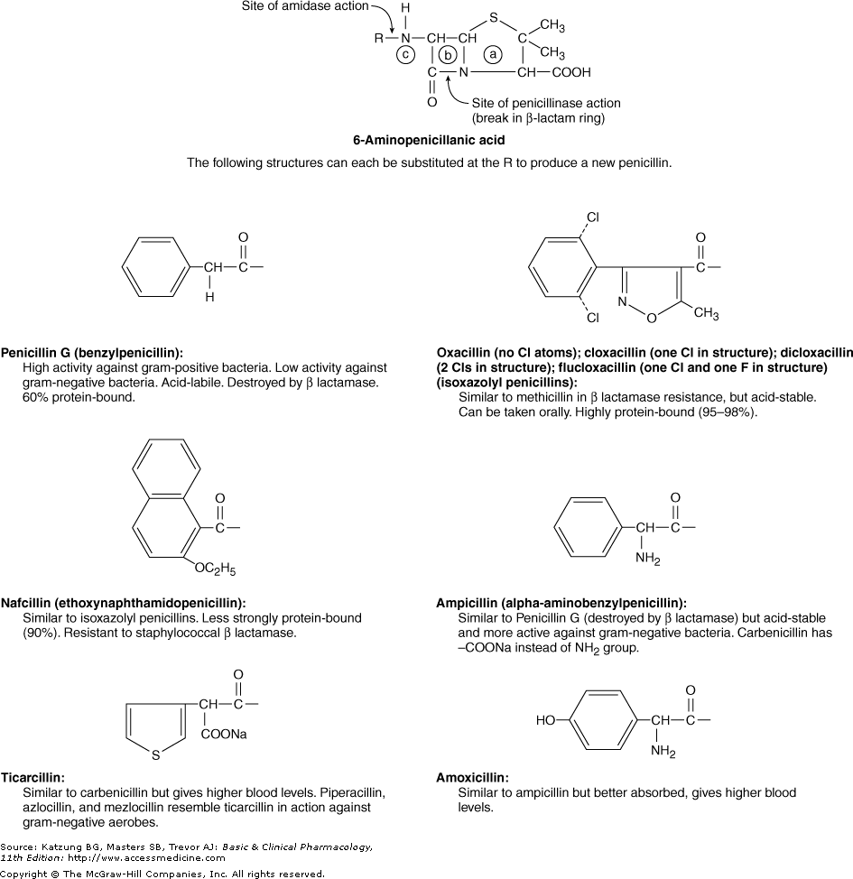

Slide 17
MECHANISM OF ACTION
Inhibit bacterial cell wall synthesis – inhibit bacterial growth
Bacterial cell wall-------- normal structure & synthesis !
Bactericidal – cell death
Mechanism:
Binding to PBP
Inhibition of transpeptidation reaction
Disruption of cell wall morphogenesis
Autolysins

Slide 18
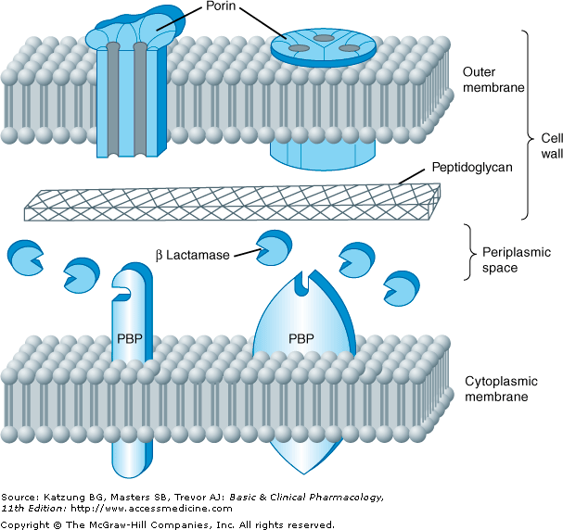

Slide 19
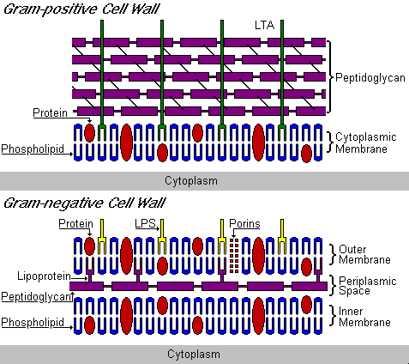

Slide 20
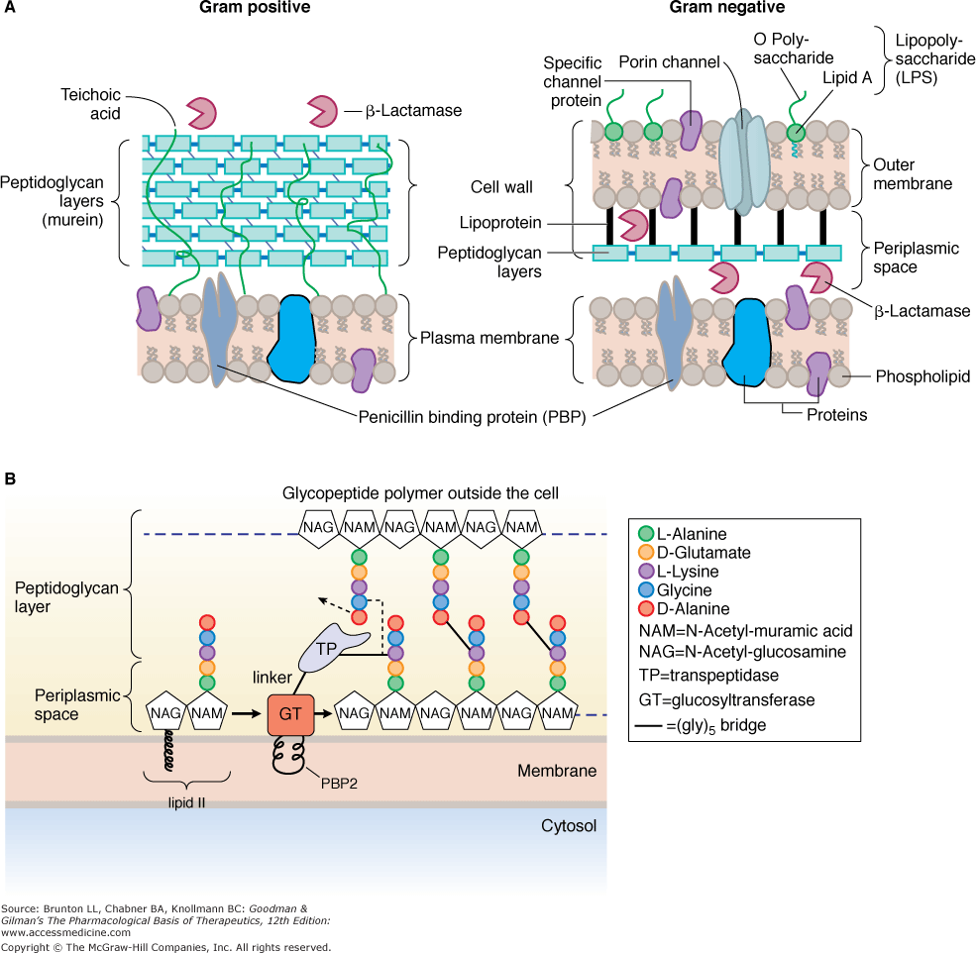

Slide 21
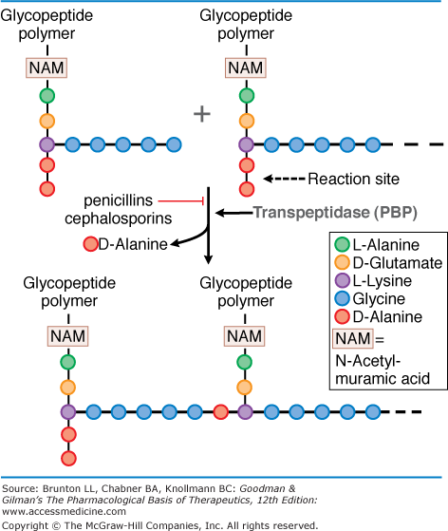

Slide 22
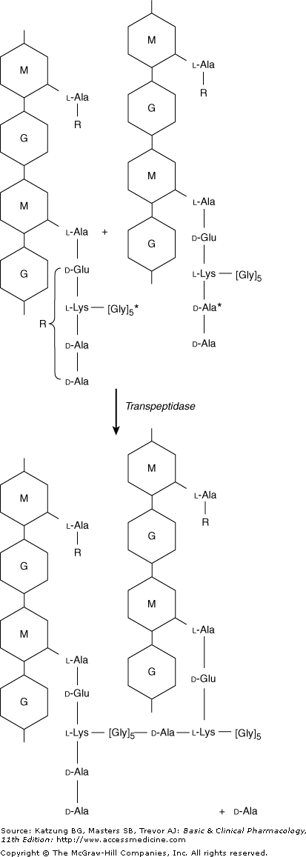

Slide 23
MECHANISM OF ACTION
Mechanism:
Binding to PBP
Inhibition of transpeptidation reaction
Disruption of cell wall morphogenesis
Autolysins- murein hydrolases
Non-lytic killing: holin-like proteins in bacterial membrane that collapses the membrane potential

Slide 24
RESISTANCE
Inactivation of antibiotic by β-lactamases
Modification of target PBPs
Impaired penetration of drug to target PBPs -reduced permeability of outer membrane (G-ve organisms)
Efflux
Lack of cell wall (mycoplasma)

Slide 25
β – lactamase producing organisms:
S. aureus
N. gonorrhea
Haemophilus species
E. coli
Proteus
Klebsiella (all known species)

Slide 26
Types:
About fifty (A, B, C, D)
MOA:
Breaks β-lactam ring
Penicillin → penicilloic acid (inactive)
Control of β – lactamase production:-
Genetics: Genes reside in
Chromosomes (less common)
Plasmid (more common)
Transmission:- Mostly transduction
(Staph. enzyme → inducible , 50 - 80 fold ↑ after exposure to sub. MIC)

Slide 27
PHARMACOKINETICS
Oral absorption depends on acid stability
Absorption of most penicillins EXCEPT amoxicillin is impaired by food
I/V route preferred over I/M for penicillin G because of irritation & local pain
Lower free drug concentration of highly protein bound penicillins like nafcillin
Widely distributed
Penetration into eyes, CNS and prostate is poor
Polar molecules so I/C concentrations below E/C

Slide 28
Benzathine and procaine penicillins are formulated for prolonged action
Benzathine penicillin- 3-4wks (once monthly for rheumatic fever prophylaxis)
Procaine penicillin- 24hrs

Slide 29
BENZYL PENICILLIN SPECTRUM OF ACTIVITY
Gram positive cocci (Streptococci, pneumococci, non b-lactamase producing staphylococci)
Gram negative cocci (Meningococci, gonococci)
Gram positive bacilli (Bacillus anthracis, corynebacterium, diphtheria clostridia)
Spirochetes (Treponema pallidum)
Others (actinomyces israeli, pasturella multocida, listeria monocytogenes)

Slide 30
USES OF BENZYL PENICILLIN
β-hemolytic streptococcal infections (tonsillitis, acute pharyngitis, endocarditis, meningitis, skin & bone infections)
Pneumococcal infections (pneumonia, meningitis)
Meningococcal infections (meningitis-large doses)
Staphylococcal infections (infections of soft tissues, bone and skin--non β-lactamase producing)
Anaerobic infections (excluding due to B.fragilis)
Syphilis
Actinomycosis
Anthrax
Leptospirosis (Weil’s disease)
Prophylaxis of rheumatic fever

Slide 31
SPECTRUM & USES OF PENICILLINASE-RESISTANT PENICILLINS
1. Staphylococcal Infections
• Spectrum similar to Pen G, but includes staph. aureus & staph. epidermidis.
• Staphylococci cause skin infections (impetigo), abcesses in many organs, pneumonias, prosthetic joint, catheter, and artificial valve infections, endocarditis, meningitis (rare), & bone infections (osteomyelitis). Osteomyelitis may require months of therapy.
2. Streptococcal infections (use when staph. is also a possibility) – almost as active as Pen V.

Slide 32
SPECTRUM OF AMINO-PENICILLINS (Amoxicillin & Ampicillin)
Have similar Gram + spectrum to Penicillin V & K (slightly less active)
E. coli, Proteus mirabilis - especially for UTIs (however 25-50% make ß-lactamase)
Haemophilus influenzae- resistance is common (30-40%) & Neisseria sp., Listeria
Shigella & Salmonella- usually treat with ampicillin for GI infections

Slide 33
USES OF AMINO-PENICILLINS
1. Otitis Media - still drug of choice.
2. Bronchitis/Pneumonia
3. Enterococcal endocarditis
4. Meningitis
5. Urinary Tract Infections
6. Prophylaxis for bacterial endocarditis
7. Lyme Disease (Borrelia burgdorferi)
8. Alternate for susceptible strains of N. gonorrhea
Notes:
Note: Amoxicillin is the number one antibiotic sold in U.S.
1. Otitis Media - still drug of choice.
• Strep. pneumoniaeresistance is increasing. Vaccine should reduce incidence of
invasive infections but may not be effective vs. all otitis media strains.
• Haemophilustype b infections are rapidly decreasing due to vaccination, but
vaccine is directed against capsular antigens. Haemophilussp. that cause otitis
media are not encapsulated, vaccine is not effective. 40-50% are penicillinase +
• Moraxella catarrhalisstrains are b-lactamase positive and are resistant.
2. Bronchitis/Pneumonia – may be used, but resistance is a problem.
3. Enterococcal endocarditis (ampicillin or PenG + aminoglycoside is DOC)
4. Meningitis – Ampicillin - alternative choice to 2nd gen. cephalosporins (+
chloramphenicol).
• Infant meningitis – Ampicillin covers Strep. pneumoniae, N. meningitidis, H.
influenzae
• Neonatal meningitis - group B Strep., Listeria, & E. coli. (the most common
causative organisms)
• Some strains of Strep. pneumoniae, H. influenzae & E. coliare resistant. DOC
for Listeria(in combo with gentamicin). Note: cephs are not active vs. Listeria
5. Urinary Tract Infections - Covers three most common organisms
E. coli, Proteus mirabilis, & Staph. Saprophyticus but resistance is common in E. coli
6. Prophylaxis for bacterial endocarditis - 2 gm 1 h prior to dental procedures - DOC
7. Lyme Disease (Borrelia burgdorferi) and Erlichiosis (Erlichia chaffeinsis) - alternate to
doxycycline (1 g amoxicillin + 0.5 g probenicid q 8 h)
8. Alternate for susceptible strains of N. gonorrheae(3.5 g oral ampicillin or
amoxicillin + 1 g probenecid.)
G. SPECTRUM OF BROAD-SPECTRUM PENICILLINS
1. Pseudomonas aeruginosa- Ticarcillin 2-4 x better than carbenicillin (rarely used).
Piperacillin 4-8x more potent, but more expensive.
2. Enterobacteriaceae (see Table 15) - activity is generally OK for urinary tract infections
(typical MIC values are 2-16 µg/ml). Piperacillin has activity vs. Klebsiella.
Piperacillin generally more potent against other Gm - bacteria

Slide 34
Prophylactic use of long acting penicillins
Prevention of secondary & tertiary syphilis
Rheumatic fever
Endocarditis

Slide 35
SPECTRUM OF EXTENDED SPECTRUM PENICILLINS
Pseudomonas aeruginosa
Ticarcillin 2-4 x better than carbenicillin (rarely used).
Piperacillin 4-8x more potent, but more expensive.
Enterobacteriaceae
Piperacillin has activity vs. Klebsiella.
Piperacillin generally more potent against other Gm - bacteria

Slide 36
ADVERSE EFFECTS
Hypersensitivity reactions
Anaphylaxis, angioedema, eosinophilia, serum sickness, SJ syndrome, skin rashes, erythema nodosum, oral lesions, fever, interstitial nephritis, vasculitis, hemolytic anemia
Penicilloyl moeity – hapten- IgE antibodies
Desensitization - test dose
Management – epinephrine

Slide 37
Patients of renal failure, hyponatremia & CNS lesions: seizures in high doses parenterally
Methicillin: interstitial nephritis
Aminopenicillins: non-allergic skin reactions

Slide 38
Related to administration
GI upset with larger doses-NVD
Injection in sciatic nerve: severe pain & dysfunction
Pain & sterile inflammatory reactions at site of I/M injection
Penicillin G potassium: hyperkalemia
Penicillin G procaine: hallucinations, seizures

Slide 39
Pseudomembranous colitis
Decreased microflora in the GIT
Superinfection
Clostridium difficile
Treatment: metronidazole, vancomycin

Slide 40
Jarisch Herxheimer Reaction
Penicillin treatment of syphilis & spirochetes
Fever, chills, rigor, hypotension, headache, tachycardia, hyperventilation, vasodilation with flushing, myalgia & exacerbation of skin lesions

Slide 41
β-LACTAMASE INHIBITORS
β-lactam antibiotics require β-lactam ring for activity
β- lactamases destroy this ring and inactivate the drug
β-lactamase inhibitors resemble β-lactam molecules and inactivate β-lactamases, thereby preventing destruction of β-lactam drugs
Most active against plasmid encoded ambler class A β-lactamases such as those produced by staphylococci, H.influenza, N. gonorrhea, salmonella, shigella, E. coli, K. pneumoniae

Slide 42
Clavulanic Acid
Sulbactam
Tazobactam
Combinations:
Amoxicillin + clavulinic acid (oral)
Ticarcillin + clavulinic acid (parenteral)
Ampicillin + sulbactam
Piperacillin + tazobactam

Slide 43
CLAVULANIC ACID
(A suicide inhibitor)
Isolated from streptomyces clavuligerus
Is a suicide inhibitor of enzyme
Has β-lactam ring
Attracts & binds the enzyme covalently (at or near active site)
Complex is slowly cleaved
Some enzyme molecules are irreversibly inactivated.
t½ → 1 hr. excretion → Glom. filt.

Slide 44
Thank you!

