Slide 1
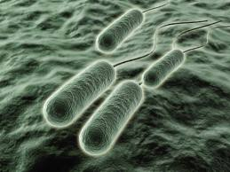
Pseudomonas

Slide 2
Diseases
Sepsis
Pneumonia
Urinary tract infections
Chronic lower respiratory tract infections -cystic fibrosis
Wound infections (cellulitis) in burn patients
Malignant otitis externa in diabetic patients
Pseudomonas pseudomallei -melioidosis

Slide 3
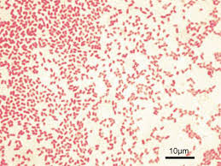
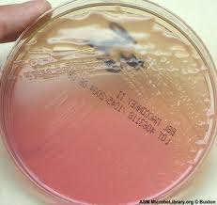
Important Properties
Pseudomonads are gram-negative rods
They are strict aerobes, i.e., they derive their energy only by oxidation of sugars rather than by fermentation
Because they do not ferment glucose, they are called nonfermenters
Oxidase-positive

Slide 4
Pseudomonads are able to grow in water containing only traces of nutrients, e.g., tap water
Pse. aeruginosa and Bur. cepacia have a remarkable ability to withstand disinfectants- hospital-acquired infections
They have been found growing in hexachlorophene-containing soap solutions, in antiseptics, and in detergents

Slide 5
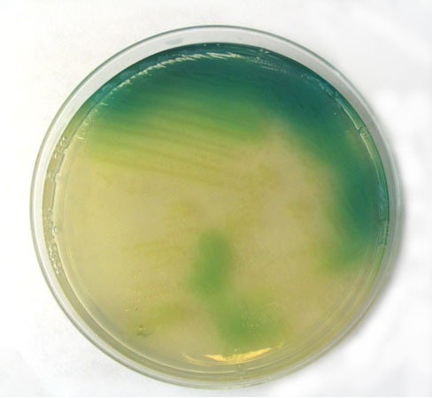
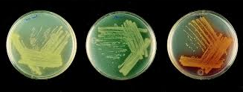
Pse. aeruginosa produces two pigments useful in clinical and laboratory diagnosis:
Pyocyanin, which can color the pus in a wound blue
(2) Pyoverdin (fluorescein), a yellow-green pigment that fluorescence under ultraviolet light
In the laboratory, these pigments diffuse into the agar, imparting a blue-green color that is useful in identification
Pse. aeruginosa is the only species of Pseudomonas that synthesizes pyocyanin

Slide 6
Strains of Pse. aeruginosa have a prominent slime layer (glycocalyx), which
Gives their colonies a very mucoid appearance
It mediates adherence of the organism to mucous membranes of the respiratory tract
Prevents antibody from binding to the organism

Slide 7
Pathogenesis & Epidemiology
Pse. aeruginosa is found chiefly in soil and water
Approximately 10% of people carry it in the normal flora of the colon
It is found on the skin in moist areas
Colonize the upper respiratory tract of hospitalized patients
Its ability to grow in simple aqueous solutions has resulted in contamination of respiratory therapy and anesthesia equipment, intravenous fluids, and even distilled water

Slide 8
Pse. aeruginosa is primarily an opportunistic pathogen that causes infections in hospitalized patients, e.g.,
those with extensive burns
in whom the skin host defenses are destroyed
in those with chronic respiratory disease (e.g., cystic fibrosis)
in whom the normal clearance mechanisms are impaired
in those who are immunosuppressed
in those with neutrophil counts of less than 500/ μL
in those with indwelling catheters
It causes 10% to 20% of hospital-acquired infections and, in many hospitals, is the most common cause of gram-negative nosocomial pneumonia

Slide 9
Pathogenesis is based on multiple virulence factors:
Endotoxin, sepsis and septic shock
Exotoxins, exotoxin A, which causes tissue necrosis . It inhibits eukaryotic protein synthesis by ADP-ribosylation of elongation factor 2
Enzymes -elastase and proteases- histotoxic and facilitate invasion of the organism into the bloodstream
Pyocyanin damages the cilia and mucosal cells of the respiratory tract

Slide 10
Type III secretion system
This secretion system transfers the exotoxin from the bacterium directly into the adjacent human cell, which allows the toxin to avoid neutralizing antibody
Type III secretion systems are mediated by transport pumps in the bacterial cell membrane
Of the four exoenzymes known to be transported by this secretion system, Exo S is the one most clearly associated with virulence
Exo S has several modes of action, the most important of which is ADP-ribosylation of a Ras protein, leading to damage to the cytoskeleton

Slide 12
Clinical Findings
Pse. aeruginosa can cause infections virtually anywhere in the body
Urinary tract infections
Pneumonia (especially in cystic fibrosis patients)
Wound infections (especially burns) predominate
The organism can enter the blood, causing sepsis
The bacteria can spread to the skin, where they cause black, necrotic lesions ecthyma gangrenosum

Slide 13
An important cause of endocarditis in intravenous drug users
Severe external otitis (malignant otitis externa)
Skin lesions (e.g., folliculitis) occur in users of swimming pools and hot tubs (hot tub folliculitis) in which the chlorination is inadequate
Osteochondritis of the foot in those who sustain puncture wounds through the soles of gym shoes
Corneal infections caused by Pse. aeruginosa are seen in contact lens users

Slide 14
Laboratory Diagnosis
Pse. aeruginosa grows as non–lactose-fermenting (colorless) colonies on MacConkey's or EMB agar
It is oxidase-positive
A typical metallic sheen of the growth on TSI agar, coupled with the blue-green pigment on ordinary nutrient agar and a fruity aroma, is sufficient to make a presumptive diagnosis
The diagnosis is confirmed by biochemical reactions
Identification for epidemiologic purposes is done by bacteriophage or pyocin typing

Slide 15
Treatment
Pse. aeruginosa is resistant to many antibiotics
The treatment of choice is an antipseudomonal penicillin, e.g., piperacillin/tazobactam or ticarcillin/clavulanate, plus an aminoglycoside, e.g., gentamicin or amikacin
The drug of choice for urinary tract infections is ciprofloxacin
The drug of choice for infections caused by Bur. cepacia and Ste. maltophilia is trimethoprim-sulfamethoxazole

Slide 16
Prevention
Prevention of Pse. aeruginosa infections involves
Keeping neutrophil counts above 500/ μ L
Removing indwelling catheters promptly taking special care of burned skin
Taking other similar measures to limit infection in patients with reduced host defenses

Slide 17
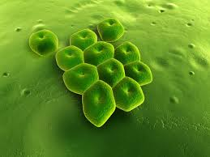
Acinetobacter

Slide 18
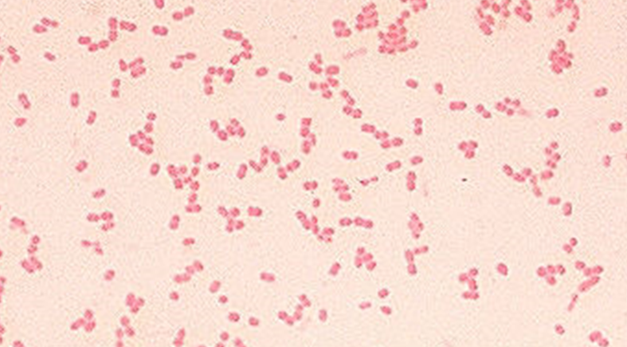
Important Properties
Acinetobacter species are gram-negative coccobacillary rods
Oxidase negative
Nitrate negative
Catalase positive
Nonfermentative
Nonmotile
Strictly aerobic

Slide 19
Found commonly in soil and water
They can be part of the normal flora
They are opportunistic pathogens that readily colonize patients with compromised host defenses

Slide 20
Acinetobacter baumannii, the species usually involved in human infection
Causes disease chiefly in a hospital setting usually associated with respiratory therapy equipment and indwelling catheters
Sepsis, pneumonia, and urinary tract infections are the most frequent manifestations

Slide 21
Infections
Ventilator-associated pneumonia
Urinary tract
Bloodstream infection
Secondary meningitis
Skin/wound infections
Endocarditis
Peritonitis
Ventriculitis

Slide 22
Treatment
A baumannii is remarkably antibiotic resistant
Some isolates are resistant to all known antibiotics

Slide 23
Pathogenesis of Typhoid fever
In typhoid and other enteric fevers, organisms pass the acidic barrier of stomach and enter the intestinal lumen
In intestine the organism first attach to the epithelial cell & then through pinocytic movement enter the intracellular space
The organism can multiply in pinocytic vacuole & then pass to lamina propria
In lamina propria organisms enter the lacteals and through them to local lymph glands & thoracic duct
This opens into the blood stream, this is the Primary bacteraemia

Slide 24
The organisms are then carried to reticuloendothelial organ by the blood stream like liver, spleen, bone marrow, kidney, lymph nodes & Peyer's patches of small intestine
The organism multiply in these organ and enter blood stream for second time
This is the stage of Secondary bacteraemia, which is associated with the onset of fever
The swelling of Peyer's patches causes ulceration of S.I. Intestinal perforation can also occur
The microorganisms multiply in intestinal lymphoid tissue and are excreted in stool
Survival and growth of the organism within phagosomes in phagocytic cells are a striking feature of this disease, as is the predilection for invasion of the gallbladder, which can result in establishment of the carrier state and excretion of the bacteria in the feces for long periods

