Slide 1
Q.2. ENLIST FIVE GRANULOMATOUS DISEASIS AND GIVE THE HISTOLOGICAL FEATURES OF A TYPICAL GRANULOMA.

Slide 2
Tuberculosis is the prototype of the granulomatous diseases, but sarcoidosis, cat-scratch disease, lymphogranuloma inguinale, leprosy, brucellosis, syphilis, some mycotic infections, berylliosis, reactions of irritant lipids, and some autoimmune diseases are also included.

Slide 3
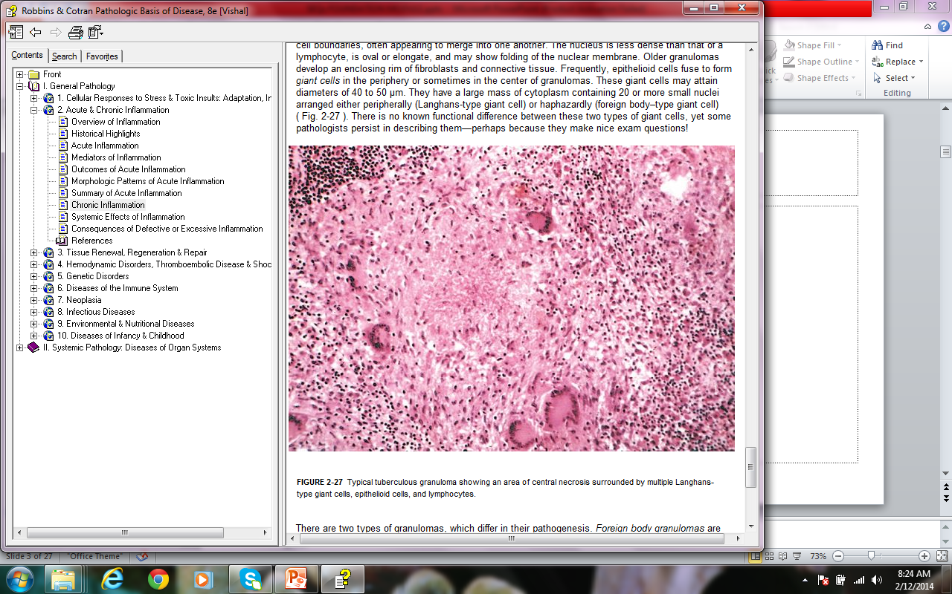

Slide 4
A granuloma is a focus of chronic inflammation consisting of a microscopic aggregation of macrophages that are transformed into epithelium-like cells, surrounded by a collar of mononuclear leukocytes, principally lymphocytes and occasionally plasma cells.

Slide 5
In the usual hematoxylin and eosin–stained tissue sections, the epithelioid cells have a pale pink granular cytoplasm with indistinct cell boundaries, often appearing to merge into one another. The nucleus is less dense than that of a lymphocyte, is oval or elongate, and may show folding of the nuclear membrane.

Slide 6
Older granulomas develop an enclosing rim of fibroblasts and connective tissue.

Slide 7
Frequently, epithelioid cells fuse to form giant cells in the periphery or sometimes in the center of granulomas. These giant cells may attain diameters of 40 to 50 μm. They have a large mass of cytoplasm containing 20 or more small nuclei arranged either peripherally (Langhans-type giant cell) or haphazardly (foreign body–type giant cell).

Slide 8
Q.3. WHAT TYPE OF CELL INJURY OCCURS IN A CASE OF MYOCARDIAL INFARCTION AND WHAT IS ITS MECHANISM?

Slide 9
In ischemic tissues, not only is aerobic metabolism compromised but anaerobic energy generation also stops after glycolytic substrates are exhausted, or glycolysis is inhibited by the accumulation of metabolites that would have been removed otherwise by blood flow. For this reason, ischemia tends to cause more rapid and severe cell and tissue injury than does hypoxia in the absence of ischemia.

Slide 10
As the oxygen tension within the cell decreases, there is loss of oxidative phosphorylation and decreased generation of ATP. The depletion of ATP results in failure of the sodium pump, with loss of potassium, influx of sodium and water, and cell swelling. There is also influx of Ca²⁺, with its many deleterious effects. There is progressive loss of glycogen and decreased protein synthesis.

Slide 11
The functional consequences may be severe at this stage. For instance, heart muscle ceases to contract within 60 seconds of coronary occlusion. Note, however, that loss of contractility does not mean cell death. If hypoxia continues, worsening ATP depletion causes further deterioration.

Slide 12
Q.4. ENLIST DIFFERENT TYPES OF CELLULAR ADAPTATIONS. WHAT TYPE OF ADAPTATION OCCURS IN UTERINE MUSCLE IN PREGNANCY AND WHAT ARE ITS CHARACTERS?

Slide 13
Cell Adaptations
Hypertrophy
Hyperplasia
Atrophy
Metaplasia

Slide 14
Hypertrophy refers to an increase in the size of cells, resulting in an increase in the size of the organ.

Slide 15
The hypertrophied organ has no new cells, just larger cells. The increased size of the cells is due to the synthesis of more structural components of the cells.

Slide 16
Cells capable of division may respond to stress by undergoing both hyperplasia (described below) and hypertrophy, whereas in nondividing cells (e.g., myocardial fibers) increased tissue mass is due to hypertrophy. In many organs hypertrophy and hyperplasia may coexist and contribute to increased size.

Slide 17
The massive physiologic growth of the uterus during pregnancy is a good example of hormone-induced increase in the size of an organ that results mainly from hypertrophy of muscle fibers. The cellular enlargement is stimulated by estrogenic hormones acting on smooth muscle estrogen receptors, eventually resulting in increased synthesis of smooth muscle proteins and an increase in cell size

Slide 18
Q.5. ENUMERATE THE CAUSES OF CELL INJURY AND HOW DOES OXIDATIVE STRESS PLAY ITS ROLE IN CELL INJURY?

Slide 19
Causes of Cell Injury
Oxygen Deprivation.
Physical Agents.
Chemical Agents and Drugs.
Infectious Agents.
Immunologic Reactions.
Genetic Derangements.
Nutritional Imbalances.

Slide 20
ACCUMULATION OF OXYGEN-DERIVED FREE RADICALS (OXIDATIVE STRESS)
Cell injury induced by free radicals, particularly reactive oxygen species, is an important mechanism of cell damage in many pathologic conditions, such as chemical and radiation injury, ischemia-reperfusion injury (induced by restoration of blood flow in ischemic tissue), cellular aging, and microbial killing by phagocytes.

Slide 21
Free radicals are chemical species that have a single unpaired electron in an outer orbit. Energy created by this unstable configuration is released through reactions with adjacent molecules, such as inorganic or organic chemicals—proteins, lipids, carbohydrates, nucleic acids—many of which are key components of cell membranes and nuclei.

Slide 22
ROS are produced normally in cells during mitochondrial respiration and energy generation, but they are degraded and removed by cellular defense systems. Thus, cells are able to maintain a steady state in which free radicals may be present transiently at low concentrations but do not cause damage.

Slide 23
When the production of ROS increases or the scavenging systems are ineffective, the result is an excess of these free radicals, leading to a condition called oxidative stress. Oxidative stress has been implicated in a wide variety of pathologic processes, including cell injury, cancer, aging, and some degenerative diseases such as Alzheimer disease.

Slide 24
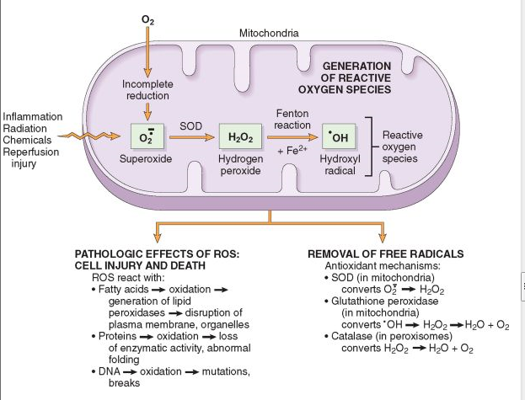

Slide 25
Removal of Free Radicals.
Antioxidants
The levels of the reactive metals are minimized by binding of the ions to storage and transport proteins (e.g., transferrin, ferritin, lactoferrin, and ceruloplasmin),
Enzymes. Catalase, Superoxide dismutase, Glutathione peroxidase

Slide 26
Q.6. TABULATE THE DIFFERENCES BETWEEN METASTATIC AND DYSTROPHIC CALCIFICATION AND CLINICAL EXAMPLES OF EACH TYPE.

Slide 27
Dystrophic Cacification
Metastatic calcification
When the deposition occurs locally in dying tissues it is known as dystrophic calcification.
The deposition of calcium salts in otherwise normal tissues is known as metastatic calcification.

Slide 28
despite normal serum levels of calcium.
absence of derangements in calcium metabolism.
Necrotic areas
Atheromas. Aging and damaged heart valves, tuberculous lymph nodes.
Hypercalcemia
secondary to some disturbance in calcium metabolism.

Slide 29
Heterotopic bone
Psammoma bodies
Asbestos, Calcium and Iron deposits in lung

Slide 30
Q.7. DEFINE ACUTE INFLAMMATION AND GIVE A BRIEF ACCOUNT OF VASCULAR CHANGES IN IT.

Slide 31
Acute inflammation is a rapid host response that serves to deliver leukocytes and plasma proteins, such as antibodies, to sites of infection or tissue injury.

Slide 32
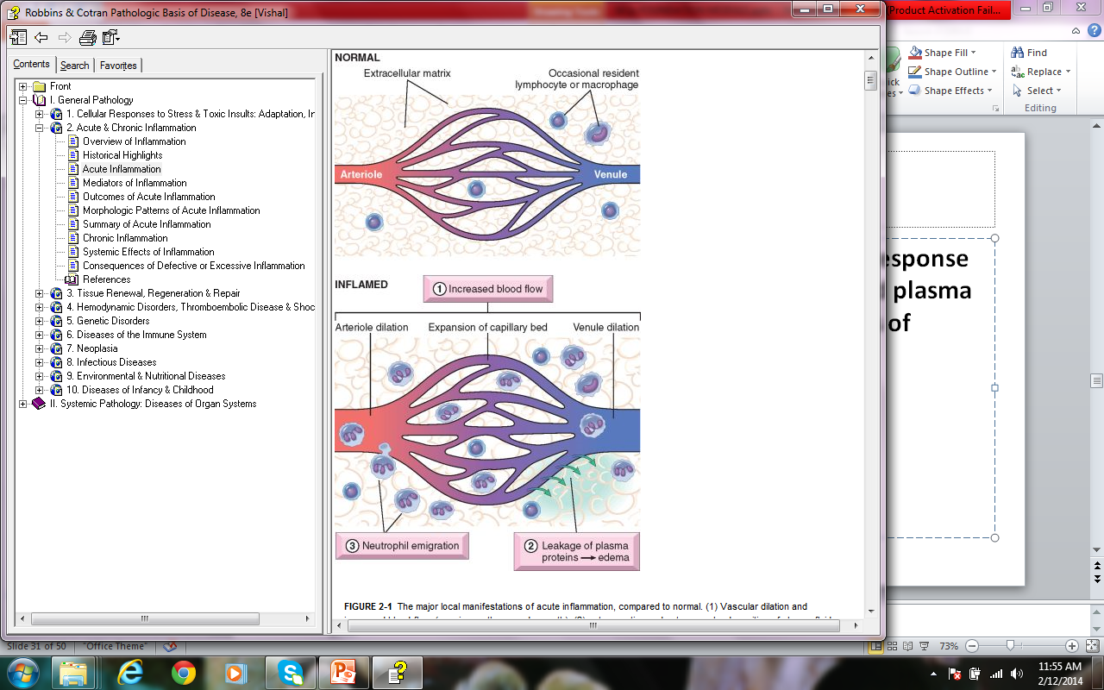

Slide 33
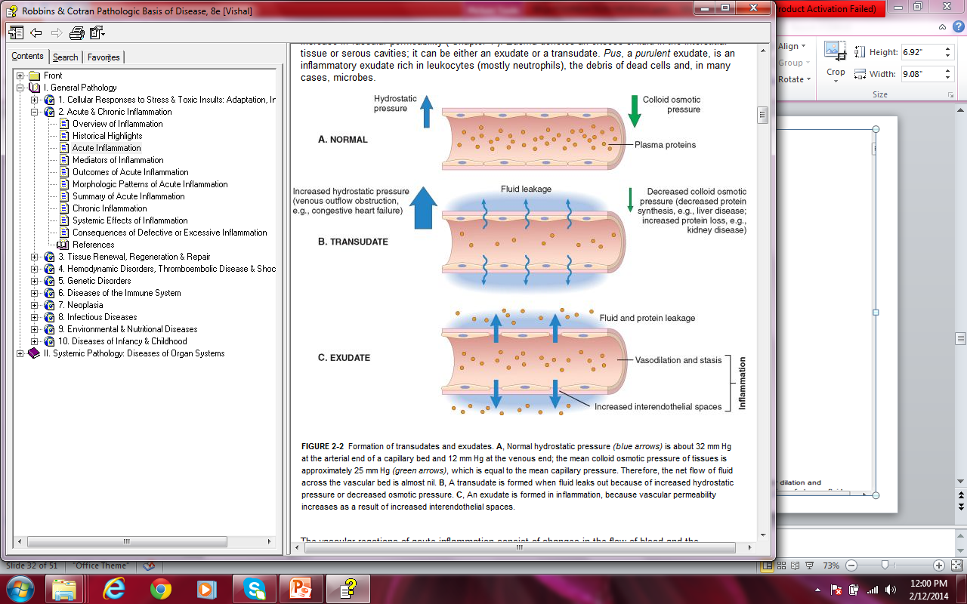

Slide 34
Vasodilation is one of the earliest manifestations of acute inflammation; sometimes it follows a transient constriction of arterioles, lasting a few seconds. Vasodilation first involves the arterioles and then leads to opening of new capillary beds in the area. The result is increased blood flow, which is the cause of heat and redness (erythema) at the site of inflammation. Vasodilation is induced by the action of several mediators, notably histamine and nitric oxide (NO), on vascular smooth muscle.

Slide 35
Vasodilation is quickly followed by increased permeability of the microvasculature, with the outpouring of protein-rich fluid into the extravascular tissues; this process is described in detail below.

Slide 36
The loss of fluid and increased vessel diameter lead to slower blood flow, concentration of red cells in small vessels, and increased viscosity of the blood. These changes result in dilation of small vessels that are packed with slowly moving red cells, a condition termed stasis, which is seen as vascular congestion (producing localized redness) upon examination of the involved tissue.

Slide 37
As stasis develops, blood leukocytes, principally neutrophils, accumulate along the vascular endothelium. At the same time endothelial cells are activated by mediators produced at sites of infection and tissue damage, and express increased levels of adhesion molecules. Leukocytes then adhere to the endothelium, and soon afterward they migrate through the vascular wall into the interstitial tissue.

Slide 38
Q.8. ENLIST MEDIATORS OF INFLAMMATION AND BRIEFLY DESCRIBE ARACHIDONIC ACID METABOLITES.

Slide 39
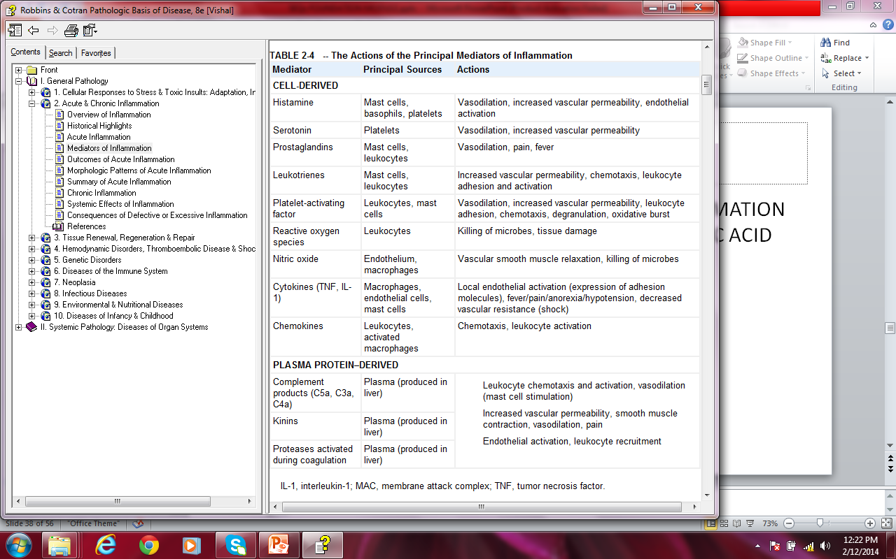

Slide 40
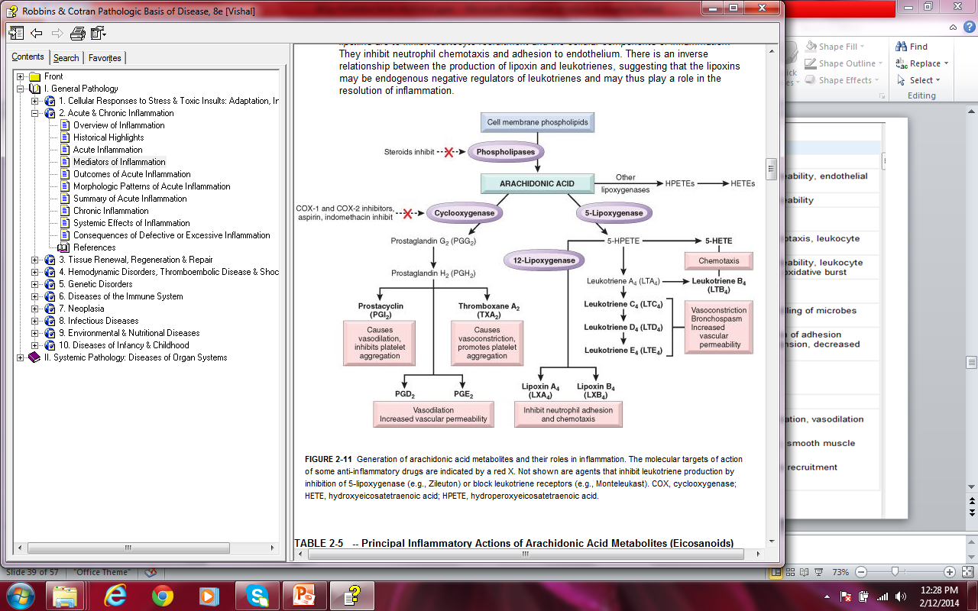

Slide 41
Q.9. OUTLINE THE ROLE OF LEUCOCYTES IN ACUTE INFLAMMATION.

Slide 42
A critical function of inflammation is to deliver leukocytes to the site of injury and to activate the leukocytes to eliminate the offending agents. The most important leukocytes in typical inflammatory reactions are the ones capable of phagocytosis, namely neutrophils and macrophages. These leukocytes ingest and kill bacteria and other microbes, and eliminate necrotic tissue and foreign substances. Leukocytes also produce growth factors that aid in repair.

Slide 43
A price that is paid for the defensive potency of leukocytes is that, when strongly activated, they may induce tissue damage and prolong inflammation, because the leukocyte products that destroy microbes and necrotic tissues can also injure normal host tissues.

Slide 44
The processes involving leukocytes in inflammation consist of: their recruitment from the blood into extravascular tissues, recognition of microbes and necrotic tissues, and removal of the offending agent.

Slide 45
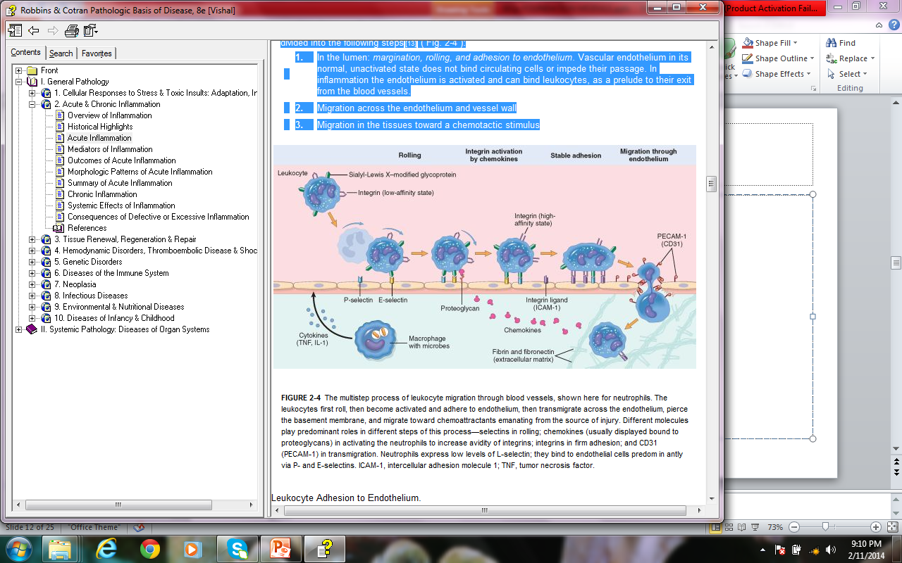

Slide 46
Q.10. A YOUNG LADY OF 25 YEARS HAD PLANNED (ELECTIVE) CAESERIAN SECTION AND STITCHES ARE REMOVED ROUTINELY ON 7TH POST OP DAY. ENLIST THE SEQUENCE OF EVENTS IN HEALING IN THIS CASE AND COMMENT ON THE TYPE OF HEALING WHICH TOOK PLACE IN THIS PATIENT.

Slide 47
 | • | inflammation
 | • | angiogenesis,
 | • | migration and proliferation of fibroblasts,
 | • | scar formation
 | • | connective tissue remodeling.
Repair by connective tissue deposition includes the following basic features:

Slide 48
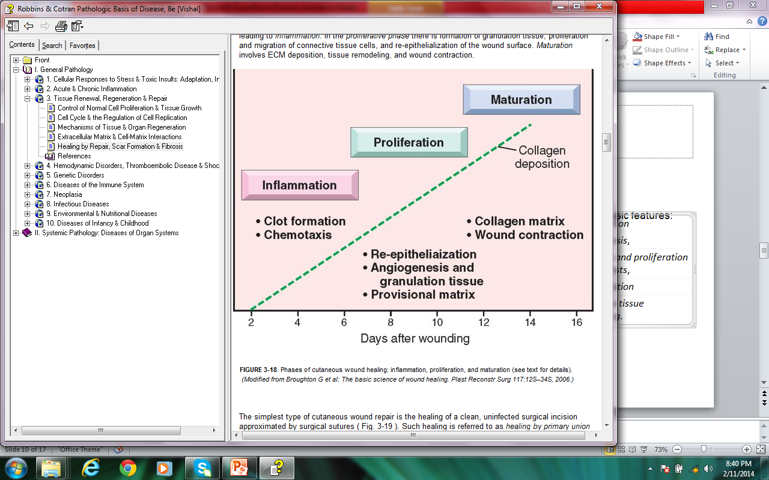

Slide 49
Cutaneous wound healing is divided into three phases: inflammation, proliferation, and maturation. These phases overlap, and their separation is somewhat arbitrary, but they help to understand the sequence of events that take place in the healing of skin wounds. The initial injury causes platelet adhesion and aggregation and the formation of a clot in the surface of the wound, leading to inflammation.

Slide 50
In the proliferative phase there is formation of granulation tissue, proliferation and migration of connective tissue cells, and re-epithelialization of the wound surface. Maturation involves ECM deposition, tissue remodeling, and wound contraction.

Slide 51
The simplest type of cutaneous wound repair is the healing of a clean, uninfected surgical incision approximated by surgical sutures. Such healing is referred to as healing by primary union or by first intention.

Slide 52
Q.11. ENLIST THE SYSTEMIC EFFECTS OF INFLAMMATION AND COMMENT ON ACUTE PHASE PROTEINS.

Slide 53
Fever, characterized by an elevation of body temperature, usually by 1° to 4°C, is one of the most prominent manifestations of the acute-phase response, especially when inflammation is associated with infection.

Slide 54
Acute-phase proteins are plasma proteins, mostly synthesized in the liver, whose plasma concentrations may increase several hundred-fold as part of the response to inflammatory stimuli. Three of the best-known of these proteins are C-reactive protein (CRP), fibrinogen, and serum amyloid A (SAA) protein.

Slide 55
Another peptide whose production is increased in the acute-phase response is the iron-regulating peptide hepcidin. Chronically elevated plasma concentrations of hepcidin reduce the availability of iron and are responsible for the anemia associated with chronic inflammation.

Slide 56
Leukocytosis is a common feature of inflammatory reactions, especially those induced by bacterial infections. The leukocyte count usually climbs to 15,000 or 20,000 cells/μL, but sometimes it may reach extraordinarily high levels of 40,000 to 100,000 cells/μL. These extreme elevations are referred to as leukemoid reactions, because they are similar to the white cell counts observed in leukemia and have to be distinguished from leukemia.

Slide 57
Other manifestations of the acute-phase response include increased pulse and blood pressure; decreased sweating, mainly because of redirection of blood flow from cutaneous to deep vascular beds, to minimize heat loss through the skin; rigors (shivering), chills (search for warmth), anorexia, somnolence, and malaise, probably because of the actions of cytokines on brain cells.

Slide 58
In severe bacterial infections (sepsis) the large amounts of organisms and LPS in the blood stimulate the production of enormous quantities of several cytokines, notably TNF and IL-1. As a result, circulating levels of these cytokines increase and the nature of the host response changes. High levels of cytokines cause various clinical manifestations such as disseminated intravascular coagulation, cardiovascular failure, and metabolic disturbance, which are described as septic shock.

