Slide 1
SHOCK
BY
DR KAUSAR MALIK
Assistant professor Medicine

Slide 2
Shock occurs when the rate of arterial blood flow is inadequate to meet tissue metabolic needs.

Slide 3
SHOCK
Regional hypoxia
Subsequent lactic acidosis from anaerobic metabolism in peripheral tissues
End-organ damage and failure.

Slide 4
Classification
Hypovolemic shock
Cardiogenic shock
Obstructive shock
Distributive shock

Slide 5
Hypovolemic shock
Loss of blood (hemorrhagic shock)
External hemorrhage
Trauma
Gastrointestinal tract bleeding
Internal hemorrhage
Hematoma
Hemothorax or hemoperitoneum
Loss of plasma
Burns

Slide 6
Hypovolemic shock
Loss of fluid and electrolytes
External
Vomiting
Diarrhea
Excessive sweating
Hyperosmolar states (diabetic ketoacidosis, hyperosmolar nonketotic coma)
Internal ("third spacing")
Pancreatitis
Ascites
Bowel obstruction

Slide 7
Cardiogenic shock
Dysrhythmia
Tachyarrhythmia
Bradyarrhythmia
"Pump failure" (secondary to myocardial infarction or other cardiomyopathy)
Acute valvular dysfunction (especially regurgitant lesions)
Rupture of ventricular septum or free ventricular wall

Slide 8
Obstructive shock
Tension pneumothorax
Pericardial disease (tamponade, constriction)
Disease of pulmonary vasculature (massive pulmonary emboli, pulmonary hypertension)
Cardiac tumor (atrial myxoma)
Left atrial mural thrombus
Obstructive valvular disease (aortic or mitral stenosis)

Slide 9
Distributive shock
Septic shock
Anaphylactic shock
Neurogenic shock
Vasodilator drugs
Acute adrenal insufficiency

Slide 10
Clinical Findings
Hypotension
A systolic blood pressure of 90 mm hg or less or
A mean arterial pressure of < 60–65 mm hg
Must be evaluated relative to the patient's normal blood pressure.

Slide 11
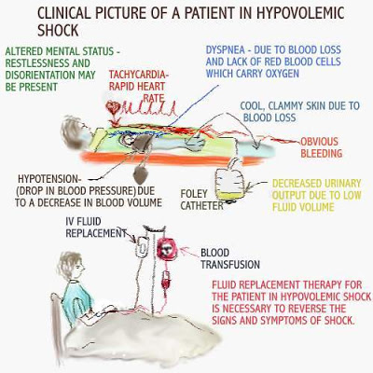

Slide 12
Hypotension
POSTURAL DROP
A drop in systolic pressure of more than 10–20 mm Hg
an increase in pulse of more than 15 beats per minute with positional change suggests depleted intravascular volume.

Slide 13
Hypotension
However, blood pressure is often not the best indicator of organ perfusion because compensatory mechanisms, such as increased heart rate, contractility, and vasoconstriction can occur to prevent hypotension.

Slide 14
Clinical Findings
Cool or mottled extremities
Weak or thready peripheral pulses.
Splanchnic vasoconstriction
oliguria, bowel ischemia, and hepatic dysfunction

Slide 15
Clinical Findings
Patients may become restless, agitated, confused, lethargic, or comatose as a result of inadequate perfusion of the brain. .

Slide 16
Hypovolemic shock
Oliguria, altered mental status, and cool extremities
Jugular venous pressure is low, and
There is a narrow pulse pressure indicative of reduced stroke volume.
Rapid replacement of fluids restores tissue perfusion

Slide 17
cardiogenic shock
Signs of global hypoperfusion with oliguria
Altered mental status, and
Cool extremities.
Jugular venous pressure is elevated.
There may be evidence of pulmonary edema in the setting of left-sided heart failure.

Slide 18
obstructive shock
In, the central venous pressure may be elevated but the TEE or TTE may show reduced left ventricular filling, a layer of fluid between the pericardium as in the case of tamponade, or thickened pericardium as in the case of pericarditis.
Pericardiocentesis or pericardial window –cardiac temponade
Chest tube placement-pneumothorax
Catheter-directed thrombolytic therapy-pulmonary embolism

Slide 19
Distributive shock
hyperdynamic heart sounds,
warm extremities initially, and
a wide pulse pressure indicative of large stroke volume.
The echocardiogram may show hyperdynamic left ventricle.
Fluid resuscitation may have little effect on blood pressure, urinary output, or mentation.

Slide 20
Septic shock
clinical evidence of infection in the setting of persistent hypotension and evidence of organ hypoperfusion, such as lactic acidosis, decreased urinary output, or altered mental status despite volume resuscitation.

Slide 21
Neurogenic shock
Central nervous system injury and
Persistent hypotension despite volume resuscitation.

Slide 22
APPROACH TO THE PATIENT
Obtain history for underlying cause, including
• Known cardiac disease (coronary disease, CHF, pericarditis)
• Recent fever or infection (leading to sepsis)
• Drugs, e.G., Excess diuretics or antihypertensives
• Conditions predisposing for pulmonary embolism
• possible bleeding from any site, particularly GI tract.

Slide 23
PHYSICAL EXAMINATION
Jugular veins are flat in oligemic or distributive shock
Jugular venous distention(JVD) suggests cardiogenic shock
JVD in presence of paradoxical pulse may reflect cardiac tamponade

Slide 24
PHYSICAL EXAMINATION
Evidence of CHF
Murmurs of aortic stenosis,
Acute regurgitation (mitral or aortic), ventricular septal defect.
Check for asymmetry of pulses (aortic dissection)
Tenderness or rebound in abdomen may indicate peritonitis or pancreatitis;
High-pitched bowel sounds suggest intestinal obstruction.

Slide 25
LABORATORY
Obtain hematocrit, WBC, electrolytes.
If actively bleeding, check platelet count, PT, PTT, DIC screen.
Arterial blood gas usually shows metabolic acidosis

Slide 26
If sepsis suspected, drawblood cultures, perform urinalysis, and obtain Gram stain and cultures of sputum, urine, and other suspected sites.
Obtain ECG (myocardial ischemia or acute arrhythmia),
chest x-ray (CHF ,tension pneumothorax, aortic dissection, pneumonia).
Echocardiogram maybe helpful (cardiac tamponade, CHF).

Slide 27
Central venous pressure or pulmonary capillary wedge (PCW) pressure measurements may be necessary to distinguish between different categories of shock
Mean PCW < 6 mmHg suggests oligemic or distributive shock
PCW > 20 mmHg suggests left ventricular failure.

Slide 28
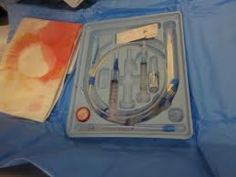

Slide 29
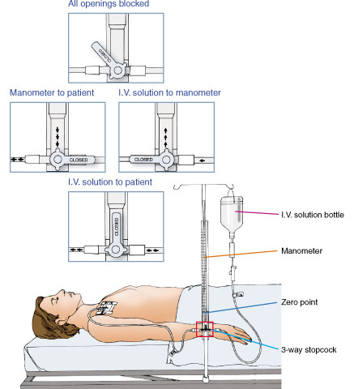

Slide 30
TREATMENT
Aimed at rapid improvement of tissue hypoperfusion and respiratory impairment
Serial measurements of BP (intraarterial line preferred),
heart rate,
continuous ECG monitor,
urine output,
pulse oximetry

Slide 31
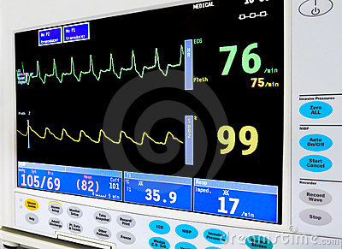

Slide 32
Blood studies:
HCT, electrolytes ,creatinine, BUN, ABGS, ph, calcium, phosphate, lactate, urine Na concentration (<20 mmol/L suggests volume depletion)

Slide 33
Consider continuous monitoring of CVP and/or pulmonary artery pressure, with serial PCW pressures in pts with ongoing blood loss or suspected cardiac dysfunction.
• Insert Foley catheter to monitor urine flow.
• Assess mental status frequently

Slide 34
Augment systolic BP to >100 mmHg:
(1) place in reverse trendelenburg position;
(2) IV volume infusion (500- to 1000-ml bolus), unless cardiogenic shock suspected
Begin with normal saline, then whole blood,or packed RBCS, if anemic
Continue volume replacement as needed to restore vascular volume

Slide 35
Medications
Vasoactive Therapy
Vasopressors and inotropic agents are administered only after adequate fluid resuscitation.

Slide 36
Choice of vasoactive therapy
etiology of shock
cardiac output.
If there is evidence of low cardiac output with high filling pressures, inotropic support is needed to improve contractility.
If there is continued hypotension with evidence of high cardiac output after adequate volume resuscitation, then vasopressor support is needed to improve vasomotor tone.

Slide 37
Dobutamine
Adrenergic agonist,
First-line drug for cardiogenic shock, increasing contractility and decreasing afterload.
The initial dose is 0.5–1 mcg/kg/min as a continuous intravenous infusion, which can be titrated every few minutes as needed to hemodynamic effect;
The usual dosage range is 2–20 mcg/kg/min intravenously.

Slide 38
Norepinephrine
Alpha -adrenergic and beta -adrenergic agonist,
It preferentially increases mean arterial pressure over cardiac output. .

Slide 39
Epinephrine,
Both alpha-adrenergic and beta -adrenergic effects,
May be used in severe shock and during acute resuscitation.
It is the vasopressor of choice for anaphylactic shock

Slide 40
Dopamine
variable effects according to dosage.
At low doses (2–5 mcg/kg/min intravenously), stimulation of dopaminergic and -adrenergic receptors produces increased glomerular filtration, heart rate, and contractility.
At doses of 5–10 mcg/kg/min, 1-adrenergic effects predominate, resulting in an increase in heart rate and cardiac contractility.
At higher doses (> 10 mcg/kg/min), -adrenergic effects predominate, resulting in peripheral vasoconstriction.

Slide 41
Vasopressin (antidiuretic hormone or ADH) is often used as an adjunctive therapy to catecholamine vasopressors in the treatment of distributive or vasodilatory shock.

Slide 42
Antibiotics
Definitive therapy for septic shock includes an early initiation of empiric broad-spectrum antibiotics after appropriate cultures have been obtained.
Imaging studies may prove useful to attempt localization of sources of infection.
Surgical management may also be necessary if necrotic tissue or loculated infections are present (see Table 30–9).

