Slide 1
SNAKES (OPHIDIA) By Dr. Romana

Slide 2
Classification
Poisonous snakes
Non- poisonous snakes
Poisonous snakes
Elapids (secreting neurotoxic venom)
Vipers (vasculotoxic)
Sea snakes (myotoxic)

Slide 3
Differences
Poisonous Non poisonous
Head: triangular round/oval
Teeth: grooved/canalized short/solid
Head scales: small large
Belly scales: broad small
Tail: compressed rounded
Venom: toxic Non toxic
Habits: nocturnal not so

Slide 4
Classification
Poisonous snakes
Non- poisonous snakes
Poisonous snakes
Elapids (secreting neurotoxic venom)
Vipers (vasculotoxic)
Sea snakes (myotoxic)

Slide 5
Vipers: 1. Pit vipers
-bamboo snake
2. Pitless vipers
- Russell’s snake
-Saw scaled viper
Sea snakes

Slide 6
Elapids: 1. cobra
2. king cobra
3. Common krait
4. Banded krait
5. coral

Slide 7
Differences
Elapids Vipers
Long/cylinder Short, narrow body neck
Head: nearly same triangular, wider width as neck than neck
Pupils: round vertical
Tail: round tapering
Venom: neurotoxic vasculotoxic

Slide 8
Maxillary bone: only poison has other teeth also fangs besides poison fang
Fangs: short, fixed long,movable, grooved canalized
Oviparous ovo-viviparous

Slide 9
Venoms
Neurotoxic Venom:
Muscular weakness of legs
Paralysis of resp. muscles
Cobra venom produces convulsions and paralyses
Krait venom produces paralyses
Local symp at site of bite are minimum

Slide 10
Myotoxic venom
Generalized muscular pain
Myoglobinuria
Resp failure in fatal cases

Slide 11
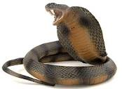
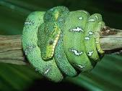

Slide 12
Vasculotoxic venom
Coagulation disorders
Bld vessels are destroyed
RBC’s are lysed
Locally: oozing of heamolytic bld, cellulitis
Hmgs from body orifices

Slide 13
Characteristics of venom
Fibrinolysin Cardiotoxin
Proteolysin Coagulase
Hyaluronidase Neurotoxin
Cholinestrase Lecithinase
Hemolysin
Thormboplastin
Agglutinin

Slide 14
Principles of Treatment
Allying anxiety and fight
Prevention of spread of venom
Antivenin and antitoxic therapy
General measures

Slide 15
B. Prevention of spread
Immobilization
Tourniquet
Cleaning
Incision and suction

Slide 16
C. Antivenin: two types
Specific: prepared by hyperimmunizing horses against venom of a particular snake
Polyvalent: Prepared by hyperimmunizing horses against venoms of four
common poisonous snakes.

Slide 17
These snakes are:
Cobra 2) Common krait
Russell’s viper 4) Saw-scaled viper
Dose: A test dose prior to therapeutic dose is necessary to test for serum sensitivity.
If sensitivity is present, desensitisation by multiple small doses

Slide 18
For adult 60ml of polyvalent serum is injected:
1/3 subcut or locally around bite
1/3 IM
1/3 IV
D. General treatment

Slide 19
PM appearance:
Elapid, 1cm deep one or two bite marks.
Signs of asphyxia.
Viper,2.5cm deep one or two bite marks.
Local signs.

Slide 20
Vegetable Poisons
By
Dr. Romana

Slide 21
Ricinus communis Calotropis
Croton tiglium Plumbago
Abrus precatorius
Colocynth
Ergot
Capsicum
Semecarpus anacardium

Slide 22
Act as irritants due to an active principle present in them
S/S: Externally: Inflammation, sores,
vesication,pustules
Internally: GIT irritation

Slide 23
Ricinus communis
Castor oil plant, Arandi
Active principle is called ricin which is a toxalbumin. Toxalbumin (phytotoxin) is a toxic protein, causes agglutination and lysis of RBC’s and has antigenic properties.
Oil extracted from seeds is not poisonous but residue is poisonous (press cake)

Slide 24
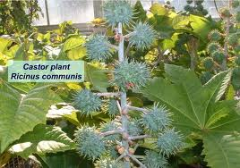

Slide 25
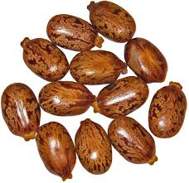
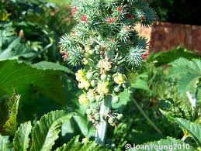

Slide 26
Fatal Dose: 6mg of ricin
Fatal Period: several days George Markov
Treatment: No specific antidote

Slide 27
Abrus precatorius (jequirity)
Active principle is abrin, a toxalbumin, and its actions resemble those of viper snake bite.
SUI POISONING:
Suis are fine needles prepared by mixing powered seeds with opium, onions, dhatura and spirit or water to make a paste. Needles are made 15mm long and 90- 120mg in wt.

Slide 28
Two or three of these suis are fitted
on a wooden stick and pierced into the
animal.
Punctured site is characterised by odema,
necrosis,oozing of hmg fluid.
Animal becomes drowsy,comatose and dies.

Slide 29
Fatal dose: 1-2 seeds orally, 90-120mg abrin by inj.
Fatal period: 3-5 days
Treatment: dissect out the sui and inject
anti- abrin.

Slide 30
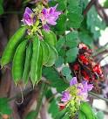
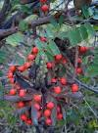

Slide 31
Ergot
Chronic poisoning (ergotism)
Convulsive ergotism:
Gangrenous ergotism:(raynaud’s)
Fatal dose: 1gm
Fatal period: 24hrs or may be delayed for several day
Stimulant action on uterus
Treatment

Slide 32
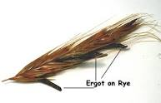

Slide 33
Capsicum (chillis)
Chilli seeds Dhatura
Small/thin large/thick
Pale yellow brown/black
Smooth/round kidney shaped
Pungent odorless
Pungent bitter
Single edge double edge
Embryo curved embryo curved inward outward

Slide 34
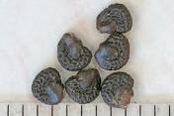
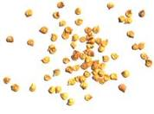

Slide 35
Semecarpus anacardium
(marking nut)
Washermen ---- mark clothes
Malingerers to make artificial bruise to support a false charge
Differences b/w bruises:
Artificial True
Cause: chemical trauma
Site: accessible parts anywhere

Slide 36
Appearance: blister no blister
Color change: no yes
Itching: yes no
Fingers: marks present no
Contents: acrid serum extravasated blood

