Slide 1
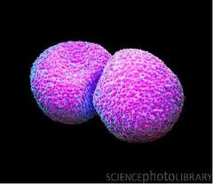
Streptococcus pneumoniae

Slide 2
Diseases
Pneumonia
Bacteremia
Meningitis
Infections of the URT such as otitis media, mastoiditis, and sinusitis
Sepsis in splenectomized individuals
Conjunctivitis, especially in children

Slide 3
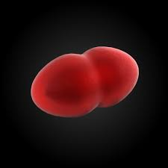
Important Properties
Gram-positive
Lancet-shaped cocci
Arranged in pairs (diplococci) or short chains (the term "lancet-shaped" means that the diplococci are oval with somewhat pointed ends rather than being round)
On blood agar they produce α-hemolysis
In contrast to viridans streptococci, they are lysed by bile or deoxycholate and their growth is inhibited by optochin

Slide 4
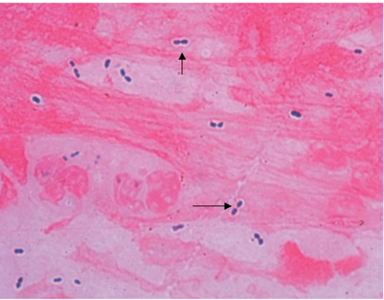
Streptococcus pneumoniae—Gram stain. Arrows point to typical gram-positive diplococci. Note that the clear area around the organism is the capsule

Slide 5
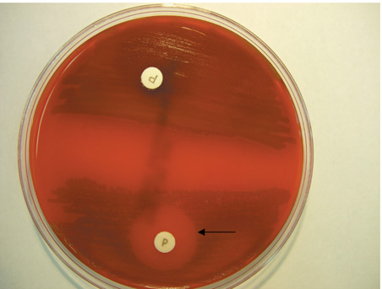
Optochin test—Arrow points to zone of inhibition of growth of Streptococcus pneumoniae caused by optochin that has diffused from the disk labeled P. In the lower half of the blood agar plate, there is -hemolysis caused by Str. pneumoniae, except in the region around the optochin disk. The arrow points to the outer limit of the zone of inhibition. Upper half of blood agar plate shows -hemolysis caused by a viridans streptococcus and there is no zone of inhibition around the optochin disk

Slide 6
Capsules
Possess polysaccharide capsules of more than 85 antigenically distinct types
With type-specific antiserum, capsules swell (quellung reaction), and this can be used to identify the type
Are virulence factors, i.e., they interfere with phagocytosis and favor invasiveness
Capsular polysaccharide elicits primarily a B-cell (i.e., T-independent) response

Slide 7
C-substance
Another important surface component of str. pneumoniae is a carbohydrate in the cell wall called C-substance
This carbohydrate reacts with a normal serum protein made by the liver called C-reactive protein (CRP)

Slide 8
CRP
CRP is an "acute-phase" protein that is elevated as much as a 1000-fold in acute inflammation
Nonspecific indicator of inflammation and is elevated in response to the presence of many organisms, not just str. pneumoniae
Clinically, CRP in human serum is measured in the laboratory by its reaction with the carbohydrate of str. pneumoniae
An elevated CRP appears to be a better predictor of heart attack risk than an elevated cholesterol level

Slide 9
Transmission
Humans are the natural hosts for pneumococci
There is no animal reservoir

Slide 10
Pathogenesis
Lipoteichoic acid, which activates complement and induces inflammatory cytokine production, contributes to the inflammatory response and to the septic shock syndrome that occurs in some immunocompromised patients
Pneumolysin, the hemolysin that causes α-hemolysis, may also contribute to pathogenesis
IgA protease that enhances the organism's ability to colonize the mucosa of the upper respiratory tract

Slide 11
Factors that lower resistance and predispose persons to pneumococcal infection include
(1) Alcohol or drug intoxication or other cerebral impairment
(2) Abnormality of the respiratory tract (e.g., Viral infections)
(3) Abnormal circulatory dynamics (e.g., Pulmonary congestion and heart failure)
(4) Splenectomy
(5) Certain chronic diseases such as sickle cell anemia and nephrosis
Trauma to the head that causes leakage of spinal fluid through the nose predisposes to pneumococcal meningitis

Slide 12
Clinical Findings
Pneumonia often begins with a sudden chill, fever, cough, and pleuritic pain
Sputum is a red or brown "rusty" color
Bacteremia occurs in 15% to 25% of cases
Spontaneous recovery may begin in 5 to 10 days and is accompanied by development of anticapsular antibodies

Slide 13
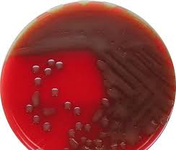
Laboratory Diagnosis
In sputum, pneumococci are seen as lancet-shaped gram-positive diplococci in Gram-stained smears
They can also be detected by using the quellung reaction with multitype antiserum
On blood agar, pneumococci form small α-hemolytic colonies. The colonies are bile-soluble, i.e., are lysed by bile, and growth is inhibited by optochin
Blood cultures are positive in 15% to 25% of pneumococcal infections

Slide 14
Treatment
Most pneumococci are susceptible to penicillins and erythromycin
In severe pneumococcal infections, penicillin G is the drug of choice, whereas in mild pneumococcal infections, oral penicillin V can be used
A fluoroquinolone with good antipneumococcal activity, such as levofloxacin, can also be used
In penicillin-allergic patients, erythromycin or one of its long-acting derivatives, e.g., azithromycin, can be used

Slide 15
Prevention
Despite the efficacy of antimicrobial drug treatment, the mortality rate is high in elderly (i.e., persons older than 65 years), immunocompromised (especially splenectomized), or debilitated persons
Such persons should be immunized with the polyvalent (23-type) polysaccharide vaccine
The vaccine is safe and fairly effective and provides long-lasting (at least 5 years) protection

Slide 16
A booster dose is recommended for
(1) People older than 65 years who received the vaccine more than 5 years ago and who were younger than 65 years when they received the vaccine
(2) People between the ages of 2 and 64 years who are asplenic, hiv-infected, receiving cancer chemotherapy, or receiving immunosuppressive drugs to prevent transplant rejection. Oral penicillin is given to young children with hypogammaglobulinemia or splenectomy because such children are prone to pneumococcal infections and respond poorly to the vaccine

Slide 17
A different pneumococcal vaccine containing pneumococcal polysaccharide coupled (conjugated) to a carrier protein (diphtheria toxoid) is given to children younger than 5 years
This "conjugate" vaccine is effective in young children in preventing both bacteremic infections, such as meningitis, and mucosal infections, such as otitis media
The vaccine contains the capsular polysaccharide of the seven most common pneumococcal serotypes
Immunization of children reduces the incidence of pneumococcal disease in adults because children are the main source of the organism for adults and immunization reduces the carrier rate in children

Slide 18
Serotype replacement
Will the vaccine reduce the incidence of disease caused by the serotypes in the vaccine but not the overall incidence of pneumococcal disease because other serotypes that are not in the vaccine will now cause disease?
There is evidence that an increase in invasive pneumococcal disease caused by a nonvaccine strain (serotype 19A) is occurring
Addition of serotype 19A to the vaccine may be necessary
A conjugate vaccine containing 13 serotypes, including 19A, was approved in February 2010

