Slide 1
SYMPATHOMIMETIC DRUGS

Slide 2
Sympathetic nervous system is activated in case of stress.
Nor-adrenaline act as neurotransmitter
Adrenaline act as hormone released from adrenal medulla.

Slide 3
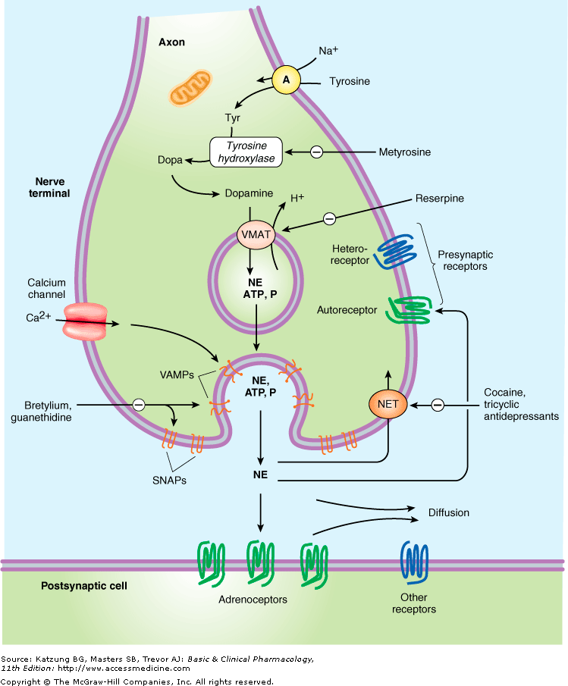

Slide 5
Distribution of Adrenoceptor Subtypes
Type | Tissue | Actions
_{α1} | Most vascular smooth muscle | Contraction
 | Pupillary dilator muscle | Contraction (dilates pupil)
 | Pilomotor smooth muscle | Erects hair
 | Prostate | Contraction
 | Heart | Increases force of contraction
_{α2} | Platelets | Aggregation
 | Adrenergic nerve terminals | Inhibition of transmitter release
 | Some vascular smooth muscle | Contraction
 | Fat cells | Inhibition of lipolysis

Slide 6
Distribution of Adrenoceptor Subtypes
Type | Tissue | Actions
_{β1} | Heart, juxtaglomerular cells | Increases force and rate of contraction; increases renin release
_{β2} | Respiratory, uterine, and vascular smooth muscle | Promotes smooth muscle relaxation
 | Skeletal muscle | Promotes potassium uptake
 | Human liver | Activates glycogenolysis
_{β3} | Fat cells | Activates lipolysis
D₁ | Smooth muscle | Dilates renal blood vessels
D₂ | Nerve endings | Modulates transmitter release

Slide 7
CLASSIFICATION
Chemical
Mode of action
Receptor activation
Therapeutic

Slide 8
CHEMICAL CLASSIFICATION
CATECHOLAMINES
Natural: Epinephrine, norepinephrine,
Dopamine
Synthetic: Isoproterenol, dobutamine,
Rimiterol

Slide 9
NON-CATECHOLAMINES
Ephedrine
Pseudoephedrine
Amphetamine
Methylphenidate
Salbutamol
Terbutaline
Phenylephrine
Methoxamine
Phenylpropanolamine
Xylometazoline
Oxymetazoline
Ritodrine
Isoxsuprine

Slide 10
Chemistry & Structure –Activity Relationship of Sympathomimetic Amines

Slide 11
Substitution on the Benzene Ring

Slide 12
Maximal activity is found on adrenergic receptors with catecholamines having OH group on position 3 and 4.
Metabolised by COMT.
Absence of these group lead to increase in their bioavailability.

Slide 13
Substitution on the Amino Group enhance activity at β receptor

Slide 14
Substitution on the Alpha Carbon block oxidation by MAO and prolong the action of the drug.

Slide 15
Substitution on the Beta Carbon storage of sympathomimetic in neural vesicles.

Slide 16
Mode of Action
DIRECTLY ACTING
Act on adrenoceptors
INDIRECTLY ACTING
Displacement of stored catecholamines
Inhibition of reuptake
Inhibition of metabolism
MIXED ACTING
Indirectly release norepinephrine & also directly activate receptors

Slide 18
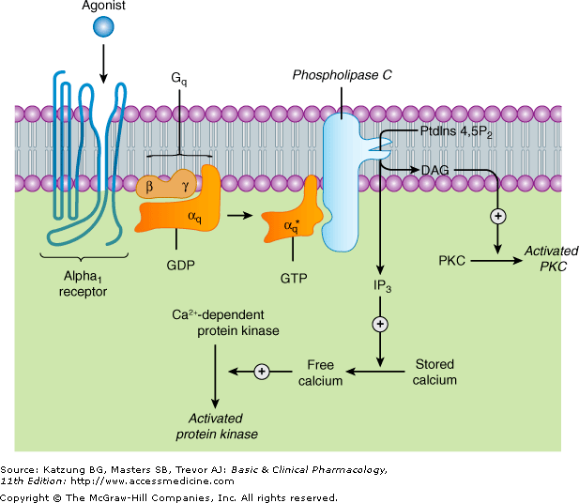
Activation of Alpha 1 Response

Slide 19
Activation of Alpha 2 Responses

Slide 20
Activation of Beta Responses

Slide 21
Receptor Selectivity
Relative receptor affinities
Alpha agonists
Phenylephrine, Methoxamine | α₁> α₂ >>>>> β
Clonidine, Methylnorepinephrine | α₂ > α₁ >>>>> β
Mixed α and β agonists
Norepinephrine | α₁ = α₂ ; β ₁ >> β₂
Epinephrine | α₁ = α₂ ; β ₁ = β₂
Beta agonists
Dobutamine | β ₁ > β₂ ; >>>> α
Isoproterenol | β ₁ = β₂ >>>> α
Albuterol, Terbutaline, Ritodrine | β ₂ >> β₁ >>>> α
Dopamine agonists
Dopamine | D₁ = D₂ >> >> β > α
Fenoldopam | D₁ >> D₂

Slide 23
Receptor Regulation

Slide 24
EPINEPHRINE
Receptor Selectivity
α ₁ = α ₂ ; β ₁ = β ₂
MOA
α ₁ = IP₃ DAG cascade
α ₂ = Decrease cAMP
β = Increase cAMP

Slide 25
Organ System Effects
Pharmacological actions depend on
Receptor selectivity
Intrinsic activity
Predominance of receptors
Other reflexes modulating effects of these drugs

Slide 26
CVS
Heart (positive chronotropic, dromotropic and inotropic effect)
Blood Vessels
Blood pressure

Slide 27
Cardiovascular Responses to Sympathomimetic Drugs
 | Phenylephrine | Epinephrine | Isoproterenol
Vascular resistance (tone)
Cutaneous, mucous membranes (α) |  |  | 0
Skeletal muscle (β₂, α ) |  | or
Renal (α, D₁)
Splanchnic (α, β) |  | or
Total peripheral resistance |  | or
Venous tone (α, β)

Slide 28
 | Phenylephrine | Epinephrine | lsoproterenol
Cardiac
Contractility (β₁) | 0 or
Heart rate (predominantly β₁) | (vagal reflex) | or
Stroke volume | 0, ,
Cardiac output

Slide 29
 | Phenylephrine | Epinephrine | lsoproterenol
Blood pressure
Mean
Diastolic |  | Or
Systolic |  |  | 0 or
Pulse pressure | 0

Slide 30
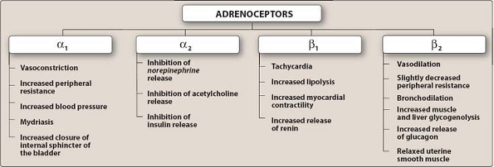

Slide 31
Non-cardiac Effects of Sympathomimetics
Genitourinary (bladder base, urethral sphincter and prostate contain α receptors, Detrusor muscle is relaxed)
Salivary Glands (regulate release of amylase and water)
Apocrine Sweat Glands (increased sweat production)
CNS (nervousness to an adrenaline rush)
Metabolic (increase lipolysis, glycogenolysis)
Miscellaneous (regulators of hormone release)

Slide 32
SPECIFIC SYMPATHOMIMETIC DRUGS
Mixed Alpha & Beta Agonists
Epinephrine
Norepinephrine
Ephedrine
Pseudoephedrine
Phenylpropanolamine

Slide 33
Alpha₁ Agonists
Phenylephrine
Mephentermine
Midodrine
Methoxamine
Xylometazoline
Oxymetazoline
Alpha₂ Agonists
Clonidine
Apraclonidine
Brimonidine
Guanfacine
Guanabenz
Methyldopa
Dexmedetomidine
Tizanidine

Slide 34
Non-selective β Agonist
Isoproterenol
Orciprenaline
β₁ selective Agonist
Dobutamine
Prenalterol
β₂ selective Agonists
Metaproterenol
Salbutamol (Albuterol)
Terbutaline
Fenoterol
Salmeterol
Formoterol
Ritodrine

Slide 35
INDIRECT-ACTING SYMPATHOMIMETICS
Amphetamine-like
Amphetamine
Methamphetamine
Phenmetrazine
Methylphenidate
Modafinil
Tyramine
Catecholamine Reuptake Inhibitors
Atomoxetine
Reboxetine
Sibutramine
Duloxetine
Cocaine

Slide 36
THERAPEUTIC USES OF SYMPATHOMIMETIC DRUGS
CARDIOVASCULAR APPLICATIONS
VASCULAR
Acute Hypotension
Chronic Orthostatic Hypotension (Midodrine α₁ agonist)
Inducing Local Vasoconstriction
Control of local bleeding ( epistaxis, gingivectomy)
Hypertension
Prolonging the duration of infiltration of nerve block.
Mucous membrane decongestants (Hay fever, common cold)

Slide 37
Cardiac Applications
Cardiac arrest
Heart block
CCF

Slide 38
PULMONARY APPLICATIONS
Bronchial asthma, COPD
Allergic disorders (physiologic antagonist of histamine)
ANAPHYLAXIS
bronchospasm, mucous membrane congestion, angioedema, severe hypotension, parenteral epinephrine
OPHTHALMIC APPLICATIONS
mydriatic examination of retina,
glaucoma (Apraclonidine and brimonidine)

Slide 39
GENITOURINARY APPLICATIONS
Suppress premature labour
CNS APPLICATIONS
ADHD (Amphetamines)
NARCOLEPSY (Modafanil)

Slide 40
DIABETIC AUTONOMIC NEUROPATHY DIARRHEA (clonidine because of enhanced salt and water absorption from intestine)
NARCOTIC & ALCOHOL WITHDRAWAL
MENOPAUSAL HOT FLUSHES
Nocturnal Enuresis in children and urinary incontinence (Amphetamines central action as well as by increasing tone of vesical sphincter)

Slide 41
Therapeutic Classification
USED AS BRONCHODILATORS
Salbutamol (Albuterol)
Terbutaline
Salmeterol
Formoterol
Isoprenaline
Epinephrine

Slide 42
USED IN HYPOTENISVE SHOCK
Dopamine
Phenylephrine
Methoxamine
USED AS CARDIAC STIMULANTS
Epinephrine
Isoprenaline
Dobutamine
USED IN ANAPHYLAXIS
Epinephrine

Slide 43
USED TO PROLONG THE EFFECT OF LOCAL ANAESTHETICS
Epinephrine
Phenylephrine
USED AS NASAL DECONGESTANTS
Phenylephrine
Pseudoephedrine
Phenylpropranolamine
Xylometazoline
Oxymetazoline
Naphazoline

Slide 44
UTERINE RELAXANTS
Salbutamol
Ritodrine
Isoxsuprine
USED IN ATTENTION DEFICIT HYPERKINETIC DISORDER
Amphetamines
Methylphenidate
Modafinil
USED IN THE TREATMENT OF NARCOLEPSY
Amphetamines
Ephedrine
Methylphenidate
Modafinil

Slide 45
ANOREXIC AGENTS
Phenmetrazine
Amphetamine
Fenfluramine
MYDRIATICS
Phenylephrine
Epinephrine
USED IN OPEN ANGLE GLAUCOMA
Dipevefrin
Epinephrine
Apraclonidine
Brimonidine

Slide 46
CATECHOLAMINES
NONCATECHOLAMINES
CATECHOL NUCLEUS
NO CATECHOL NUCLEUS
CANNOT BE GIVEN ORALLY
(NATURAL)
GIVEN BY ORAL ROUTE
DURATION OF ACTION SHORTER BECAUSE THESE ARE METABOLISED BY COMT & MAO
DURATION OF ACTION IS LONGER BECAUSE NOT METABOLISED BY COMT & MAO
POLAR SUBST. CANNOT CROSS THE B.B.B. NO DIRECT STIMULANT ACTION ON CNS
THESE CROSS THE B.B.B. AND HAVE A STIMULANT EFFECT ON CNS
THEY ACT DIRECTLY ON ADRENERGIC RECEPTORS
ACT BOTH DIRECTLY, INDIRECTLY & MIXED ACTION ON ADRENERGIC RECEPTORS

Slide 47
Cheese reaction :
Tyramine metabolized with MAO
Indirect sympathomimetic actions caused by release of stored catecholamines
Seen in patients taking MAO inhibitors
Marked increase in blood pressure

Slide 48
Epinephrine Reversal

Slide 49
Toxicity, adverse effects and contraindications
Restlessness
Throbbing headache
Tremor , palpitation
Cardiac arrhythmias
Angina in patients with coronary artery disease
Excessive use of vasoconstrictor can lead to gangrene.
Contraindicated in patients taking non-selective β-receptor antagonists.

