Slide 1
Protein synthesis inhibitors
TETRACYCLINES
Notes:
Antimicrobial drugs are classified as those that inhibit cell wall synthesis, those that inhibit protein synthesis and than those that act to inhibit DNA and RNA synthesis. Tetracyclines belong to the group of dugs that inhibit bacterial protein synthesis by binding to and interfering with ribosomes. They are broad spectrum and bacteriostatic and because of overuse resistance is common.

Slide 2
Learning Objectives
After these sessions, you will be able to:
classify tetracyclines on the basis of source and duration of action;
discuss salient pharmacokinetic features of various tetracyclines;
describe the mechanism of action, spectrum and clinical uses of tetracyclines; and
describe the adverse effects, including contraindications and drug interactions of tetracyclines.

Slide 3
Tetracyclines
OH
O
O
OH
O
10
12
1
2
C
8
9
NH₂
3
OH
7
6
5
4
R7
R6
OR
H
R5
H
N (CH₃)2
Obtained from:
Streptomyces aureofaciens:
Chlortetracycline
Streptomyces rimosus:
Oxytetracycline
Notes:
They are so named for their four (tetra) hydrocarbon rings
Derivatives of POLYCYCLIC NAPHTHACENE CARBOXAMIDE
Crystalline amphoteric substances of low solubility , available as hydrochlorides which are more soluble and stable except chlortetracycline.
Tetracyclines chelate divalent metal ions, which can interfere with their absorption and activity
Tigecycline is a glycylcycline and a semisynthetic derivative of minocycline. It has a long half life of 36 hrs and is not excreted by the kidneys.

Slide 4
CLASSIFICATION BASED ON SOURCE
NATURAL
Chlortetraycline
Oxytetracycline
Demeclocyline
SEMI-SYNTHETIC
Tetraycline
Minocycline
Doxycycline
Methacycline
Lymecycline
Clomocycline
Rolicycline
Notes:
Chlortetracycline is the prototype of this group was introduced in 1948, but is no longer marketed
Demeclocycline id the product of mutant strain of streptomyces aureofaaciens and methacycline

Slide 5
CLASSIFICATION ACCORDING TO
DURATION OF ACTION
Short acting (t ½ 6-9 hrs)
Tetracycline, oxytetracycline, chlortetracycline
Intermediate acting (t ½ up to 16 hrs)
Demeclocycline, methacycline, clomocycline, lymecycline
Long acting ( t ½ 17-20 hrs)
Doxycycline, minocycline, tigecycline(glycyclines)

Slide 6
ANTIMICROBIAL ACTIVITY
Broad-spectrum
Gram-positive & gram-negative bacteria
Aerobic & Anaerobes
Rickettsia
Chlamydia spp.
Mycoplasmas
Listeria
Actinomyces
Some protozoa – amebas
Plasmodium

Slide 7
Spirochetes
Intestinal flora
Hemophilis ducreyi - Chanchroid
Brucella
Vibrio cholerae
Helicobacterpylori
Yersinia

Slide 8
MECHANISM OF ACTION
Entry
Passive diffusion
Energy dependent process of active transport
Inhibit protein synthesis by binding reversibly with 30S ribosomal subunits
Interaction between amino acid transfer RNA complex and mRNA ribosomal complex is inhibited.
Amino acid are not added to the peptide chain
Notes:
Donot reach the human RNA as the energy dependent transport systems are not present in humans

Slide 9
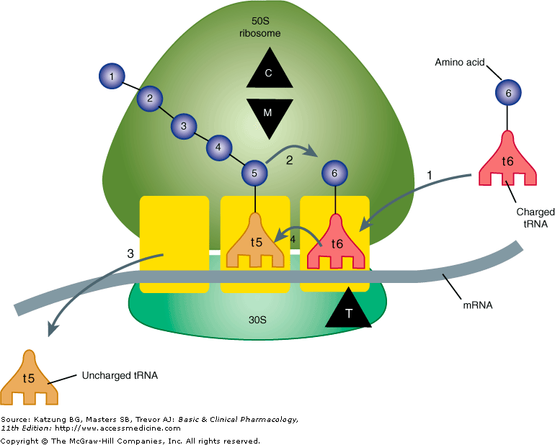

Slide 10
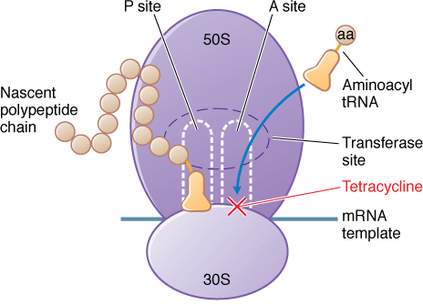

Slide 11
RESISTANCE
Decreased accumulation
Impaired influx or increased efflux by an active transport pump
Ribosome protection
Production of proteins that interfere with binding to the ribosome
Enzymatic inactivation
Notes:
Plasmid-mediated and inducible
Tet (AE) efflux pump-expressing gm-ve species are resistant to the loder tetracyclines, doxycycline & minocycline
Tet (K) efllux pump of stap confers resistance to tetracycline but not doxy, mino or tige
Tet (M) ribosomal protection expressed by gm+ve organisms produces resistance to tetra, doxy & mino but not tige
Tigecycline is a substrate of the chromosomally encoded Multidrug efflux pumps of proteus sp. And pseudomonas aeruginosa, accounting for their intrinsic resistance to all tetracyclines including tigecycline

Slide 12
Pharmacokinetics
ABSORPTION
Adequately but incompletely absorbed from GIT
PLASMA PROTEIN BINDING
40-80%
DISTRIBUTION
Chlortetracycline, doxycycline enters paranasal sinuses
Minocycline enters & secreted in tears & saliva
Can not cross blood brain barrier
Can cross placental barrier
Secreted in milk of nursing mothers
Notes:
30% for chlortetracycline, 60-70% tetra, oxy, deme & metha 95-100% for doxy & mino
Tigecycline poorly absorbed and given I/V
A portion of the orally given dose remains in the gut lumen, modifies intestinal flora and is excreted in the feces
Absorption mainly occurs in the upper small intestine and is impaired by food (except doxy and mino), by divalent cations (Ca, Mg, Fe) or AL, by diary products and antacids which contain multivalent cations and by alkaline pH

Slide 13
EXCRETION
t1/2 shortened by enzyme inducers
Excreted in bile & urine
Enterohepatic circulation
Doxycycline & tigecycline- nonrenal mechanism, do not accumulate significantly and require no dosage adjustment in renal failure

Slide 14
THERAPEUTIC USES
Drug of choice for
Rickettsiae
Mycoplasma pneumoniae
Chlamydia
Some spirochetes
In combination regimens for
Gastric or duodenal ulcer due to helicobacter pylori
Resistant malaria (in combination with quinine)
Brucellosis in combination with rifampicin/ aminoglycosides)

Slide 15
Vibrio infections-cholera
Chlamydial infections
Plague, Tularemia, Brucellosis
Entamoeba histolytica
Acne
Pulmonary infections
Exacerbations of bronchitis, CAP
Lyme disease
Relapsing fever
Leptospirosis
Non-tuberculosis mycobacterial infections

Slide 16
Minocycline: meningococcal carrier state
200mg orally daily for 5days
rifampin preferred
Demeclocycline: SIADH

Slide 17
Tigecycline: unique features
Tetracycline-resistant strains are susceptible
Spectrum very broad
MRSA, Vancomycin -resistant strains
Streptococci, enterococci
Penicillin resistant enterococci
Enterobacteriaeae, Actinobacter sp.
Anaerobes & atypical agents
I/V only
Large Vd – 100mg loading dose then 50mg/24hr
Biliary excretion primarily
Nausea in one third patients
Skin & skin structure infections
Intra-abdominal infections

Slide 18
Doxycycline (100mg OD or BD)
Sinusitis
Syphilis
Chlamydia-PID, Prostatitis
Rickettsial infections
Brucellosis
Acne
Bacillus anthracis
Yersinia pestis (bubonic plague)
Traveller’s diarrhea
Vibrio cholera
Malaria
Elephantiasis
Leptospirois
Actinomycosis
Borellia infectuins

Slide 19
ADVERSE EFFECTS
Hypersensitivity reactions
Gastrointestinal
Calcified tissue: Bones & Teeth
Liver toxicity
Local tissue toxicity
Photosensitization
Vestibular reactions
Notes:
Hypersensitivity reactions
topical use
dermatitis, morbiliform rashes
Gastrointestinal
Irritation - epigastric distress, nausea, vomiting, diarrhea
Superinfection - Psuedomembranous colitis
Bound to calcium deposited in newly formed bone or teeth in young children
During pregnancy – deposited in fetal teeth leading to fluorescence, discoloration & enamel dysplasia
Deposition in bone can lead to deformity or growth inhibition
Similar changes if given under 8 years of age
Liver toxicity
during pregnancy
in patients with pre-existing hepatic insufficiency
high doses given intravenously
Local tissue toxicity
Venous thrombosis
I/M – painful local irritation
Photosensitization- Demeclocycline
Vestibular reactions
Minocycline 200-400mg/d – 35-70% pts
Nausea, vomiting dizziness, vertigo & ataxia
Doxycycline doses above 100mg

Slide 20
Kidney toxicity
Outdated tetracyclines - decomposed to epianhydrotetrayclines
Fancony like syndrome: polyuria, proteinuria, amino acid urea, polydypsia, nausea vomiting
Nephrogenic diabetes insipidus - with demeclocycline, this effect has been used for the treatment of chronic inappropriate secretion of antidiuretic hormone

Slide 21
Miscellaneous
Pseudo tumor cerebri
Thrombocytopenia, leukocytosis
Uremia – in patients of renal dysfunction, aggravate uremia because of catabolic effect on proteins (they load of N)

Slide 22
Dosage & Administration
ORAL
Adults: 0.25 – 0.5 g four times daily
Children: 20-40mg/kg/d
Doxycycline: 100mg O.D or B.D
Minocycline: 100mg B.D
PARENTERAL
Doxycycline: 100mg every 12 – 24 hrs
I/M not recommended
OPHTHALAMIC
Chlortetracycline, oxytetracycline

