Slide 1


Slide 2
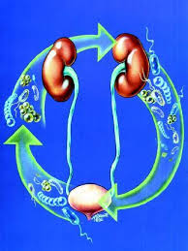
URINARY ANTISEPTICS
Dr. Sarwat Jahan

Slide 3
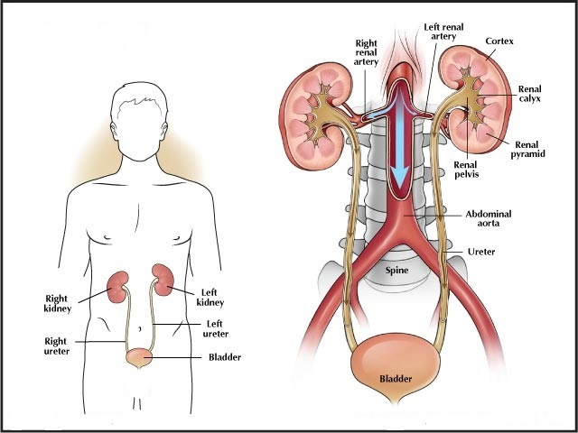
Little Bit About The Anatomy Of Urinary System

Slide 4
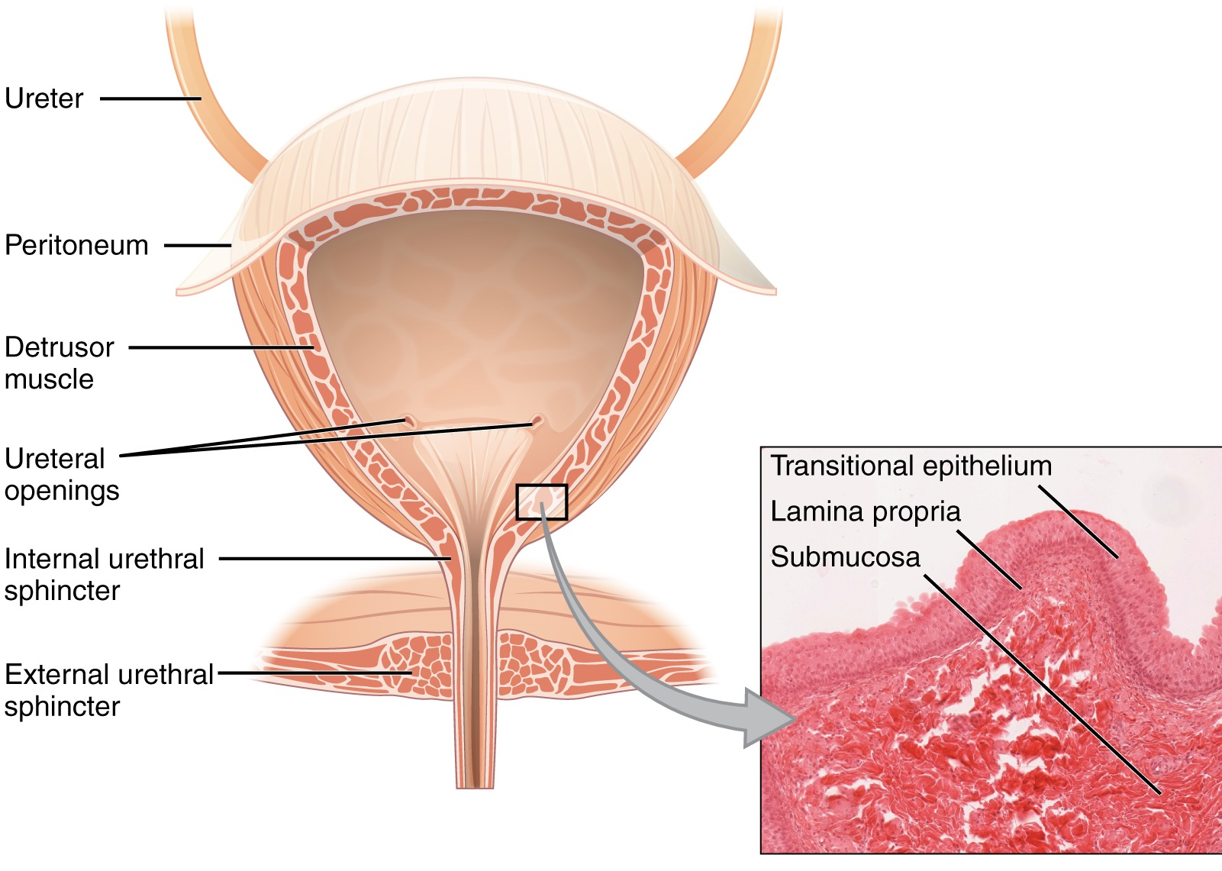

Slide 5
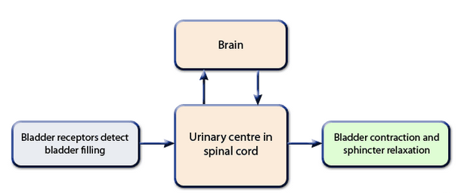
The Urinary Cycle

Slide 6
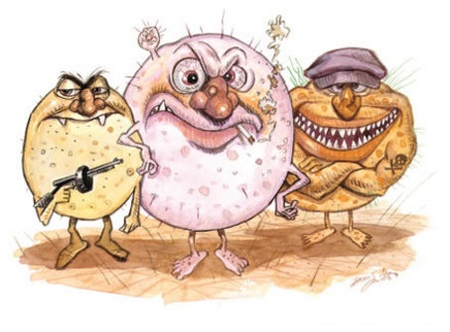
U.T.I
Pyelonephritis
Cystitis
Asymptomatic
Bacteriuria
Ascending infection
URETHERAL TERRORSIT INCIDENT

Slide 7

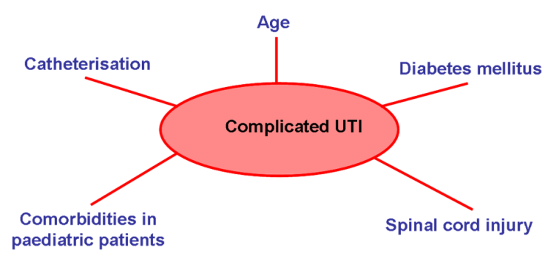
Classification
Uncomplicated
Complicated
Primary
Recurrent

Slide 8
Epidemiology
Most common bacterial infections
high % of consultations
Females: 1,200 cases per 100,000 persons annually
Males: 30 cases per 100,000 persons annually
About 50% women have UTI at some point in their life
Males till first year of life and after 60 years

Slide 9
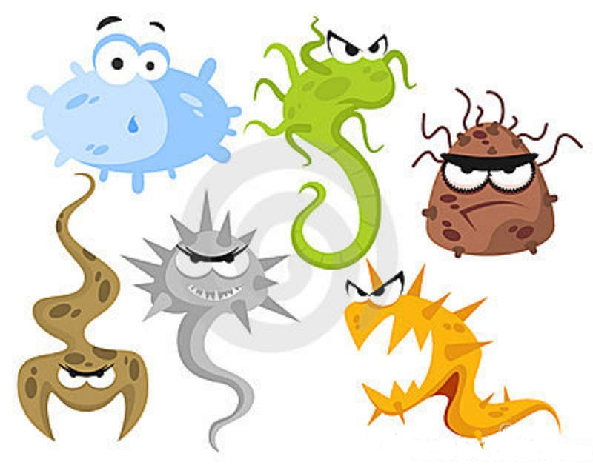
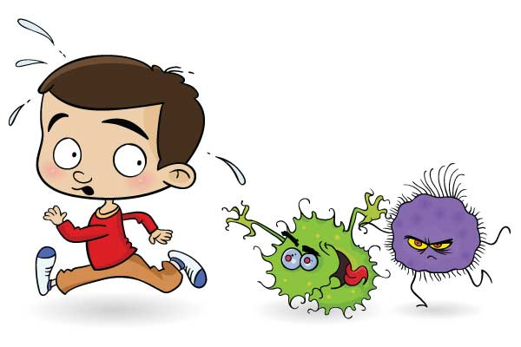
Aetiology
E.Coli
Staphylococcus Saprophticus
Klebsiella
Proteus
Pseudomonas Species
Streptococci
Enterococcus

Slide 10
Risk Factors For UTI
INCOMPLETE BLADDER EMPTYING
Bladder Outflow Obstruction Neurological Problems( Diabetic Neuropathy) Vesico-Ureteric Reflux
FOREIGN BODIES
Urethral catheter or Stent
LOSS OF HOST DEFENCES
Atrophic Urethritis Diabetes Mellitus

Slide 11
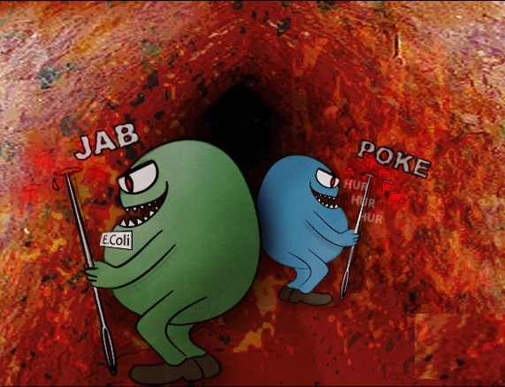
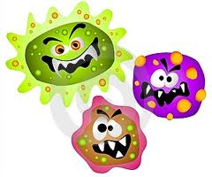


The Story Of Lower UTI
*
Entrance through the urethra
*
Attachment to the urothelium
*
Ascend of Infection
Bowel, Blood or lymph

Slide 12


Urinary Antiseptics
Urinary antiseptics are antimicrobial drugs that are excreted mainly in the urine, and perform the antisepic action in the bladder
These drugs have little or no systemic antibacterial effect

Slide 13
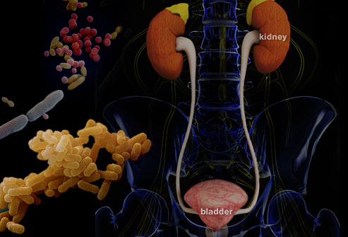
INDICATION
Prolonged suppression of bacteriuria in chronic or recurrent UTIs, in which eradication of infection was not complete after short term systemic therapy

Slide 14
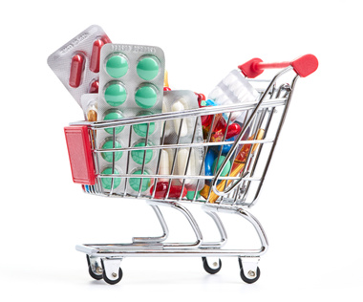
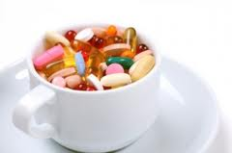
Drugs Used As Urinary Anti Septics Are…
Nalidixic Acid and Cinoxacin
Nitrofurantoin
Methenamine
Phenazopyridine

Slide 15
Nalidixic Acid & Cinoxacin
synthetic quinolones
Pharmacokinetics:
Well absorbed orally.
Bioavailability 80-95%
Widely distributed in body fluids and tissues.
Plasma Half life 3-10 hrs permitting once daily dosing.

Slide 16

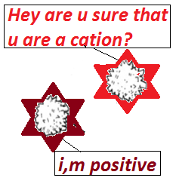
Oral absorption is impaired by divalent cations.
Serum concentration of I/V administration is equal to orally administered drug.
Excretion is renal either GF or Tubular secretion

Slide 17
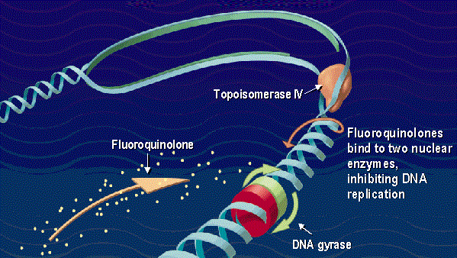
Mechanism Of Action
Inhibit DNA gyrase

Slide 18
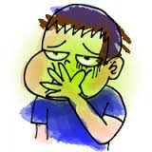
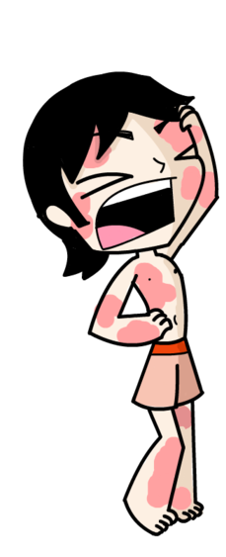
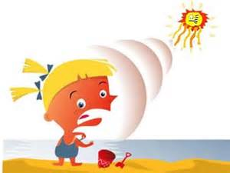
Therapeutic Uses
Gm –ve organisms.
Lower urinary tract infections.
Adverse Effects
    GIT irritation
    Allergic reactions
    (Erythema Multiforme &
    Stevens-Johnson syndrome )
    Photo sensitization.
    Visual disturbances
    CNS effects
    Increased ICP

Slide 19
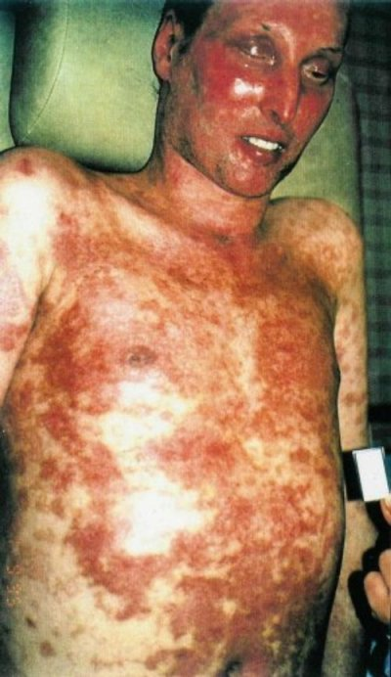
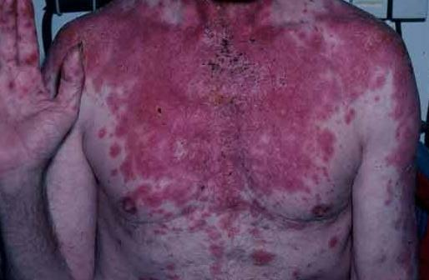
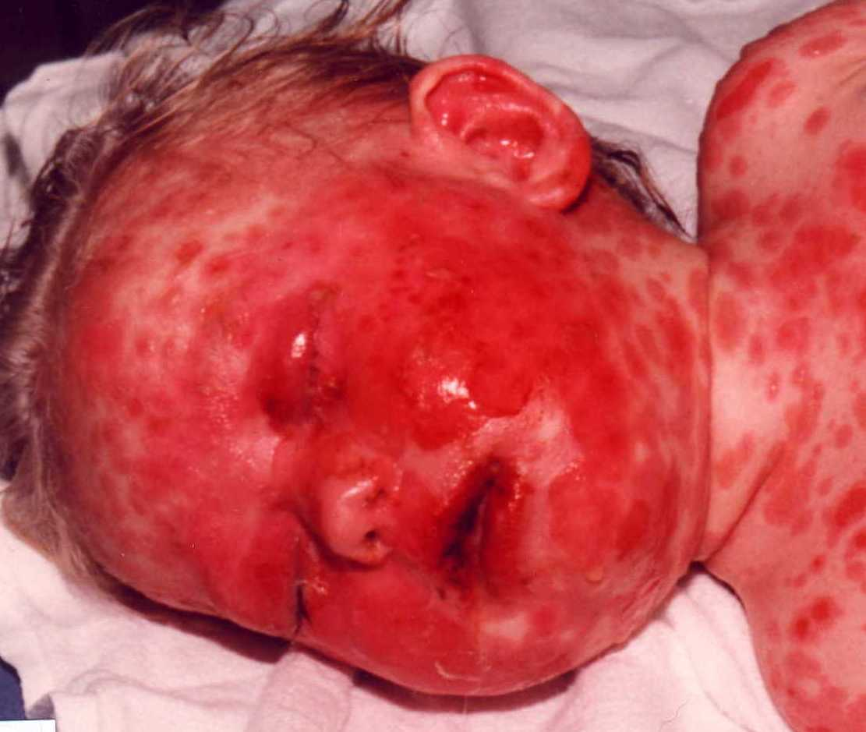
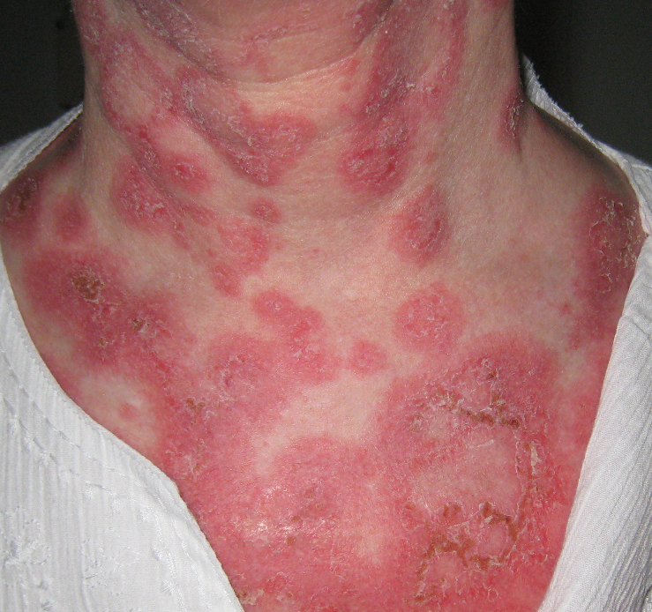

Slide 20
Nitrofurantoin
Bactericidal for many Gm +ive &
Gm–ive bacteria
Treatment of uncomplicated UTI
Pharmakokinetics
  Well absorbed orally
  Rapidly metabolized and excreted through kidneys
  No systemic antibacterial activity
  Excreted in urine by glomerular filteration & Tubular excretion

Slide 21
Mechanism of Action
Rapid intracellular conversion to reactive intermediates by Bacterial reductases
Intermediates react non-specifically with ribosomal proteins
Disrupt synthesis of DNA, RNA, Proteins & Metabolic processes

Slide 22
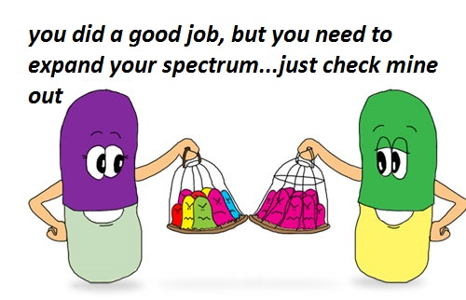
Anti bacterial spectrum:
E. coli, enterococci.
Most species of Proteus ,Pseudomonas, Enterobacter and Klebsiella are resistant.

Slide 23
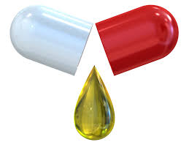
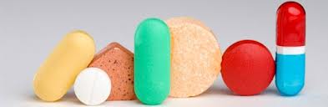
Therapeutic Uses
Active against many urinary tract pathogens (but not proteus or pseudomonas)
Daily dose for adults is 100 mg orally 6 hourly
Urinary levels of 200 µ g/ml
Desirable to keep urinary PH below 5.5

Slide 24
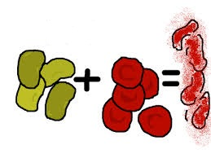
Adverse Effects
  GIT irritation, anorexia, nausea, vomiting
  Skin rashes and hypersensitivity reactions
  Neuropathy
  Hemolysis in patients with G6PD deficiency
  Pulmonary infilteration & fibrosis
Resistance
  Resistance emerges slowly
  No cross resistance between Nitrofurantion and other antimicrobial agents

Slide 25

Contraindications
Pregnant woman
Individuals with impaired renal function.
Children younger than 1 month of age.

Slide 26
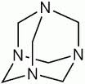
Methenamine
Chemistry:
It is hexamethylenetetramine.
The compound decomposes to form formaldehyde.
Acidification of urine is required for this decomposition.
Methenamine mandelate is salt of mandelic acid and methenamine
Methenamine Hippurate is salt of huppuric acid and methenamine

Slide 27
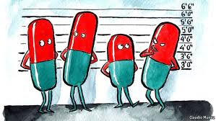
Absorbed orally excreted unchanged in urine
Combination with sulfonamide lead to mutual antagonism.
Dose
Methenamine mandelate 1g QID
Methenamine Hippurate 1g BD
Acidifying agents (Ascorbic acid 4-12 gm / day)

Slide 28
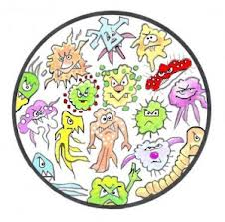
Therapeutic uses
Not a primary drug, effective for chronic suppressive treatment.
Effective against E. coli, S. aureus, S epidermidis and common gram negative bacteria.
Microorganisms such as proteus are usually resistant

Slide 29
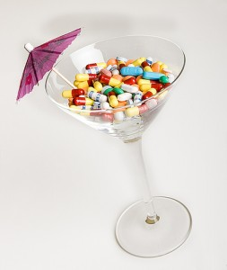
Adverse Effects
Nausea
Vomiting
Pruritis
Rash
Drug Interactions
Sulfathiazole

Slide 30

Phenazopyridine
Phenazopyridine hydrochloride has an analgesic action in urinary tract
Dysuria
Frequency
Burning
Dose
200mg thrice a day

Slide 31

Adverse Effects
Azo dye so colors the urine orange or red
GI distress
Methemoglobinemia

Slide 32
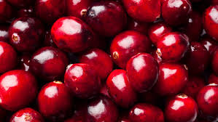
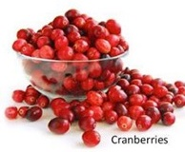
Cranberry Juice
Cranberries contain an antibacterial agent, Hippuric acid & tannins(proanthocyanadins)
Drinking 1-2 cups a day
300-400mg tablets BD

Slide 33
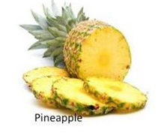
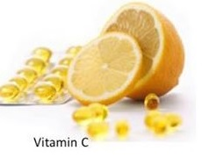


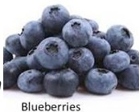
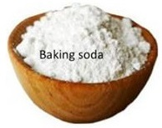
Some Home Remedies For UTI

Slide 34


